Slide 1

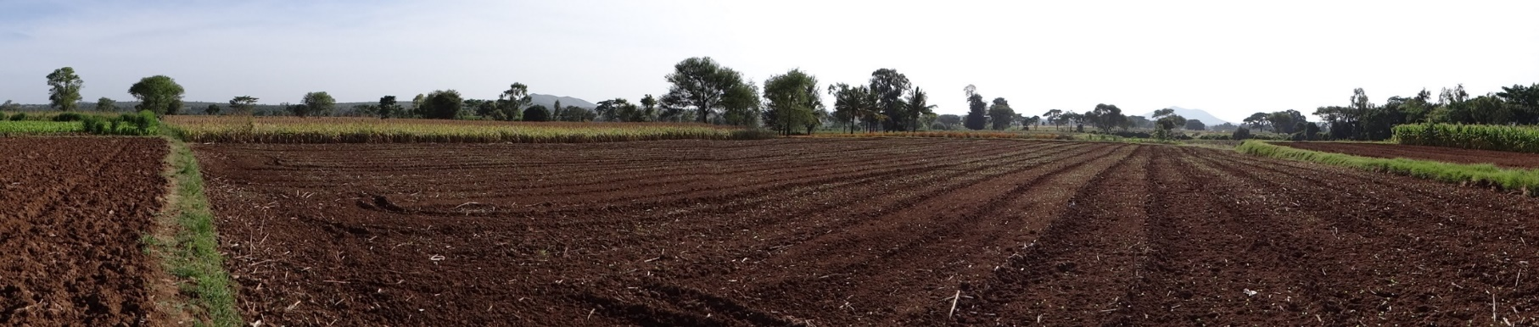





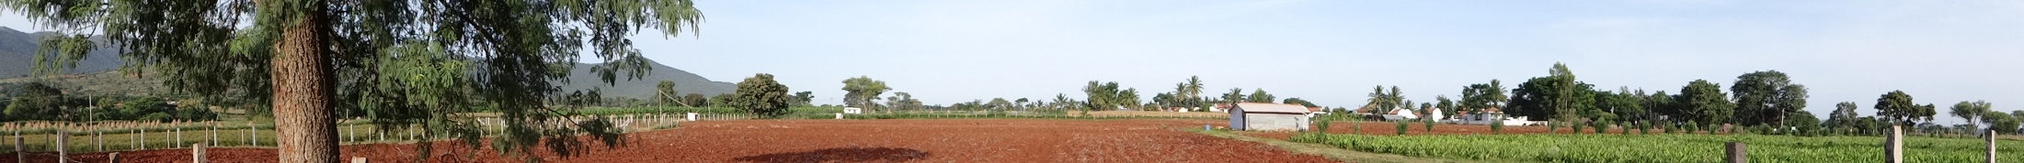
Water quality in Berambadi
Buvaneshwari S (PhD student)
J. Riotte, L. Ruiz, Sekhar M., Mohan Kumar M.S.

Slide 2
Objectives
1- What is the status of groundwater quality in Berambadi ?
= link with GW resource, land use practices ?
= possible issues, positive aspects for crop yield ?
= influence of soil type ?
2- Fate of nutrients at soil-plant scale ?
= Providing N data for STICS calibration
Monitoring spatial variability of groundwater chemistry (n=160)
(supported by environmental observatory BVET), comparison with resource
N and Cl mass balance at soil-plant scale : influence of soil on recharge and N leaching

Slide 3
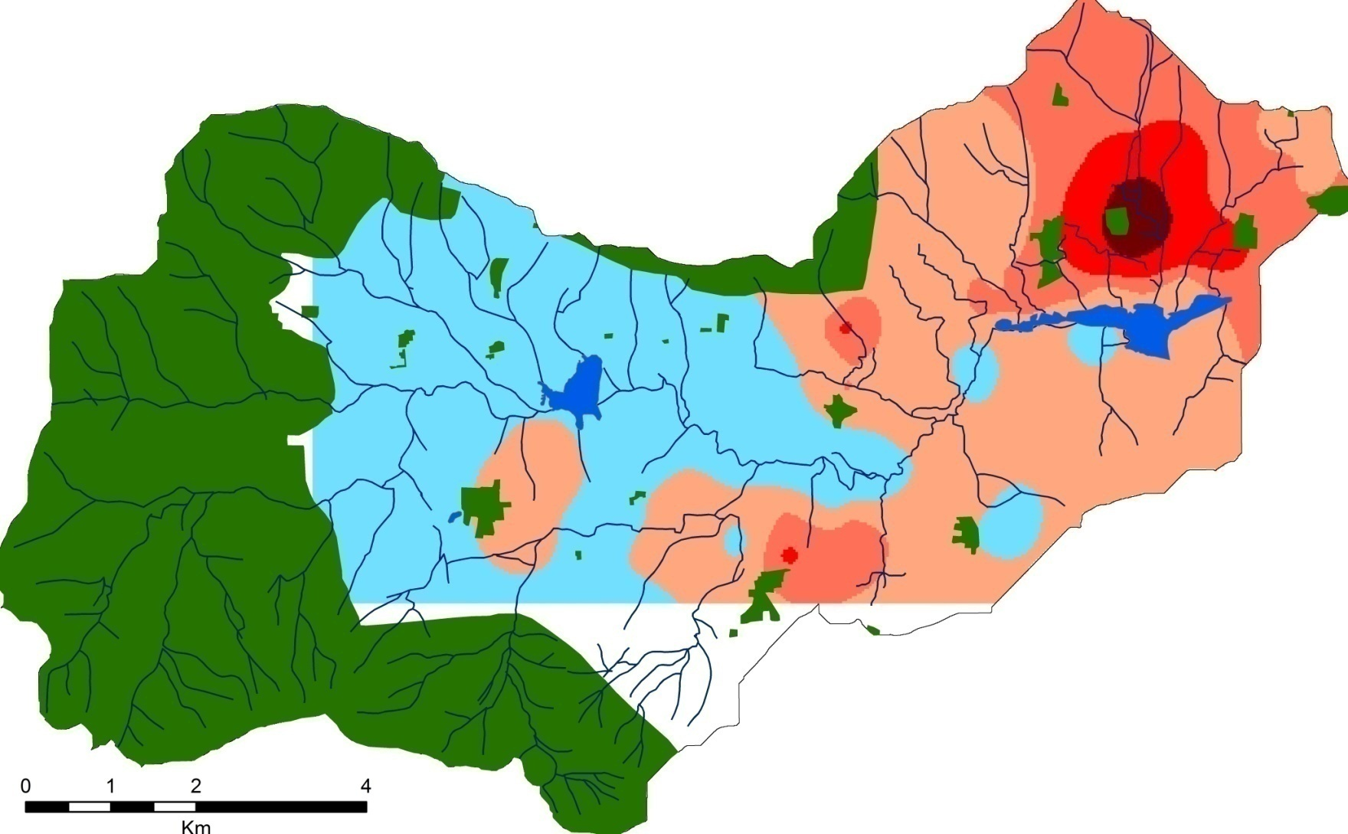
Spatial variations of NO₃ in Berambadi groundwater
(ppm)
Deep GW levels, many borewells failed in this region
Annual N application in watershed ≈ 12 tons N/km²
Application in irrigated area = 2 x rainfed area
Buvaneshwari et al., in press STOTEN

Slide 4
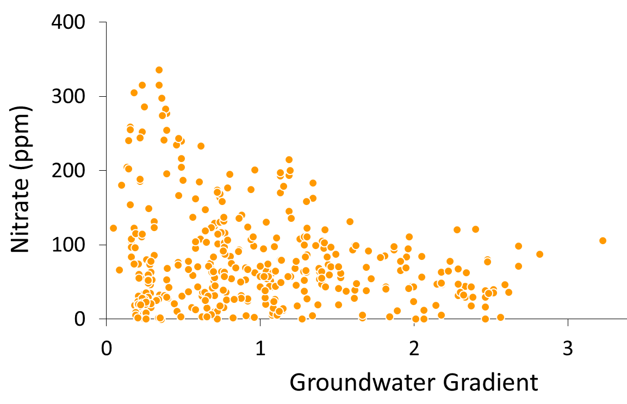
Groundwater flow and NO₃
1D- Solute recycling
2D- Lateral flow
Groundwater gradient (%)
1D governed by local practices => solute recycling
2D controlled by the Lateral groundwater flow
Buvaneshwari et al., in press STOTEN

Slide 5
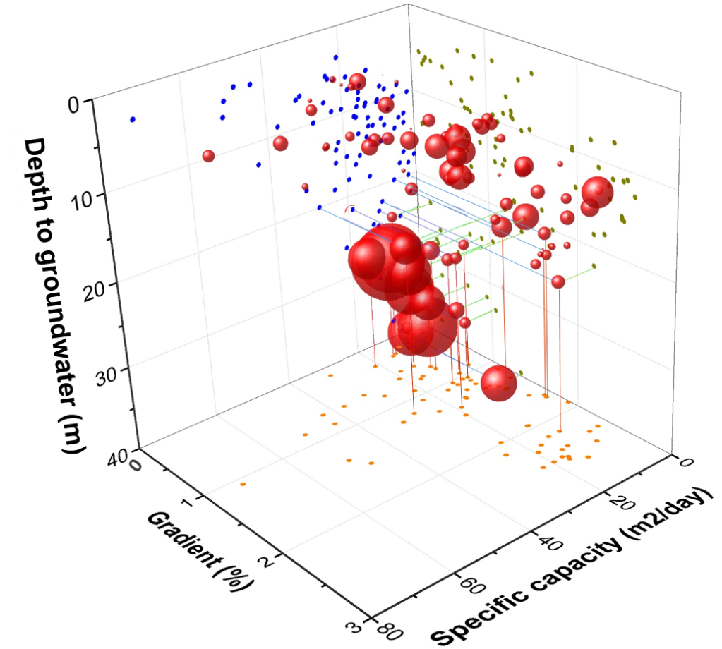


Groundwater status and NO₃
NO3 (mg/L)
50
100
200
360
Extreme nitrate :
+ Deep GW
+ Very Low gradient
+ Very low discharge
= Severely depleted water resource
Low to moderate NO₃ =
High gradient + high discharge and/or
Shallow GW (= Potential water resource)
Buvaneshwari et al., in press STOTEN

Slide 6
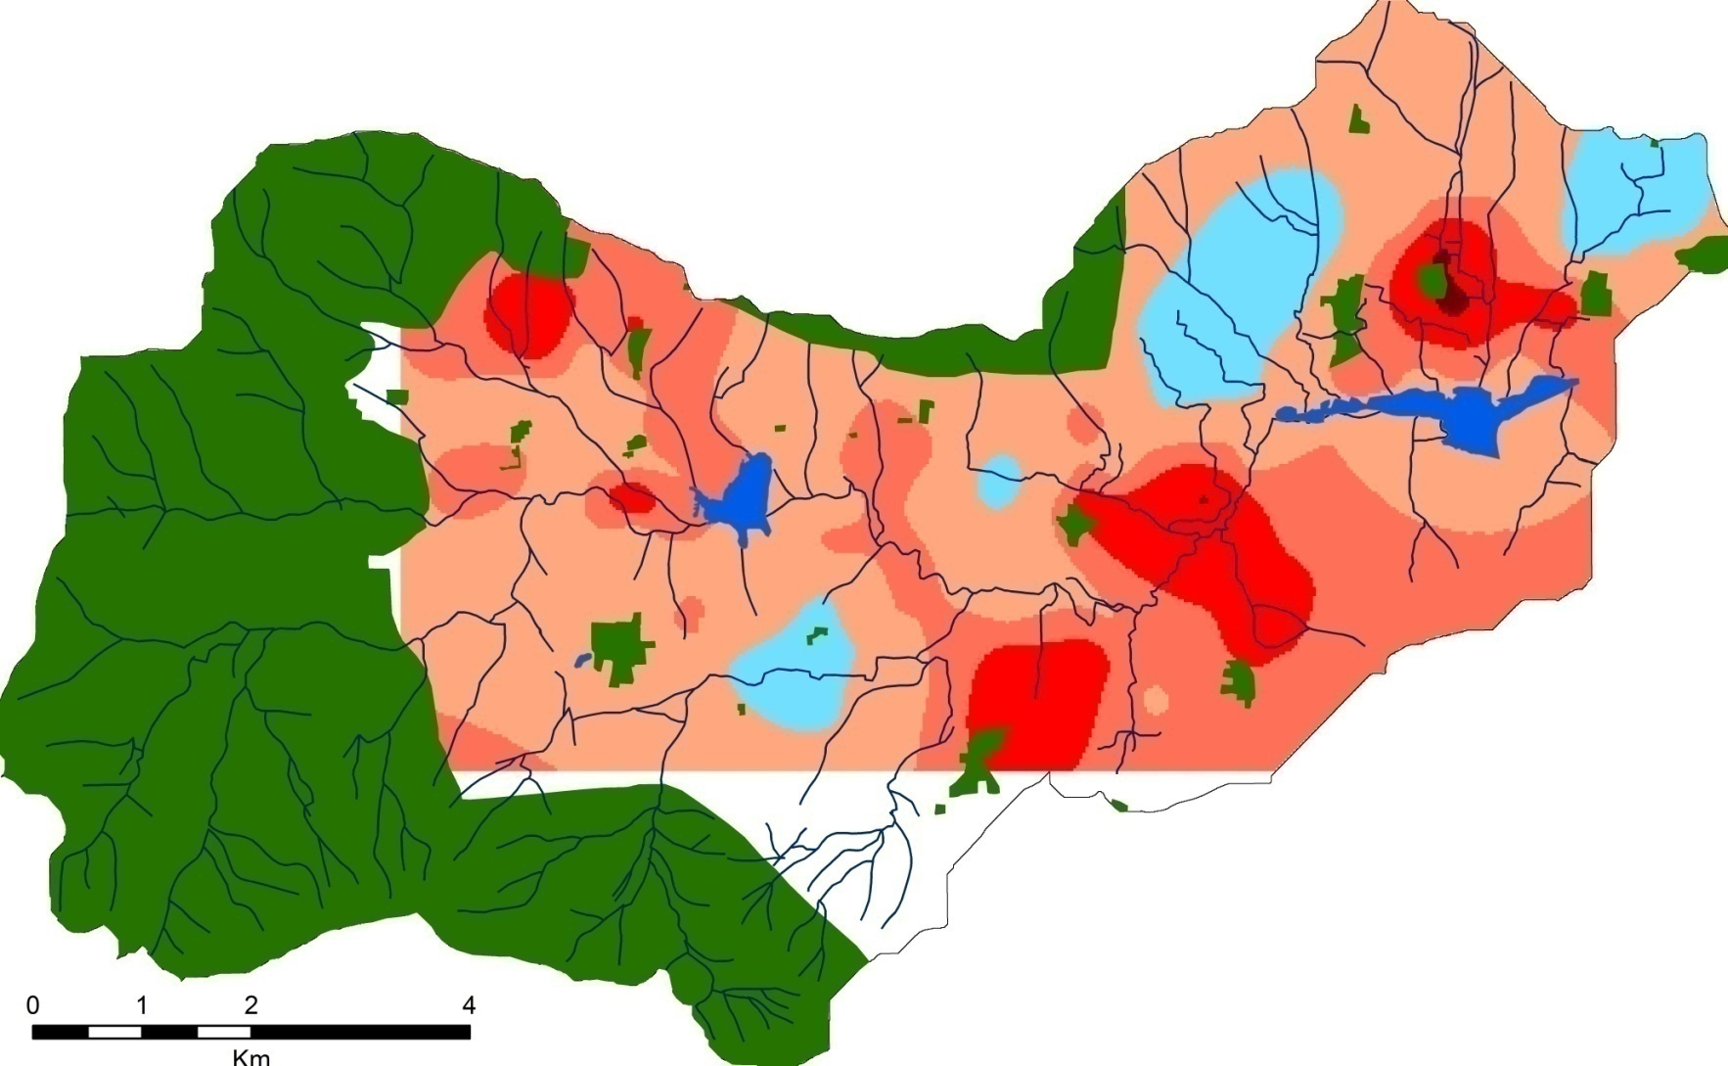
Vulnerability to salinization : Chlorine in groundwater
Hot spots of Cl spread in the watershed
Buvaneshwari et al., in prep.

Slide 7
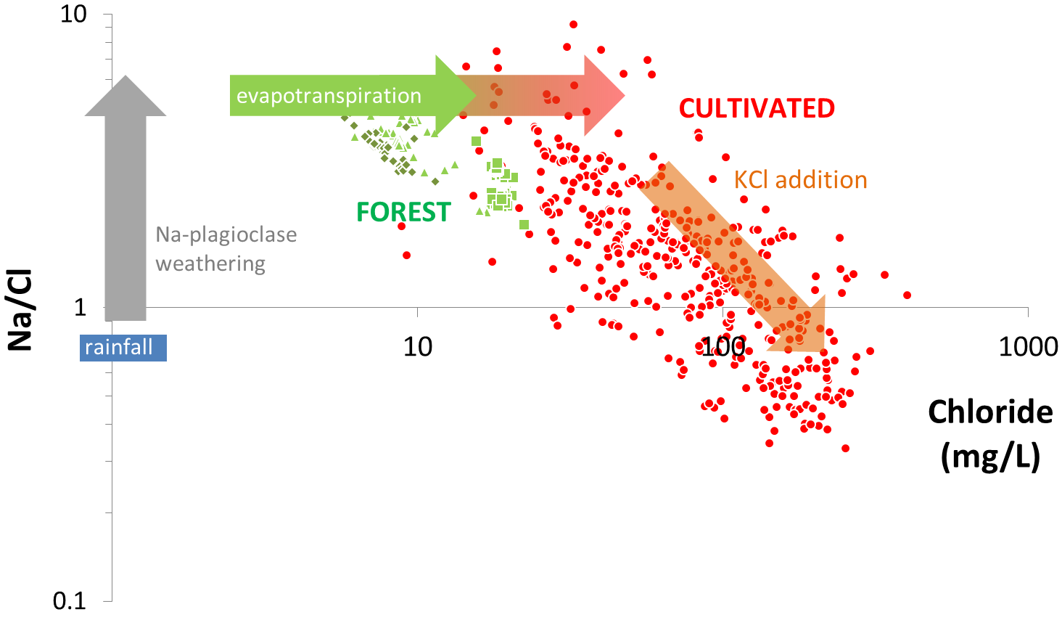
Controls of Cl in groundwater
Compared to nearby forest groundwater,
= highest evapotranspiration + evidence of KCl impact
Buvaneshwari et al., in prep.

Slide 8
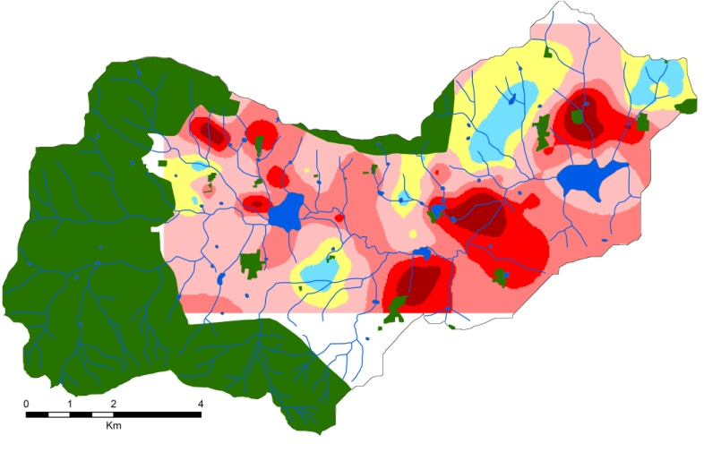
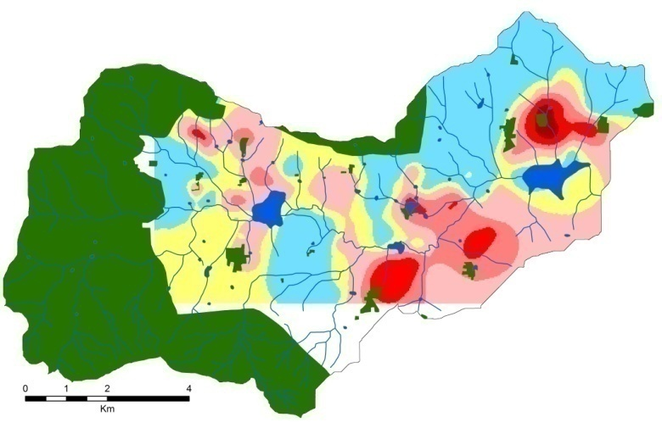
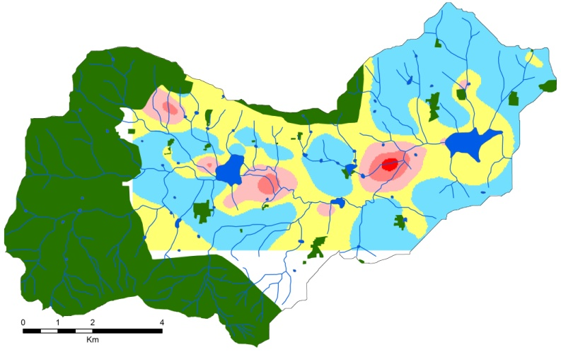
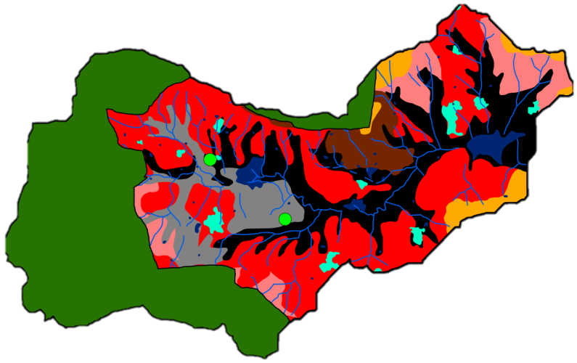
Deconvolution natural vs anthropogenic chloride
Total GW chloride
Chloride excess
mg Cl /L
30
30 - 45
45 - 70
70 - 100
100 - 140
> 140
Chloride natural
Soil texture
Buvaneshwari et al., in prep.
Chloride excess due to KCl application explains hot spots
Hot spots = up to 95 % of Cl originates from fertilizer (highest in GW depleted areas)
Highest natural chloride located in lowland = Vertisols areas (higher evapotranspiration)

Slide 9





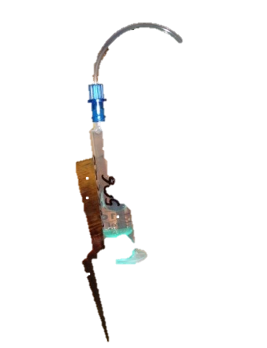




Soil-plant scale solute budget : monitoring set up
LAI
Fertilizer input
Water input (irrigation, rainfall)
Rain gauge
Soil moisture profile
Soil solution composition
TDR tube
Profile of rhizon samplers
above root zone (soil input, 10cm)
Monitoring
Turmeric + barren soil
Vertisol + Ferralsol
Root zone
Sampling frequency: every 15 days
= 40 Soil pore water and 60 soil samples per month
below root zone (soil output, 100cm)

Slide 10
First assessment of chlorine mass balance (turmeric crop)
Ferralsol
Vertisol
FCl input
63 250mm
300mm
15
(g_{Cl} /m²)
Irrigation
Fertilizer
9.5
Rain = 0.7
16
[Cl]output 90 mg/L 370 mg/L
Estimated recharge : 280 mm/yr 210 mm/yr
Cl from rain negligible in the balance
Cl from fertilizer and irrigation higher in Vertisol than Ferralsol
Recharge in Ferralsol > in Vertisol

Slide 11
Simplified N mass balance in Ferralsols and Vertisols (turmeric crop)
Ferralsol
Vertisol
2.5 (250mm)
7 (300mm)
FN input
Irrigation
35
(g_{N} /m²)
25
Fertilizer
Rain = 1
NO₃ leaching :
≈ 30 g_{N} /m²
≈ 2-10 g_{N} /m²
N flushed down in Ferralsols
N consumed efficiently in Vertisols… but risk of salinization
N by irrigation = potentially important source than should be taken into account by farmers

Slide 12
Conclusions & perspectives
Watershed scale :
Monthly monitoring of groundwater levels (n=200) available
Bi-annual monitoring of GW composition, 2012-15 (n= 160) available
=> Links between extreme NO3 and GW depletion areas
=> “hidden” NO₃ flux due to irrigation up to 200 kgN/ha/yr
=> Cl impacted by both fertilizer (KCl) application and relative evapotranspiration
Soil-plant scale :
Bi-monthly monitoring of soil pore water composition (turmeric, bare soil) available
=> role of soil type on water and nutrient balance
Perspectives
“hidden” NO₃ flux due to GW irrigation up to 200 kgN/ha/yr needs to be taken into account in fertilization plan
Risk of salinization
Need to improve nutrient balance at soil-plant scale (gas component, crop diversity)

Slide 13
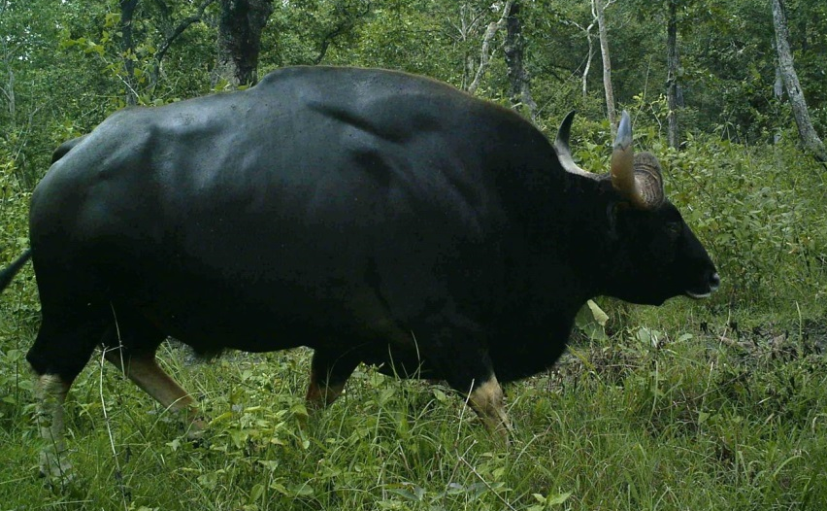

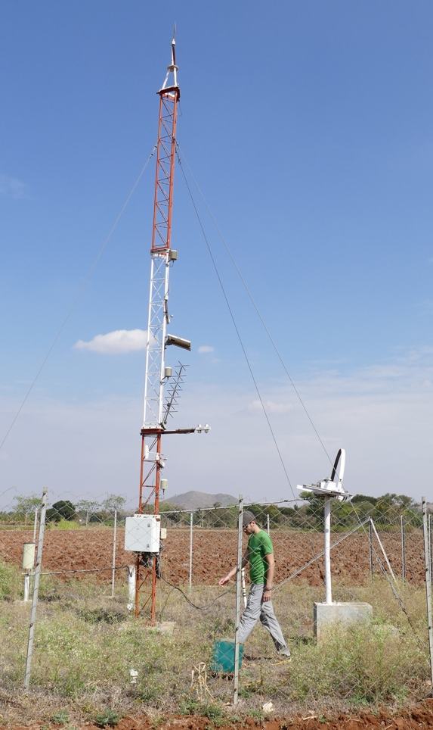
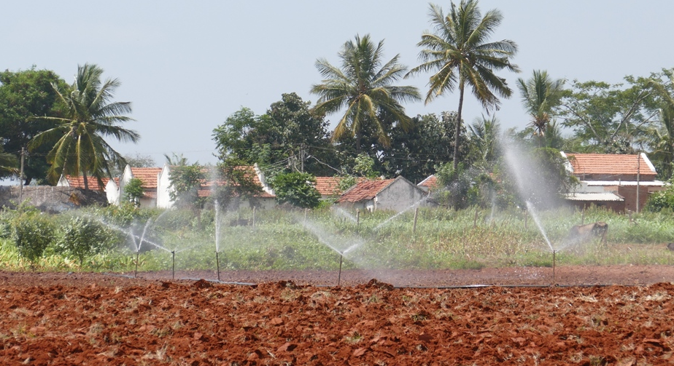

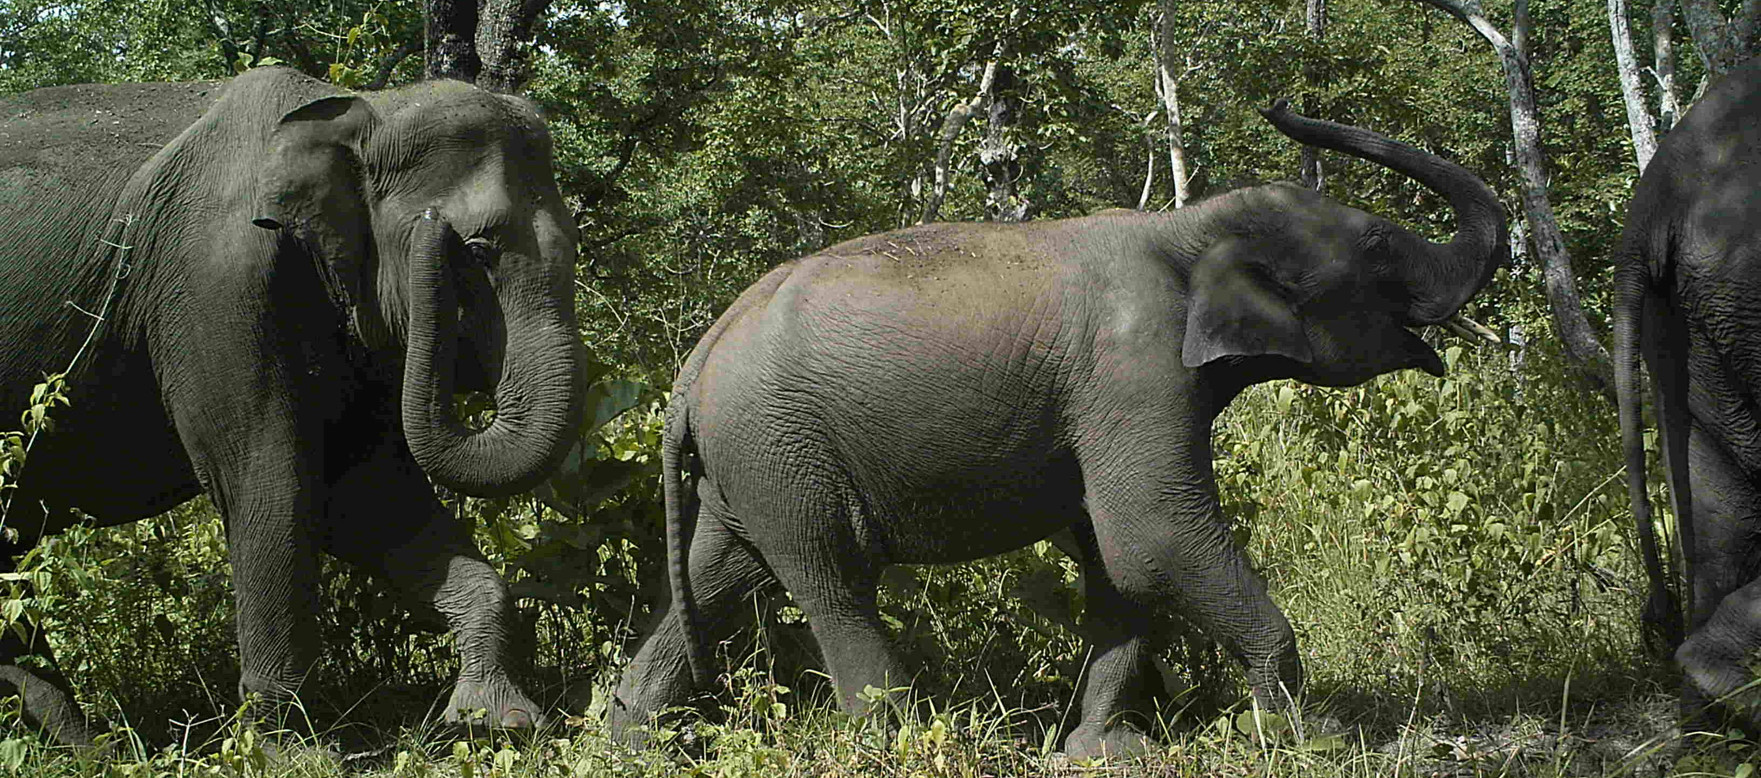
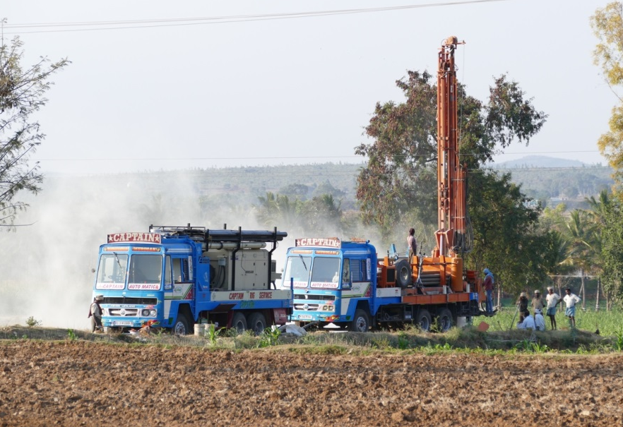
Thank you

Slide 14
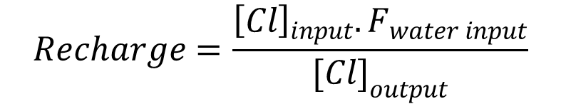
Estimation of local recharge with chlorine mass balance
FCl soil input
Fertilizer (KCl)
GW irrigation
Rainfall
Soil
$$Recharge=\frac{{\left[Cl\right]}_{input}.F_{water input}}{{[Cl]}_{output}}$$
FCl soil output
Assumption : Cl conservative
Steady state (Cl_{input} = Cl_{output}) at yearly scale
No stock variation within soil
Plant uptake neglected

Slide 15
Profiles of NO3 in soil pore water, turmeric crop
Nitrate (mg NO₃/l)
Ferralsol
Vertisol
Depth
(cm)
High, stable NO3
lower, variable NO3 (peak diffusion)

