Slide 1

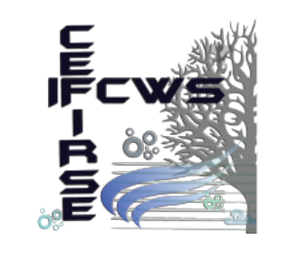




ACCAF

Slide 2
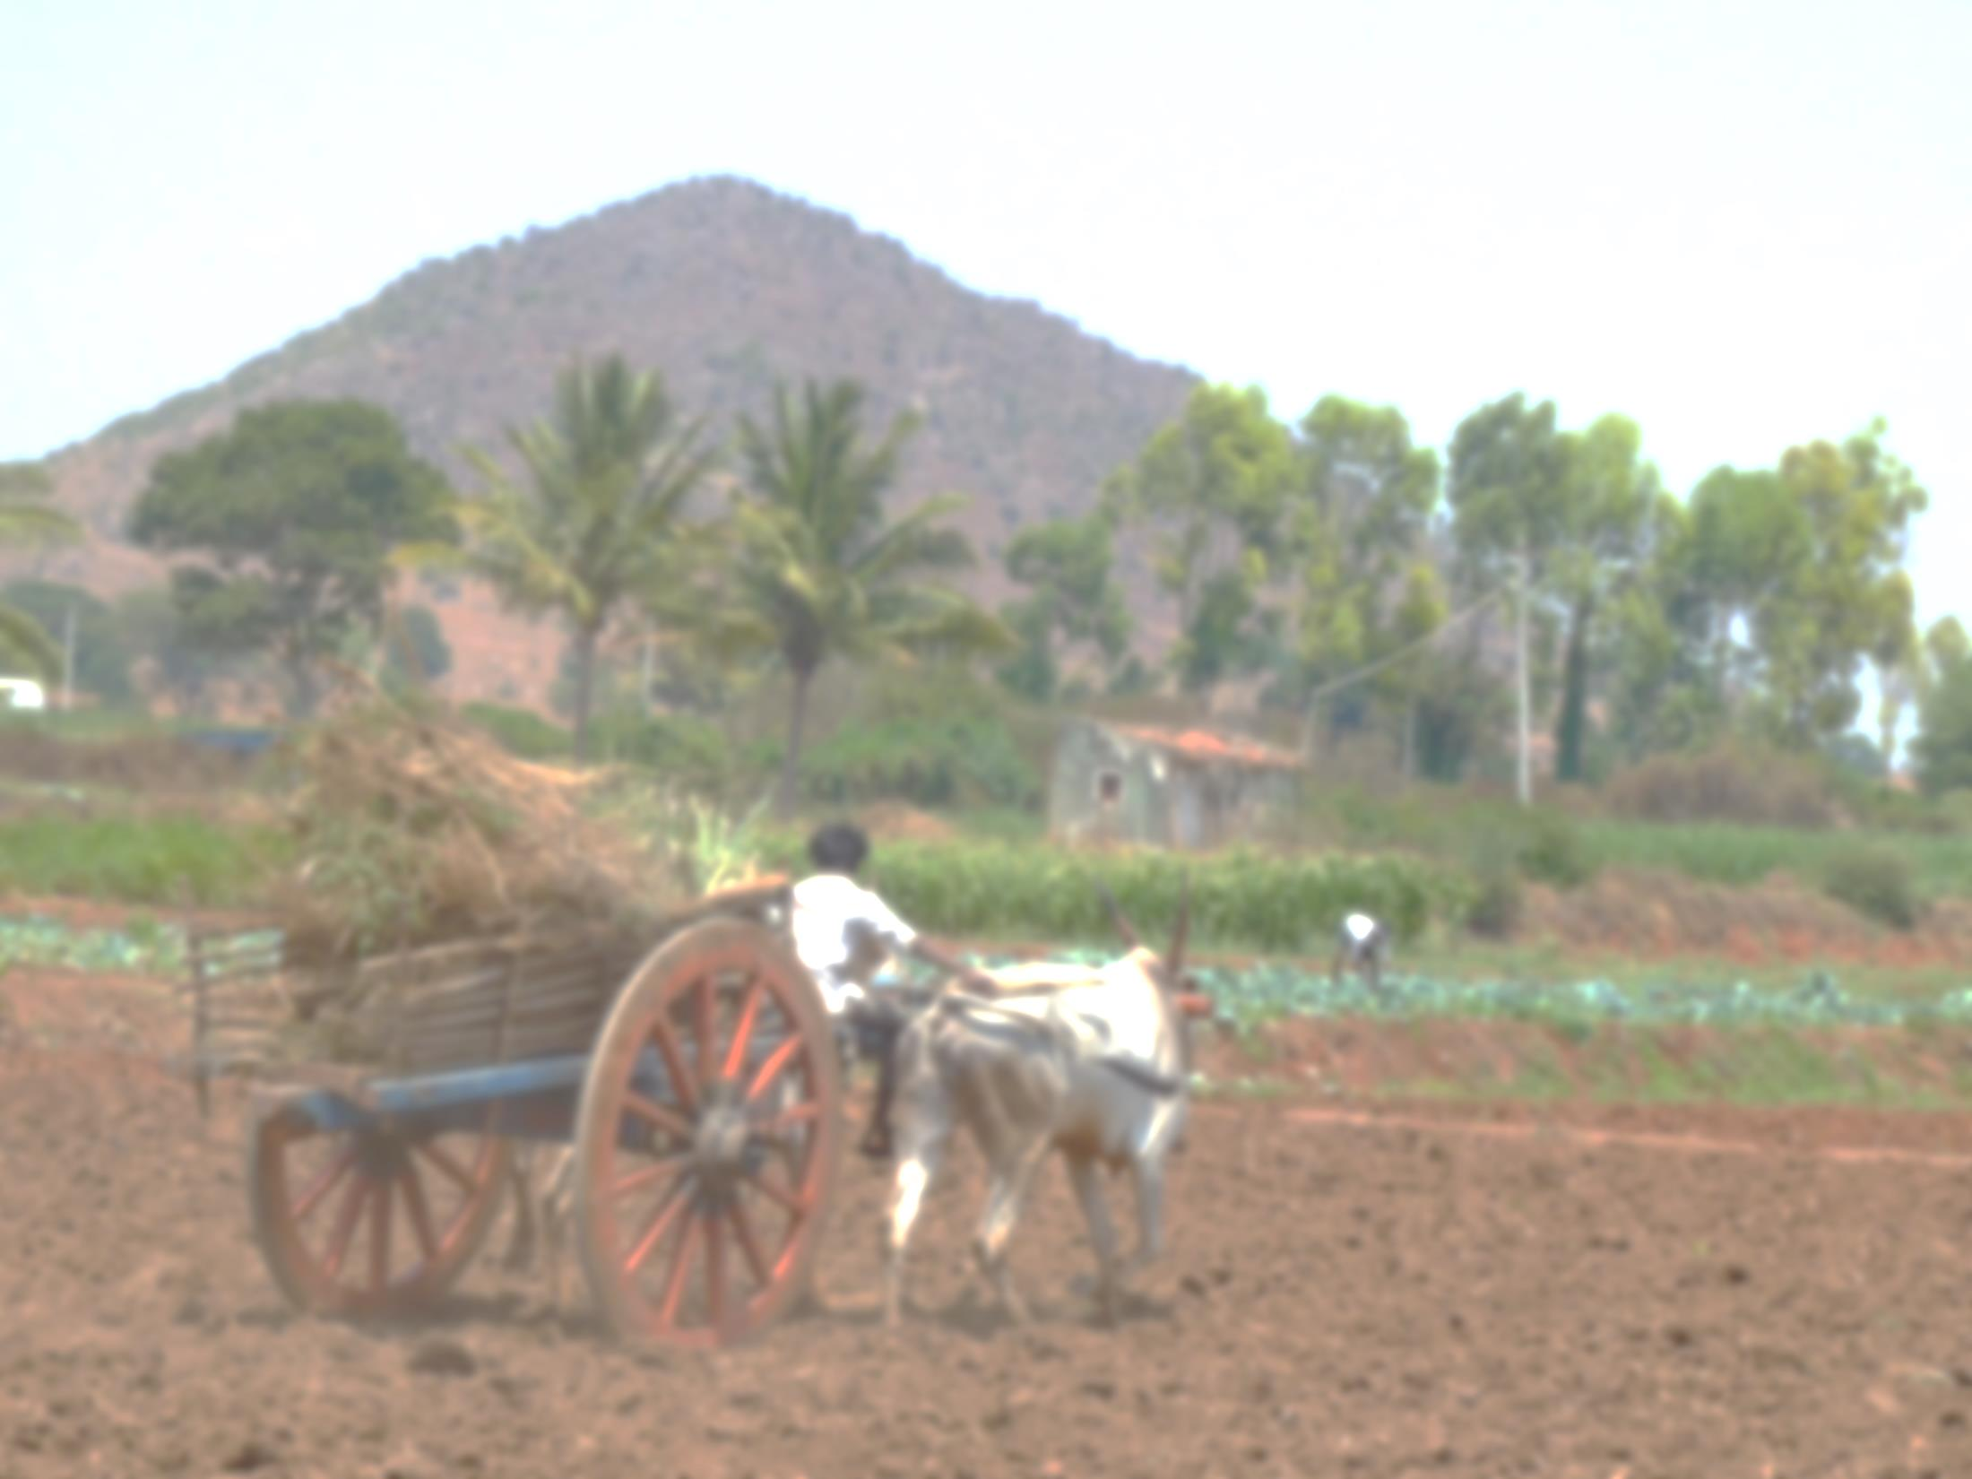
assessing sustainability and possible adaptation of current and alternative agricultural systems
Can we increase crop productivity and farmer’s incomes without further depleting groundwater levels? integrated models realistic scenarios
AICHA - 2012 2106
Adaptation of
Irrigated Agriculture to climate CHAnge
Objectives:
Methods:

Slide 3
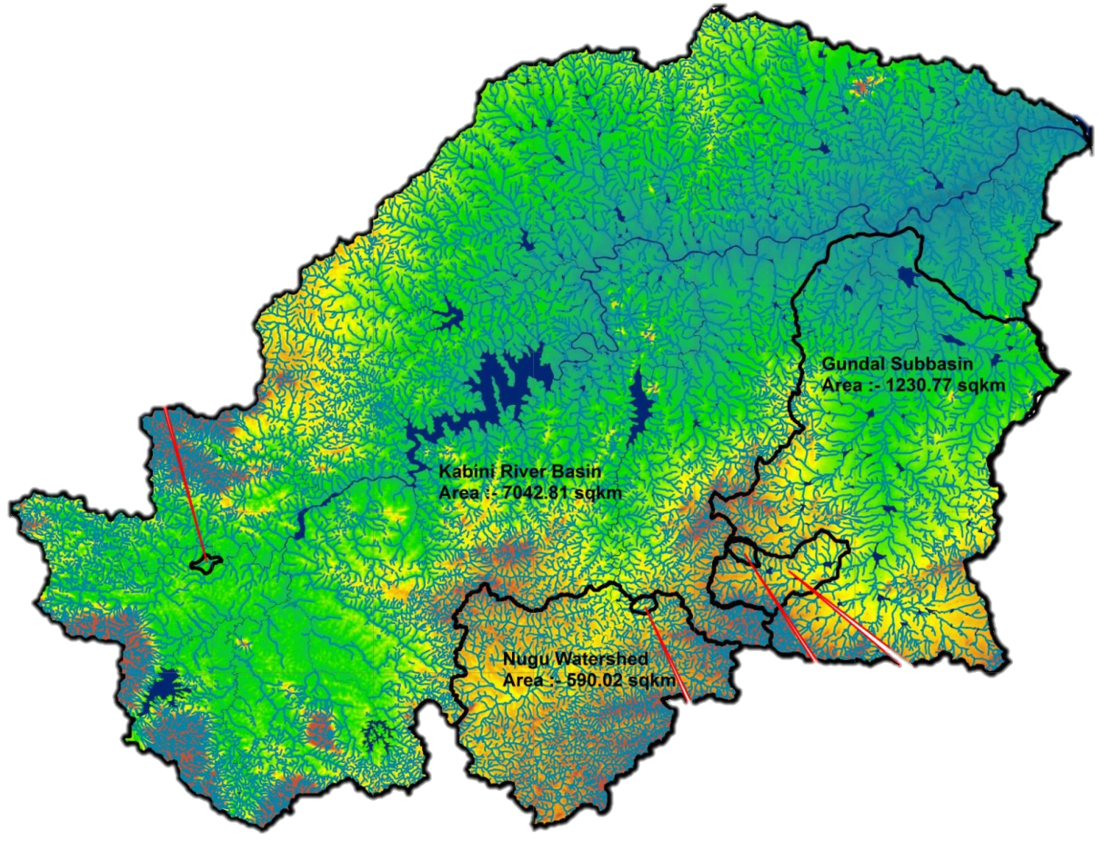
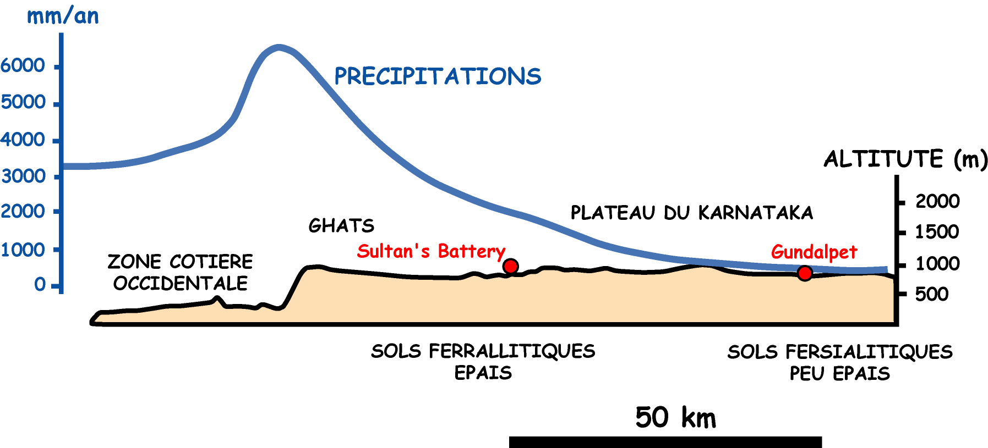
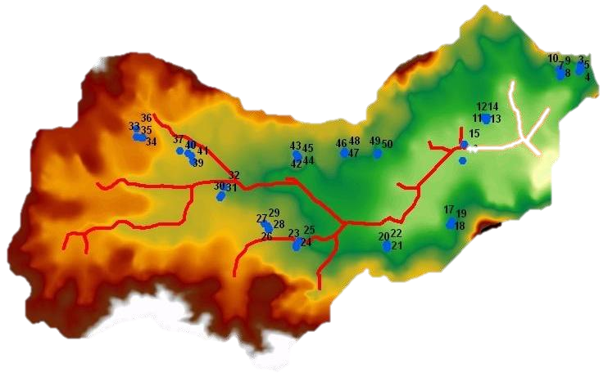
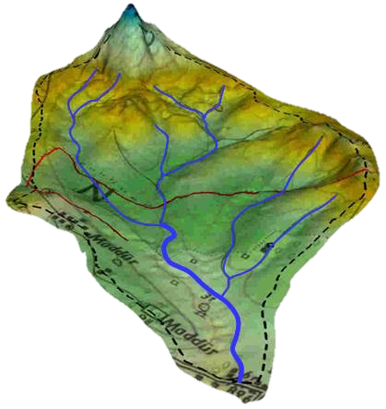
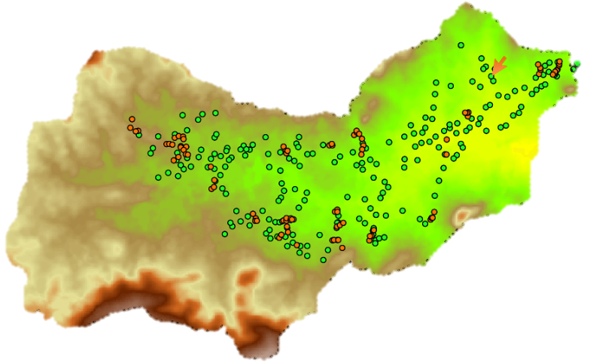
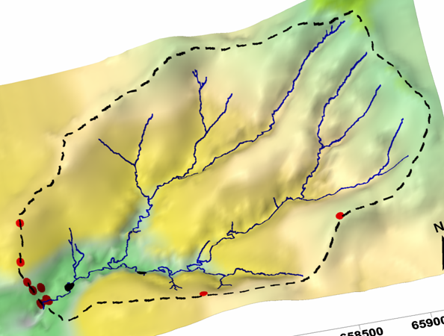
Ending AICHA project based on the Kabini CZO
Strong climatic gradient
Monitoring of variables:
Meteorology
Hydrology
Geochemistry
Soils and crops
Land use & social survey
mm/yr
Semi-arid
900
Transition
1500
0
20km
0
0
20km
20km
Gundal
Gundal
Humid
5000
Nugu
Nugu
Berambadi (2008-)
Cultivated
84km²
Maddur (2005-)
Cultivated
7.1km²
Mule Hole (2003-)
Forested
4.3km²
BVET
Environmental Observatory

Slide 4
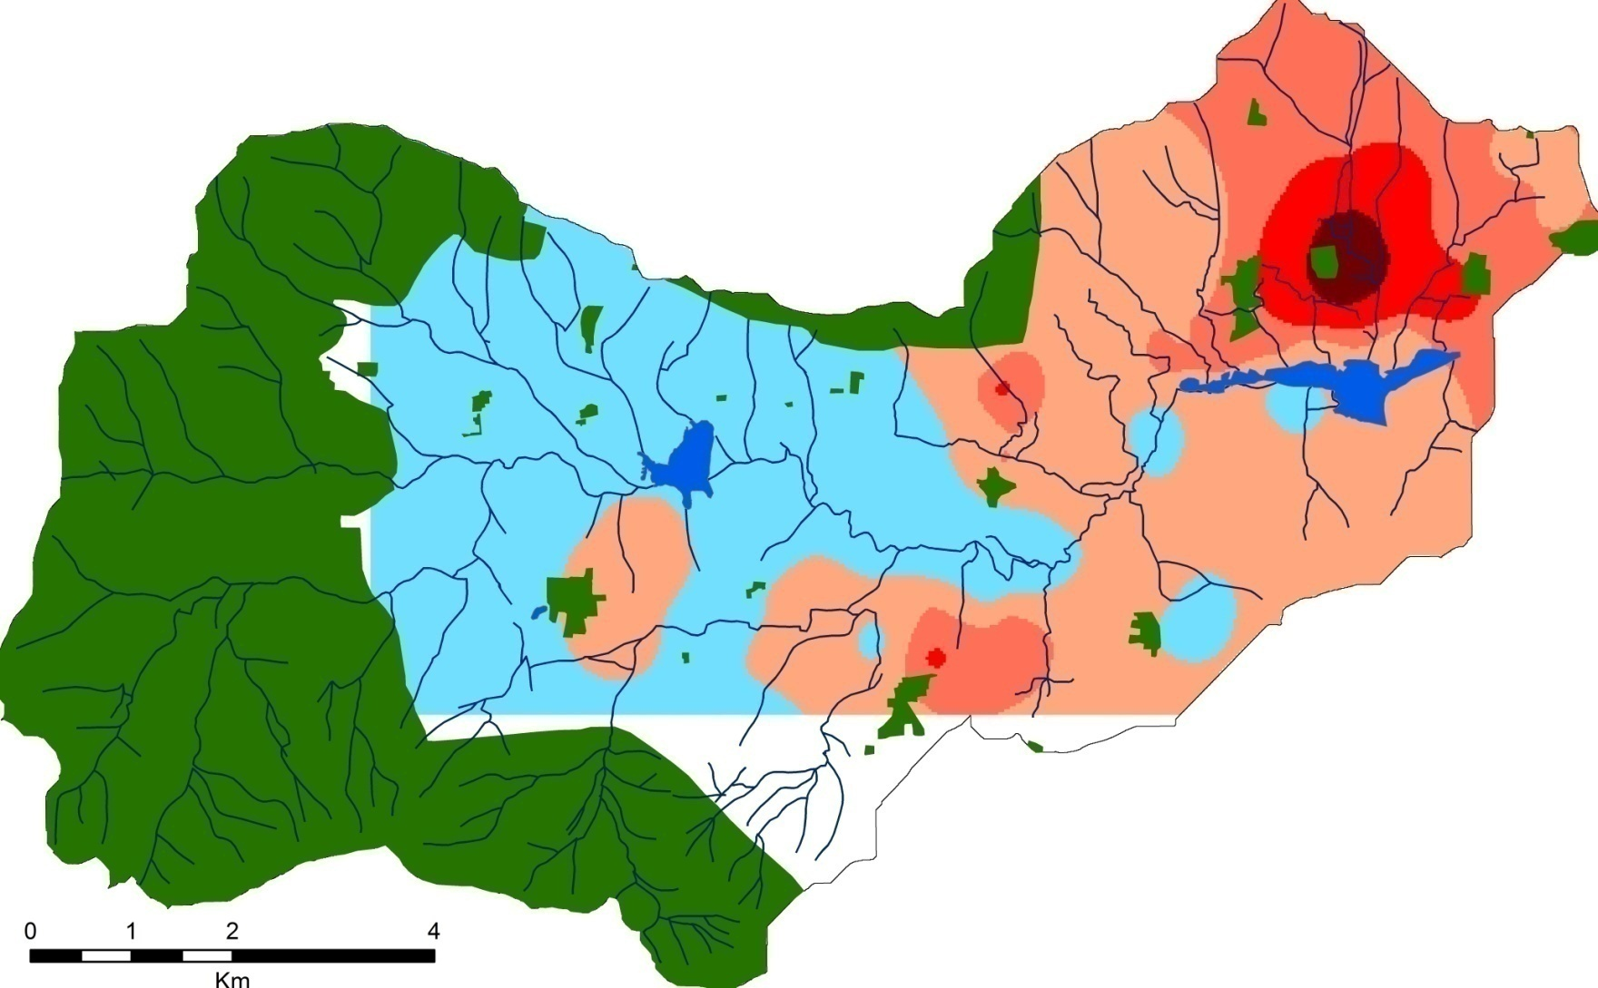
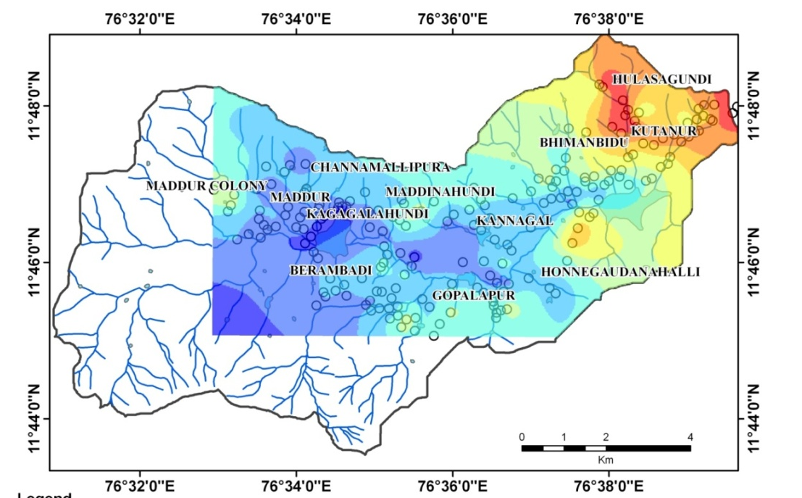
Berambadi watershed
… of GW quality
Dramatic Increase of borewells since early 1990s
groundwater levels recorded monthly
on 200 bore wells since 2010
(NO3 ppm)
Increase of the hydraulic gradient,
Disconnection between GW and rivers,
turned into ephemeral streams
Large spatial variability
… of GW levels

Slide 5
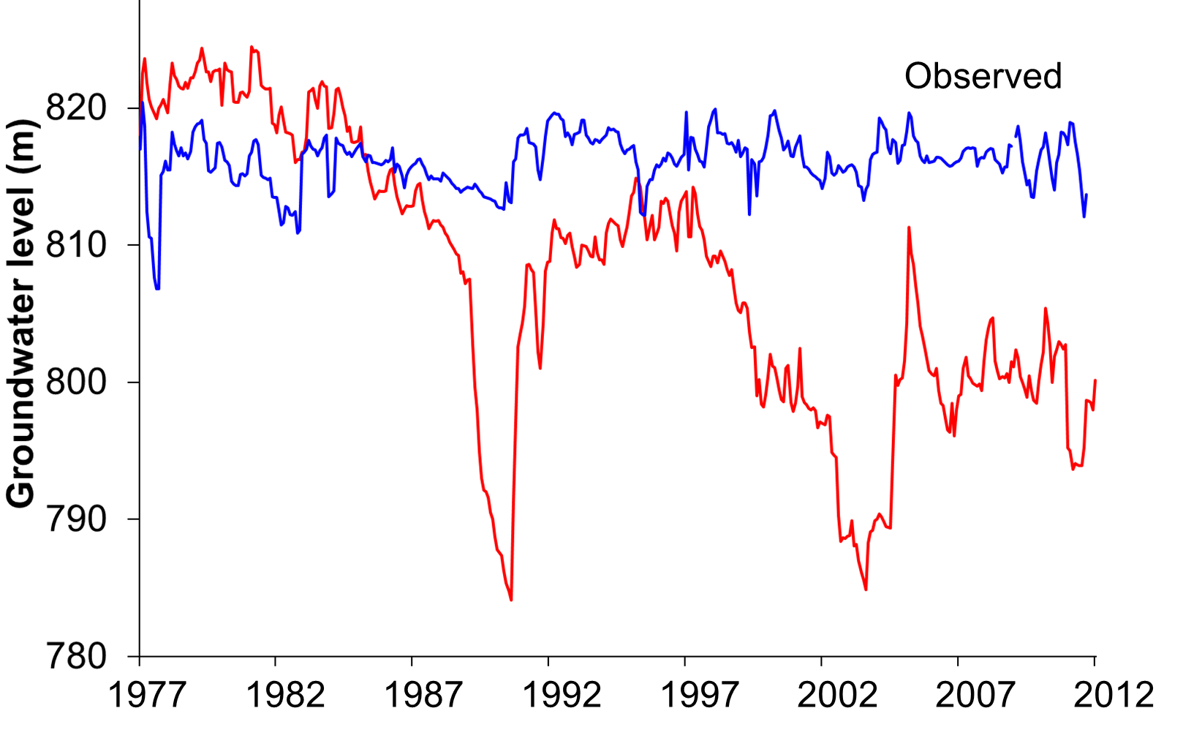
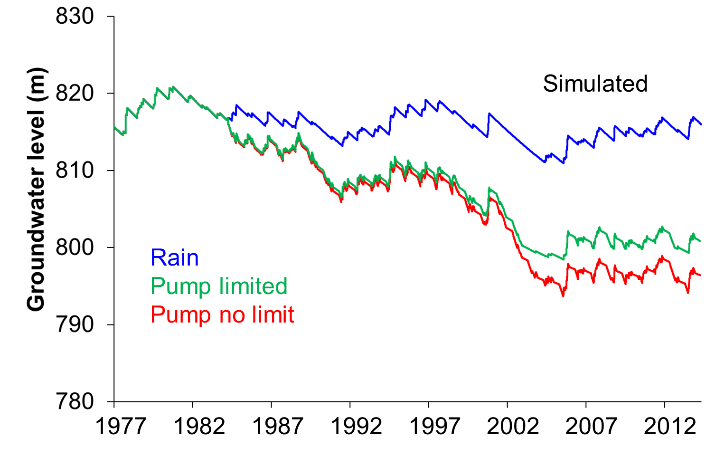
assessing current and alternative agricultural systems for
sustainability
Realistic scenarios ????
Inputs
feedback
between GW and irrigation
(yield of 120 wells)

Slide 6
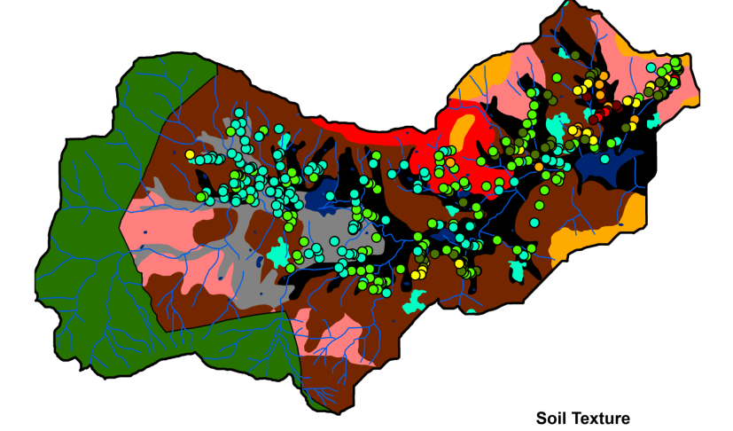


assessing current and alternative agricultural systems for
sustainability and possible adaptations
Inputs
Land Use and
Agricultural
practices
Impact of spatial
distribution of practices =>
Distributed model

Slide 7
Accompanying
The adaptation of irrigated agriculture to climate
CHAnge
4 years 2017-2020
Objective:
implement an
Integrated Modelling and Assessment approach with stakeholders
to co-build and assess scenarios
of
sustainable development
of agriculture
in Karnataka in the context of climate change.
Build on
- the knowledge gained through the ending project AICHA (2013-2016)
on the processes and drivers governing groundwater sustainability
and farmer adaptation
- The connection established with the project SUJALA-III (2014-2019, World Bank).

Slide 8
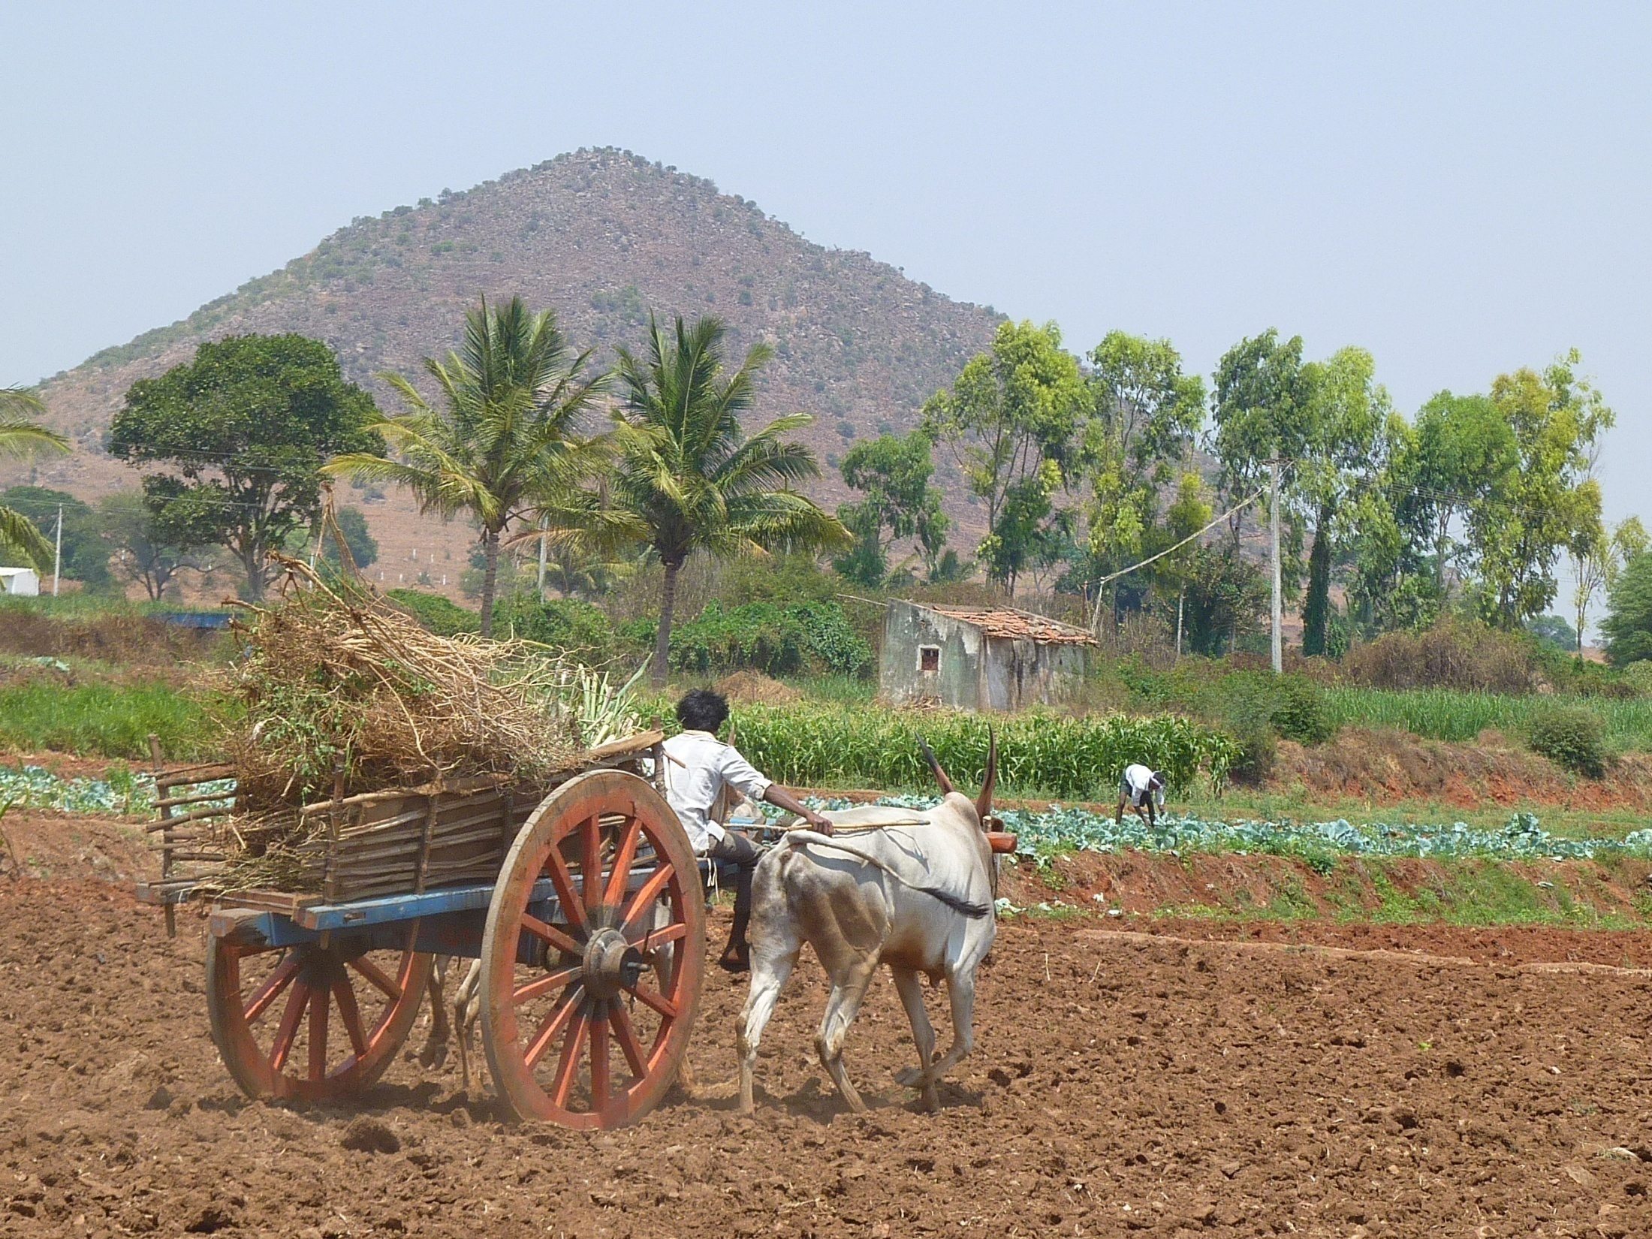
AICHA ATCHA HAI
= AICHA IS ATCHA
= AICHA IS GOOD!

Slide 9
ATCHA Partnership
Agronomy
cropping systems
crop modelling
French (14)
UMR SAS Rennes / UMR SELMET
UMR AGIR Toulouse / UR MIAT RECORD
UMR EMMAH Avignon / UMR LISAH / UR AGROCLIM/ UR AgroImpact
UMR TSE-R Toulouse
UMR GET Toulouse / UMR CESBIO / UMR LA
UR2 UMR LETG-COSTEL Rennes
Indo-French (2)
IFP Pondicherry
Indo-French Cell for water Sciences (LMI CEFIRSE)
Indian (3+)
Indian Institute of Science
ATREE
Watershed Development Department + Sujala-III partners
ICAR-NBSS&LUP, UAS Bangalore, UAS, Raichur, UAS Dharwad, UHS Bagalkot,
KSNDMC, KSRSAC
hydrology
Remote sensing
Soil Science
Social Sciences
Economy
Sociology

Slide 10
Use the model for co-building scenarios with Stakeholders
Accompanying
The adaptation of irrigated agriculture to climate
CHAnge
Partnership:
(socio Economy)
UAS
Two main scientific hypotheses:
in hard-rock aquifers, management of groundwater resources in a changing climate
must take into account spatial interactions and feedback
between biophysical and socio-economic drivers influencing farmer decisions
integrated model of soil, crops, water, and humans
2) integrated models and scenarios are boundary objects that can help,
through participatory processes, bridging the gaps between the knowledge produced,
used and needed both by scientists and stakeholders
Stakeholder meetings to design and assess scenarios

Slide 11
Make the model more realistic
Accompanying
The adaptation of irrigated agriculture to climate
CHAnge
Partnership:
ICAR-NBSS&LUP
Two main scientific hypotheses:
in hard-rock aquifers, management of groundwater resources in a changing climate
must take into account spatial interactions and feedback
between biophysical and socio-economic drivers influencing farmer decisions
integrated model of soil, crops, water, and humans
2) integrated models and scenarios are boundary objects that can help,
through participatory processes, bridging the gaps between the knowledge produced,
used and needed both by scientists and stakeholders
Stakeholder meetings to design and assess scenarios
Digital Soil Mapping

Slide 12
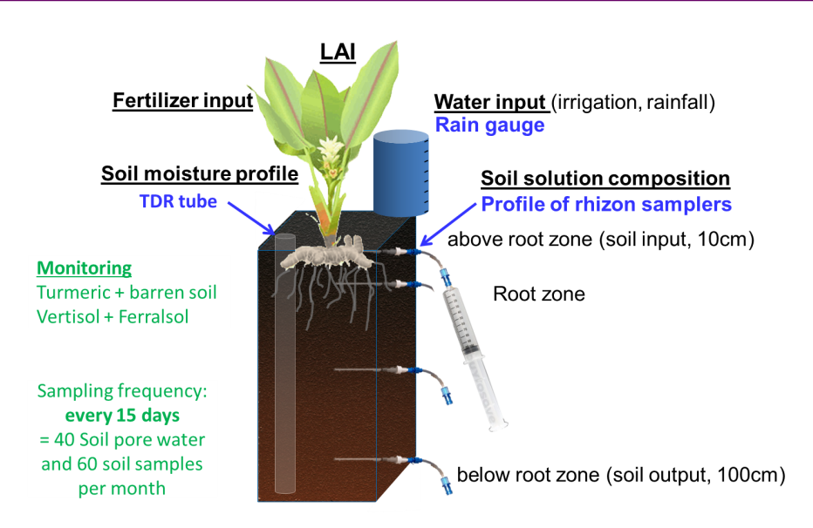

Make the model more realistic
Accompanying
The adaptation of irrigated agriculture to climate
CHAnge
Partnership:
Agronomy/geochemistry
UAS
Crop modelling and nutrient cycling
Two main scientific hypotheses:
in hard-rock aquifers, management of groundwater resources in a changing climate
must take into account spatial interactions and feedback
between biophysical and socio-economic drivers influencing farmer decisions
integrated model of soil, crops, water, and humans
2) integrated models and scenarios are boundary objects that can help,
through participatory processes, bridging the gaps between the knowledge produced,
used and needed both by scientists and stakeholders
Stakeholder meetings to design and assess scenarios

Slide 14
ATCHA-SUJALA-III
Data collection, model testing:
- Berambadi watershed as a laboratory
- 14 Sujala-III Micro watersheds for model validation – Water and nutrient balances
- UAS Campus for controlled experiments
Scientific collaboration:
Student echanges – scientists visits
Training (Digital soil mapping / crop modelling, …)
Capacity building (workshops/courses/lectures)
Recommandations for extension services for farmers

Slide 15
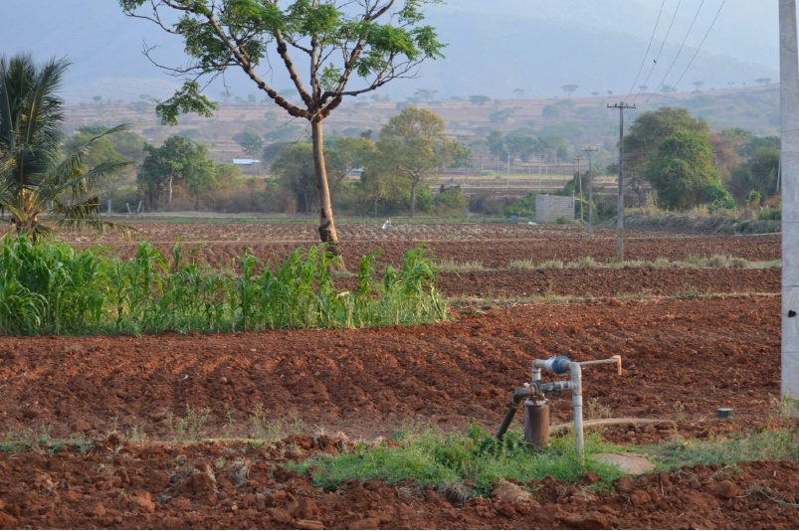
Thank you !

