Slide 1
WP-2 : Crops and nutrient cycling
2.1 STICS calibration
2.2 Nutrient mass balances & stocks at soil-plant and watershed scales
Common = need of nutrient mass balances, field data

Slide 2
Field work for nutrient mass balances
3 possible kinds of sites :
1- Plot experiments at University of Agricultural Sciences
- Response curve for N, water (STICS)
- solute and gas mass balances (STICS, CERES)
Possible to monitor many parameters, close to IISc, possibility to start first year ? Need further discussion with UAS, formal agreement
2- the 14 watersheds across Karnataka monitored by SUJALA (for STICS)
- LAI
- phenology
- agricultural practices
Data collected by SUJALA, should be available, but LAI measurement may require specific training of SUJALA people
3- Berambadi (STICS / mass balances, C-N stocks in connexion with WP1, NBSS)
Interesting for testing the effects of nitrogen-rich groundwater and soil types, from second year ?

Slide 3
Resources for the coming year (in India)
Tripti post-doc will be dedicated to GHG measurements and if possible modelling for 2 years. May partly coordinate some students
2 French master students (ISTOM) proposed for 2017 on “Diagnostic des facteurs limitant la production de cultures tropicales et modélisation », who would spend 6 months in India, gathering data needed for STICS calibration in SUJALA watersheds and calibration of STICS. Involvment in plot experiments ?
Students from UAS if it is possible to perform plot experiments at GKVK ?
Part of Buvi’s post-doc ?
Jean (up to June 2017), Laurent if deputed

Slide 4
Practical ways to move forward
Need of futher meetings with UAS (planned the week of 22nd Nov) to evaluate the feasability of plot experiments :
Administrative level : need of a MoU (maybe with WDD too for ATCHA)
Cost
Location
Facilities (for irrigation)
Manpower for cultivation (students)
Faculty(ies) involved
Specific to gas emissions
Need to design GHG monitoring to provide constrain C & N mass balance according to budget, man power, constrain on mass balance. What can be reasonably done ?
Monitoring hot spots/moments in plots ?
Link with larger scale, discrete monitoring close to flux tower ?
Taking into account GHG emissions by plants : interest of flux tower for CO2 in the Berambadi?
Do we look for additional fundings to get a fast nitrogen gas analyzer ? = additional project required, other solution with partners?

Slide 5
thoughts
General
Doing plots experiments with different doses of fertilizers ? According to irrigation practices (rainfed, drip, borewell ?)
About gas measurements
Bare soil, cultivated soil+crop (crop may release CO₂ too) ?
Ideally = need of eddy-covariance to take into account the crop component.
On the field = currently only CO₂ by eddy co-variance
Need more info in plant physiology, selection of a crop important for STICS which does not release gas = Tripti
Can we do the reverse = estimate gas emission by default (having biomass, stock & solute mass balance)
Important parameters
Mode of irrigation (need equipped facility for drip and BW irrigation),
dose of fertilizer
Soil type = If experiment at UAS, no control on soil type so this won’t be taken into account the first year
Crop = cereal (ragi), legume, bare, (if turmeric not at UAS)

Slide 6
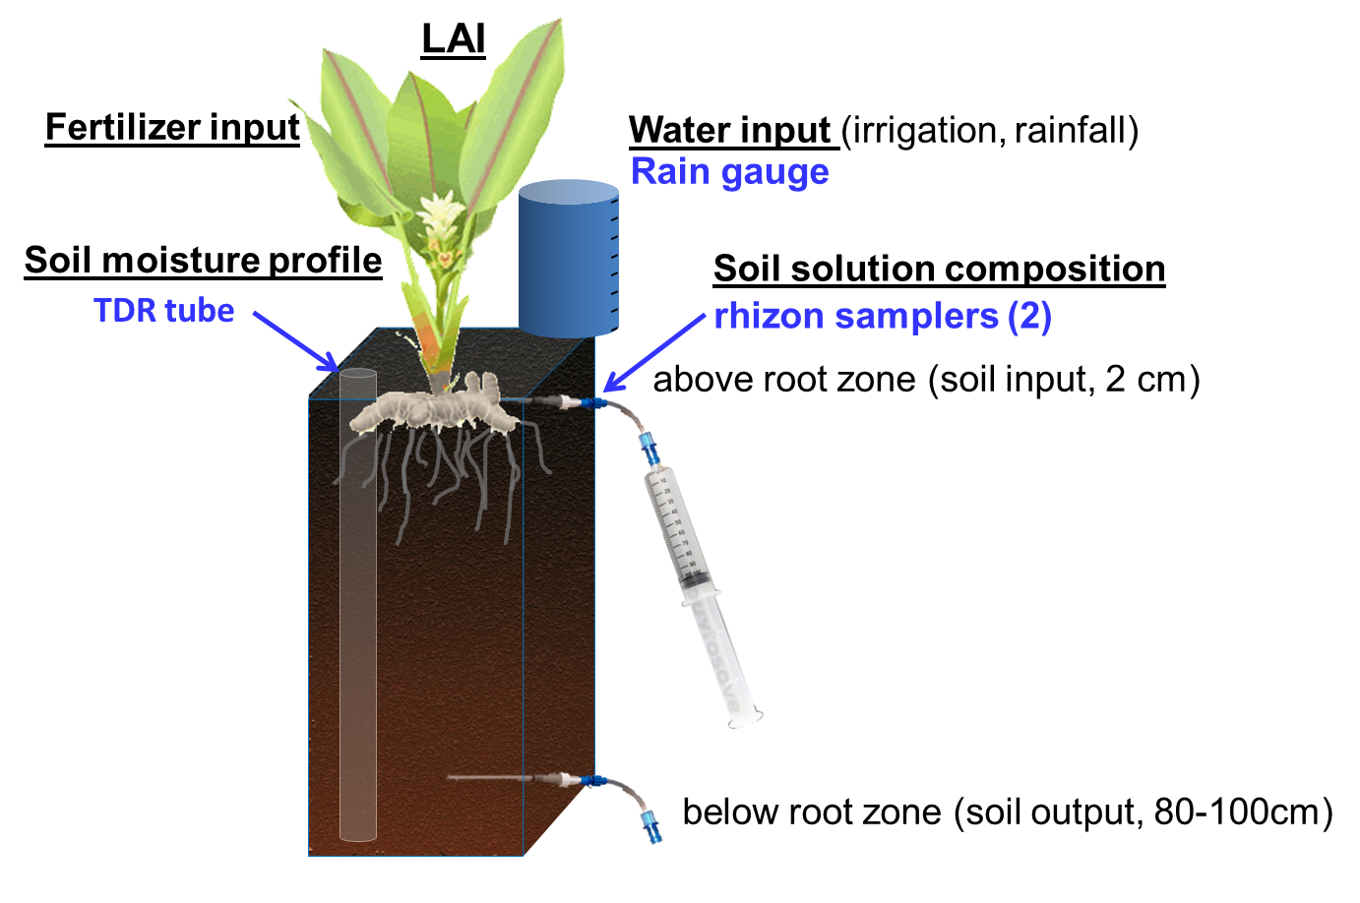
Mass balances at soil-plant scale for crop model calibration
How to increase the number of monitorings ? Ideal : small experimental plots with various treatments / crops / soils,
Emissions of N₂O, CO₂, CH₄
Crop parameters (biomass, LAI…)
Leaching of NO₃, K, alkalinity, DOC…

Slide 7
others

Slide 8
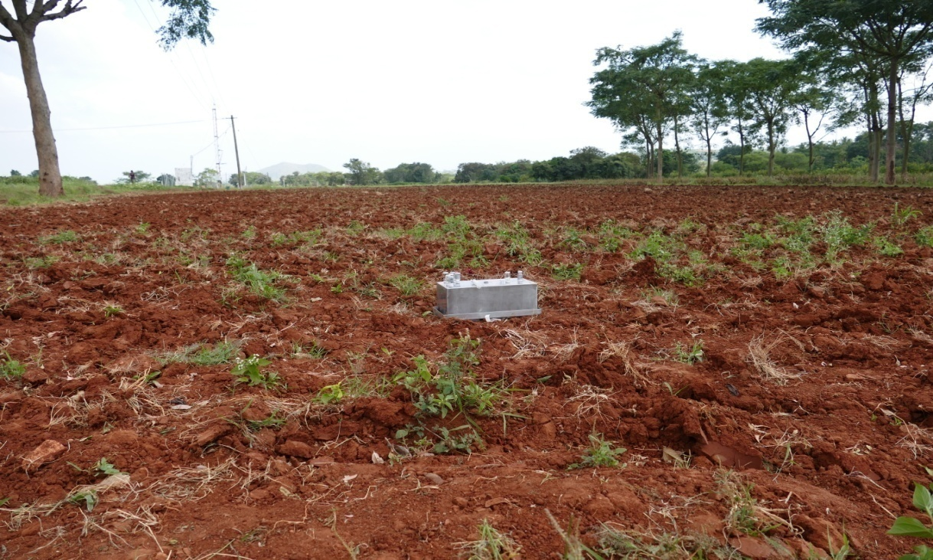
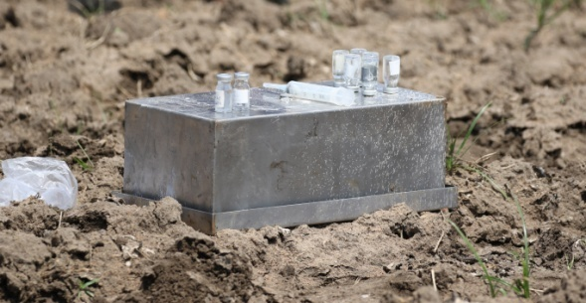
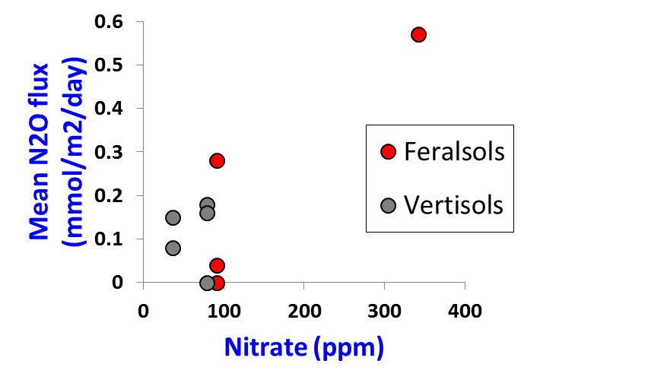
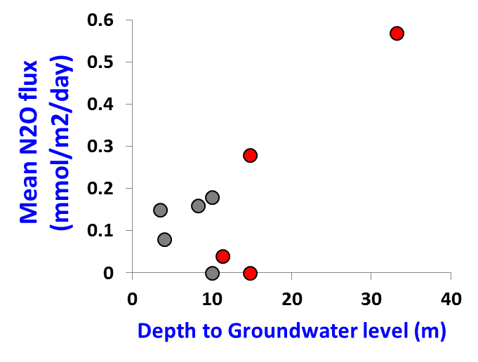
Gaseous emissions at soil-plant scale
Again small experimental plots with various treatments / crops / soils would be ideal :
= Should focus on N₂O, CO₂ (CH₄)
= Will rely on extended partnership
= New post-doc (Tripti M.) dedicated, funded by DST
for 2 years
Preliminary results (bare soils) :
At larger scale : Possibility of comparison with Eddy-covariance (CO2) ?

