Slide 1






ACCAF

Slide 3
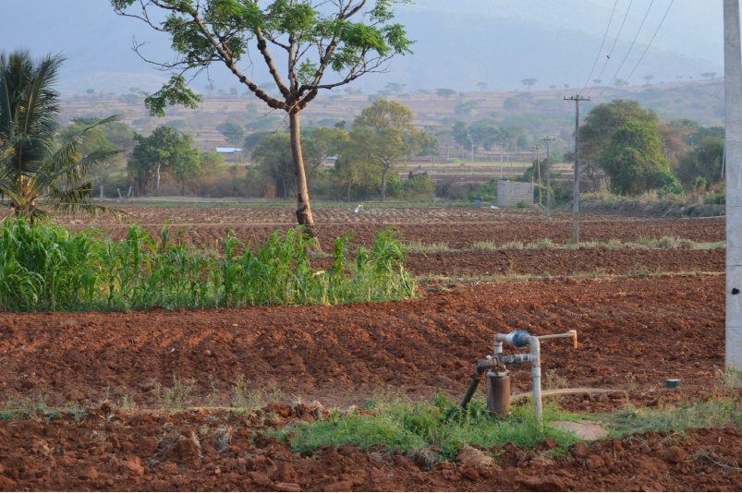

Slide 4
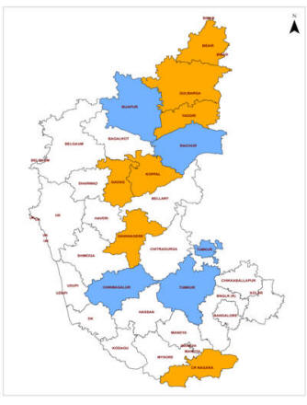

Slide 5
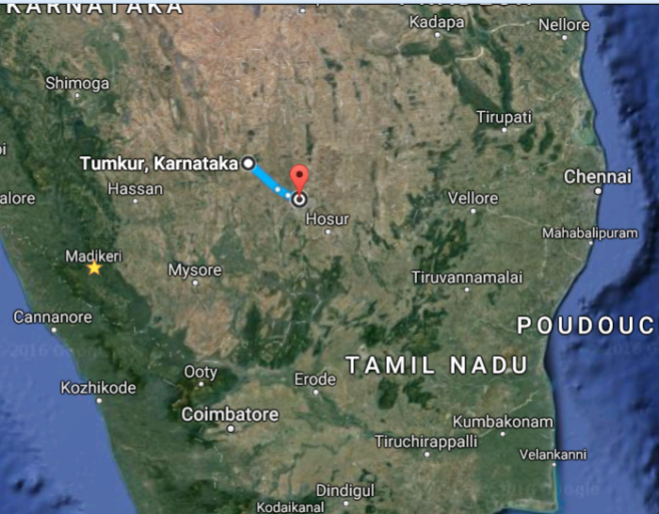
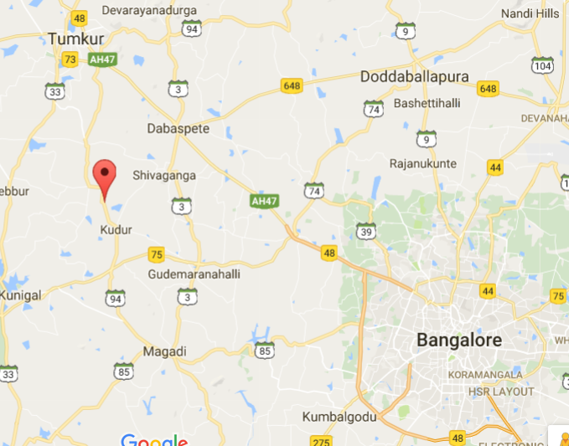
Day 4: Thursday 17th November -
Field Trip:
visit of one of the SUJALA-III experimental watersheds:
Hullyapura Microwatershed,
Hulikal, Tumkur district
9:00 AM | Assemble at ICAR - NBSS & LUP, Bangalore
9:00 – 10:15 AM | Onward journey to Hulikal
10:15 – 10:30 AM | Arrival at Hulikal & Briefing regarding contribution of Salumarada Thimmakka
10:30 – 10:45 AM | Proceed to Sugganahalli Temple
10:45 – 11:15 AM | Halt & briefing regarding history of Sugganahalli Temple
11:15 – 11:45 AM | Proceed to and study of Soil profile
11:45 – 12:30 Noon | Proceed to and study of Automatic Weather Station
12:30 – 1:00 PM | Proceed to and study of farm pond followed by refreshments
1:00 – 1:30 PM | Discussion
1:30 – 3:00 PM | Proceed to hotel for lunch
3:00 PM | Return to Bangalore

Slide 6
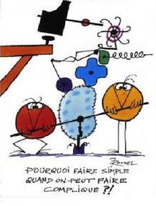

Slide 7


