Slide 1
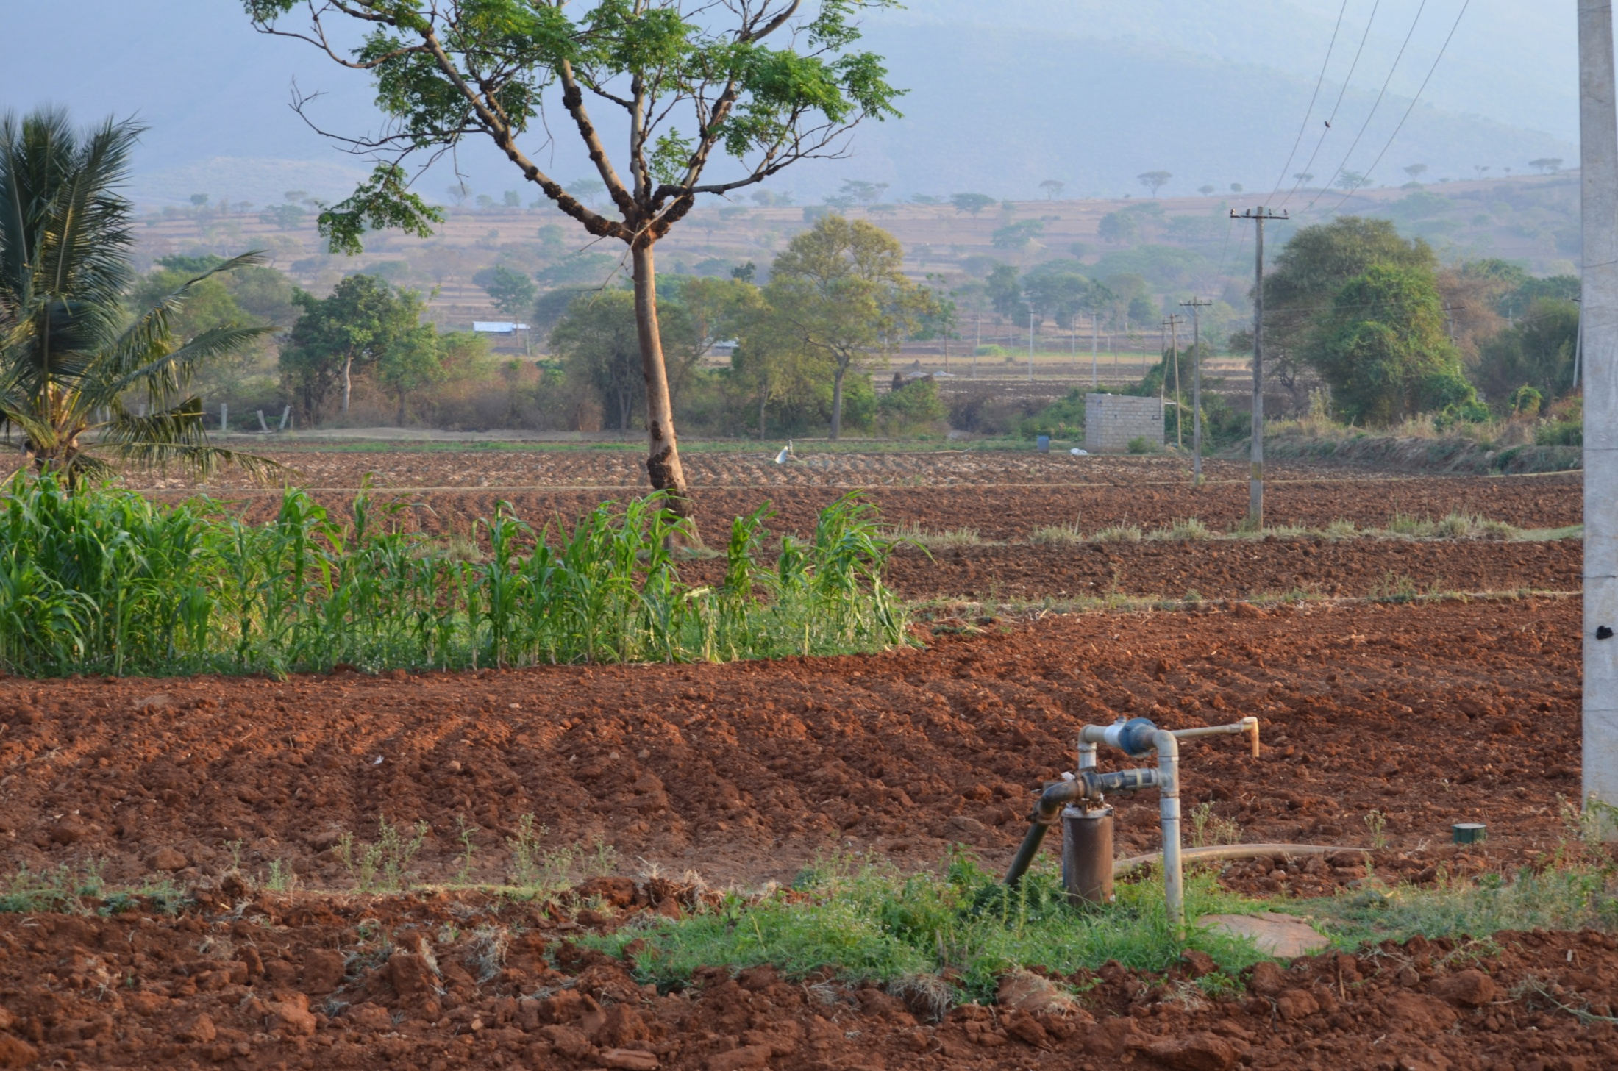
Calibration of STICS crop model for major crops in Berambadi Watershed
S. Buis, Sreelash K., M. Guérif, M. Launay, F. Ruget

Slide 2
Objective / constraints
Calibrate STICS
for new species (Turmeric, Marigold) or varieties (Maize, Sorghum, Sunflower)
for current conditions in Berambadi
for well representing the link between AWC components and LAI / SSM
… using the minimum number of situations
… from farm data

Slide 3
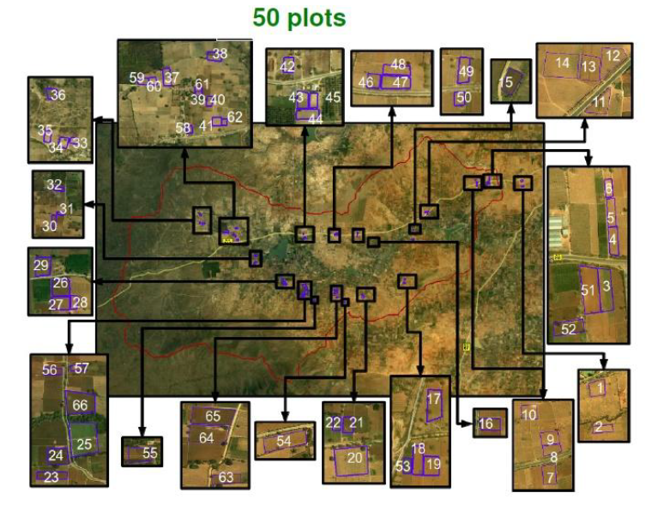
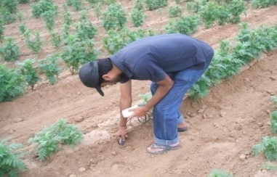
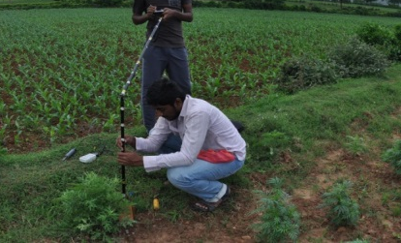
Available data
~80 km²
~4000 cultivated plots
~50 monitored plots
Measurements:
Vegetation: Leaf Area Index, Biomass, Yield at Harvest, Plant nitrogen content
Soil: Surface and Root Zone Soil Moisture (at every 10 cm upto a depth of 1 and/or 2 m), texture, nitrogen content
Farming techniques
Weather: Temperature, Rain, Radiation, Wind speed.

Slide 4
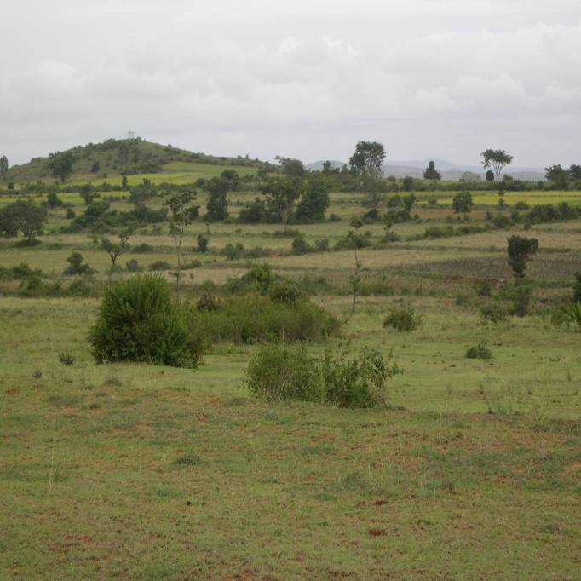
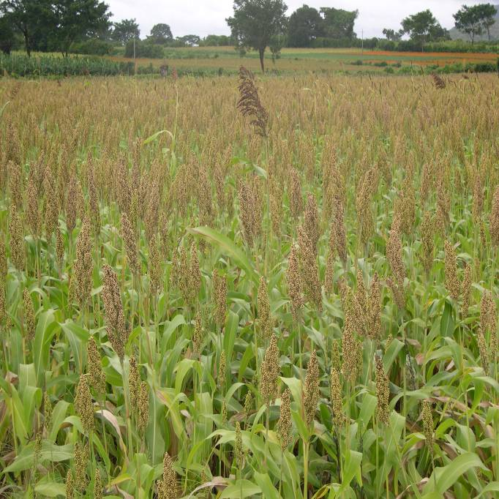
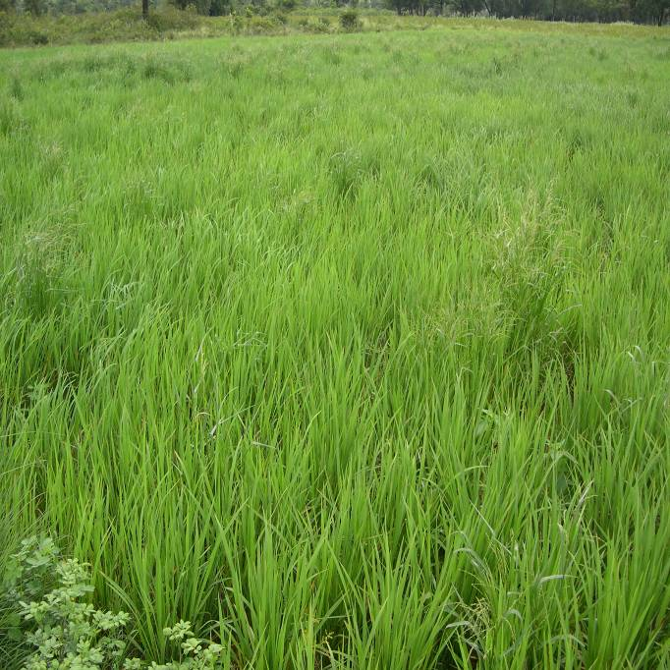
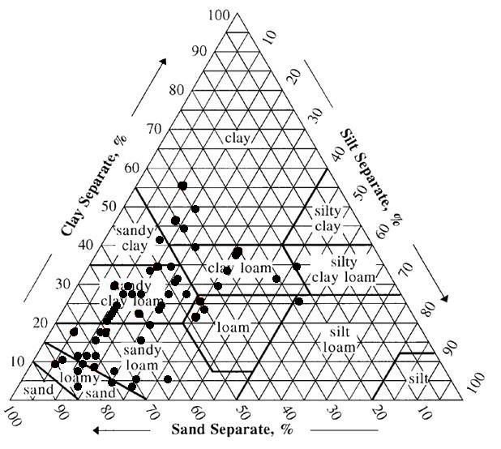
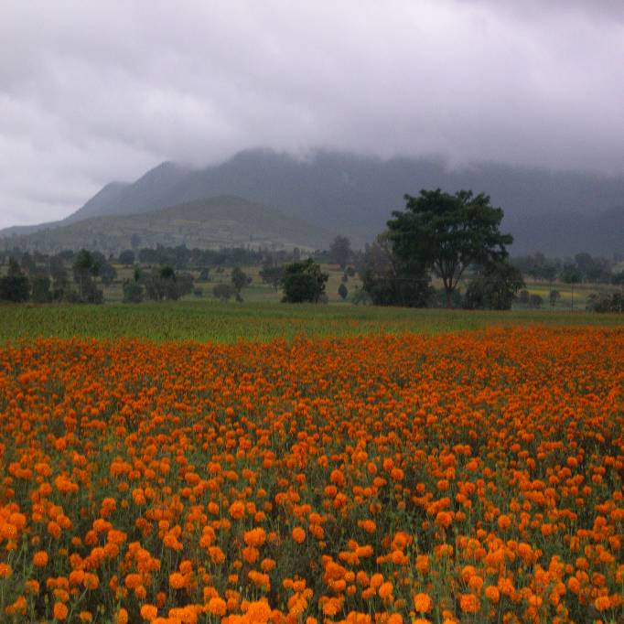
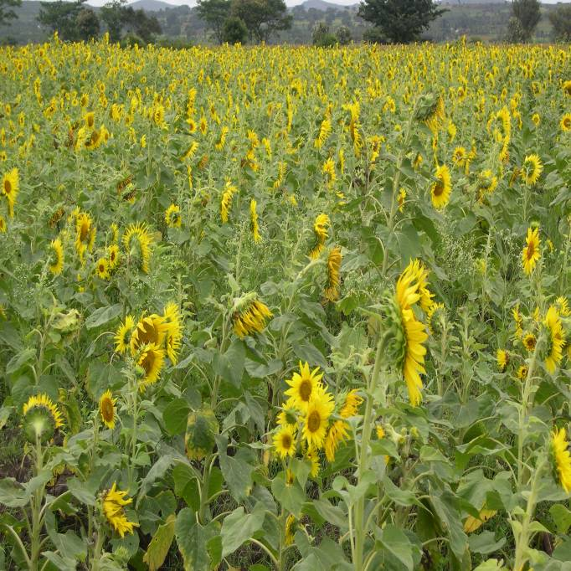
Available data
3-4 years of data for several crops on different soil types
 | 2010 | 2011 | 2012 | 2013 | Sum
Maize | 2 | 4 | 2 | 8 | 16
Turmeric | - | 8 | 9 | 7 | 24
Sunflower | - | 3 | 4 | 7 | 14
Marigold | - | 3 | 11 | 9 | 23
Horsegram | - | 4 | 3 | - | 7
Sorghum | - | - | 6 | 8 | 14
Turmeric
Sunflower

Slide 5
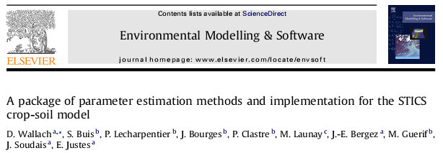
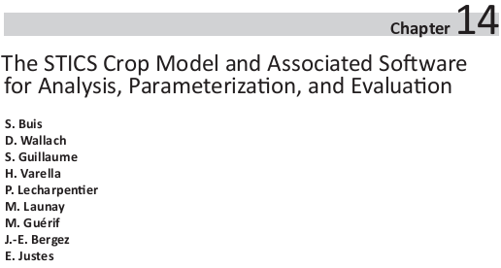
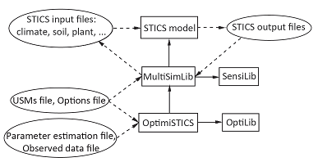
STICS calibration: software
OptimiSTICS, MultiSimLib : softwares for multi-simulation, sensitivity analysis, evaluation and parameter estimation for the STICS crop model.
In: Ma, L.R.A.a.L. (Ed.), “Methods of Introducing System Models into Agricultural Research”. ASA, CSSA, SSSA, Madison, pp. 395-426.

Slide 6
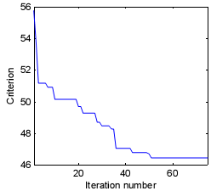
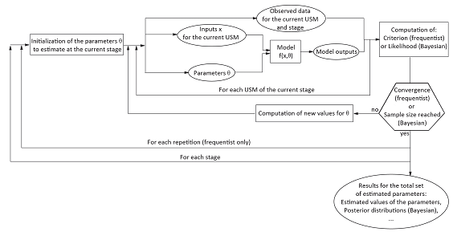
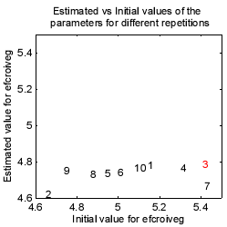
STICS calibration: method
Repeated Bound constrained minimization of mean square type criterion (concentrated likelihood) using Nelder-Meade simplex method.
${, θ}_{i}ε[θ_{i1}$; $θ_{i2}$]
Itérative minimization process
Repetition with different starting values

Slide 7
Calibration procedure
Data check and analysis (soil, plant, climate, practices)
Setting of STICS inputs
Selection of situations for calibration (potential [and stressed situations])
Successive calibration of :
[root parameters with forced LAI, (potential situations)]
LAI parameters, (potential situations)
yield and biomass parameters, (potential situations)
[stress parameters, (stressed situations)]
Evaluation on data not used for calibration
Notes:
Programme principal=plusieurs adaptés aux différents cas d’utilisation, ex: multisimulations simples (ie multilocal),
Analyse d’incertitude, sensibilité,…

Slide 8
STICS input parameters and variables
Crop Management Parameters
Parameters | Measurements /Source | Remarks
Date of sowing, harvest | Field visits/ farmer survey
Date of irrigation & fertilization |  | Uncertainty in part. for irrigation dates
Quantity / Type of fertilization |  | Uncertainty
Quantity of irrigation |  | Turmeric only. Approx values from tank volume
Density of plants |  | Measured at 3 places within a plot
Residues / manure |  | Stat. Information for manure in survey

Slide 9
STICS input parameters and variables
Soil Parameters
Parameters | Measurements /Source | Remarks
HCC, Hminf, Argi, DAF, calc | Granulometry / PTFs
Profhum | Ploughing depth
pH | ------------------ | Fixed value for all soil types
Albedo, qo | STICS manual / inversion on bare soil
Norg | Experiments CHN analyzer | Measured on a few plots, extrapolated from linear reg. on argi.
Obstarac | Field Observation | Soil Augering
ruisolnu | Inversion on bare soil
epd, pminruis, aclim, zesx, cfes, z0solnu, diftherm | STICS default values | Uncertainty?
Cailloux (stones) | Granulometry

Slide 10
STICS input parameters and variables
Parameters | Measurements /Source | Remarks
Initial soil water content at the start of simulation for different layers | Surface and profile soil moisture observations | Start full or at measured values depending on crop season and avail. of measurements. Short memory effect, checked on avail. data
Initial soil nitrogen content at the start of simulation for different layers | Measurements for 2 turmeric plots, simulation of preceding crop. | Large uncertainty. Fixed values or Simulation of preceding crop done for some maize plots in rabi season.
Initial Conditions

Slide 11
STICS input parameters and variables
Climate
Parameters | Measurements / Source | Remarks
Temperature | Automatic weather station (2 nos), Daily | Possibly large uncertainty due to spatial variability
Radiation
Rain
ETP | Automatic weather station (2 nos), Daily, computed from wind and air moisture

Slide 12
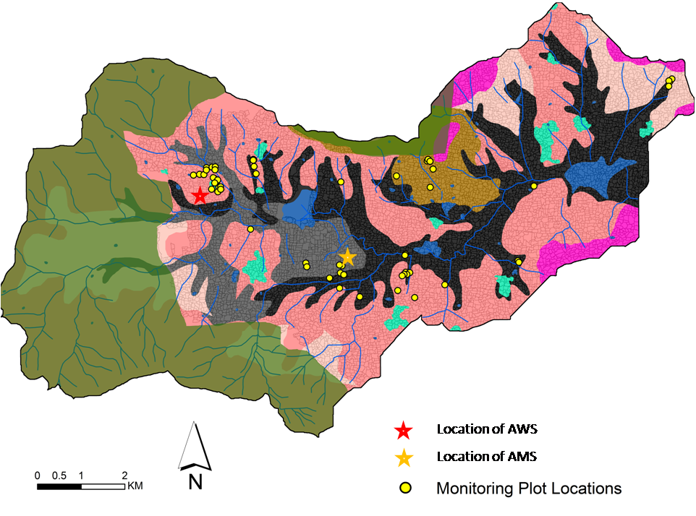
STICS input parameters and variables
What about spatial variability of climate variables?
 | Maddur |  | Flux Tower
 | Cumul. PET DOY 250-365 / DOY 110-365 (mm.d⁻¹) | Cumul. Rain DOY 250-365 / DOY 110-365 (mm) | Cumul. PET DOY 250-365 / DOY 110-365 (mm.d⁻¹) | Cumul. Rain DOY 250-365 / DOY 110-365 (mm)
2011 | 335 / 736 | 325 / 949 | - | -
2012 | 328 / 745 | 265 / 656 | 450 / 1011 | 269 / 573
2013 | 324 / 724 | 255 / 947 | 403 / 909 | 182 / 717

Slide 13
STICS input parameters and variables
Other parameters
Parameters | Measurements / Source | Remarks
Generic parameters | Original values delivered with STICS model
Plant parameters | Existing files (same specie or the closest we can find: potatoe for turmeric, tomato for marigold, …) | Only the main ones were calibrated (11-18 parameters over several dozens)

Slide 14
Calibrated parameters
roots
Parameter | Definition | Units
croirac | Growth rate of root front | Cm. degree-d-1
draclong | Maximum rate of root length production | Cm root plant-1 degree-d-1
lvfront | Root density at the front root | Cm root . Cm-3 soil
debsenrac | Life span of a root | degree-d

Slide 15
Calibrated parameters
LAI
Parameter | Definition | Units
dlaimaxbrut | maximum rate of the setting up of LAI | m2 leaf.plant-1.degree-d-1
stlevamf | cumulative thermal time between the stages LEV (emergence) and AMF (maximum acceleration of leaf growth, end of juvenile phase) | degree-d
stamflax | … AMF (maximum acceleration of leaf growth, end of juvenile phase) and LAX (maximum leaf area index, end of leaf growth ) | degree-d
durvieF | Maximal lifespan of an adult leaf | Q10

Slide 16
Calibrated parameters
Yield and biomass
Parameter | Definition | Units
vitircarb | rate of increase of the C harvest index vs time | g grain.g-1.d-1
irmax | maximum harvest index | SD
stlevdrp | … LEV (emergence) and DRP (starting date of filling of harvested organs) | degree-d
stdrpmat | … DRP (starting date of filling of harvested organs) and MAT (maturity) | degree-d
efcroijuv | maximum radiation use efficiency during the juvenile phase(LEV=emergence - AMF= maximum acceleration of leaf growth, end of juvenile phase) | g.MJ-1
efcroiveg | … vegetative stage (AMF = maximum acceleration of leaf growth, end of juvenile phase - DRP=starting date of filling of harvested organs) | g.MJ-1
efcroirepro | … grain filling phase (DRP= starting date of filling of harvested organs - MAT= maturity) | g.MJ-1

Slide 17
Calibrated parameters
stress
Parameter | Definition | Units
psisto | Absolute value of the potential of stomatal closing | bars
psiturg | Absolute value of the potential of the beginning of decrease of the cellular extension | bars
rapsenturg | Threshold soil water content active to simulate water senescence stress as a proportion of the turgor stress | -

Slide 18
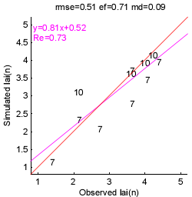
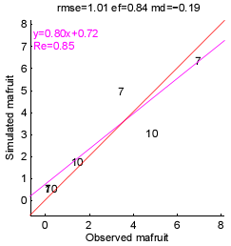
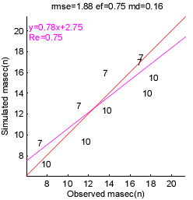
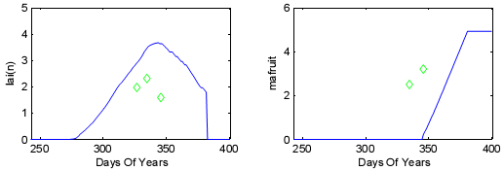
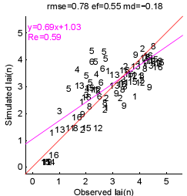
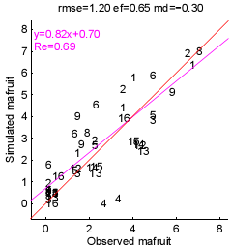
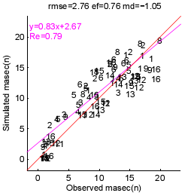
Results: Maize
Calibration Plots
40 2012, 31 2013
Evaluation Plots (14)
2010 LAI measurements
Other variety ?
Pb with data?
Particular stress?

Slide 19
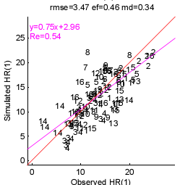
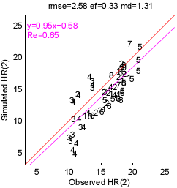
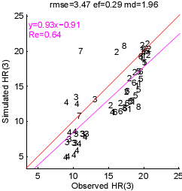
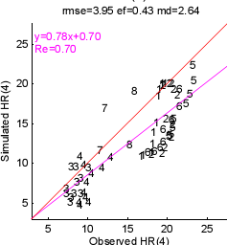
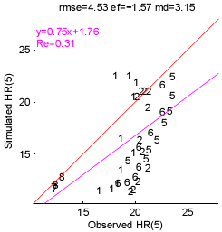
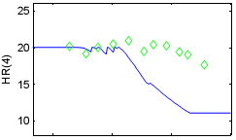
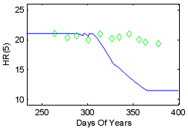
Results: Maize
62 2011
Large residues for water uptake in root zone
Notes:
2010 : 40, 41
2011 : 41, 62
= all the data for which we have HR !
For 40 and 41 we have turmeric in other years and inverse pb: 40_2011, 41_2012

Slide 20
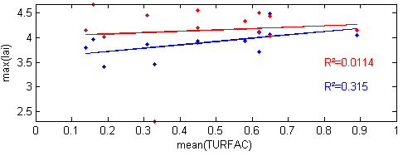
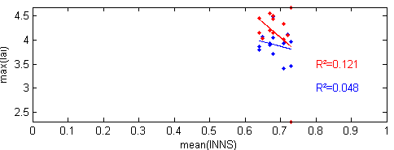
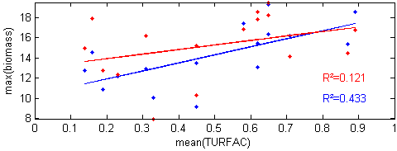
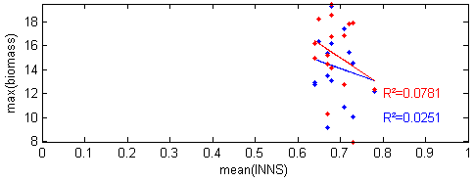
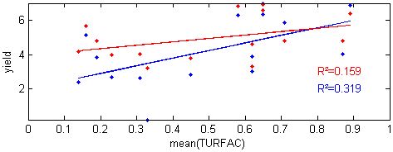
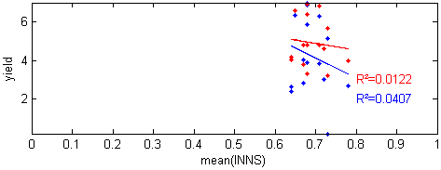
Results: Maize
Behaviour of observed and simulated values with respect to simulated stresses

Slide 21
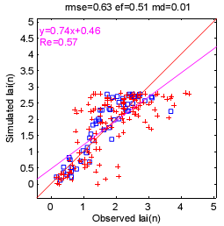
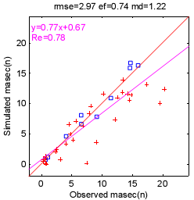
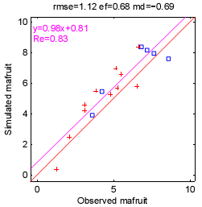
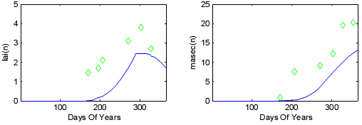
Results: Turmeric
4 situations used for calibration.
7 situations not taken into account: identified problems with pH, salinity, excessive stress, non-uniform plots, …
Other variety ?
Pb with data?
32B 2013

Slide 22
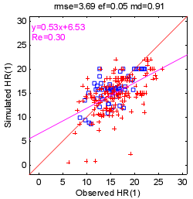
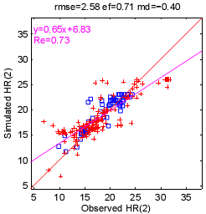
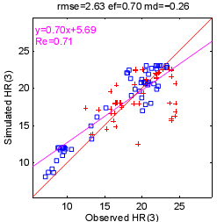
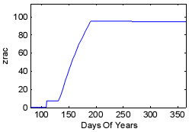
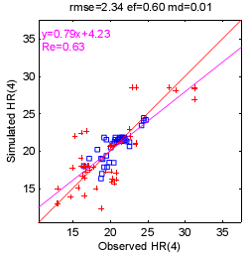
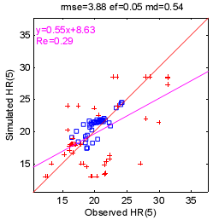
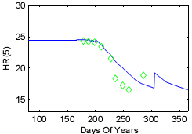
Results: Turmeric
Unrealistic ???
Max should be 60 (Buvi, Sreelash)
Root depth
Soil moisture 80-100 cm
22A 2012

Slide 23
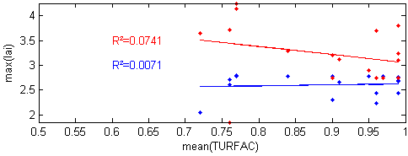
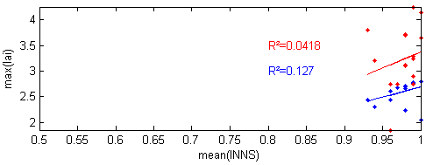
Results: Turmeric
Behaviour of observed and simulated values with respect to simulated stresses

Slide 24
Nitrogen simulation
Results: Turmeric
Plot 56B 2013
Nitrification and denitrification activated, parameterization adapted to tropical conditions (Sierra et al, 2003)
Several problems related to Nitrogen simulations:
Parameters of mineralization and (de)nitrification in our context? (pb occurring for each species)
Unknown dilution curve for turmeric
Norg values

Slide 25
Conclusions
LAI, biomass and yield correctly simulated for maize, turmeric, sunflower, sorghum as well as behavior with respect to simulated stress on the monitored plots
The calibration of marigold has not been completed
Pb with maize soil moisture, but does not seem to impact model inversions
Lots of uncertainties in input data that may have a significant impact on calibrated parameters (compensations, …) thus on simulations of situations very different from the ones used for the calibrations:
Agricultural techniques (irrigation and fert.)
Weather variables
Variety
Nitrogen relative processes parameterization, Norg value → need more and complementary soil nitrogen measurements to calibrate mineralization/nitrification process and turmeric dilution curve → see Buvi work
Nitrogen initial conditions → could be initialized from simulation of preceeding crop if calibrated
Further work needed on agronomic part for new species (Turmeric, Marigold, …) and soil nitrogen if we want to go further than a rough calibration of LAI and surface soil moisture

