Slide 1
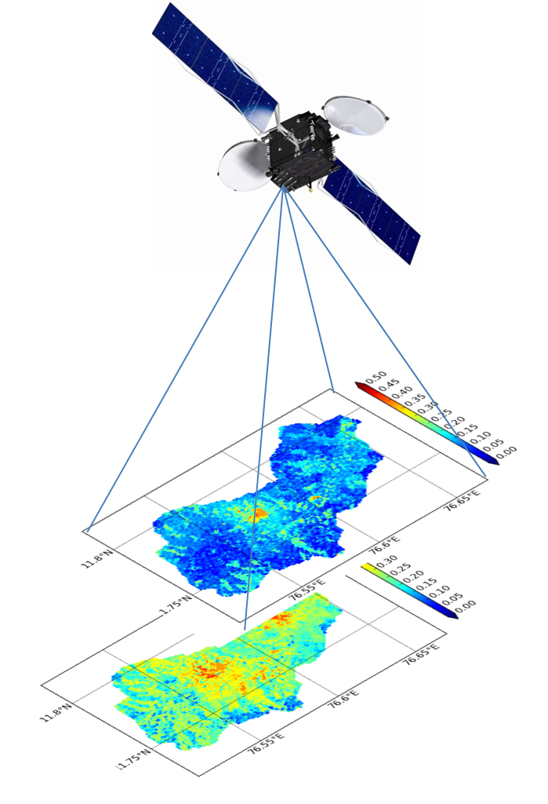


Estimating soil properties from Stics model inversion and satellite data
Samuel Buis, Sreelash K*, Martine Guérif
(EMMAH)
Sekhar Muddu (IISc)
Laurent Ruiz (SAS, IFCWS)
* CNES postdoc grant

Slide 2
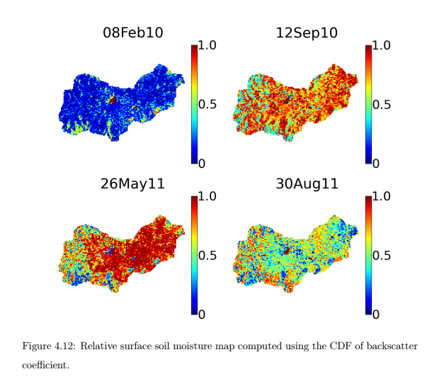



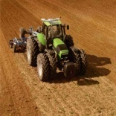
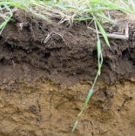
General Objective
Observable variables (RS)
Climate
Plant
LAI, biomass, yield,
harvest quality
Economic and decision modelling
- Soil moisture, water consumption deep percolation and groundwater recharge
Soil mineral N, volatilisation, Nitrate leaching
Practices
Soil
AWC components?
- Soil hydraulic properties (FC, WP)
- Soil depth
2D Groundwater Modelling

Slide 3
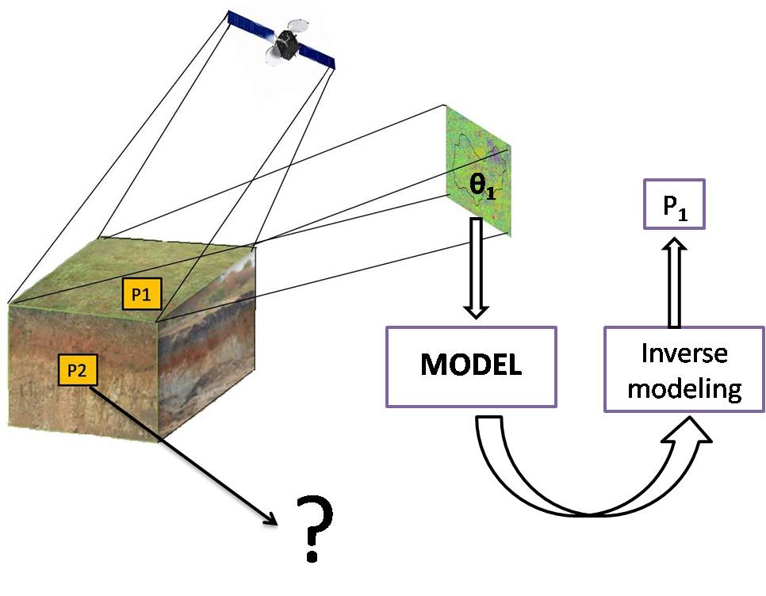
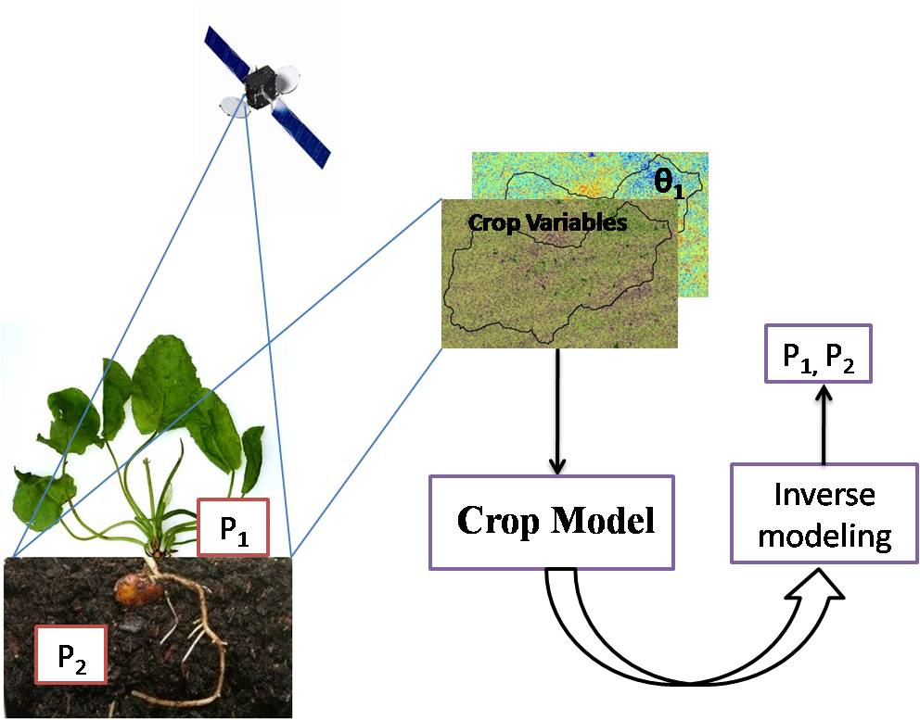
State of the art
Inversion of Crop/Vegetation Models:
Variable: Crop variables (Leaf Area Index (LAI), biomass, ET, Plant N content, …)
Crop variables bring information about root zone soil properties.
But soil properties accuracy is limited
Varella et al., 2010
Inversion of Hydrological Models:
Variable: Surface soil Moisture
Good estimation of surface layer
No information about root zone properties.
Montzka et al., 2011
Ines and Mohanty, 2008
Most studies performed on synthetic data or very limited real dataset

Slide 4
Research questions
A- Point scale study
Is it possible to estimate accurately both surface and root zone soil properties? With which observation types?
Use of observations on both plant (LAI, BM) and soil (SSM) : Sreelash et al, 2012
What is the accuracy of the soil properties estimates obtained from model inversion?
Does this accuracy depend on the configuration of the inversion (crop, climate, soil, nº of observations, …)?
Evaluation on actual ground data (2010-2013)
(Sreelash Cnes post doc at EMMAH febr 2014- jan 2016)
B- Extension to spatial application with remote sensing
Sat Kumar and Sreelash K (PhD)
Inversion of Radar data in biophysical parameters and associated uncertainty
What are the impacts on the results of the inversion of the uncertainties linked to the spatial application?
Sreelash Cnes post doc at EMMAH
From multi-points STICS model inversions to soil map generation
further work

Slide 5
Available Data: Field Data
Crop and Soil Experiments in the watershed (2010 to 2013)
Crop Experiments | No of Crops Monitored Turmeric Marigold Sorghum Sunflower Maize Variables monitored | 5 22 plots 26 plots 14 plots 13 plots 17 plots LAI, Biomass ,Yield & farm and crop management activities
Soil Experiments | Surface Soil Moisture Profile Soil Moisture Soil pit test Sieve Analysis | 90 plots 60 plots 40 plots (soil texture and depth) 40 Plots (Clay, silt and sand)
Farmer Survey * | Crop and farm management activities | Surveyed 75 farmers (for sowing data, fertilization, irrigation, harvest, etc)
Continuous surface and profile soil measurements: 30 days (Sep 2010) and 10 days (Aug 2013).
* Farmer survey done by field team of IISc

Slide 6
Available Data: Satellite Data
Year | Data | No of Images | Period
2011 | RADARSAT-2 | 8 | May to Nov
2012 |  | 7 | July to Nov
2013 |  | 6 | June to Sep
Frequency: 24 days
Spatial Resolution: 15m
Surface Soil Moisture
Algorithm based on cumulative density function (CDF)
transformation of backscatter coefficient. (Sat Kumar et al., 2015)
LAI
Method based on radar vegetation index (RVI) and parametric growth curve (K Sreelash PhD Thesis 2013)
Notes:
We had also satellite data thanks to preliminary work done by Sat and Sreelash
3 years of radarsat 2 were exploited to determine SSM and LAI on the watershed.

Slide 7
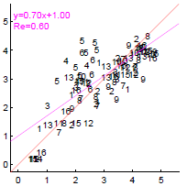
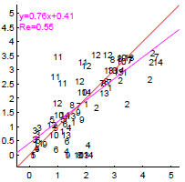
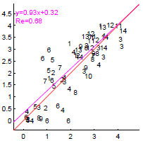
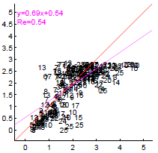
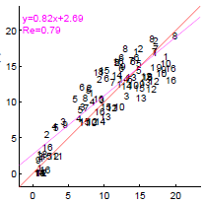
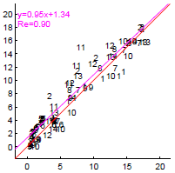
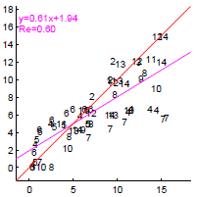
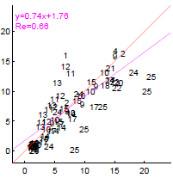
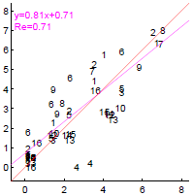
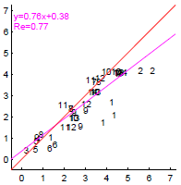
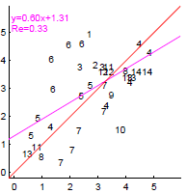
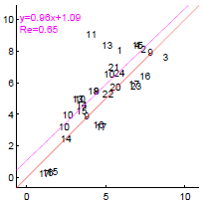
Preliminary work: STICS calibration
STICS crop model roughly calibrated for 4 crops
LAI
Biomass
Yield
Maize
Sorghum
Sunflower
Turmeric
Notes:
As a preliminary work we had also to calibrate the STICS model to represented the species and varieties used in the watershed.

Slide 8
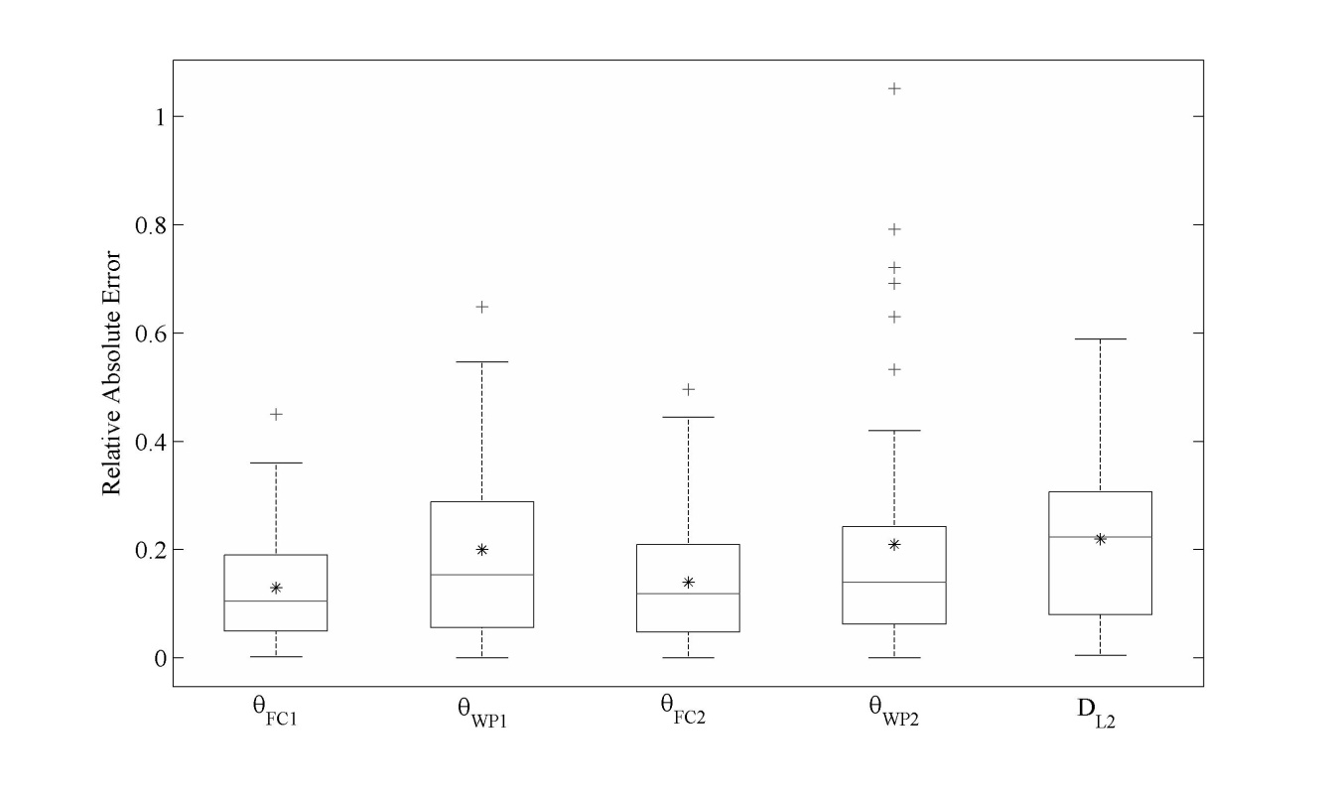
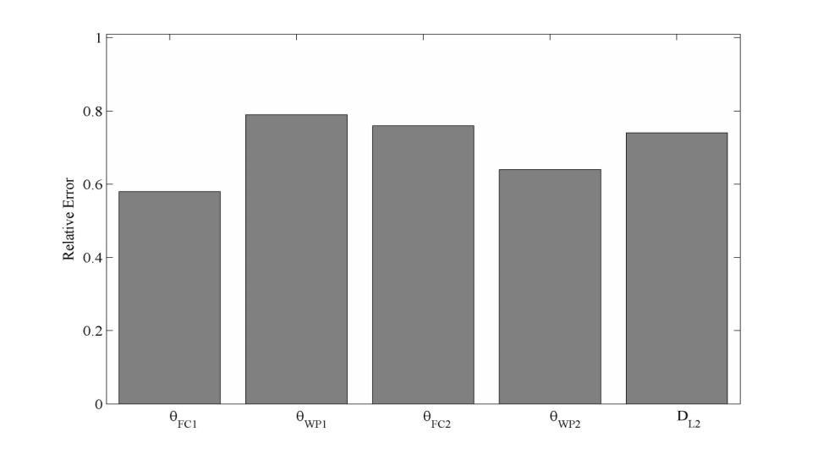
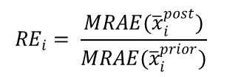
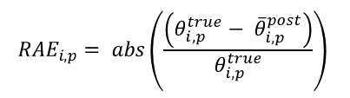
Scientific outputs:
Accuracy of soil properties estimates
$${RE}_{i}= \frac{MRAE({\overline{x}}_{i}^{post})}{MRAE({\overline{x}}_{i}^{prior})}$$
$${RAE}_{i,p}= abs\left(\frac{\left({θ_{i,p}^{true}− \overline{θ}}_{i,p}^{post}\right)}{θ_{i,p}^{true}}\right)$$
The quality of estimation of AWC components obtained on a large real dataset is:
  highly variable depending on the situations on which it was estimated
  significantly better than prior information
  good in favorable configurations:
 | θ_{FC1} | θ_{WP1} | θ_{FC2} | θ_{WP2} | D_{L2}
MRAE | 5% | 15% | 10% | 15% | 20%
Sreelash et al, JoH, under review

Slide 9
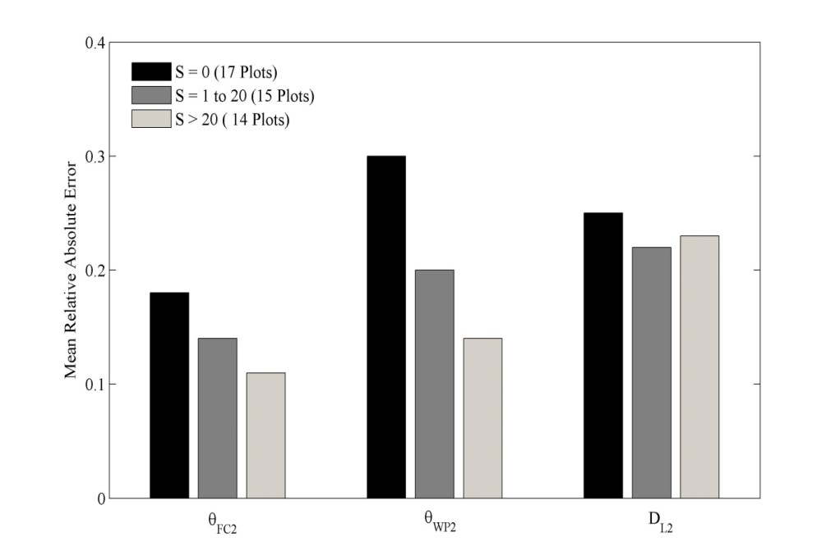
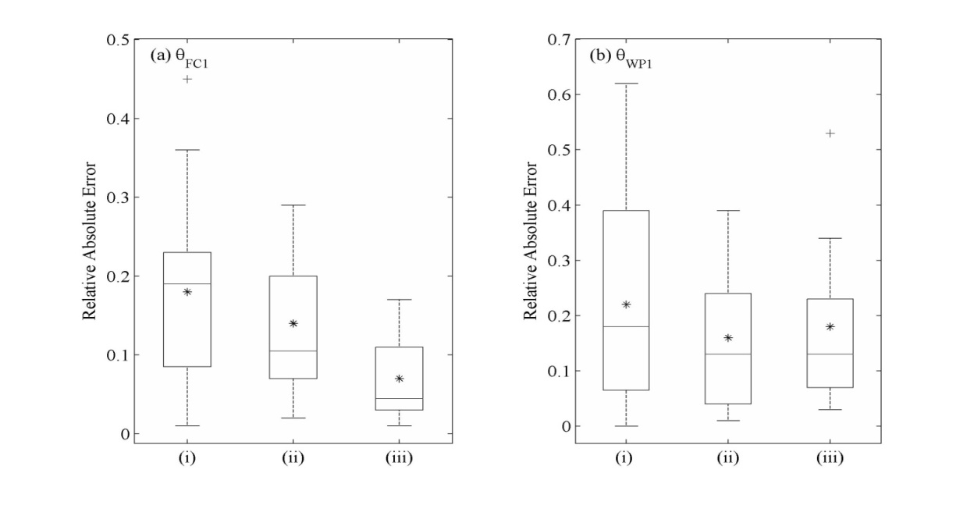
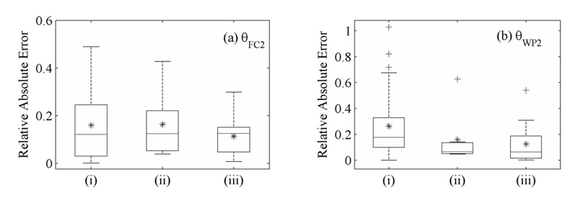
Scientific outputs: Effect of hydric regime, crop type and n° of observations
Hydric Stress
Number of SSM obs. in wet / dry situations
(i) N = 0, (ii) N = 1 to 2 and (iii) N > 2
The quality of estimation of AWC components is highly dependent on the hydric regime and its interaction with crop type
A few observations of LAI and SSM available in favorable conditions were sufficient to largely improve the estimation of AWC components.
Number of LAI obs. during high stress
(i) N = 0, (ii) N = 1 and (iii) N > 1
Sreelash et al, JoH, under review

Slide 10
Scientific outputs: Effect of uncertainty in Crop Management parameters and non-estimated soil parameters
Lvl | Crop Management Parameters
 | Sowing Date | Fert. Qty | Fert. Date
L1 | Field Data | Field Data | Field Data
L2 | DecisionRule | DecisionRule | DecisionRule
L3 | Start of season | Data fromGovt | Start of season
Lvl | Non Estimated Soil Parameters
 | Clay | Norg
L1 | Field Data | Empirical Relation
L2 | SoilMap | Empirical Relation
L3 | SoilMap | Empirical Relation
Uncertainties on crop management and non-estimated soil parameters both impact significantly the quality of estimation …
… but level of errors still acceptable

Slide 11
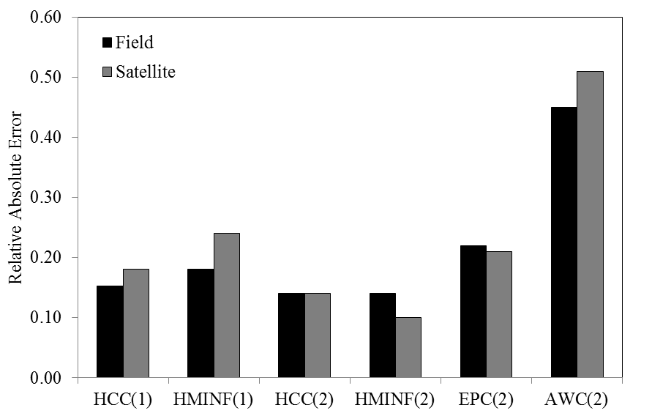
Scientific outputs:
Effect of using radar data on AWC components estimation
Using SSM and LAI from radar data does not seem to impact a lot the results
But only been studied for turmeric plots for the moment

Slide 12
Papers
Sreelash, K., Buis, S., Sekhar, M., Ruiz, L., Guerif, M. Estimation of available water capacity components of multilayered soils using crop model inversion: effect of crop type and water regime, Under review, Journal of Hydrology
Tomer, S. K., Al Bitar, A., Sekhar, M., Zribi, M., Bandyopadhyay, S., Sreelash, K., Sharma, A.K., Corgne, S., Kerr, Y. (2015). Retrieval and multi-scale validation of soil moisture from multi-temporal SAR data in a semi-arid tropical region. Remote Sensing, 7(6), 8128-8153.
Sreelash, K., Sekhar, M., Ruiz, L., Buis, S., Bandyopadhyay, S. (2013). Improved modeling of groundwater recharge in agricultural watersheds using a combination of crop model and remote sensing. Journal of the Indian Institute of Science, 93(2), 189-207.
Sreelash, K., Sekhar, M., Ruiz, L., Tomer, S.K., Guerif, M., Buis, S., Durand, P., Gascuel-Odoux, C., 2012. Parameter estimation of a two-horizon soil profile by combining crop canopy and surface soil moisture observations using GLUE. Journal of Hydrology 456, 57-67.

Slide 13
Perspectives
Complete Uncertainty study in estimation of AWC components
Study the impact of using remotely-sensed LAI-SSM for other crops and combine with other sources of uncertainty
Effect of uncertainty in rainfall? Land Use?
Spatial Application of the approach
Multiple point inversion cannot be spatially exhaustive due to computational cost, large occurrence of non-calibrated crops, …
Need of:
  Spatial sampling
  Spatialisation techniques

Slide 14
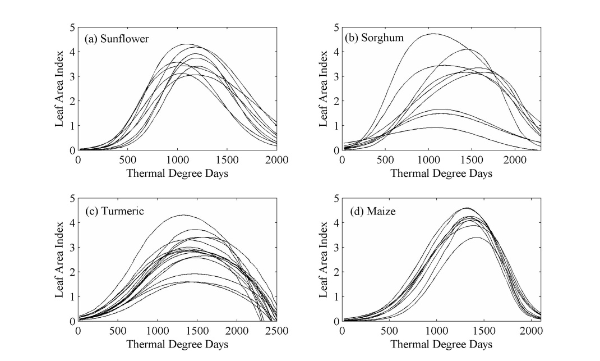
A- Point scale study
What is the accuracy of the soil properties estimates obtained from model inversion? What are the impacts of crop, climate, quantity of observations on the results?
Situations used in Inversion: 45 (11 Sunflower, 9 Sorghum, 17 Turmeric, 8 Maize)
Climate: Data from Maddur (2011 to 2013) and Flux tower stations (2012 to 2013)
Estimated Parameters: Field Capacity, Wilting Point, Depth of Horizon-2 and
Available water content (AWC2)
Non Estimated Soil Parameters: Standard Values based on soil type from references
Prior Information: Range of values of field capacity, wilting point and soil depth
from experimental data
 | (Rain+Irrigation)/PET
 | 2011 | 2012 | 2013
Sunflower / Sorghum | 1.5 | 0.83 | 1.63
Turmeric | 1.45 | 1.63 | 1.38
Maize | 0.91 | 1.06 | 0.88
Soil Type | No of Plots | Field Capacity θ_{FC} (g/g) | Wilting Point θ_{WP} (g/g) | Available water Content AWC (mm)
Sandy Loam | 11 | 14.0 to 19.5 | 4.5 to 7.5 | 127.0 to 215.0
Sandy Clay Loam | 15 | 17.5 to 23.5 | 6.5 to 11.0 | 139.0 to 231.0
Clay Loam | 7 | 22.5 to 30.0 | 10.5 to 12.5 | 129.0 to 198.0

Slide 15
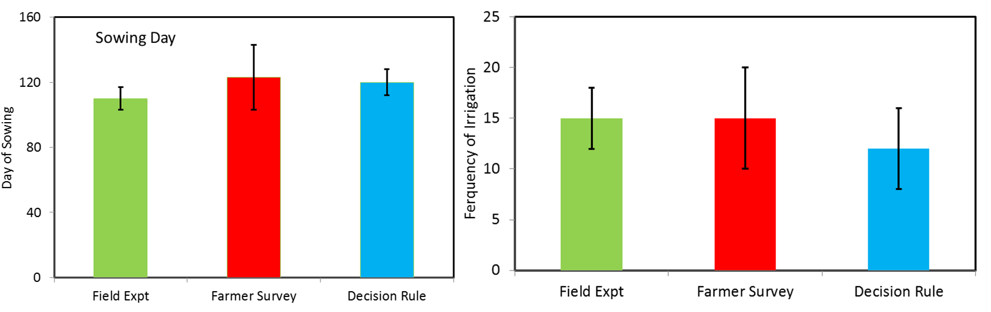
Examples of Uncertainty in the soil / crop parameters
Crop management (Turmeric Crop)
Decision Rule for Sowing date:
Sowing is assumed if 10 day rainfall > 30 mm (starting from 1st of May)
Decision Rule for frequency and date of Irrigation:
Irrigation is assumed if 10 day rainfall < 30 mm (for turmeric)

Slide 16
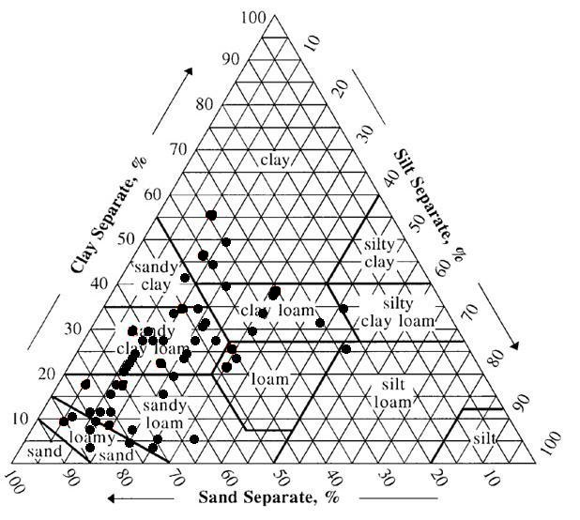
Examples of Uncertainty in the soil / crop parameters
Non estimated Soil parameters
Map Points Field Points

