Slide 1
A stochastic dynamic programming approach to analyze adaptation to climate change - application to groundwater irrigation in India
Marion ROBERT *
Alban THOMAS
Jacques-Eric BERGEZ
Notes:
Conceptual Modeling of the Farmer agent underlying Decision-Making processes in farming system

Slide 2
Objectives
Model decisions of farmers facing climate change
decisions on investment in borewell irrigation
decisions on cropping systems and irrigation water application rate on crops
Test socio-economic and water management policies under scenarios of climate change
subsidized rainfed crops
reform of subsidized energy for irrigation
water charge indexed on ambient groundwater level

Slide 3
Economic model
Framework: bio-economic model with season-specific crop choice and yearly investment decision in irrigation facilities
Stochastic dynamic programming approach
Stages of the farmer decision-making process:
Beginning of the planning horizon
Form expectation on several random variables (future climate – probability of occurrence, future market prices for crops and groundwater availability for irrigation)
Decide whether to invest or not in irrigation, or to rely on rainfall for the coming year
Decide on the type of crops to grow and plot size
Decide on the irrigation-water application rate for each crop, given total water availability and observed rainfall
Follow a set of irrigation rules to obtain the “best” crop yield, given the irrigation equipment, the selected crop, the actual climatic conditions.
Beginning of the year
At the beginning of each growing season
For each growing season
For each growing season
Robert, M., Bergez, J.E., Thomas, A., (2016) A stochastic dynamic programming approach to analyze adaptation to climate change - application to groundwater irrigation in India, European Journal of Operational Research (to be submitted)
Notes:
We consider a representative farmer who makes decisions on irrigation and crop choice, accounting for the consequences of his decisions today on future water availability (because the latter ultimately determines future crop output, hence future profit flows). Our framework is based on a bio-economic model with a season-specific crop choice and a yearly investment decision in irrigation facilities.

Slide 4
Economic model
T = years of the planning horizon
B = number of plots
C = number of crops
τ = S₁, S₂ cropping seasons
${Season1}_{length}$, ${Season2}_{length}$ = cropping season duration
Rainfall expectations:
Distributed according to a discrete distribution of five profiles (i = poor, below average, average, above average or good)
${rain}_{S1}$ and ${rain}_{S2}$= average season-specific rainfall level
${pr}_{S1}$ and ${pr}_{S2}$ = probability of occurrence of each rainfall regime (Maddur climatic series)
Crop price expectations:
${PRICE}_{c}$ = ${REF}_{c}$* $α_{i}$
${REF}_{c}$= reference price (district data - Indian Ministry of Agriculture and Cooperation / National Informatics Center)
$α_{i}$= crop price elasticity with respect to rainfall regime i
Robert, M., Bergez, J.E., Thomas, A., (2016) A stochastic dynamic programming approach to analyze adaptation to climate change - application to groundwater irrigation in India, European Journal of Operational Research (to be submitted)
Notes:
We consider a representative farmer who makes decisions on irrigation and crop choice, accounting for the consequences of his decisions today on future water availability (because the latter ultimately determines future crop output, hence future profit flows). Our framework is based on a bio-economic model with a season-specific crop choice and a yearly investment decision in irrigation facilities.

Slide 5
Economic model
Yearly investment cost:
m-year loan with fixed interest rate of r percent
$I_{t}=\left(1+r\right)\left(\frac{1}{m}\right)({COST}_{well}$ + ${COST}_{pump}$) + ${COST}_{maintenance}$ (big survey)
Cost of pumping groundwater for irrigating crops:
$${HOURS}_{irrigation}=(Power{{×Season1}_{length}+Power{×Season2}_{length})×RATE}_{irrigation}$$
${COST}_{pumping}= {HOURS}_{irrigation} ×$ $Power$ $×{ COST}_{electricity}$
Flow rate of the well:
maximum water abstraction capacity from the irrigation system
$FR=h\left(HP, {WT}_{depth}, {WELL}_{depth}\right)$
$$>0 if { WELL}_{depth}>{WT}_{depth}$$
$$0 otherwise$$
Robert, M., Bergez, J.E., Thomas, A., (2016) A stochastic dynamic programming approach to analyze adaptation to climate change - application to groundwater irrigation in India, European Journal of Operational Research (to be submitted)
Notes:
We consider a representative farmer who makes decisions on irrigation and crop choice, accounting for the consequences of his decisions today on future water availability (because the latter ultimately determines future crop output, hence future profit flows). Our framework is based on a bio-economic model with a season-specific crop choice and a yearly investment decision in irrigation facilities.

Slide 6
Economic model
State variable:
W = flow rate a specific time-period
$W_{S1}$= ${pr}_{S1}$*${RATE}_{depreciation}$*79.93*${{(WT}_{depth}−{rain}_{S1}∗{recharge}_{S1})}^{−0.728}$
$W_{S2}$= ${pr}_{S2}$*${RATE}_{depreciation}$*79.93*${{(WT}_{depth}−{rain}_{S2}∗{recharge}_{S2})}^{−0.728}$
Expected water available for irrigation:
${\overline{W}}_{S1}= W×{Power_day}_{S1}×{Season1}_{length}$
${\overline{W}}_{S2}=$*$W×{Power_day}_{S2}×{Season2}_{length}$
Total irrigation capacity expected for the year:
$\overline{W}$= ${\overline{W}}_{S1}$+ ${\overline{W}}_{S2}$
(${recharge}_{S1}$ = 10%)
Robert, M., Bergez, J.E., Thomas, A., (2016) A stochastic dynamic programming approach to analyze adaptation to climate change - application to groundwater irrigation in India, European Journal of Operational Research (to be submitted)
Notes:
flow rate dynamic and stochastic because it depends on the borewell yield, the rainfall recharge factor and it takes into consideration the depreciation of the irrigation capital stock (with a factor of ${RATE}_{depreciation}$).

Slide 7
Economic model
Crop yield:
quadratic function of irrigation water distributed to the crop (Jalota et al., 2007)
$${YIELD}_{c}\left(\tilde{R}, W\right)= a_{c}+b_{c}\min\left[({RATE}_{irrigation,c} \left(\tilde{R}\right)×{\overline{W}}_{S1} , {Irri}_{c} (\tilde{R})\right]$$
$$+ d_{c} {\min\left[{RATE}_{irrigation,c }\left(\tilde{R}\right)×{\overline{W}}_{S1} , {Irri}_{c} (\tilde{R})\right]}^{2}$$
Expected profit from crop c at season $τ$ and on plot b:
$π_{bcτ}≅\sum_{i=1}^{5}{{pr}_{τ,i}[}\left(1−{RATE}_{failure}\right)$ [${PRICE}_{cτ}\left({\tilde{R}}_{τ}\right){YIELD}_{bcτ}\left({\tilde{R}}_{τ}, W_{bcτ}\right)×$
${ SIZE}_{plot}−{COST}_{c}−{COST}_{pumping}$]$+$
$\left({RATE}_{failure}\right)$ [${PRICE}_{c_{replace},τ}\left({\tilde{R}}_{τ}\right){YIELD}_{b,c_{replace}, τ}\left({\tilde{R}}_{τ}, W_{b,c_{replace}, τ}\right)$ x
${ SIZE}_{plot} {− COST}_{c_{replace}}−{COST}_{c}−{COST}_{pumping}$]]
Robert, M., Bergez, J.E., Thomas, A., (2016) A stochastic dynamic programming approach to analyze adaptation to climate change - application to groundwater irrigation in India, European Journal of Operational Research (to be submitted)
Notes:
We consider a representative farmer who makes decisions on irrigation and crop choice, accounting for the consequences of his decisions today on future water availability (because the latter ultimately determines future crop output, hence future profit flows). Our framework is based on a bio-economic model with a season-specific crop choice and a yearly investment decision in irrigation facilities.

Slide 8
Economic model
The farmer’s problem over the planning horizon with T years:
$\max_{\left\{I_{t}\right\}}{\sum_{t=1}^{T}{{\left(1+r\right)}^{−t}}}\left\{\max_{\left\{δ_{bcτ}\right\}}\left[\sum_{b=1}^{B}{\sum_{c=1}^{C}{\sum_{τ=S1}^{S2}{{δ_{bcτ} π}_{bcτ}}}}\right]−I_{t}\right\}$
R = constant discount rate
$δ_{bcτ}=1$ if crop c is grown on plot b at season $τ$ and 0 otherwise
Bellman approach:
$V\left(W_{t}\right)$ = $\max_{I_{t}}\left\{π_{t}^{∗}\left(I_{t},W_{t}\right)+β E_{\tilde{R}}V\left(W_{t+1}\right)\right\},{∀t} ($transition equation: $W_{t+1}=f(W_{t}$,$I_{t}$) )
$V\left(W_{t}\right)$ = value function
$β$ = discount factor
Collocation method:
$\sum_{p=1}^{P}{c_{p}Φ_{p}\left(W_{p}\right)=\max\left\{π^{∗}\left(I,W_{p}\right)+ βE_{\tilde{R}}\sum_{p=1}^{P}{c_{p}Φ_{p}\left[f\left(W_{p}\right)\right]}\right\}}, p=1,…,P$,
$Φ_{p}$ = Chebyshev polynomial of order p
$c_{p}$ = associated coefficient (to be evaluated)
Robert, M., Bergez, J.E., Thomas, A., (2016) A stochastic dynamic programming approach to analyze adaptation to climate change - application to groundwater irrigation in India, European Journal of Operational Research (to be submitted)
Notes:
We consider a representative farmer who makes decisions on irrigation and crop choice, accounting for the consequences of his decisions today on future water availability (because the latter ultimately determines future crop output, hence future profit flows). Our framework is based on a bio-economic model with a season-specific crop choice and a yearly investment decision in irrigation facilities.

Slide 9
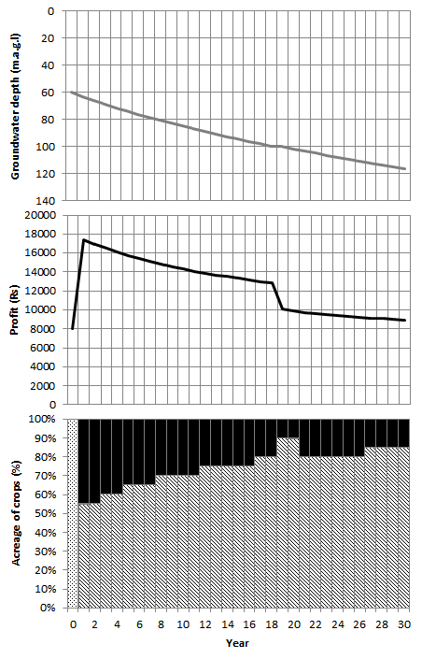
Economic model - scenarios
Baseline scenario
Average values for climate, crop marketing, water pumping conditions
Y1: invests in a borewell (100m)
irrigated system (sunflower/turmeric)
Decreasing groundwater level
Y20: borewell dried
Y21: new borewell (150m)
=> groundwater depletion from 60 m.b.g.l. to 116 m.b.g.l.
Robert, M., Bergez, J.E., Thomas, A., (2016) A stochastic dynamic programming approach to analyze adaptation to climate change - application to groundwater irrigation in India, European Journal of Operational Research (to be submitted)
Notes:
Under the baseline scenario (Figure 1), the farmer invests in a borewell the first year of simulation. Investing in a borewell allowed him to switch from a rainfed system based on marigold to an irrigated system made of irrigated sunflower and irrigated turmeric. The total amount of pumped water allowed by the borewell flow rate is used each year. The deeper the groundwater table, the lower the pump flow, which leads the farmer to review his plot allocation and water allocation among sunflower and turmeric. On the 19th year, the water in the first borewell is really low given the low flow rate, and the farmer has to decrease his area of turmeric in favor of sunflower, leading to a decrease in profit. The first borewell became dry after 20 years of pumping. To maintain this irrigated system the farmer has no other choice than to invest in a second borewell, deeper than the first one, at the beginning of the 21st year. The groundwater is depleting from 60 m.b.g.l. to 116 m.b.g.l. over the planning horizon. Loosing 93 percent of groundwater height over 30 years is an extremely severe scenario.

Slide 10
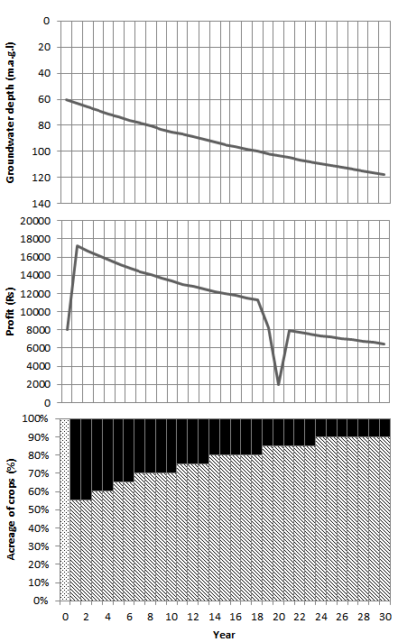
Economic model- scenarios
Climate change scenarios
+1% to the proportions of low and below average rain regimes by year
similar to baseline scenario
groundwater depletion from 60 m.b.g.l. to 118 m.b.g.l
Robert, M., Bergez, J.E., Thomas, A., (2016) A stochastic dynamic programming approach to analyze adaptation to climate change - application to groundwater irrigation in India, European Journal of Operational Research (to be submitted)
Notes:
Under the climate change scenario, the investment behavior of the farmer is similar to the one under the baseline scenario, except that the first borewell becomes dry at the end of the 19th year of pumping, leading the farmer to drill his second borewell on the 20th year (one year before than in the baseline scenario) (Figure 2). The 20th year is disastrous for the farmer because his first borewell is dry and he still has one year of payment for this borewell to cover up his first loan repayment, in addition to the new loan that is taken for his second borewell. With a higher probability of occurrence of dry year, the expected recharge of the groundwater is lower, leading the farmer to reduce his proportion of turmeric compared with the sunflower faster than with the baseline scenario. Profits are thus lower in this scenario. The groundwater is depleting from 60 m.b.g.l. to 118 m.b.g.l. over the planning horizon. As in the baseline case, losing 97 percent in terms of groundwater level over 30 years is a catastrophic scenario.

Slide 11
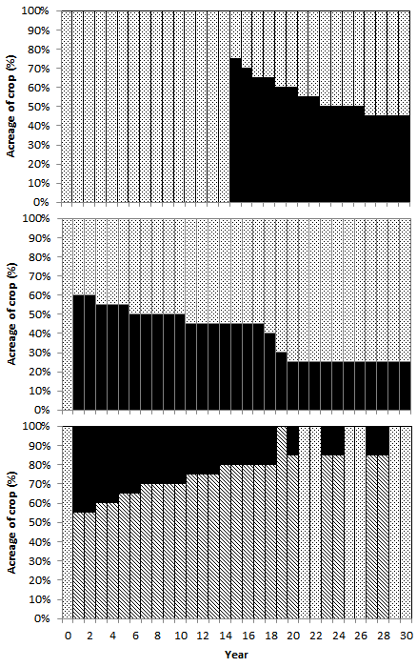
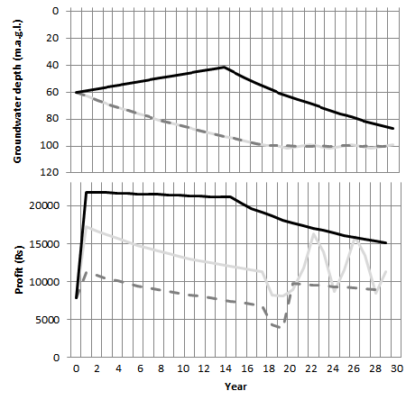
Economic model - scenarios
Water management policy: subsidized rainfed crops
Subsidy to farmers by unit of surface of land managed under rainfed condition (1000Rs/ha to 7000Rs/ha)
7000 Rs/ha
LIMITED policy
requires more than 7000Rs/ha to reduce water pumping
7000Rs.ha => groundwater depletion from 60 m.b.g.l. to 82 m.b.g.l
4000 Rs/ha
1000 Rs/ha
Robert, M., Bergez, J.E., Thomas, A., (2016) A stochastic dynamic programming approach to analyze adaptation to climate change - application to groundwater irrigation in India, European Journal of Operational Research (to be submitted)
Notes:
Under the first water management policy scenario, farmers are encouraged to grow crops under rainfed conditions and receive a subsidy from 1000 to 7000Rs per hectare of land planted with rainfed crops (Figure 3). From subsidies of 1000 to 3000 Rs/ha of rainfed crops, the farmer behavior is very similar to the scenario of climate change without any water management policy. The farmer is investing in a borewell the first year to grow turmeric and sunflower under irrigated condition. On the 19th year, instead of growing both turmeric and sunflower, the farmer is only growing sunflower in irrigated condition, providing him with one more year of pumping before drying his borewell. Instead of drilling a second borewell, the farmer will take advantage of the subsidy by growing marigold in rainfed condition. Receiving the subsidy is more profitable than investing in a new borewell. Indeed, if we compare to the scenario of climate change without water management policy we can see that profit the last ten years varies between 6400Rs and 7900Rs per hectare under the first scenario of climate change while it varies between 8400 and 15900Rs with a subsidy of 1000Rs per hectare of rainfed land. Between 4000 and 6000 Rs of subsidies per hectare, sunflower is replaced by rainfed marigold. All available water is used on turmeric until the 19th year. From there, water use goes from 70 to 65 percent of available water in kharif but stops in rabi season, corresponding to the volume of water recharge from rainfall in kharif and rabi. As a result, the borewell is not even dry after 30 years of pumping. This scenario leads to a depletion of 67 percent of groundwater table height after 30 years of planning horizon. For a subsidy of 7000Rs per hectare of rainfed crops, the decision on investing in a borewell is postponed until the 15th year. On that year, the groundwater table reaches 45 m.b.g.l. with 25 percent of recharge from rainfall. The groundwater table is high enough to grow turmeric over three-quarters of the land in the best cropping conditions, so that profit from selling the crop will cover the construction cost of the borewell and even ensure some extra revenue for the first year of investment. Unfortunately, pumping is impacting the groundwater level faster than the recharge from rainfall so that water for irrigation is rapidly getting lower, pushing the farmer to decrease the area of turmeric to be planted. Finally, with 7000Rs of subsidy, the groundwater table is only depleted by 45 percent after 30 years of planning horizon. With a subsidy of 8000Rs per hectare, the farmer is not drilling any borewell.
Providing subsidies for rainfed crops seems to be a limited policy for groundwater management purposes. Cash crops like turmeric are so profitable that it requires more than 7000Rs/ha of rainfed crop subsidies to reduce water pumping.

Slide 12
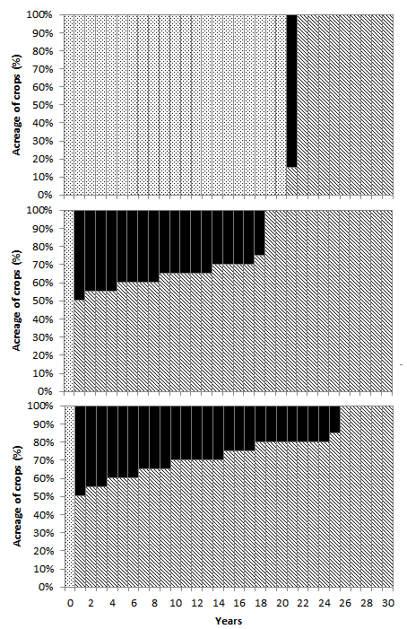
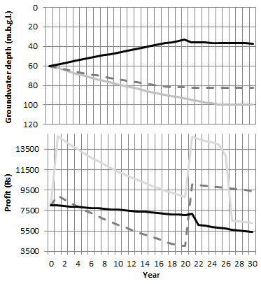
Economic model - scenarios
Water management policy: subsidized energy supply
Electricity user charge (0.50Rs/kWh to 3.50Rs/kWh)
If invest in a borewell => profit highly impacted
3,5 Rs/ha
stop rabi irrigation
Less kharif irrigation
EFFICIENT policy
But electricity cost > 2.5Rs/kWh groundwater depletion from 60 m.b.g.l. to 80 m.b.g.l
2 Rs/ha
0,5 Rs/ha
Robert, M., Bergez, J.E., Thomas, A., (2016) A stochastic dynamic programming approach to analyze adaptation to climate change - application to groundwater irrigation in India, European Journal of Operational Research (to be submitted)
Notes:
Under the second water management policy scenario, farmers are paying electricity supply from 0.5Rs/kWh to 4Rs/kWh (Figure 4). With electricity cost at 0.5Rs/kWh, farmers invest in a borewell the first year to irrigate as much as possible in kharif with a cropping system consisting of turmeric and sunflower. Pumping at this pace leads the farmer to almost turn his borewell dry after 25 years, allowing him only to grow sunflower and to pump only as much as the recharge from the rainfall. With electricity cost at 1 and 1.5Rs/kWh, farmers construct a borewell on the first year and grow maize in rabi in rainfed conditions to use all water in the kharif season for the cropping system consisting of turmeric and sunflower. At 2Rs/kWh, farmers have a similar behavior than with 1 and 1.5Rs/kWh, except that they will only grow sunflower from the 19th year, irrigating only as much as the recharge to maintain the borewell level to 82 m.b.g.l. From 2.5Rs/kWh, farmers delay the investment in a borewell, meaning that for the years preceding the investment, the groundwater table is recharging from the rainfall getting less and less deep. At 2.5Rs/kWh, the borewell is drilled on the 6th year and water is maintained at 66 m.b.g.l. from the 14th year, the farmer growing only sunflower with the same amount of water provided from the recharge. At 3Rs/kWh, a borewell is drilled on the 14th year and water is maintained at 48 m.b.g.l. from the 18th year. At 3.5Rs/kWh, the borewell is dug on the 21th year and water in the borewell his maintained at 36 m.b.g.l.
As soon as farmers invest in a borewell, profit is highly impacted by the cost of electricity. Farmers first stop irrigating in rabi and then start irrigating less in kharif to use partially their pumping capacity. This water management policy seems fairly efficient to reduce pumping and limit groundwater depletion because it leads farmers to reason their water use. However, it seems that electricity cost has to be high (at least 2.5Rs/kWh) to avoid water depleting more than 10 percent over 30 years of planning horizon.

Slide 13
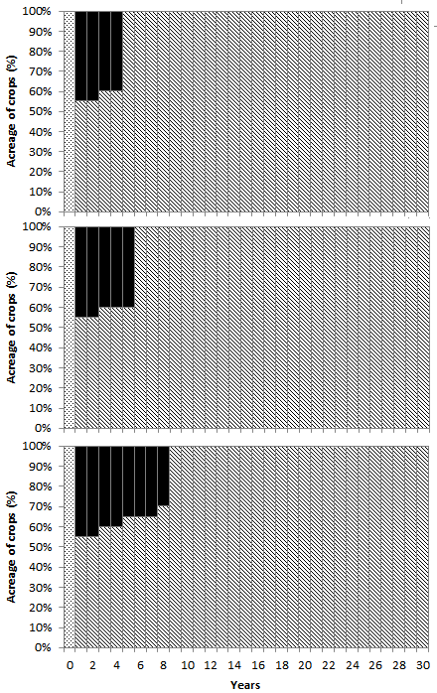
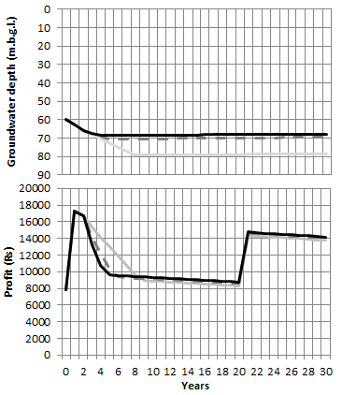
Economic model - scenarios
Water management policy: piezometric tax
Annual tax when the groundwater level reaches 10 percent below its initial height (from 200Rs to 1000Rs per %)
EFFICIENT policy
Maintain groundwater depletion < 10%
Robert, M., Bergez, J.E., Thomas, A., (2016) A stochastic dynamic programming approach to analyze adaptation to climate change - application to groundwater irrigation in India, European Journal of Operational Research (to be submitted)
Notes:
Under the third water management policy scenario, farmers are discouraged to dry up their borewell by imposing a tax when the groundwater table is going below 10 percent of a reference level (in our case, the groundwater level at the beginning of the simulation) (Figure 5). Since the groundwater level is allowed to decrease slightly, the first decision made by a famer is to drill a borewell on the first year. As long as the water level is not falling “too much”, pumping and growing crops in irrigated condition is profitable. Once the 10-percent threshold is reached, the farmer will push water extraction until a point is reached from where the farmer will only pump the equivalent of the borewell recharge from rainfall in kharif, and stop pumping in rabi so that the groundwater table will not decrease any more. In this case, only sunflower in irrigated condition is planted. For instance, with a water tax at 200Rs per percentage of groundwater depletion below ${WT}_{variation}$, the farmer will pump from his borewell so that it will never go beyond 79 m.b.g.l., which corresponds to a maximum tax to pay at around 4330Rs. From the 9th year, the farmer reaches this level and switches his cropping system from turmeric-sunflower to sunflower-sunflower, irrigating as much as the borewell recharge. At 600Rs, the farmer threshold is 70 m.b.g.l. associated with a maximum tax of 4600 Rs and it is reached on the 6th year. At 1000Rs, the farmer is only growing sunflower starting at year 5, in order not to decrease water in the borewell below 68 m.b.g.l. and have at maximum a tax of 3330 Rs.
Imposing a tax based on ambient groundwater level seems to be an efficient way to slow down groundwater depletion and encourage farmers to redesign their cropping systems and irrigation strategy.

Slide 14
Discussion
Important issues:
subsistence crops
systematically allocate a plot to a subsistence crop (sorghum) and the size of the plot will be optimized in order to fill up the stock for the coming year
estimate the costs of buying all subsistence grain at the market to cover the family needs and ensure that each season and each year the farm as enough capital to cover it
preferences of farmers regarding risk and uncertainty
risk preferences from field surveys or literature
expected-utility framework or the prospect theory
Variables and estimation functions
Price data (district level) – collect data on the watershed
Yield production function – to be calibrated based on STICS or even replace by STICS
Groudwater level function – to be calibrated with AMBHAS
Uncertainty Analysis
Robert, M., Bergez, J.E., Thomas, A., (2016) A stochastic dynamic programming approach to analyze adaptation to climate change - application to groundwater irrigation in India, European Journal of Operational Research (to be submitted)
Notes:
First, we consider investment decisions in irrigation over a long-term horizon, which is similar and therefore relevant for experiencing the impacts of climate change. This allows one to assess the expected impact of the specification of climate scenarios (rainfall average intensity and distribution) and the benefits of long-term decisions regarding irrigation infrastructure, while employing the same bio-economic decision model for crop choice and irrigation water application rate. Second, we consider a large set of policy instruments to provide farmers with incentives to manage water abstraction in an optimal manner. Third, we combine climate scenarios with economic ones to explore the robustness of farmer adaptation strategies to changes in the outlook of agricultural markets. Fourth, the description of water practices by farmers (including borewell characteristics and water application rate) is as detailed as the representation of crop choice according to the agricultural season (and including a food security constraint). Most references in the literature focus on one of these two dimensions only. Such accurate description of farmer behavior allows us to explore a wider range of adaptation strategies as a response to climate or market events. Our decision model entails a significant range of possible farmer decisions, in particular over the intra-year agricultural seasons, in a way that better represents, in our opinion, available options for adaptation to climate change for Indian farmers. It is because our representation of agricultural production technology involving groundwater irrigation is more detailed than in most papers in the empirical literature, that we are in a position to capture more accurately the implications of farmer decisions on his revenue and the groundwater level. More precisely, the flexibility introduced in the production model, in which plot size, crop choice, crop succession and irrigation application rate can be optimized upon, is expected to provide a more realistic representation of the sensitivity of farmer revenue with respect to market prices and policy instruments. It is well known (see, e.g., Chavas, 2012) that, according to the Le Chatelier - Samuelson principle, the sensitivity of an agent’s decisions with respect to external drivers is higher if there are more degrees of freedom (for instance, more control variables) (Samuelson 1961). In its more popular version, this principle states that the elasticity of input demand or output supply is lower in the short run when all technological dimensions are fixed, than in the long run when decisions can include production technology. When the representation of production technology accommodates for less flexibility than in reality, then sensitivity to prices or policy instruments is likely to be under-estimated. For example, an increase in the access cost to irrigation, when crop choice and plot size are decision variables, is likely to entail a stronger degree of adaptation by the farmer, as opposed to the case where crop systems are fixed. Additionally, a farmer may be more sensitive to changes in irrigation cost in the long run when irrigation capital becomes a control variable, than in the short run when only season-specific decisions are feasible. Allowing for more decision variables is therefore necessary to better evaluate the impact of changes in market variables and the performance of policy instruments affecting farmers’ decisions.
subsistence crops - . Indeed, such crops are not grown to be sold but to be consumed by the household. Their cultivation depends on the household needs and the actual stocks of grain. A possible way to manage this constraint will be to systematically allocate a plot to a subsistence crop (sorghum) and the size of the plot will be optimized in order to fill up the stock for the coming year. Another possibility will be to estimate the costs of buying all subsistence grain at the market to cover the family needs and ensure that each season and each year the farm as enough capital to cover it.
Third, preferences of farmers regarding risk and uncertainty are restricted in our paper to the risk neutrality and no-ambiguity case. Farmers are assumed to be maximizing expected profit with respect to decision variables in the long- and the short-run, but they are not risk averse and therefore they do not adapt their production strategy to hedge against production or price risk. Extending our model by considering the expected-utility framework or the prospect theory to avoid limitations of the expected-utility framework (see, e.g., Bocquého, Jacquet, & Reynaud, 2013) is certainly feasible, provided risk preferences can be inferred from field surveys or used from the literature (see Ridier, Chaib, & Roussy, 2016).

Slide 15
CONCLUSION
ECONOMIC MODEL:
Simulation of decision on investments in borewell irrigation and on cropping system under climate uncertainty
an original dynamic stochastic programming model with recursive programming
test socio-economic and water management policies under scenarios of climate change
initially developed to address critical issues of groundwater depletion and farming practices in a watershed in southwestern India
it structure can be used in other agricultural settings
Contact: marion.robert@toulouse.inra.fr
Acknowledgements
This research work was funded by the Indo-French Centre for the Promotion of Advanced Research (CEFIPRA), the INRA flagship program on Adaptation to Climate Change of Agriculture and Forest (ACCAF) and the Doctoral School of the University of Toulouse (EDT). We are grateful to all the experts, farmers, and trainees who helped getting the data. A special thanks to Tony Raveneau and Ronan Trepos for their help with the computer implementation.
Notes:
This methodology was successfully used to design a conceptual model for the simulation model CRASH (Crop Rotation and Allocation Simulator using Heuristics) to plan, simulate and analyze cropping-plan decision- making at the farm scale in France (Dury 2011) and the decision model NAMASTE (Numerical Assessments with Models of Agricultural Systems integrating Techniques and Economics), which simulates Indian farmers’ decision-making processes at tactical and operational levels (Robert et al. 2015; Robert et al. (Under Review)).

Slide 16
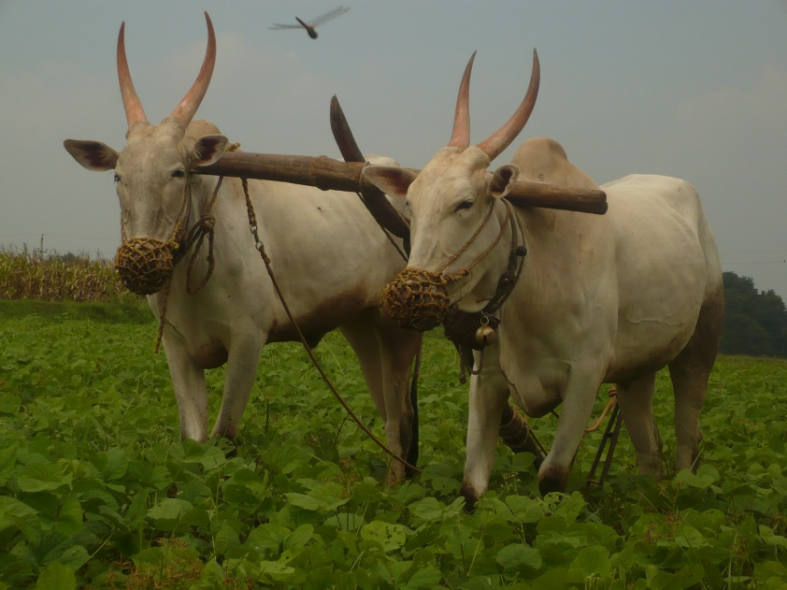
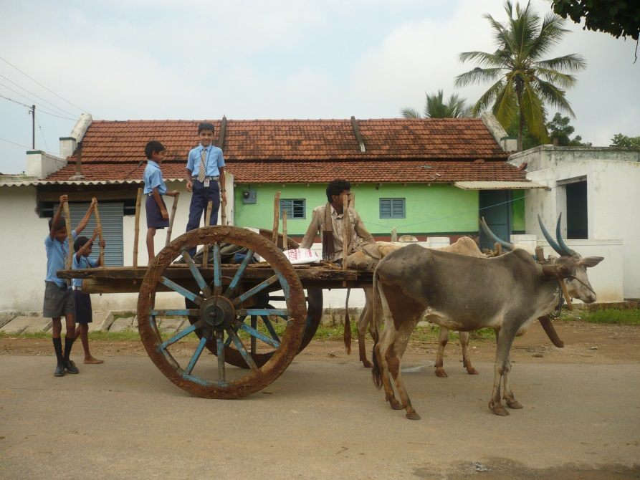
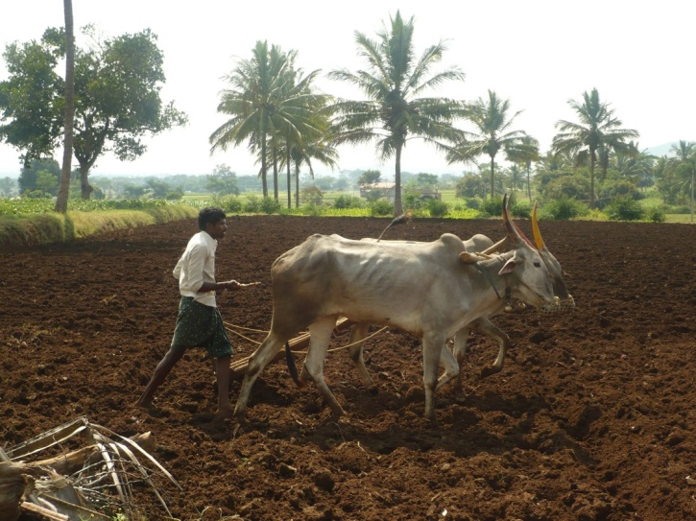
Thank you for your attention!

