Slide 1
Typology of farming systems for modeling water management issues in the semi-arid tropics (Berambadi watershed, India)
Marion ROBERT *, Alban THOMAS , Muddu SEKHAR,
Shrinivas BADIGER, Laurent RUIZ, Magali WILLAUME,
Delphine LEENHARDT, Jacques-Eric BERGEZ
AICHA – ATCHA Workshop
14th – 19th Novembre 2016
Notes:
Conceptual Modeling of the Farmer agent underlying Decision-Making processes in farming system

Slide 2
OBJECTIVES
Understand interactions among groundwater/agricultural practices/crop growth
=> model the functioning of the system
BUT
Modeling all individual farms within a region is not feasible
large number of farms
existing diversity among different farming systems
Typology
artificial way to define different homogeneous types based on specific criteria (Duvernoy 2000; Andersen et al. 2007; Valbuena et al. 2008)
convenient tool to simplify the diversity of farming systems while effectively describing their heterogeneity (Poussin et al. 2008; Valbuena et al. 2008; Daloğlu et al. 2014)
Objectives
Identifying and understanding variability in farm characteristics and farming practices on the watershed
generate a typology of farm
spatialize farm types on the watershed
Robert, M., Thomas, A., Sekhar, M., Badiger, S., Ruiz, L., Willaume, M., Leenhardt, D., Bergez, J.E. (2016) Typology of farming systems for modeling water management issues in the semi-arid tropics (Berambadi watershed, India), Water (submitted)
Notes:
The approach we are applying for software development is a combination of rapid prototyping,
incremental, and traditional methods. Rapid prototyping is used first to reach an agreement on the
initial set of the system requirements. A laboratory prototype then is incrementally developed and
tested for maturity. The field prototype is then implemented by adding a better user interface, and
more explanation facilities to the laboratory prototype, then the field prototype is tested in real
environment. Once the system is successfully field tested, it can be considered as the final
requirements specification of the production version.
Operational validation is determining whether the simulation
model’s output behaviour has the accuracy required for
the model’s intended purpose over the domain of the model’s
intended applicability. This is where much of the validation
testing and evaluation take place. Since the simulation model
is used in operational validation, any deficiencies found may
be caused by what was developed in any of the earlier steps in
developing the simulation model including developing the
system’s theories or having invalid data.

Slide 3
METHODOLOGY – THE SURVEY
Farmland ownership register (Bhoomi) of Karnataka => 5461 farm households.
Purposive stratified proportional sampling
estimate distribution parameters for a heterogeneous population (Levy and Lemeshow 2013; Laoubi and Yamao 2009)
more representative of the population than other probability methods like simple random sampling or systematic sampling (Laoubi and Yamao 2009)
ensures that every category of the population is represented in the sample
purposefully selected to represent the caste diversity in the region
Farm surveys
684 farm households (12.5% of farms on the watershed)
face-to-face interview, 2-3 hours (80 questions), September 2014 - March 2015
Part 1 : household characteristics, farm structure, assets, partnerships, farm objectives
Part 2 : farmers performances and practices over the past two years
Part 3 : in-depth questions on irrigation, borewells, rainfall
Robert, M., Thomas, A., Sekhar, M., Badiger, S., Ruiz, L., Willaume, M., Leenhardt, D., Bergez, J.E. (2016) Typology of farming systems for modeling water management issues in the semi-arid tropics (Berambadi watershed, India), Water (submitted)
Notes:
The approach we are applying for software development is a combination of rapid prototyping,
incremental, and traditional methods. Rapid prototyping is used first to reach an agreement on the
initial set of the system requirements. A laboratory prototype then is incrementally developed and
tested for maturity. The field prototype is then implemented by adding a better user interface, and
more explanation facilities to the laboratory prototype, then the field prototype is tested in real
environment. Once the system is successfully field tested, it can be considered as the final
requirements specification of the production version.
Operational validation is determining whether the simulation
model’s output behaviour has the accuracy required for
the model’s intended purpose over the domain of the model’s
intended applicability. This is where much of the validation
testing and evaluation take place. Since the simulation model
is used in operational validation, any deficiencies found may
be caused by what was developed in any of the earlier steps in
developing the simulation model including developing the
system’s theories or having invalid data.

Slide 4
METHODOLOGY – THE ANALYSIS
Four dimensions
farm structure
cropping system and farm practices
water management for irrigation
economic performances of the farm
Analysis of variance (ANOVA) permutation test / chi-square test
determine overall significance of differences among villages
Two-step multi-data statistical analysis
nominal categorical data technique of Multiple Correspondence Analysis (MCA)
Agglomerative Hierarchical Clustering (ACH) algorithm
=> Farm types described by quantitative variables
Robert, M., Thomas, A., Sekhar, M., Badiger, S., Ruiz, L., Willaume, M., Leenhardt, D., Bergez, J.E. (2016) Typology of farming systems for modeling water management issues in the semi-arid tropics (Berambadi watershed, India), Water (submitted)
Notes:
The approach we are applying for software development is a combination of rapid prototyping,
incremental, and traditional methods. Rapid prototyping is used first to reach an agreement on the
initial set of the system requirements. A laboratory prototype then is incrementally developed and
tested for maturity. The field prototype is then implemented by adding a better user interface, and
more explanation facilities to the laboratory prototype, then the field prototype is tested in real
environment. Once the system is successfully field tested, it can be considered as the final
requirements specification of the production version.
Operational validation is determining whether the simulation
model’s output behaviour has the accuracy required for
the model’s intended purpose over the domain of the model’s
intended applicability. This is where much of the validation
testing and evaluation take place. Since the simulation model
is used in operational validation, any deficiencies found may
be caused by what was developed in any of the earlier steps in
developing the simulation model including developing the
system’s theories or having invalid data.

Slide 5
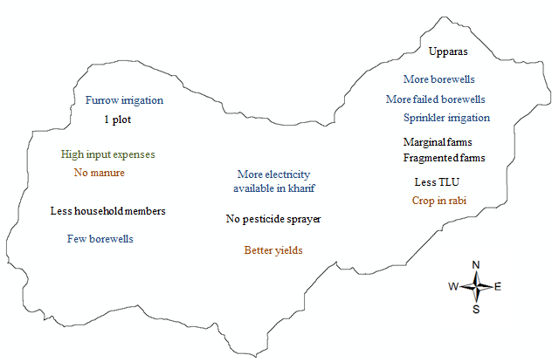
FARM CHARACTERISTICS AND PRACTICES
Farm structure
Household characteristics
Land holding
Livestock and equipment
Labor
Farm practices
Input use
Crop yield performances
Water management for irrigation
Access to irrigation
Borewells
Pumps and access to electricity
Farm ponds
Irrigation methods
Economic performances of the farm
Investment in farm structure
Cropping systems’ products and expenses
Investment in irrigation
Robert, M., Thomas, A., Sekhar, M., Badiger, S., Ruiz, L., Willaume, M., Leenhardt, D., Bergez, J.E. (2016) Typology of farming systems for modeling water management issues in the semi-arid tropics (Berambadi watershed, India), Water (submitted)
Notes:
The approach we are applying for software development is a combination of rapid prototyping,
incremental, and traditional methods. Rapid prototyping is used first to reach an agreement on the
initial set of the system requirements. A laboratory prototype then is incrementally developed and
tested for maturity. The field prototype is then implemented by adding a better user interface, and
more explanation facilities to the laboratory prototype, then the field prototype is tested in real
environment. Once the system is successfully field tested, it can be considered as the final
requirements specification of the production version.
Operational validation is determining whether the simulation
model’s output behaviour has the accuracy required for
the model’s intended purpose over the domain of the model’s
intended applicability. This is where much of the validation
testing and evaluation take place. Since the simulation model
is used in operational validation, any deficiencies found may
be caused by what was developed in any of the earlier steps in
developing the simulation model including developing the
system’s theories or having invalid data.

Slide 6
TYPOLOGY OF FARMS
Farm location:
Village
Land-resource variables:
farm size
number of jeminus
number of plots
Irrigation-resource variables:
access to irrigation
number of failed borewells
number of working borewells
hours of electricity available per day for pumping
Animal resource
Livestock unit
Farm performances
production costs (input costs spent per hectare in 2014)
incomes (rabi incomes per hectare in 2013)
Farming practices:
cropping system variable
CS1: rainfed / only cash crops
CS2: rainfed / cash + subsistence crops
CS3: irrigated / only cash crops
CS4: irrigated / cash + subsistence crops
CS5: irrigated + rainfed / cash + subsistence crops
Robert, M., Thomas, A., Sekhar, M., Badiger, S., Ruiz, L., Willaume, M., Leenhardt, D., Bergez, J.E. (2016) Typology of farming systems for modeling water management issues in the semi-arid tropics (Berambadi watershed, India), Water (submitted)
Notes:
The approach we are applying for software development is a combination of rapid prototyping,
incremental, and traditional methods. Rapid prototyping is used first to reach an agreement on the
initial set of the system requirements. A laboratory prototype then is incrementally developed and
tested for maturity. The field prototype is then implemented by adding a better user interface, and
more explanation facilities to the laboratory prototype, then the field prototype is tested in real
environment. Once the system is successfully field tested, it can be considered as the final
requirements specification of the production version.
Operational validation is determining whether the simulation
model’s output behaviour has the accuracy required for
the model’s intended purpose over the domain of the model’s
intended applicability. This is where much of the validation
testing and evaluation take place. Since the simulation model
is used in operational validation, any deficiencies found may
be caused by what was developed in any of the earlier steps in
developing the simulation model including developing the
system’s theories or having invalid data.

Slide 7
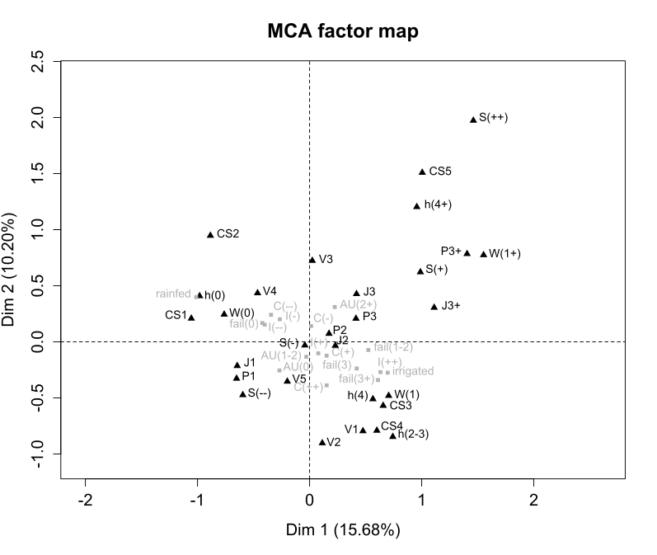
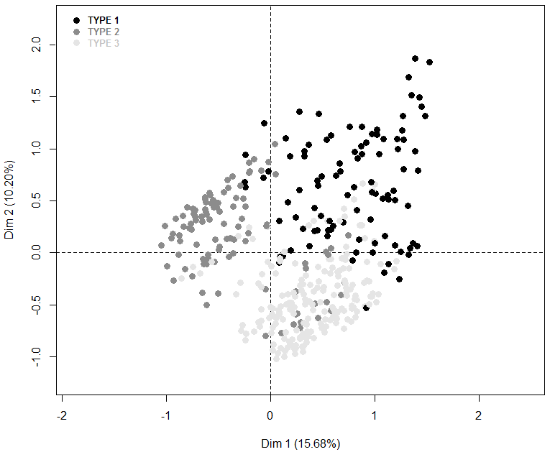
TYPOLOGY OF FARMS
large farms
Center
Mixed CS
rainfed farms
irrigated farms
small farms
East / West
Cash crops
Robert, M., Thomas, A., Sekhar, M., Badiger, S., Ruiz, L., Willaume, M., Leenhardt, D., Bergez, J.E. (2016) Typology of farming systems for modeling water management issues in the semi-arid tropics (Berambadi watershed, India), Water (submitted)
Notes:
The first axis discriminates 1) rainfed farms that grow rainfed crops without access to irrigation water and 2) irrigated farms that grow mixed crops based on irrigation water from borewells and access to electricity (Figure 4). The second axis discriminates 1) large farms (S(+)) with several jeminus (J3+) and several plots that use water from borewells located in the center of the watershed (V3 and V4), where electricity is more available (hours(4+)) and that grow irrigated and rainfed crops for cash and subsistence purposes (CS5 and CS2) from 2) smaller farms (S(-) and S(--)) located in the eastern and western portions of the watershed (V1, V2 and V5) that grow crops on one or two plots (J1 and J2) as a cash crop (CS4 and CS3) and have less available electricity (hours(2-3) and hours(4)).

Slide 8
TYPOLOGY OF FARMS
Farm type 1: Large diversified and productivist farms
located mainly in center of the watershed
all large farms in the sample and some medium farms
highest amount of electricity available for pumping
more than 2 hectares of land
often composed of several jeminus
several plots
irrigated from one or more borewells
64% have experienced a failed borewell
graze livestock to provide animal traction and manure
high input costs and income from selling cash crops
diversified farming practices (mix irrigated / rainfed /cash /subsistence CS)
Robert, M., Thomas, A., Sekhar, M., Badiger, S., Ruiz, L., Willaume, M., Leenhardt, D., Bergez, J.E. (2016) Typology of farming systems for modeling water management issues in the semi-arid tropics (Berambadi watershed, India), Water (submitted)

Slide 9
TYPOLOGY OF FARMS
Farm type 2: Small and marginal rainfed farms
marginal and small rainfed farms
located in the central and western portions of the watershed
less than 2 hectares
1 jeminu
1-2 plots
no access to irrigation
few have ever attempted to drill a borewell
lowest farming expenditures
65% grow only cash crops
35% grow also subsistence crops
Robert, M., Thomas, A., Sekhar, M., Badiger, S., Ruiz, L., Willaume, M., Leenhardt, D., Bergez, J.E. (2016) Typology of farming systems for modeling water management issues in the semi-arid tropics (Berambadi watershed, India), Water (submitted)

Slide 10
TYPOLOGY OF FARMS
Farm type 3: Small irrigable marketing farms
small irrigated farms
located in the eastern portion of the watershed
less 2 hectares
1 jeminu
1-2 plots
at least one borewell
67% have experienced a failed borewell
electricity for pumping is less available than type 1
medium to large expenses
medium to large incomes from selling crops
diversified cropping systems (mixing irrigated and rainfed crops)
all production in cash crops
Robert, M., Thomas, A., Sekhar, M., Badiger, S., Ruiz, L., Willaume, M., Leenhardt, D., Bergez, J.E. (2016) Typology of farming systems for modeling water management issues in the semi-arid tropics (Berambadi watershed, India), Water (submitted)

Slide 11
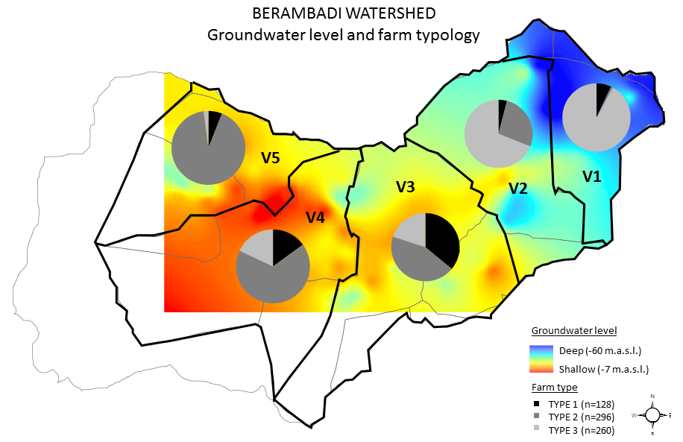
TYPOLOGY OF FARMS
Robert, M., Thomas, A., Sekhar, M., Badiger, S., Ruiz, L., Willaume, M., Leenhardt, D., Bergez, J.E. (2016) Typology of farming systems for modeling water management issues in the semi-arid tropics (Berambadi watershed, India), Water (submitted)
Notes:
Type 1 farms are located mainly in the center of the watershed (73% of type 1 farms are in V3, where 36% of farms are type 1)
Type 2 includes marginal and small rainfed farms located in the central (39% of type 2 farms are in V3) and western portions of the watershed (45% of type 2 farms are in V4 and V5)
Type 3 consists of small irrigated farms located in the eastern portion of the watershed (72% are in V1 and V2)

Slide 12
DISCUSSION
Farm typologies
representing while also simplifying the diversity of farms in a large area
effectively represent the heterogeneity of farmers’ objectives and socio-eco-agronomic conditions relative to their decision-making processes regarding farm management
Farm-type locations
east-west gradient (more irrigated farms in the east ; more rainfed farms in the west)
Generic study methodology
Study’s results
specific to its purpose and study area
farm types identified cannot necessarily be extrapolated to a larger context outside the Berambadi watershed
Robert, M., Thomas, A., Sekhar, M., Badiger, S., Ruiz, L., Willaume, M., Leenhardt, D., Bergez, J.E. (2016) Typology of farming systems for modeling water management issues in the semi-arid tropics (Berambadi watershed, India), Water (submitted)
Notes:
The approach we are applying for software development is a combination of rapid prototyping,
incremental, and traditional methods. Rapid prototyping is used first to reach an agreement on the
initial set of the system requirements. A laboratory prototype then is incrementally developed and
tested for maturity. The field prototype is then implemented by adding a better user interface, and
more explanation facilities to the laboratory prototype, then the field prototype is tested in real
environment. Once the system is successfully field tested, it can be considered as the final
requirements specification of the production version.
Operational validation is determining whether the simulation
model’s output behaviour has the accuracy required for
the model’s intended purpose over the domain of the model’s
intended applicability. This is where much of the validation
testing and evaluation take place. Since the simulation model
is used in operational validation, any deficiencies found may
be caused by what was developed in any of the earlier steps in
developing the simulation model including developing the
system’s theories or having invalid data.

Slide 13
CONCLUSION
Typology based on farming context, farm performances and farming practices
Farm type 1 - large diversified and productivist farms - center of the watershed
Farm type 2 - small and marginal rainfed farms – center/western parts
Farm type 3 - small irrigable marketing farms - eastern parts
Typology and simulation model
typology can be used in simulation models to predict impacts of climate change on farming practices and the groundwater level
such simulation models are useful to test policies
Example of two scenarios for the watershed
Farmers (especially type 1 and 3) continue to maximize profits by producing high water-demanding crops and cash crops
irrigation technology spread toward the west - convert type 2 into type 3
Contact: marion.robert@toulouse.inra.fr
Acknowledgements
This study was funded by the Indo-French Centre for the Promotion of Advanced Research (CEFIPRA), the INRA flagship program on Adaptation to Climate Change of Agriculture and Forest (ACCAF), the Doctoral School of the University of Toulouse (EDT) and ORE BVET (http://bvet.obs-mip.fr). We are grateful to all the experts, farmers, and trainees who helped implement the method. We are also very grateful for the help and hard work of the field team. Particular thoughts go to Jarayma and his family, to whom we convey my sincere condolences.
Robert, M., Thomas, A., Sekhar, M., Badiger, S., Ruiz, L., Willaume, M., Leenhardt, D., Bergez, J.E. (2016) Typology of farming systems for modeling water management issues in the semi-arid tropics (Berambadi watershed, India), Water (submitted)
Notes:
This methodology was successfully used to design a conceptual model for the simulation model CRASH (Crop Rotation and Allocation Simulator using Heuristics) to plan, simulate and analyze cropping-plan decision- making at the farm scale in France (Dury 2011) and the decision model NAMASTE (Numerical Assessments with Models of Agricultural Systems integrating Techniques and Economics), which simulates Indian farmers’ decision-making processes at tactical and operational levels (Robert et al. 2015; Robert et al. (Under Review)).

Slide 14
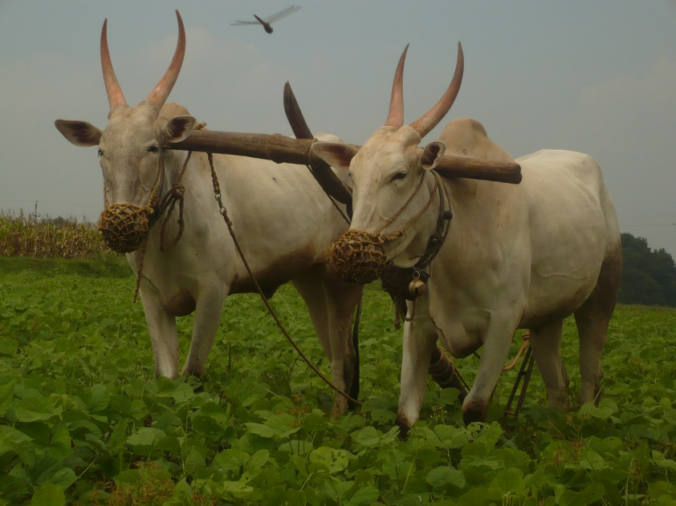
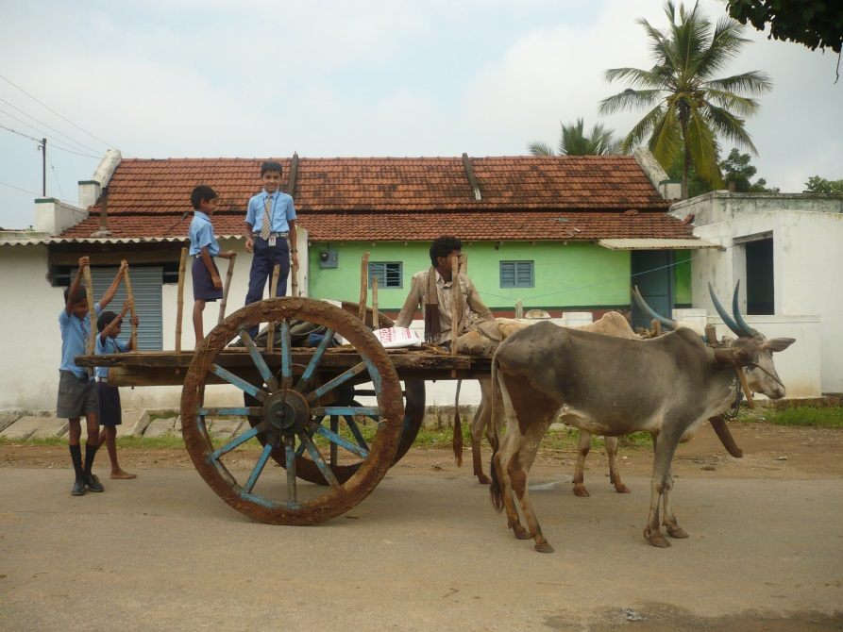
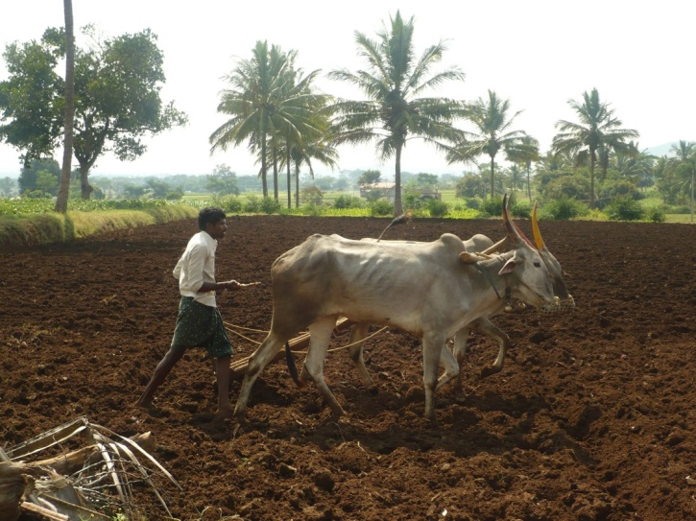
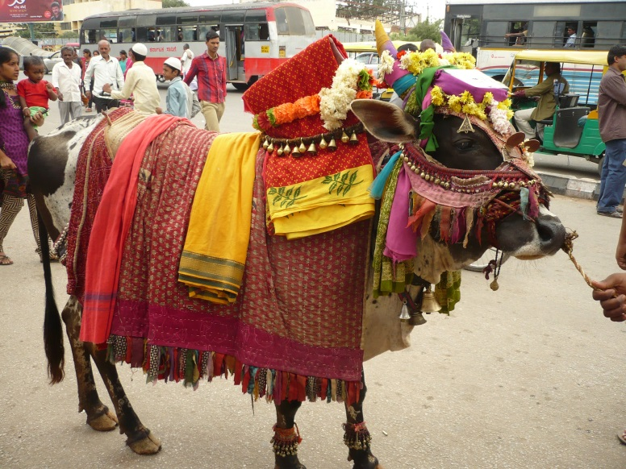
Thank you for your attention!

Slide 15
TYPOLOGY OF FARMS
Category | Code | Definition | Class | Abbreviation
Farming context
Spatial | village | Kuthanur | village 1 | V1
 |  | Bheemanabeedu, Mallaianapura | village 2 | V2
 |  | Kannagala, Gopalpura, Maddaiana Hundi, Haggadahalli, Hangala Hosahalli, Kallipura, Kunagahalli, Honnegowdanahal, Devarahalli | village 3 | V3
 |  | Berambadi, Berambadi Colony, Navilgunda, Kaggalada Hundi, Bechanahalli, Lakkipura | village 4 | V4
 |  | Maddur, Maddur Colony, Channamallipura | village 5 | V5
Land resource | nbJeminu | number of plots (jeminu) of the farm | 1 jeminu | J1
 |  |  | 2 jeminus | J2
 |  |  | 3 jeminus | J3
 |  |  | >3 jeminus | J3+
 | nbPlot2013 | number of plots cultivated in 2013 | 1 plot | P1
 |  |  | 2 plots | P2
 |  |  | 3 plots | P3
 |  |  | >3 plots | P3+
 | totalHHSize | total farm size per farm in hectares | <0.8 hectares | S(--)
 |  |  | ]0.8 hectares;2 hectares] | S(-)
 |  |  | ]2 hectares;4 hectares] | S(+)
 |  |  | >4 hectares | S(++)
Irrigation resource | isIrrigated | at least one jeminu irrigated | yes | rainfed
 |  |  | no | irrigated
 | nbWorkingBorewell | number of working borewells in 2014 | none | W(0)
 |  |  | 1 borewell | W(1)
 |  |  | >1 borewell | W(1+)
 | nbFailedBorewell | number of failed borewells in 2014 | none | fail(0)
 |  |  | 1-2 borewells | fail(1-2)
 |  |  | 3 borewells | fail(3)
 |  |  | >3 borewells | fail(3+)
 | hoursKharif | number of hours of electricity per day during kharif in 2014 | none | hours(0)
 |  |  | [2 hours;3 hours] | hours(2-3)
 |  |  | ]3 hours;4 hours] | hours(4)
 |  |  | ]4 hours;8 hours] | hours(4+)
Animal resource | globalAU | number of livestock on the farm {oxen, bull, buffalo, cow}=1, {sheep, goat}=0.2 | none | AU(0)
 |  |  | ]0 AU;2 AU] | AU(1-2)
 |  |  | >2 AU | AU(2+)
Farm performances
Production costs | CostInput2014 | cost of farming per hectare during kharif in 2014 | [0 Rs-3700 Rs] | C(--)
 |  |  | ]3700 Rs-7400 Rs] | C(-)
 |  |  | ]7400 Rs-14800 Rs] | C(+)
 |  |  | >14800 Rs | C(++)
Production incomes | IncomeRabi2013 | income from selling crops per hectare during rabi in 2013 | [0 Rs-18500 Rs] | I(--)
 |  |  | ]18500 Rs-37000 Rs] | I(-)
 |  |  | ]37000 Rs-74000 Rs] | I(+)
 |  |  | >74000 Rs | I(++)
Farming practices
Cropping system | CS | type of cropping system in 2014 | rainfed, only cash crops | CS1
 |  |  | rainfed, cash and subsistence crops | CS2
 |  |  | irrigated, only cash crops | CS3
 |  |  | irrigated and rainfed, only cash crops | CS4
 |  |  | irrigated and rainfed, cash and subsistence crops | CS5
Notes:
The approach we are applying for software development is a combination of rapid prototyping,
incremental, and traditional methods. Rapid prototyping is used first to reach an agreement on the
initial set of the system requirements. A laboratory prototype then is incrementally developed and
tested for maturity. The field prototype is then implemented by adding a better user interface, and
more explanation facilities to the laboratory prototype, then the field prototype is tested in real
environment. Once the system is successfully field tested, it can be considered as the final
requirements specification of the production version.
Operational validation is determining whether the simulation
model’s output behaviour has the accuracy required for
the model’s intended purpose over the domain of the model’s
intended applicability. This is where much of the validation
testing and evaluation take place. Since the simulation model
is used in operational validation, any deficiencies found may
be caused by what was developed in any of the earlier steps in
developing the simulation model including developing the
system’s theories or having invalid data.

