Slide 1
NAMASTE: A dynamic integrated model for simulating farm practices under groundwater scarcity in semi-arid region of India
Marion ROBERT *
Alban THOMAS
Jacques-Eric BERGEZ
Notes:
Conceptual Modeling of the Farmer agent underlying Decision-Making processes in farming system

Slide 2
THESIS OBJECTIVES
Represent farmers’ decision-making and adaptation processes
What are the processes engaged in farmers’ decision-making?
How can we integrate adaptive behaviors in farmers’ decision-making processes?
How can we represent interactions between different dimensions of decision of decision-making processes?
Conceive a flexible and resilient agricultural production system
How can we design agricultural production system from field observations?
Which representation should be used in conceptual modeling of farming system?
How should be implemented the conceptual representation of farming system for computerized simulation?
Consider a context of water scarcity and climate change
How can we account for the effect of groundwater level on farming practices and simulate the retro-action of farming practices and in particular irrigation, on the variability of the aquifer?
Which scenarios should be tested for water management policies?

Slide 3
Represent farmers’ decision-making and adaptation processes

Slide 4
ADAPTIVE PROCESSES IN DECISION MODELS
Goal: modeling farming systems to simulate opportunities for adaptation
=> include adaptation to decision model
Literature review: bio-economic and bio-decision approaches (40 scientific references)
Common ways to characterize farmers' decision-making: adaptability, flexibility and dynamic processes
Adaptation: reactive or proactive process depending on farmer flexibility and expectation capabilities
Various modeling methods are used ; some methods can be combined
Sequential representation: particularly interesting and appropriate to model the entire decision-making processes
Conclusion: combining several formalisms within an integrated model in which strategic and tactical adaptations and decisions influence each other is a good starting point for modeling adaptive behavior within farmers’ decision-making processes
Robert, M., Thomas, A., Bergez, J.E. (2016) Integrating adaptative processes in farming decision-making models – a review, Agronomy for Sustainable Development, doi: 10.1007/s13593-016-0402-x
Notes:
To review the way adaptive behaviors in farming systems has been considered (modeled) in bio-economic and bio-decision approaches; we analyzed approximately 40 scientific references. This work reviews several modeling formalisms that have been used in bio-economic and bio-decision approaches, comparing their features and selected relevant applications. We chose to focus on the formalisms rather than the tools as they are the essence of the modeling approach (Figure 5).
The major points are: adaptability, flexibility and dynamic processes are common ways to characterize farmers' decision-making. Adaptation is either a reactive or a proactive process depending on farmer flexibility and expectation capabilities. Various modeling methods are used to model decision stages in time and space, and some methods can be combined to represent a sequential decision-making process. Sequential representation is particularly interesting and appropriate to model the entire decision-making processes from strategic to tactical and operational decisions. Strategic adaptations and decisions influence tactical adaptations and decisions and vice-versa. Decisions made at one of these levels may disrupt the initial organization of resource availability and competition among activities over the short term (e.g., labor availability, machinery organization, irrigation distribution) but also lead to reconsideration of long-term decisions when the cropping system requires adaptation (e.g., change in crops within the rotation, effect of the previous crop). In the current agricultural literature, these consequences on long- and short-term organization are rarely considered, even though they appear an important driver of farmers’ decision-making (Daydé et al. 2014). Combining several formalisms within an integrated model in which strategic and tactical adaptations and decisions influence each other is a good starting point for modeling adaptive behavior within farmers’ decision-making processes.

Slide 5
The 3D model: three levels of decision
Generic sequential decision-making framework:
(Le Gal et al. 2011; Risbey et al. 1999)
1) STRATEGIC decision stage: yearly / farm / LT effect
Decision: investment in irrigation system
Adaptation: yearly reviews investment in irrigation equipment
2) TACTIC decision stage : seasonally / farm / MT effect
Decision: select crops and allocation
Adaptation: update cropping system
3) OPERATIONAL decision stage : daily / plot / ST effect
Decision: crop operations
Adaptation: new plan if can’t sow or bad germination
Economic Model
Management Model
Robert, M., Thomas, A., Sekhar, M., Badiger, S., Ruiz, L., Raynal, H., & Bergez, J. E. (2016). Adaptive and dynamic decision-making processes: A conceptual model of production systems on Indian farms. Agricultural Systems, doi : 10,1016/j.agsy.2016.08.001

Slide 6
The 3D model - Strategic decision
Framework: bio-economic model with season-specific crop choice and yearly investment decision in irrigation facilities
Stages of the farmer decision-making process:
Beginning of the planning horizon
Form expectation on several random variables (future climate – probability of occurrence, future market prices for crops and groundwater availability for irrigation)
Decide whether to invest or not in irrigation, or to rely on rainfall for the coming year
Decide on the type of crops to grow and plot size
Decide on the irrigation-water application rate for each crop, given total water availability and observed rainfall
Follow a set of irrigation rules to obtain the “best” crop yield, given the irrigation equipment, the selected crop, the actual climatic conditions.
Beginning of the year
At the beginning of each growing season
For each growing season
For each growing season
Robert, M., Bergez, J.E., Thomas, A., (2016) A stochastic dynamic programming approach to analyze adaptation to climate change - application to groundwater irrigation in India, European Journal of Operational Research (to be submitted)
Notes:
We consider a representative farmer who makes decisions on irrigation and crop choice, accounting for the consequences of his decisions today on future water availability (because the latter ultimately determines future crop output, hence future profit flows). Our framework is based on a bio-economic model with a season-specific crop choice and a yearly investment decision in irrigation facilities.

Slide 7
The 3D model - Strategic decision
The farmer’s problem over the planning horizon with T years:
$\max_{\left\{I_{t}\right\}}{\sum_{t=1}^{T}{{\left(1+r\right)}^{−t}}}\left\{\max_{\left\{δ_{bcτ}\right\}}\left[\sum_{b=1}^{B}{\sum_{c=1}^{C}{\sum_{τ=S1}^{S2}{{δ_{bcτ} π}_{bcτ}}}}\right]−I_{t}\right\}$
R = constant discount rate
$δ_{bcτ}=1$ if crop c is grown on plot b at season $τ$ and 0 otherwise
Bellman approach:
$V\left(W_{t}\right)$ = $\max_{I_{t}}\left\{π_{t}^{∗}\left(I_{t},W_{t}\right)+β E_{\tilde{R}}V\left(W_{t+1}\right)\right\},{∀t} ($transition equation: $W_{t+1}=f(W_{t}$,$I_{t}$) )
$V\left(W_{t}\right)$ = value function
$β$ = discount factor
Collocation method:
$\sum_{p=1}^{P}{c_{p}Φ_{p}\left(W_{p}\right)=\max\left\{π^{∗}\left(I,W_{p}\right)+ βE_{\tilde{R}}\sum_{p=1}^{P}{c_{p}Φ_{p}\left[f\left(W_{p}\right)\right]}\right\}}, p=1,…,P$,
$Φ_{p}$ = Chebyshev polynomial of order p
$c_{p}$ = associated coefficient (to be evaluated)
Robert, M., Bergez, J.E., Thomas, A., (2016) A stochastic dynamic programming approach to analyze adaptation to climate change - application to groundwater irrigation in India, European Journal of Operational Research (to be submitted)
Notes:
We consider a representative farmer who makes decisions on irrigation and crop choice, accounting for the consequences of his decisions today on future water availability (because the latter ultimately determines future crop output, hence future profit flows). Our framework is based on a bio-economic model with a season-specific crop choice and a yearly investment decision in irrigation facilities.

Slide 8
The 3D model - Tactic decision
Framework: bio-economic model with season-specific crop choice
Stages of the farmer decision-making process:
Form expectation on the year climate (100% chance poor or 100% chance below average or 100% chance average or 100% chance above average or 100% chance good)
At fixed investment, decide on the type of crops to grow and plot size
Decide on the irrigation-water application rate for each crop, given total water availability and observed rainfall
Follow a set of irrigation rules to obtain the “best” crop yield, given the irrigation equipment, the selected crop, the actual climatic conditions.
Beginning of the season
At the beginning of each growing season
For each growing season
For each growing season
Robert, M., Thomas, A., Raynal, H., Casellas, E., Casel, P., Chabrier, P., Joannon, A., Bergez, J.E. (2016) NAMASTE: a dynamic model for water management at the farm level integrating strategic, tactic and operational, Environmental Modelling and Software (to be submitted)
Notes:
We consider a representative farmer who makes decisions on irrigation and crop choice, accounting for the consequences of his decisions today on future water availability (because the latter ultimately determines future crop output, hence future profit flows). Our framework is based on a bio-economic model with a season-specific crop choice and a yearly investment decision in irrigation facilities.

Slide 9
The 3D model - Tactic decision
T = 1 year
Investment fixed
Rainfall fixed
The farmer’s problem :
$\max_{\left\{δ_{bcτ}\right\}}\left[\sum_{b=1}^{B}{\sum_{c=1}^{C}{\sum_{τ=S1}^{S2}{{δ_{bcτ} π}_{bcτ}}}}\right]$
$δ_{bcτ}=1$ if crop c is grown on plot b at season $τ$ and 0 otherwise
Robert, M., Thomas, A., Raynal, H., Casellas, E., Casel, P., Chabrier, P., Joannon, A., Bergez, J.E. (2016) NAMASTE: a dynamic model for water management at the farm level integrating strategic, tactic and operational, Environmental Modelling and Software (to be submitted)

Slide 10
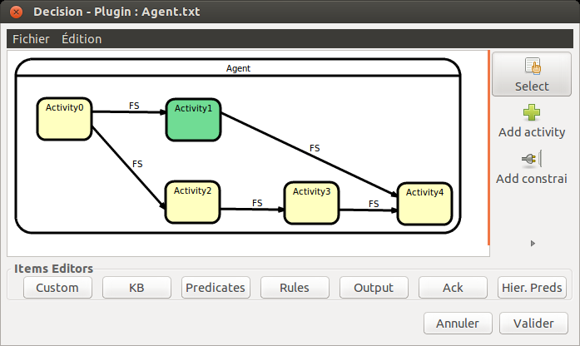
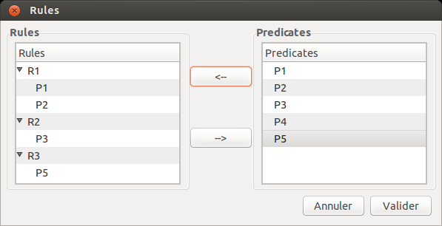
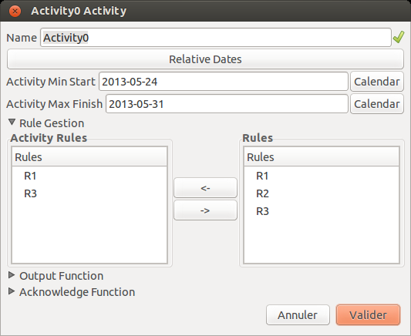
The 3D model - Operational decision
Crop management practices from land preparation to harvest
RECORD decision plugin
CONCEPTS
Knowledge base : representation of operating and bio-physical system
Predicates : boolean system conditions needed to trigger an operation
Rules : conjunction of predicates, valid if all predicates are valid
Activity : technical operation done on the field
Temporal constraints : time slot in which an activity can start
Precedence constraint : link an activity to another
Pre-conditions : conjunction of rules, valid if at least one rules is valid
Parameters : effects of an activity on the biophysical system
Based on case-based survey (27 farmers) / big survey (684 farmers) / experimental plots (52 plots)
Robert, M., Thomas, A., Sekhar, M., Badiger, S., Ruiz, L., Raynal, H., & Bergez, J. E. (2016). Adaptive and dynamic decision-making processes: A conceptual model of production systems on Indian farms. Agricultural Systems, doi : 10,1016/j.agsy.2016.08.001

Slide 11
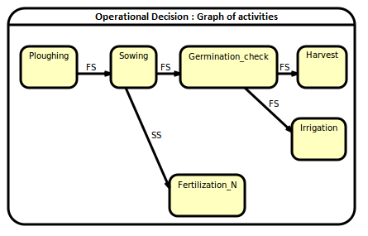
Management model: Operational decision
EXEMPLE: SOWING
Activity = sowing
State = wait
Earliest beginning date = April 8th
Latest beginning date = June 20th
Optimal rule:
Soil moisture HUR/HUCC ≥ 0,6
Soil temperature TS ≥ 6°C
Rainfall $\sum_{1}^{10}{PP\left(day−j\right)≥40 mm}$
Relaxed rule:
Relaxed date = June 1st
Rainfall $\sum_{1}^{10}{PP\left(day−j\right)≥10 mm}$
Precedence constraint = FS (Ploughing)
Output function:
Sowing density: density = 16 grains/m²
Sowing depth: depth = 6 cm
Failure: fail all activities, load new graph
EXEMPLE: CHECK GERMINATION
Activity = germination check
State = wait
Earliest beginning date = April 18th
Latest beginning date = June 30th
Optimal rule:
Minimal crop stage = sowing date + 10
Germination rate ≥ 60%
Relaxed rule:
Relaxed date = June 1st
Rainfall $\sum_{1}^{10}{PP\left(day−j\right)≥10 mm}$
Precedence constraint = FS (Sowing)
Output function:
Failure: fail all activities, load new graph
Robert, M., Thomas, A., Sekhar, M., Badiger, S., Ruiz, L., Raynal, H., & Bergez, J. E. (2016). Adaptive and dynamic decision-making processes: A conceptual model of production systems on Indian farms. Agricultural Systems, doi : 10,1016/j.agsy.2016.08.001

Slide 12
Management model: Operational decision
Definition - conditional/discrete/returnable resources:
crucial to execute an operation
can be mobilized by an activity and then relaxed
(e.g. labor, tractor)
Resource manager:
extension to the decision plugin of the RECORD platform
resources defined and structured by categories within the knowledge base
resource constraints declared in the plan of activities (needed quantity, possible alternatives and priorities)
during simulation, the resource allocation is sequentially managed depending on resource availability and activity priorities
Robert, M., Thomas, A., Raynal, H., Casellas, E., Casel, P., Chabrier, P., Joannon, A. & Bergez, J. E. (2016). NAMASTE: a dynamic model for water management at the farm level integrating strategic, tactic and operational decisions. Environmental Modelling & Software (to be submitted)

Slide 13
Conceive a flexible and resilient agricultural production system

Slide 14
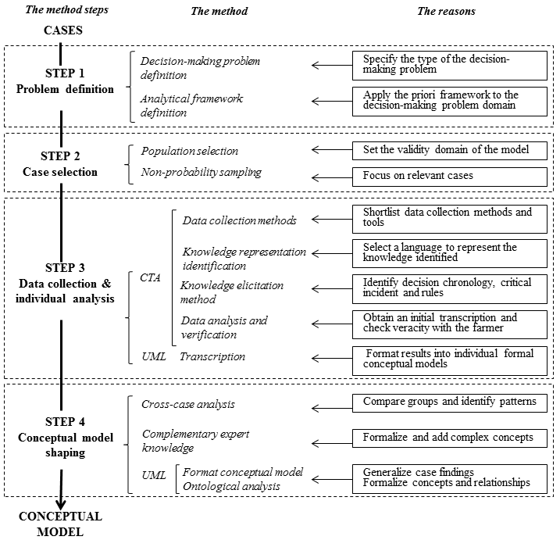
METHODOLOGY
From cases
TO
conceptual model in readily usable form for computer programming
Robert, M., Dury, J., Thomas, A., Therond, O., Sekhar, M., Badiger, S., Ruiz, L., Bergez, J.E. (2016) CMFDM a methodology to guide the design of a conceptual model of farmers’ decision-making processes, Agricultural Systems, Vol. 148, p 86-94, doi: 10.1016/j.agsy.2016.07.010
Notes:
The agricultural research community has a particular interest in modeling farming systems to simulate opportunities for adaptation that ensure flexibility and resilience of farming systems. To account for actors and their actions in the environment, it is essential to precisely represent their decision-making processes.
Le système de production d’une exploitation agricole se définit par la combinaison de ses moyens de production, ses activités de production, ses processus biologique et ses processus décisionnels destinés à transformer un capital de ressources en produits agricoles utiles pouvant être consommés ou vendus afin de couvrir les besoins divers d’une famille agricole (Tristan et al. 2011). C’est donc une matrice d’interactions complexes entre éléments interdépendants contrôlés en parties par l’agriculteur ou la famille agricole et subissant des influences extérieurs socio-économiques et climatiques à plusieurs niveaux.
L’agriculteur et son foyer apportent les objectifs de production et la gestion au système de production agricole qui lui est associé afin de couvrir ses objectifs socio-économiques. Ce sont aussi les bénéficiaires principaux du système de production. Les objectifs principaux classiquement relevés pour les systèmes de production agricoles sont la productivité, la profitabilité, la stabilité, la diversité et la flexibilité du système, l’équilibre entre temps de travail et de loisir, la limitation de l’impact environnementale du système. Il gère aussi les moyens de productions du système de production agricoles qui sont l’ensemble des ressources en terre, capital et travail disponibles. Ils se traduisent en termes d’indicateurs tels la surface de l’exploitation, le capital économique et les investissements en équipements et bâtiments, les espèces végétales et animales disponibles, la main-d’œuvre. L’activité de production du système de production agricole est caractérisée par la nature des produits, les itinéraires techniques suivis et les actes techniques associés, les rendements de ces productions (productivité) et les débouchés des produits. Les caractéristiques du système de production agricole sont aussi très liées à l’environnement extérieur du système. L’environnement socio-politico-économique de l’exploitation influence les objectifs de la famille agricole. Etre socialement intégré et respecté fait souvent partis des contraintes de gestion de l’exploitation. La variabilité des prix de marché (intrants et ventes), celle des ressources communes telles la main d’œuvre, l’eau d’irrigation, et la variabilité climatique impactent à la fois les caractéristiques des moyens de production, les actes techniques et les objectifs de production.

Slide 15
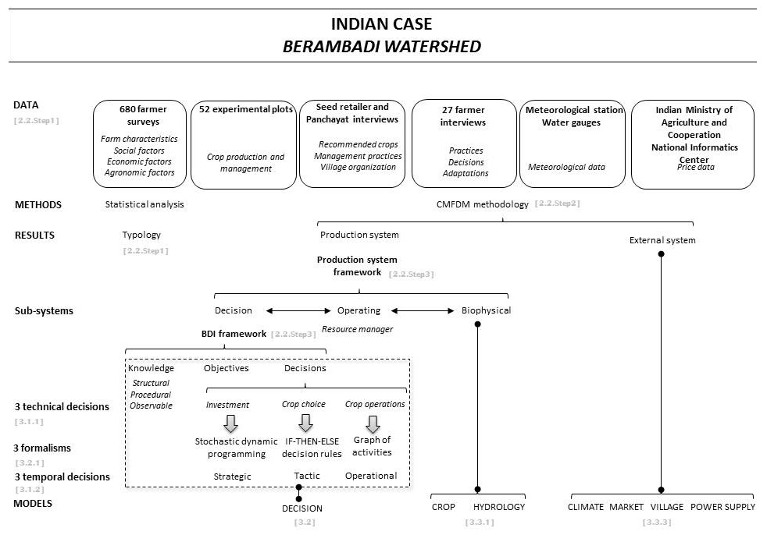
FROM FIELD TO THE CONCEPTUAL MODEL
Robert, M., Thomas, A., Sekhar, M., Badiger, S., Ruiz, L., Raynal, H., & Bergez, J. E. (2016). Adaptive and dynamic decision-making processes: A conceptual model of production systems on Indian farms. Agricultural Systems, doi : 10,1016/j.agsy.2016.08.001

Slide 16
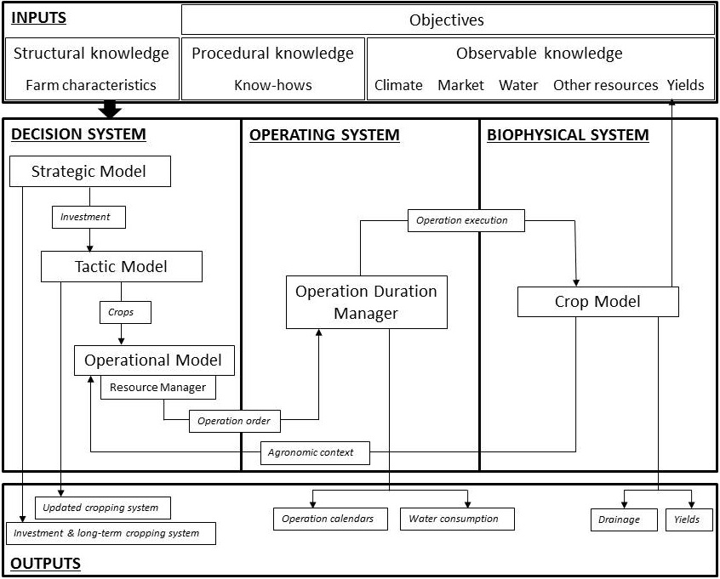
FARMING SYSTEM – GENERIC CONCEPTUAL MODEL
Robert, M., Thomas, A., Sekhar, M., Badiger, S., Ruiz, L., Raynal, H., & Bergez, J. E. (2016). Adaptive and dynamic decision-making processes: A conceptual model of production systems on Indian farms. Agricultural Systems, doi : 10,1016/j.agsy.2016.08.001

Slide 17
AICHA specific farm system
FARM SYSTEM
Desires
DECISION SYSTEM
Beliefs
STRUCTURAL
PROCEDURAL
OBSERVABLE
Intentions
STRATEGIC
TACTIC
OPERATIONAL
OPERATING SYSTEM
EXTERNAL SYSTEM
BIOPHYSICAL SYSTEM
WEATHER
MARKET
AMBHAS
STICS
VILLAGE

Slide 18
AICHA specific farm system
At the beginning of the year…
FARM SYSTEM
Desires
DECISION SYSTEM
Beliefs
STRUCTURAL
PROCEDURAL
OBSERVABLE
Intentions
STRATEGIC
TACTIC
OPERATIONAL
Farm characteristics
Know-hows
Investment
Observations
Update
observables
Rainfall
OPERATING SYSTEM
EXTERNAL SYSTEM
Prices
GW level
BIOPHYSICAL SYSTEM
WEATHER
MARKET
AMBHAS
STICS
VILLAGE
Information flux for strategic decision

Slide 19
AICHA specific farm system
At the beginning of the season…
FARM SYSTEM
Desires
DECISION SYSTEM
Beliefs
STRUCTURAL
PROCEDURAL
OBSERVABLE
Intentions
STRATEGIC
TACTIC
OPERATIONAL
Farm characteristics
Know-hows
Investment
Observations
CS
Update
observables
Rainfall
OPERATING SYSTEM
EXTERNAL SYSTEM
Prices
GW level
BIOPHYSICAL SYSTEM
WEATHER
MARKET
AMBHAS
STICS
VILLAGE
Information flux for strategic decision
Information flux for tactic decision

Slide 20
AICHA specific farm system
Daily …
FARM SYSTEM
Desires
DECISION SYSTEM
Beliefs
STRUCTURAL
PROCEDURAL
OBSERVABLE
Intentions
STRATEGIC
TACTIC
OPERATIONAL
Farm characteristics
Know-hows
Investment
Observations
Own labor
equipment
CS
Update
observables
Operation
Operation
series
Rainfall
OPERATING SYSTEM
EXTERNAL SYSTEM
Prices
Operation
action
GW level
BIOPHYSICAL SYSTEM
WEATHER
Crop changes
soil
Labor
equipment
MARKET
AMBHAS
Pumped water
Percolation
Recharge
STICS
VILLAGE
Information flux for strategic decision
Information flux for tactic decision
Information flux for operational decision

Slide 21
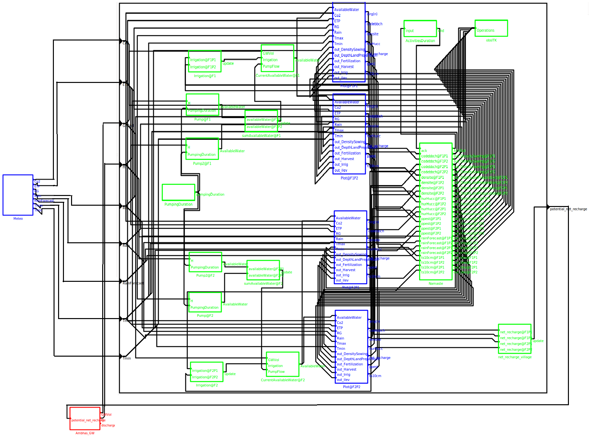
NAMASTE on RECORD platform

Slide 22
Issues and improvements
Issues
Improvements
Fixed number of farms and plots
Variable plot size and soil status
Specific farm ITK
Activity duration set to 1 day
Alternative crops and rotation
Decision-rules & activities
New crops
Subsistence crop in economic model
Risk in economic model
Difficulties to associate independent models
Make it dynamic
Sub-plots or average status
Generic ITK
OS management duration
Rotator/STICS
Indian agronomy experts + STICS experts
Template for non-IT person
Add constraint on stocks
expected-utility framework/prospect theory risk preferences from field surveys or literature
Calibration and validation – individual models and global model

Slide 23
CONCLUSION - PERSPECTIVES
NAMASTE:
Simulation of decision making processes of farmers
different time scales (strategic, tactic, operational)
different space scales (from the farm to the plot)
Simulation of interactions between farmers for shared resources (water, labor, equipment)
Field prototype => computer experimentation/operational validation
Toward scenario testing
Contact: marion.robert@inra.fr
Acknowledgements
This study was funded by the Indo-French Centre for the Promotion of Advanced Research (CEFIPRA), the INRA flagship program on Adaptation to Climate Change of Agriculture and Forest (ACCAF) and the Doctoral School of the University of Toulouse (EDT) and ORE BVET (http://bvet.obs-mip.fr). We are grateful to all the experts, farmers, survey conductors and trainees who helped implement the methodology. A special thanks to Tony Raveneau for his help with the computer implementation.
Notes:
This methodology was successfully used to design a conceptual model for the simulation model CRASH (Crop Rotation and Allocation Simulator using Heuristics) to plan, simulate and analyze cropping-plan decision- making at the farm scale in France (Dury 2011) and the decision model NAMASTE (Numerical Assessments with Models of Agricultural Systems integrating Techniques and Economics), which simulates Indian farmers’ decision-making processes at tactical and operational levels (Robert et al. 2015; Robert et al. (Under Review)).

Slide 24
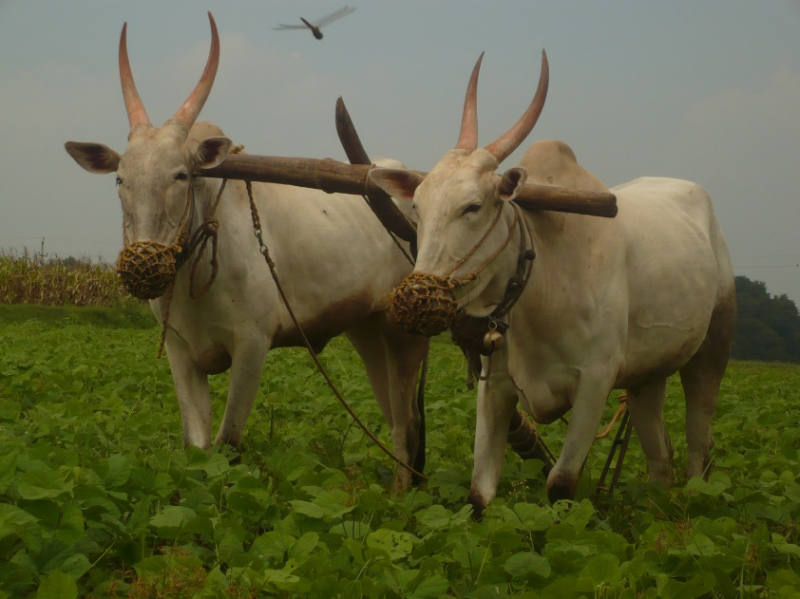
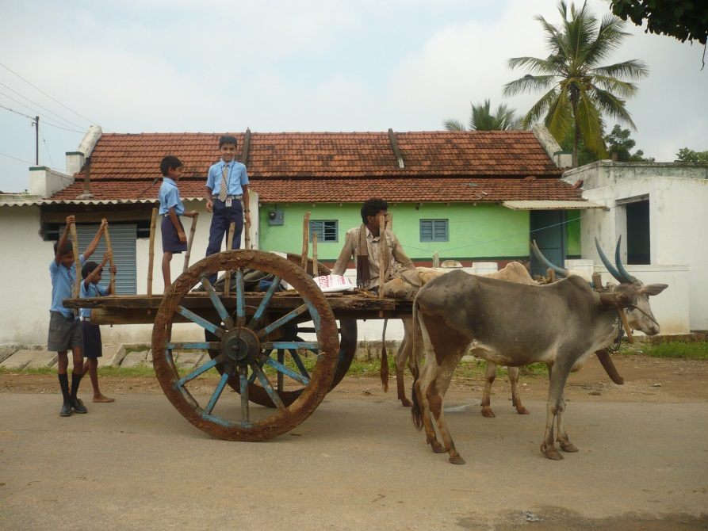
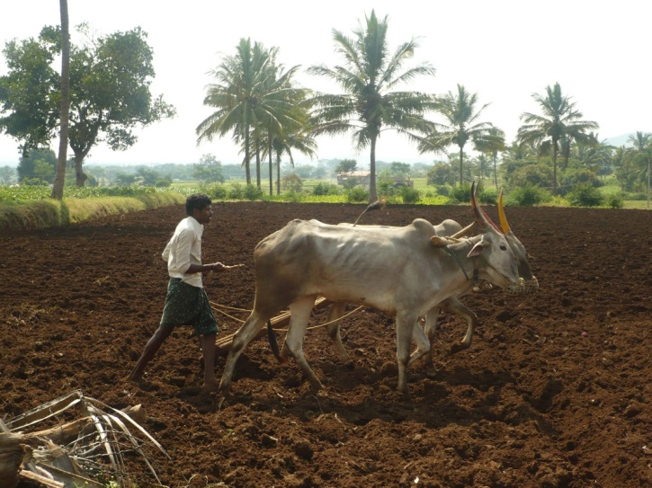
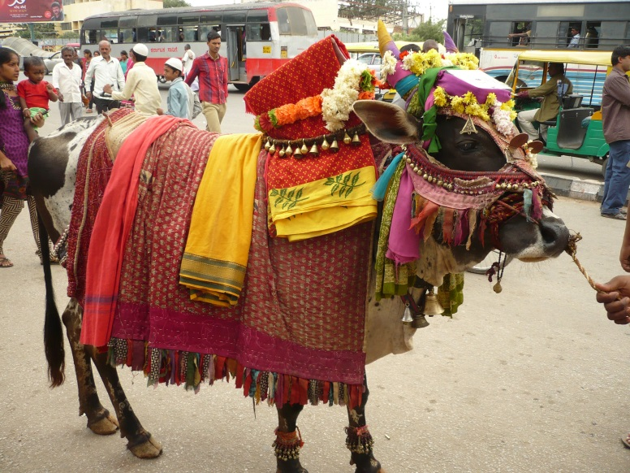
Thank you for your attention!

Slide 25
CLIMATE CHANGE SCENARIO
Goal: test how CC impacts farmers decisions on investment in irrigation and on cropping system choices
SCENARIO 1: INCREASE CHANCE OF DRIER YEARS
Increase probability of drier occurrences (low & below average) by 30% in 30 years
(+ 5% each 5 years)
SCENARIO 2: DECREASE RAINFALL AMOUNT
decrease annual rainfall by ${\text{1,85\%}}^{∗}$in Chamaraja nagar district in 30 years
(- 0,062% each year)
*Bangalore Climate Change Initiative – Karnataka (BCCI-K), 2011
Notes:
Two approaches are considered in scenario testing on climate change to test how it impacts farmers strategic decisions on investment in irrigation and on cropping system choices. First, probability of occurrence on rainfall regimens may be adapted so that climate changes toward drier occurrences (low and below average) or toward wetter occurrences (above average and good) would happen more often. We introduce three additional parameters: 1) ${shift}_{PERC}$ describes the additional weight provided to the two first or two last regimens in percent, 2) ${shift}_{DRY}$ indicates more weight on the two drier regimens when it is equal to two, 3) ${shift}_{WET}$ indicates more weight on the two wetter regimens when it is equal to two. Second, the amount of rainfall may be changed for all regimens such that the level of rainfalls for each occurrence increases by a certain percent with ${rain}_{increase}$ or decreases by a certain percent with ${rain}_{decrease}$

Slide 26
WATER POLICY SCENARIOS
Market change scenarios
Goal: test how economic change on crop prices and crop production costs encourage farmers to adapt their strategies toward less water consuming cropping systems
Subsidies on rainfed crops
Taxes on turmeric
Water management policies scenarios
Goal: test how water management policies encourage less water consuming cropping systems
Electricity fee
Hours of electricity available
Taxes on groundwater variation
Farm location and interaction with other farmers
Goal: test how other farming conditions impact on farmers decisions and integrate relationship between farmers’ practices on sharing resources (labor, equipment, water)
Notes:
Autres types a tester

Slide 27
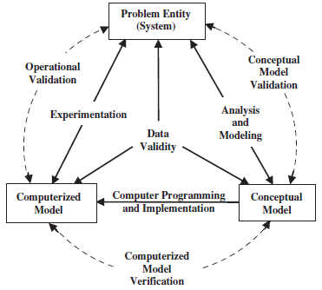
DISCUSION
Development process of the model
Field prototype
Computer model allowing scenarios testing on CC, public policies, resource restrictions
ID adaptive strategies of farmers
Qualitative calibration
Computer experimentation
Operational validation
Production model
(Sargent, 2013)
Notes:
The approach we are applying for software development is a combination of rapid prototyping,
incremental, and traditional methods. Rapid prototyping is used first to reach an agreement on the
initial set of the system requirements. A laboratory prototype then is incrementally developed and
tested for maturity. The field prototype is then implemented by adding a better user interface, and
more explanation facilities to the laboratory prototype, then the field prototype is tested in real
environment. Once the system is successfully field tested, it can be considered as the final
requirements specification of the production version.
Operational validation is determining whether the simulation
model’s output behaviour has the accuracy required for
the model’s intended purpose over the domain of the model’s
intended applicability. This is where much of the validation
testing and evaluation take place. Since the simulation model
is used in operational validation, any deficiencies found may
be caused by what was developed in any of the earlier steps in
developing the simulation model including developing the
system’s theories or having invalid data.

Slide 28
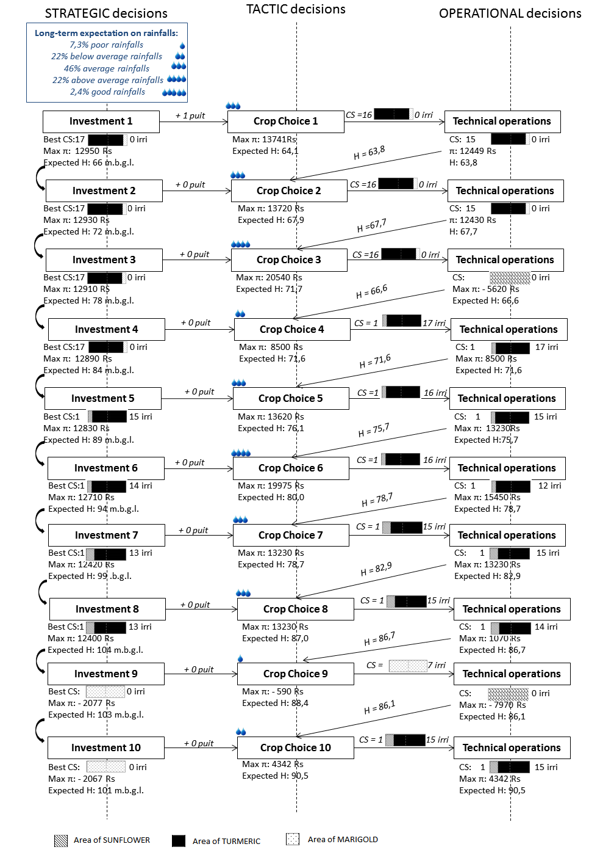
BERAMBADI – 1st results
Crop choice adaptation at the tactic level:
e.g. 4th year (below average rainfall)
Beginning of the season – observations:
rainfed crops particularly affected
groundwater level higher than expected (12.4 m more of water in the borewell)
=> switch from rainfed marigold to irrigated sunflower

Slide 29
BERAMBADI – 1st results
Crop choice adaptation at the operational level:
e.g. 3rd year (above average rainfall).
Tactic plan: 0.9 ha turmeric / 0.1 ha marigold
sowing conditions (rules):
soil moisture ϵ [60-75 %] of field capacity
expected total rainfall at day of sowing and day after < 5mm
Five days (6th, 7th, 8th, 9th and 11th of April) favorable in terms of soil moisture
None for the rainfall condition
review his cropping plan : switch to maize crop

Slide 30
BERAMBADI – 1st results
Technical practice adaptation at the operational level:
e.g. 6th year (above average rainfall).
Important rainfall events from sowing to harvest
Irrigation rule:
total rainfall over the past three days < 50 mm
expected total rainfall at day of sowing and day after < 5mm
=> decrease number of irrigations for the turmeric

Slide 31
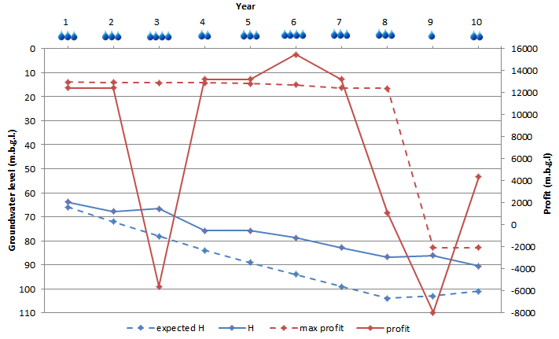
BERAMBADI – 1st results
Tactic and operational adaptations => impact on groundwater level and farmer’s profit
pumping less intensive and recharge was more important than predicted
groundwater level is not decreasing as much as expected and the borewell is not getting dry after 9 years of the planning horizon.
Extreme rainfall events
=>sowing incapacity of the initial crops replace by maize
disastrous year (3rd and 9th)
rainfall events well distributed during crop growth
good yields
very profitable year (6th )
irrigation capacity
manage dryness of the year
very profitable year (10th )

