Slide 1
Reframing Climatic and Non-climatic Vulnerability in Semi-arid Agrarian Socio-Ecological Systems
Shrinivas Badiger
ATREE, Bangalore. India
AICHA Annual Project Meeting, Bangalore
14 November 2016

Slide 2
Regional Climate Trends
Evidence of an increase in 0.4-0.6°C in the past 100 years (Bhattacharya, 2007).
IPCC 4th AR (2007) predicts a +0.68°C increase/century for India
KSCCAP Projections 2021-2050 (Ch’nagar Dist):
Increase in T_{min} = +3 ̊C; and T_{max} = +2 ̊C
Decrease in SW Monsoon: - 9 %
Annual rainfall: no significant change
Increase in drought incidences: 10-80% in kharif
**KAR has more than 70% cultivated area under rainfed irrigation

Slide 3
Implications for Agriculture
Increase in temperature:
drastic increase in extraction of GW for irrigated crops with increased PET/AET
crop water (soil moisture) stress, reduction in yields or crop failures for rainfed crops (covers ~70% cultivated)
lower returns to increasing investments in primary farm inputs
Predicted productivity decreases in irrigated and rainfed crops (KSCCAP, 2012):
irrigated-rice (10-15%); rainfed-rice (10%)
maize (20-28%); sorghum (10-18%)

Slide 4
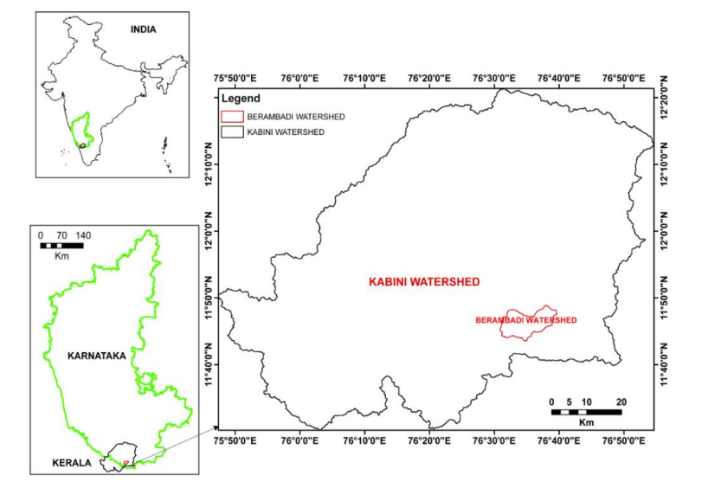
Geographic Context
RF = ~650 mm
AET = 600 - 1000 mm
84 sq.km
Gundal//Kabini//Cauvery

Slide 5
Changing Farmer Responses
Traditional crops in Kharif season: finger millet, sorghum and pulses (also have sunflower, maize and onion)
Recent shift to water-intensive crops such as groundnut, sunflower, floriculture, turmeric, banana and vegetables
Borewell density: 10-40 wells per sq.km.
Wells increased by 21% between 3rd census (2000-01) and 4th census (2005-06).
Cumulatively more than 75% borewells dug have failed (during or after)

Slide 6
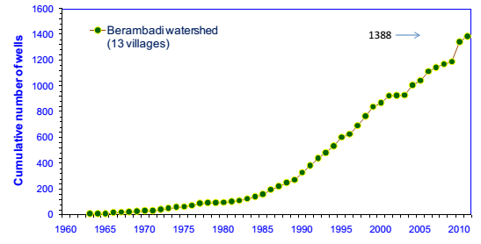
Borewell Distribution and Status
Total borewells drilled till June.2014 = 2303
Borewells drilled between 2011-2014 = ~900
Failed Borewells = 1259
Ownership: Small = 777; Medium+Large = 267
Total functioning = 1044
Fully operational = 219
Seasonal/Yield depleted = 825
Source: Berambadi watershed well census IISc-2011 and ATREE-2014

Slide 7
Broad Objectives SE Component:
Assess farmers vulnerability to climatic and non-climatic stressors
Understand current farming practices that influence crop choice and water use management, and resulting livelihoods and the environment
To develop different scenarios of water use choices in agriculture driven by changing livelihood aspirations, market forces, policies/regulation, depleting resources (soil and groundwater) and varying/ changing climate
SE: Socio-Economic
Notes:
Objectives as written initially
! Develop scenarios means : building hypotheses for the future, choose what is of interest + assessment of their impact on the systme, in particular water comsumption
For assessment of scénario, Tools are needed : simulation of water soil plant, farmers behaviour « models »

Slide 8
Main Activities
Pilot Wellbeing Survey: to identify specific socio-economic drivers/ variables that better describe vulnerability of the community and individual household types in semi-arid agro-ecosystems(n=100, 4 villages), to assist in developing global and vulnerability survey design.
Global Household Survey: Understand current and near-past framing practices including cropping systems and water management; trajectory of cropping system (n=650; 14/21 villages))
Vulnerability Survey: Understand farmers vulnerability to key socio-economic and environmental drivers, with specific objectives to capture their potential responses to future scenarios with changing forcings including markets, policies, environmental depletion and climate (droughts, etc) to assist in identifying key policy and institutional interventions (n=400; 14/21 villages)

Slide 9
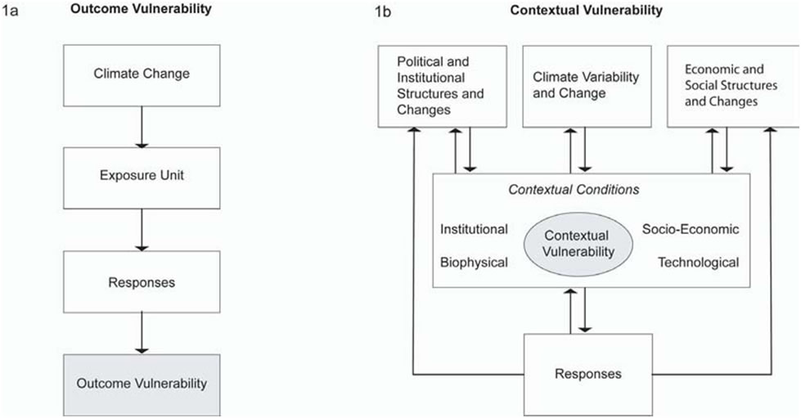
Outcome Vs. Contextual Vulnerability
adapted from Füssel [2009] and O’Brien, K. L. et al. [2007] Framework depicting two interpretations of vulnerability to climate change: (a) outcome vulnerability and (b) contextual vulnerability.

Slide 10
Composite Indices of Vulnerability
IPCC – LVI**
Livelihood Vulnerability Index (LVI)*
Livelihood Effect Index (LEI)#
Advantages:
Use similar socio-ecological sub-components
Integrate the sustainable livelihoods framework (SLF)
Focus on climate change impacts
**adapted from Hahn et al. (2009) and # Urothody and Larsen (2010)

Slide 11
LVI-IPCC
LVI-IPCC derives from the IPCC vulnerability definition that characterises vulnerability with three components: Exposure, Sensitivity and Adaptive Capacity.
It was combined with the nine major components of the LVI and its values, with the three components of the IPCC vulnerability definition
Exposure is measured by aggregating the major components of natural vulnerability and climate variability.
Sensitivity is quantified by the components of health, water and food security.
Adaptive Capacity is measured through demographic profile, social networks, livelihood strategies, knowledge/skills, and finance.

Slide 12
LVI: Livelihood Vulnerability Index
LVI includes nine major components:
Socio-demographic profile, livelihood strategies, social networks, health, food security, water security, natural vulnerability and climate variability (and knowledge/ skills, and finance).
The index uses a balanced weighted average approach,, even though each major component is comprised of different number of subcomponents.

Slide 13
LEI: Livelihood Effect Index
The LEI is derived from the SLF that identifies five different types of vulnerability indicators or capitals: Natural, Human, Physical, Social and Financial capital.
This vulnerability index can help identify and target vulnerable regions and sectors of populations, raise awareness, and be par t of a monitoring strategy.
We used the major components and their values from the LVI index to calculate the scores for each type of capital asset by combining them
**Used for household level analysis

Slide 14
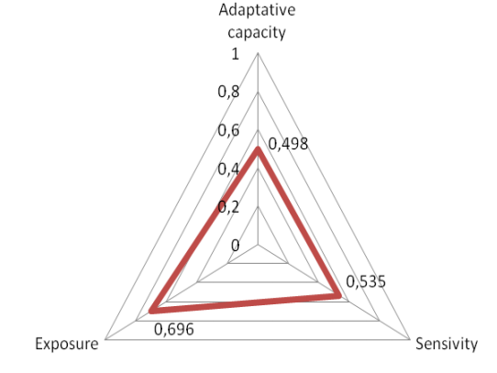
Results: LVI-IPCC
Overall value for the LVI-IPPC suggests moderate vulnerability to CCV
value > 0 indicates community is more exposed to climate extremes and natural disasters than its capacity to
Adaptive capacity of 0.5, indicates moderate AC, but not good enough to decrease the exposure and sensitivity.

Slide 15
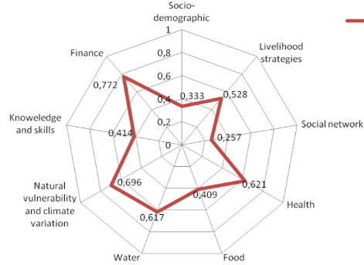
Results: LVI
66% Hh reported to more expenses than income
95% reported having to resort to loans
72% were unable to repay loans.
65% can only pay interest
17% could not pay anything
76% fully depend on farming
LVI for the villages was around 0.5, moderate (0: low vulnerability; 1 : high vulnerability) vulnerability to the impacts of climate change and environmental degradation.

Slide 16
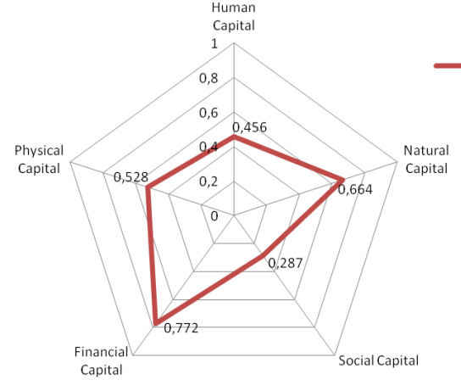
SLF Indicators of LEI

Slide 17
Key Insights
The region is moderately vulnerable to the impacts of CCV and ED:
76% of the households fully depend on farming as the primary source of income
95% reported having taken loans, most unable to pay
57% farmers have some access to irrigation water:
88% of the farmers claim that their groundwater is depleting
83% claim to not have a consistent water supply.
53% of respondents claim that droughts have increased, and 22% claimed flooding has increased.

Slide 18
Limitations of Composite Indices
Indicator based frameworks to analyze vulnerability do not fully represent the inter-linkages and causal relationships.
Power relations within the actors in the system were largely unaccounted for.
The temporal and spatial dynamics of vulnerability was not reflected in any of the methodologies.
The methods lacked flexibility and oversimplified complex interactions between biophysical and social processes within the system.
Ignores the dynamic nature of confounding system variables and the interactions including climate/rainfall, markets, socio-institutional.

Slide 19
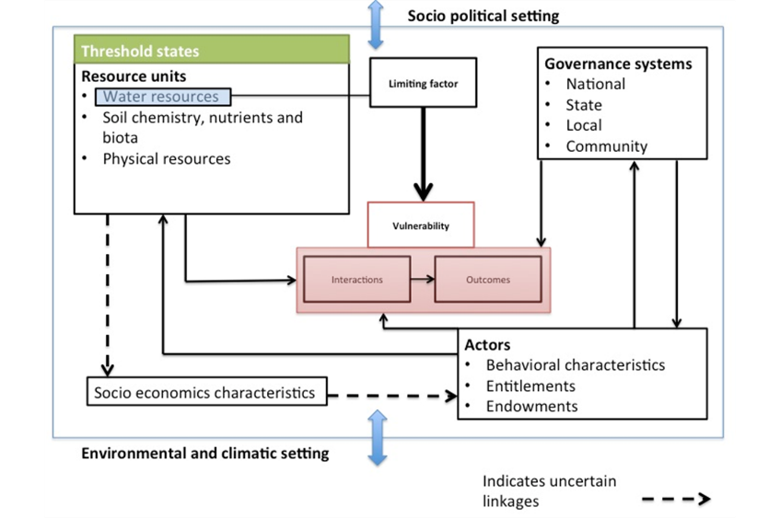
Modified Agrarian Vulnerability Framework
Source: author’s own adapted from several literature sources

Slide 20
Adaptive Vulnerability Framework
Combines quantitative metrics with qualitative indicators to capture nuances.
Persistent chronic farmer indebtedness is due to combined and compounding effects of social, environmental and institutional factors.
Lack of supporting developmental policies; aspirations to move out of agrarian system

Slide 21
Key Features of the Framework
Combine SES framework with a structured approach of mapping vulnerability considering temporally varying socio-ecological dynamics
The “Law of Minimum” (Leibig, 1840) is introduced into the governance of resource units, which identifies minimum resource threshold (limiting factors) that determine the state of vulnerability.
Explores resilience pathways in SES with emphasis on the interactions between natural and socio-economic systems.
Identification of key points/variables for policy intervention

Slide 22
Potential Policy Interventions
Changing policy scenarios (reduction or targeted) regarding subsidies for electricity/pumping, fertilizers, pesticides, etc.
Policy and market interventions that promote environmentally sound cropping practices (crop insurance and incentives; and pricing support for rainfed and less water-intensive crops. i.e., millets, pulses, etc)
Groundwater governance: Institutional arrangements for collective management of groundwater and implementation of the Karnataka Ground Water (Regulation and Control of Development and Management) Act, 2011
Access to improved technology (irrigation and fertilization), drought-tolerant varieties of rainfed crops

Slide 23
Acknowledgments
Iswaragouda Patil
Divya Susan Solomon
Field Research Team and Students
IISc, IFCWS and INRA Team
CEFIPRA/IFCPAR

