Slide 1
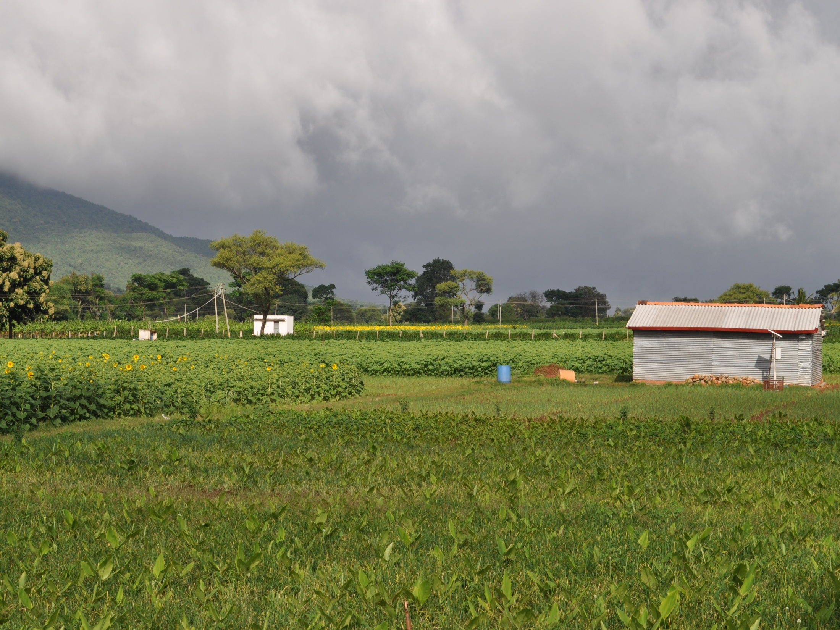
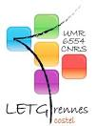



Land Use and Land Cover Monitoring
            Prof. Laurence H. Moy Prof. Samuel Corgne
            Prof. M. Sekhar Dr. Sylvain Mangiarotti
            Dr. Laurent Ruiz Dr. S. Bandyopadhayay
Amit Sharma (PhD Student)
AICHA- 14th November 2016

Slide 2
WP3: AICHA-2D:
Impact of spatial interactions on the sustainability of farming systems under climate change at the watershed scale
Task 3-2:
  Land use dynamics characterization (long and short time)
  Land use change (Irrigated and Non-Irrigated cropland),
  Crop variables (LAI) estimation
  Crop classification using combination of multi-temporal Optical and SAR images.

Slide 3
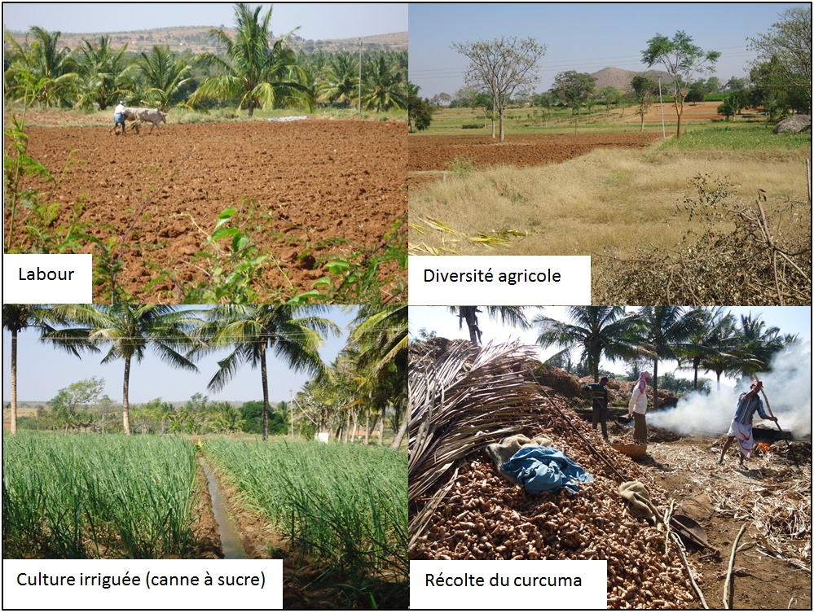
High spatio-temporal changes at different scales
Ground observed and Satellite Dataset
Crop type GCP’s (2011-15)
Surface soil Moisture (2011-15)
Biomass (2012-14)
LAI Licor (2012-15)
Aerial Survey (Sept, 2014)
2 or 3 crops per year
Optical data long-term (1990-2015) and short term (2014-15)
LS-5(TM), 8 (OLI), EO1-ALI, IRS-LISS III and IV, SPOT5-Take5 (CESBIO)
Multi-temporal data acquisition during all three seasons.

Slide 4
Radarsat-2 SAR Satellite Images
2011 – 2012 – 2013 – 2014 - 2015
2011 | 2012 | 2013 | 2014 | 2015
26th May, 2011 | 07th July, 2012 | 08th June, 2013 | 17th June, 2014 | 28th Aug, 2015
19th June, 2011 | 31st July, 2012 | 02nd July, 2013 | 11th July, 2014 | 20th Sept, 2015
13th July, 2011 | 24th Aug, 2012 | 26th July, 2013 | 15th July, 2014 | 14th Oct, 2015
06th Aug, 2011 | 17th Sept, 2012 | 19th Aug, 2013 | 04th Aug, 2014 | 07th Nov, 2015
30th Aug, 2011 | 11th Oct, 2012 | 12th Sept, 2013 | 28th Aug, 2014 | 01st Dec, 2015
23rd Sept, 2011 | 04th Nov, 2012 | 06th Oct, 2013 | 01st Sept, 2014 | 25th Dec, 2015
 | 28th Nov, 2012 | 10th Oct, 2013 | 21st Sept, 2014
 | 22nd Dec, 2012 | 24th Oct, 2013 | 15th Oct, 2014
 | 15th Jan, 2013 | 30th Oct, 2013 | 08th Nov, 2014
 |  | 23rd Nov, 2013 | 12th Nov, 2014
 |  |  | 02nd Dec, 2014
6 images FullPol | 9 images FullPol | 9 images FullPol | 8 images FullPol | 6 images UltraFine
 |  | 1 image UltraFine | 3 images UltraFine
Ground observation has been done at the time of Radarsat-2 pass.
The spatial resolution of QuardPol (FullPol) and Ultrafine images are 5.8m and 2m respectively.

Slide 5
Land use characterization-Objectives
Radar polarimetric data for land use characterization.
Definition of a new and simplified nomenclature of all 7 main monitored crops.
Optical and radar data fusion evaluation to improve land use classification.
The main monitored crops in the watershed are:
Turmeric
Maize
Sorghum
Sunflower
Marigold
Sugarcane
Banana

Slide 6
Land use Land cover classification
NDVI
Irri
MSAVI
NDMI
Total Area : 88.44 Km²
Total Cropland Area : 43.8 Km²
Total Number of Croplands :17354

Slide 7
Irrigated and Non-Irrigated Cropland Classification
Summer season spatio-temporal irrigated / Non-irrigated cropland classification for year 1990-2015
Sharma et al., in preparation

Slide 8
Irrigated and Non-Irrigated Cropland Classification
Rabi season spatio-temporal irrigated / Non-irrigated cropland classification for year 1990-2015
Sharma et al., in preparation

Slide 9
Crop identification :Turmeric identification in 2014
Accuracy accessment of Turmeric crop classification using various optical and SAR variables
Variable | R² | Kappa coefficient
LAI | 0.77 | 0.87
T33 | 0.78 | 0.95
HV | 0.65 | 0.79
FD_Vol | 0.65 | 0.75
Alpha | 0.63 | 0.75
Shannon Entropy | 0.61 | 0.76
T22 | 0.61 | 0.79
Entropy | 0.60 | 0.80
Combination of Variables | Kappa coefficient
T33 + HV + LAI | 1.0
T33 + LAI | 0.97
T33 + SE + Entropy | 0.97

Slide 10
Crop type Classification
Relation between Ground Observed and Satellite estimated indices
R² ~ 0.65
R² ~ 0.79
R² ~ 0.57
Remotely Sensed LAI =
0.9 (Ground observed LAI) + 0.98
R² ~ 0.53
SAR polarimetric decomposition and ground observed LAI

Slide 11
Temporal Turmeric NDVI, year 2014
The parcel mean NDVI signature distinguished the turmeric crop (growth phase jun-dec) from other crops

Slide 12
Turmeric NDVI Uncertanity, year 2014

Slide 13
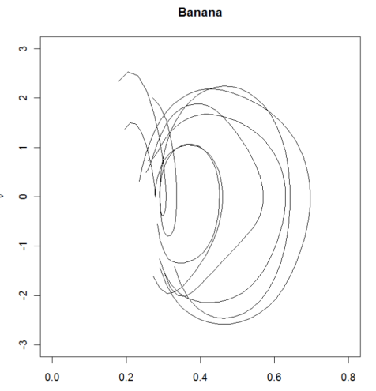
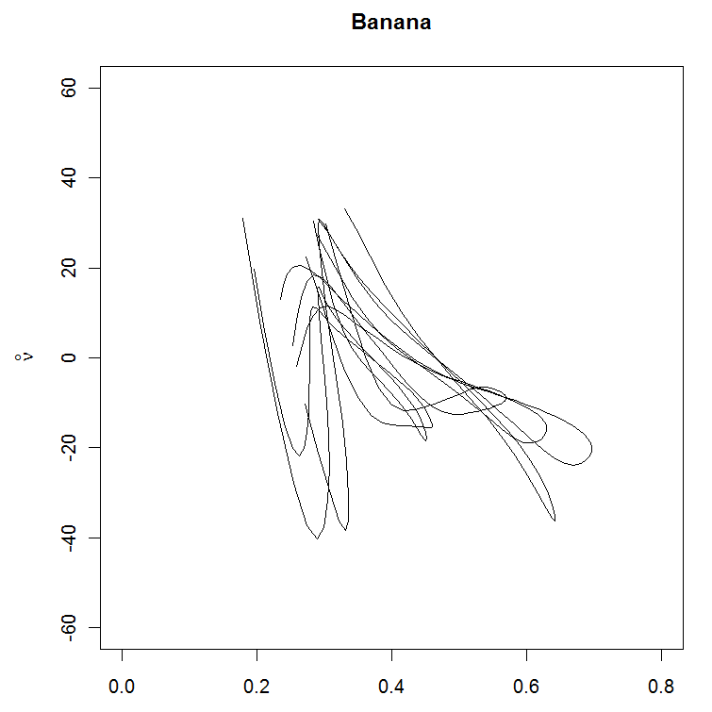
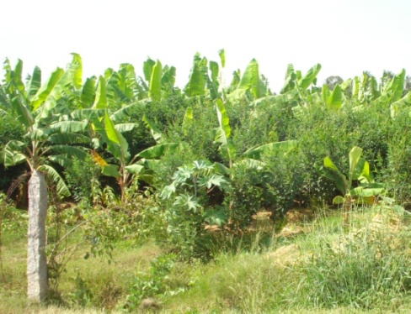
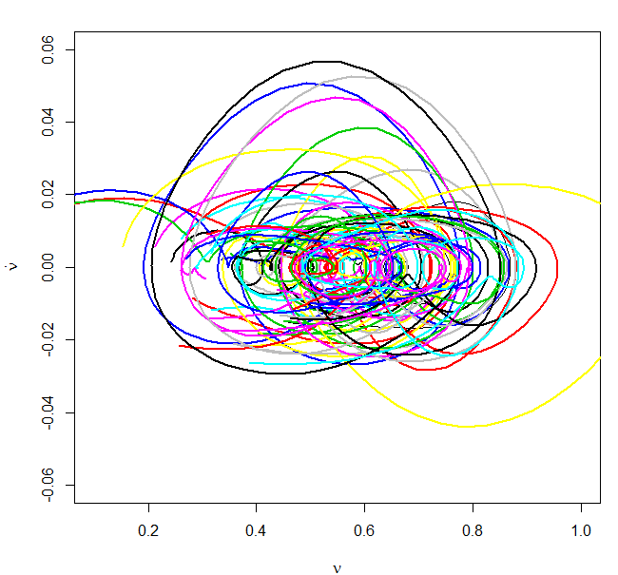
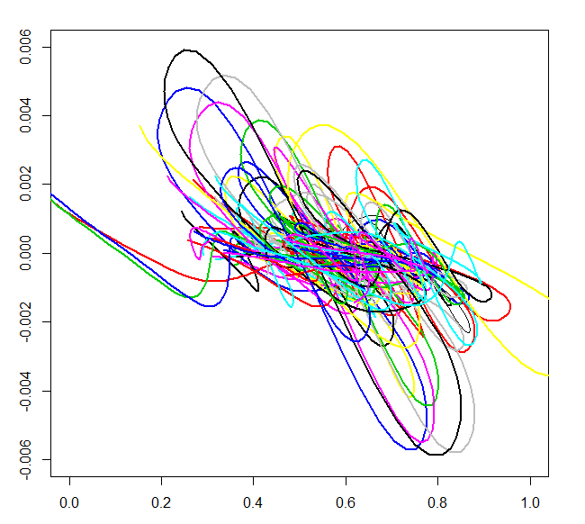
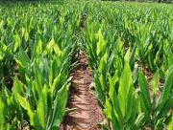
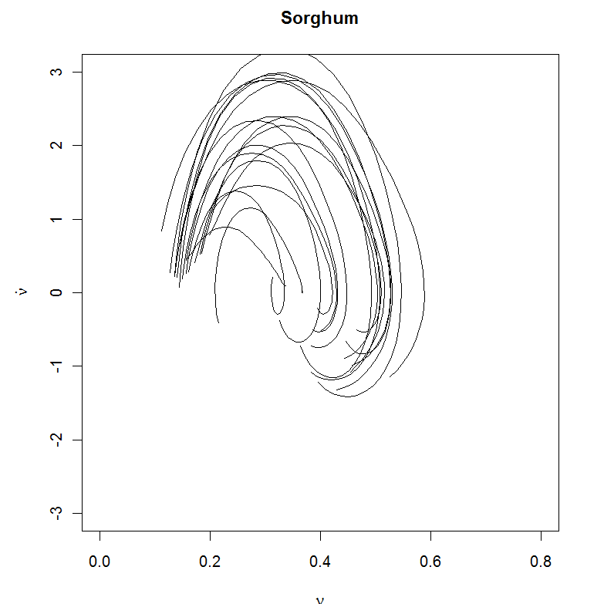
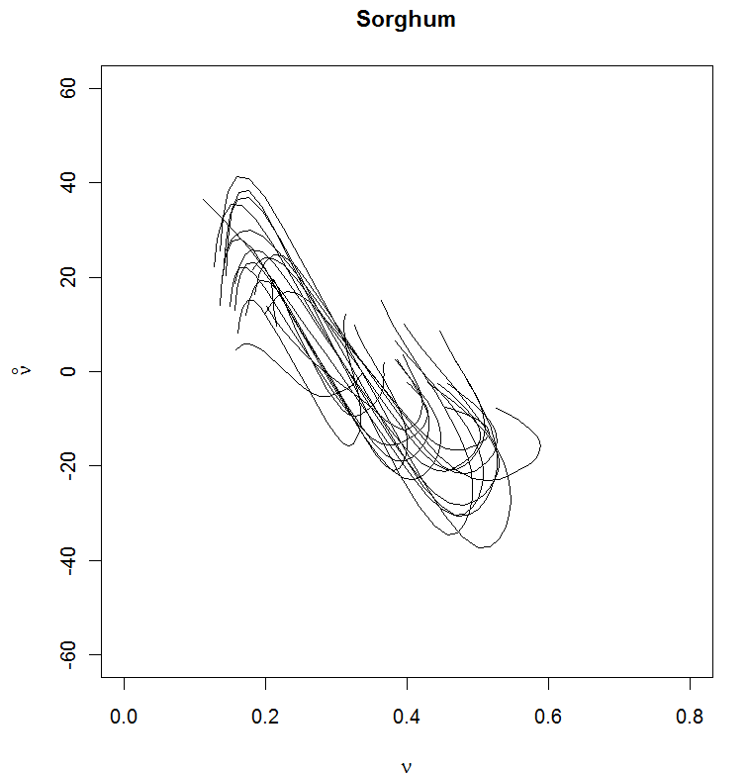
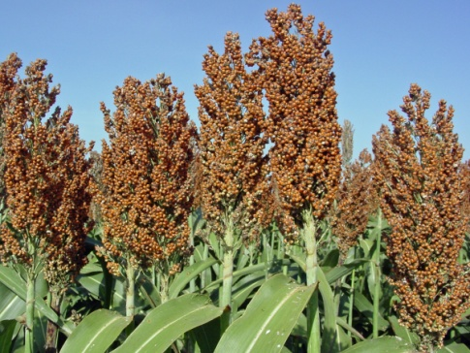
Chaos implementation for precise crop classification
Banana
Turmeric
Sorghum

Slide 14
Deliverables
Metadata for remote sensing data
Remote Sensing data collection (Radar and Optical)
Aicha GeoPortail
  (http://geowww.agrocampus-ouest.fr/portails/?portail=aicha)
Land use monitoring
Long term Irrigated / Non-Irrigated cropland classification
7 majors Kharif crops classification during for 2014 and 2015

Slide 15
Conference and Poster Presentation
Sharma A. K., Hubert-Moy L., Betbeder J., Ruiz L., Sekhar M., Corgne S., 2016. Crop Identification Using Time Series of Landsat-8 and Radarsat-2 Images: Application in a Groundwater Irrigated Region, South India, SP 740 Living Planet Symposium, 09-13 May, 2013 Prague, Czech Republic. (http://lps16.esa.int/page_session106.php#2301p). Oral + Proceeding
Mangiarotti S., Sharma A. K., Sekhar M., Corgne S., Ruiz L., Hubert-Moy L.& Kerr Y., 2016. Chaos theory applied to crops detection in South India, 14th Experimental Chaos and Complexity Conference, Banff, Canada, 113-115. Oral + Proceeding
Mangiarotti S., Sharma A. K., Sekhar M., Corgne S., Ruiz L., Hubert-Moy L. & Kerr Y., 2016. La modélisation du chaos appliquée à la classification des couverts agricoles (bassin versant de Berambadi, Inde du Sud), ISBN 978-2-9538596-5-2, 19e Rencontre du Non Linéaire, 19, Paris, France, 73-78. Oral + Proceeding
Sekhar M., Mangiarotti S., Sharma A. K., Corgne S., Ruiz L., Hubert-Moy L., 2015. Crop identification for the delineation of irrigated regions under scarce data conditions: a new approach based on chaos theory, AGU Fall meeting, 14-18 dec. 2015, SanFrancisco, (https://agu.confex.com/agu/fm15/meetingapp.cgi/Paper/78863).

Slide 16
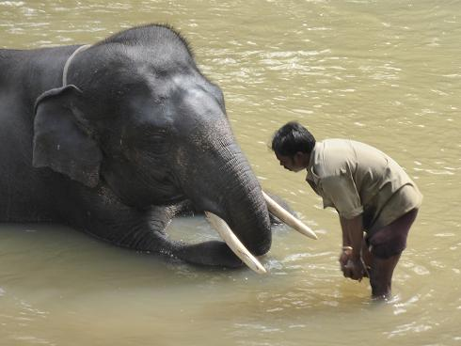
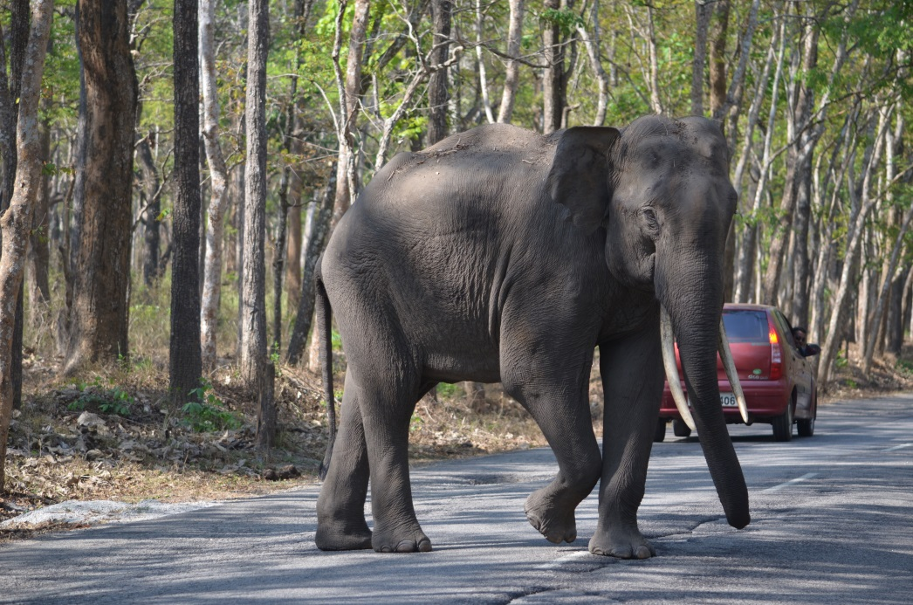
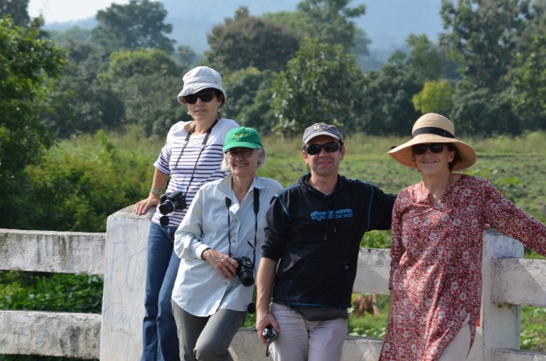
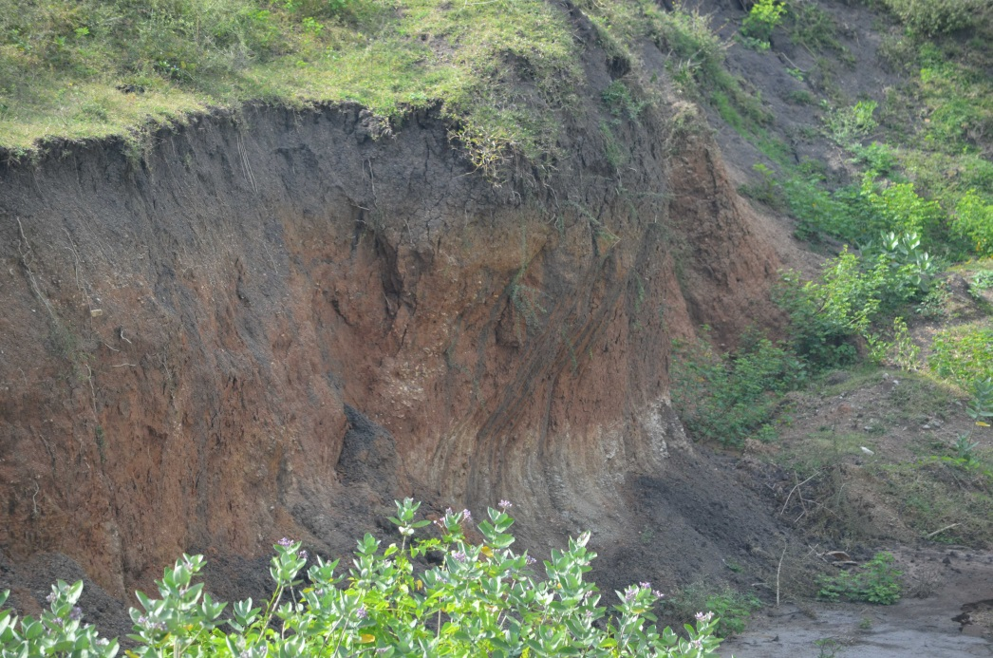
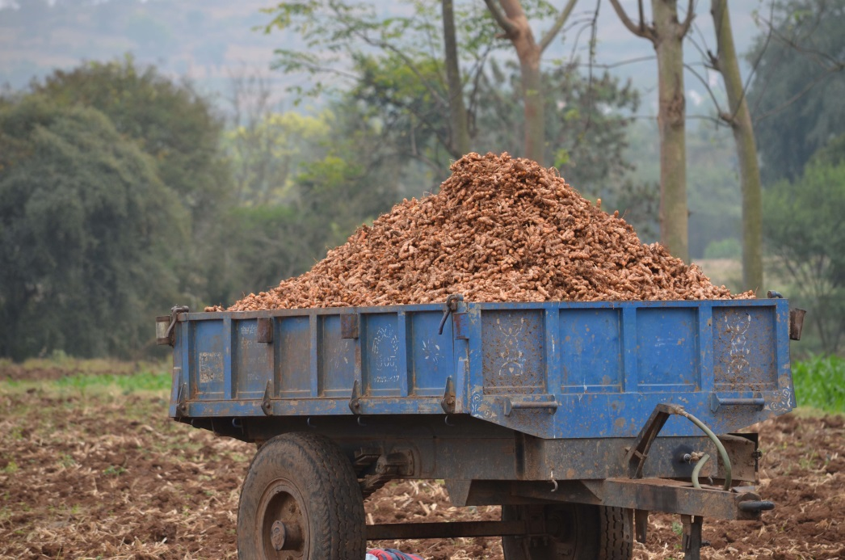
Thanks for your kind Attention

