Slide 1
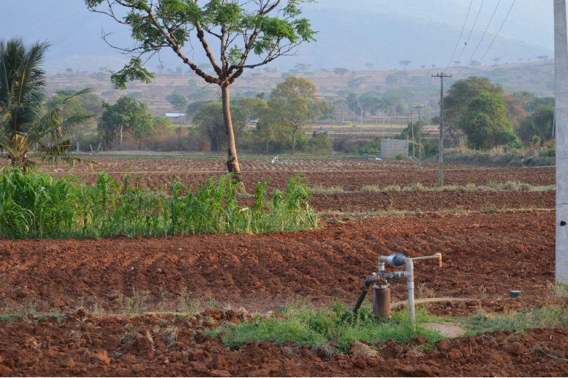

Accompanying
The adaptation of irrigated
agriculture to climate
CHAnge
THE BUDGET…

Slide 2
BUDGET
ANR-16-CE03-0006
TOTAL = 743 k€ (5.5 crores Rs)
Non permanent staff (France) = 317 k€
= 6 years of “postdoc”
+ 14 Master students (including stipend and travel)
Travel costs = 163 k€
consumables, chemical analysis, and publication fees = 123 k€
Equipment (computers) = 23 k€
External service (workshop logistics and field work in India) = 75 k€ (55 lakhs Rs)

Slide 3
Expenses eligible from 01/10/2016 to 30/09/2021 (5 years)
Flexibility ? (except for non permanent staff ratio and Equipment
Meeting at ANR Paris on december 5th about adminsitrative
management of projects
Money will be sent in 6 instalments ...

Slide 4
Short description of non-permanent staff hired by the project
IE land use land cover (4 months) / (COSTEL)
IR crop modelling (24 months) / Agronomy, statistics, crop modelling (SAS)
IE Integrated Model (24 months) / Computer science (AGIR – RECORD)
IR “assessment and design” (24 months) / systemic agronomy (AGIR)

Slide 5
WORKPACKAGES
WP1: Building methodology to collect adequate spatial database for modelling (S Buis)
Task 1.1: Modelling land use and land cover change using multi satellite high resolution data.
Task 1.2: Digital Soil Mapping for spatial modelling .
WP2: Bridging knowledge gaps for agro system modelling in the tropics (J Riotte)
Task 2.1: Calibration and evaluation of the STICS crop model for a sufficient variety
of crops under tropical conditions
Task 2.2: Modelling nutrient cycling in irrigated tropical agro-systems.
Task 2.3 Modelling water fluxes
WP3: Sharing knowledge through scenarios (Coord JE Bergez)
Task 3.1: Scenario Design and Assessment
Task 3.2: Agrarian system analysis and ethnographic approach
to support the participatory process
WP4: Coordination, modelling, dissemination and capacity building (Coord. H Raynal)
Task 4.1 Coordination
Task 4.2 Integrated modelling under the RECORD platform
Task 4.3 dissemination and capacity building:

