Slide 1
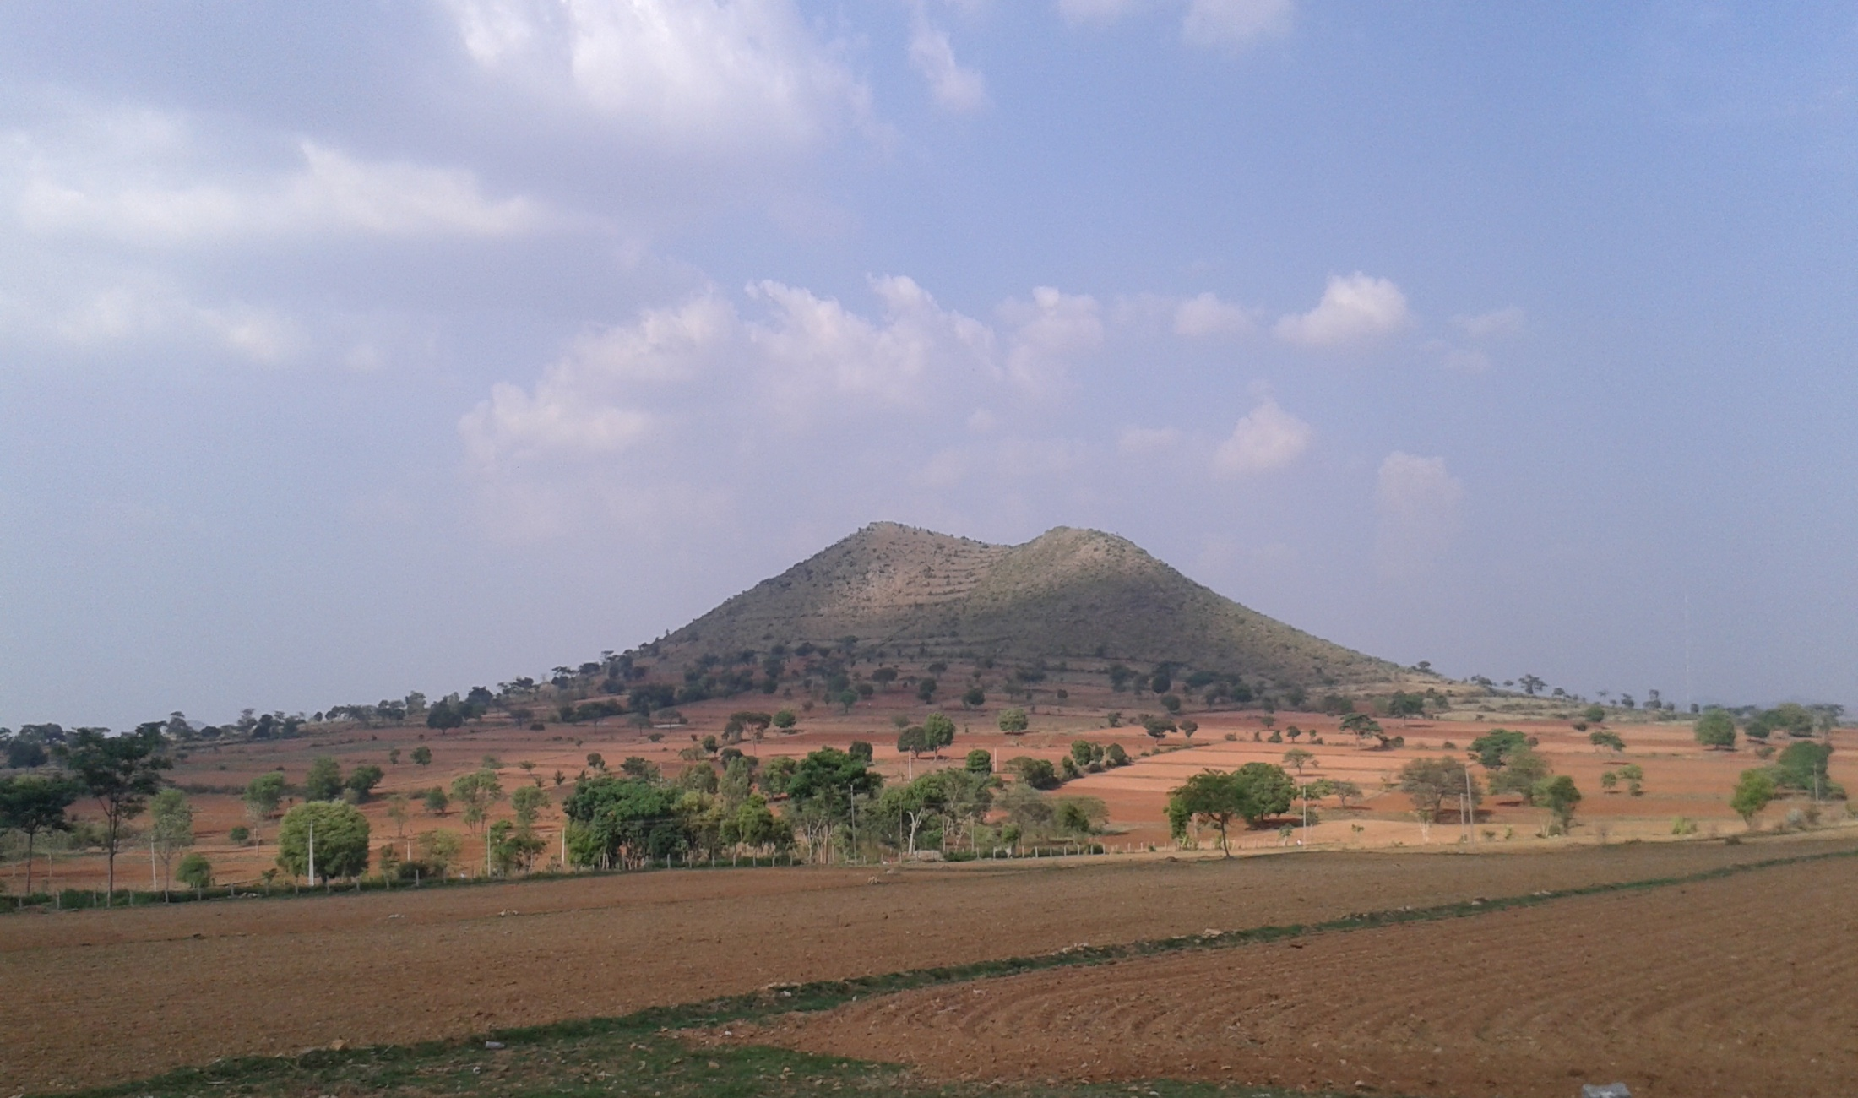




Agrarian system diagnosis
In a semi arid zone in Southern India
Encadrement Claire Aubron, Aurélie Trouvé, Laurent Ruiz
Mars – Aout 2016
Chloé FISCHER
Développement agricole et agriculture comparée
20 octobre 2016 Montpellier

Slide 2
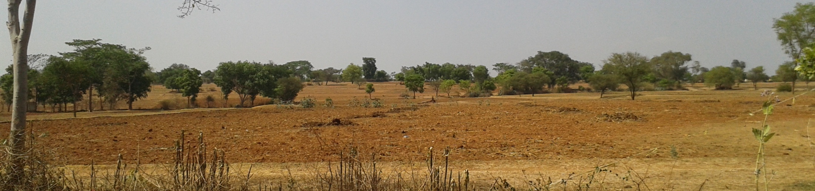
Agrarian system diagnosis
Landscape analysis
Agrarian history and trajectory of production systems
Compared economic analysis of production systems

Slide 3
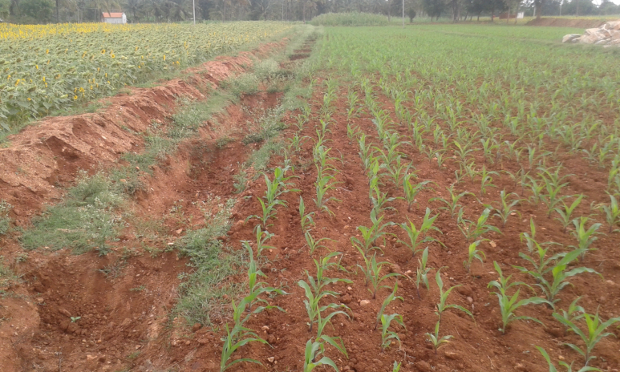
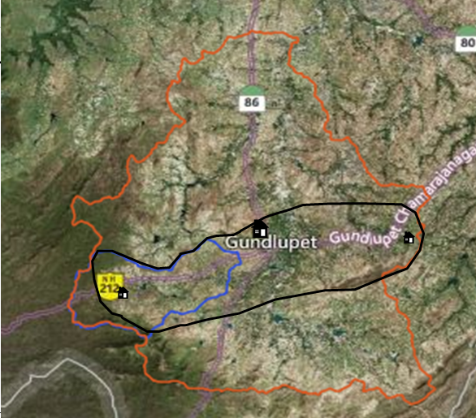
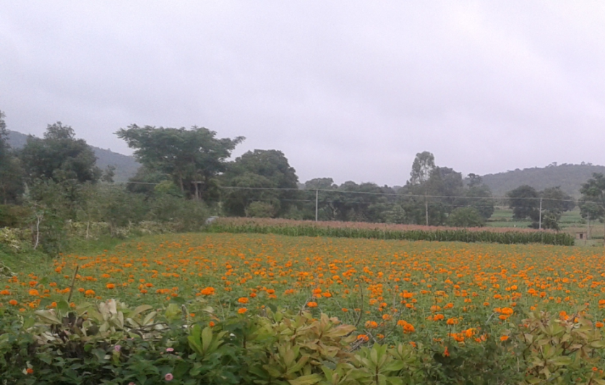
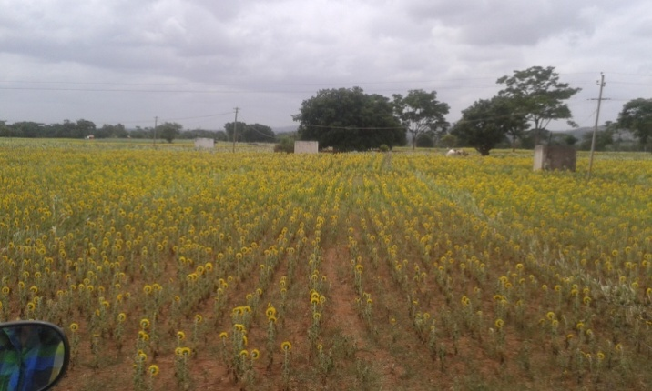
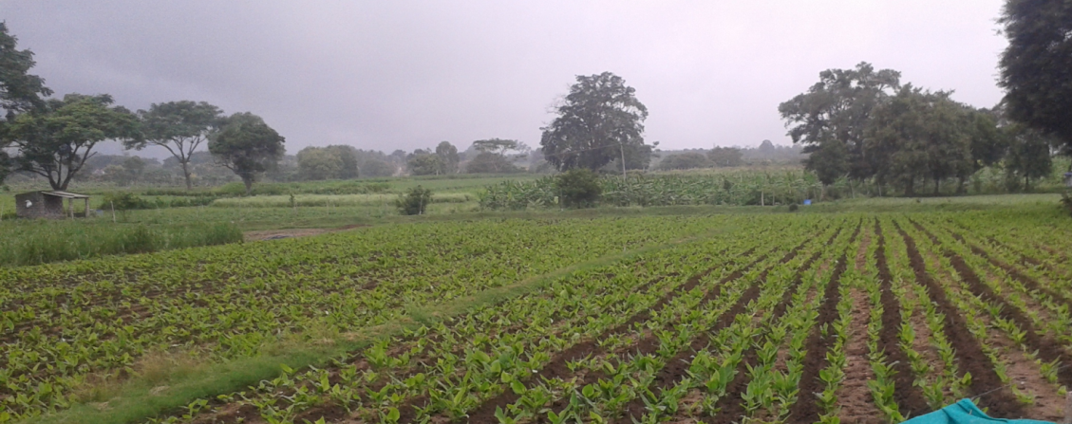
Variabilité de précipitations et du niveau des nappes au sein de la zone d’étude
Terakanambi
Forêt de Berambadi
Berambadi
+
Précipitations
-
Notes:
Ici il faut que je parle des surfaces irriguées à l’est et ouest

Slide 4
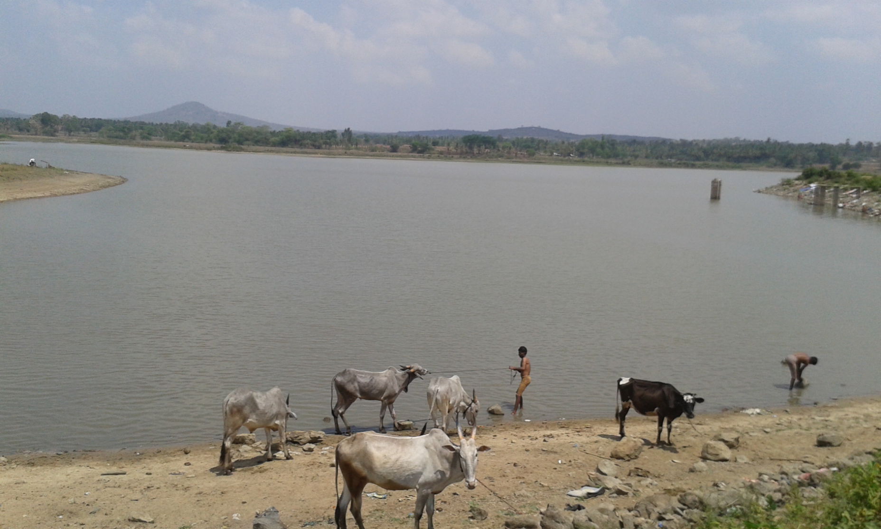
II. Agrarian history since independence

Slide 5
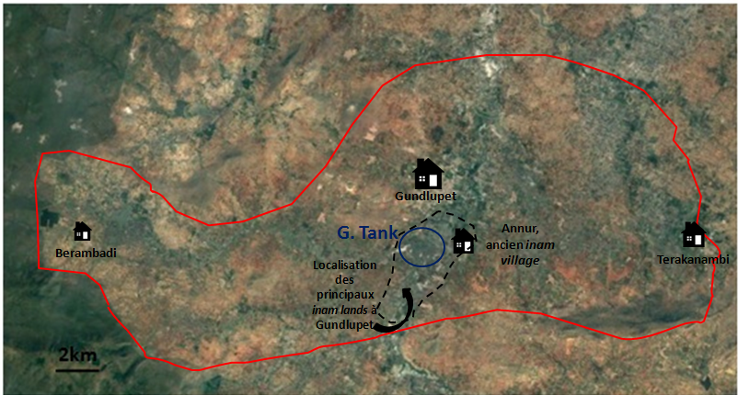
Land tenure at independence
Most lands is own by lingayats
« Inam lands » previously owned by Brahmins, redistributed to « métayers » in 1954

Slide 6
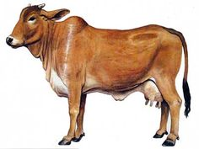
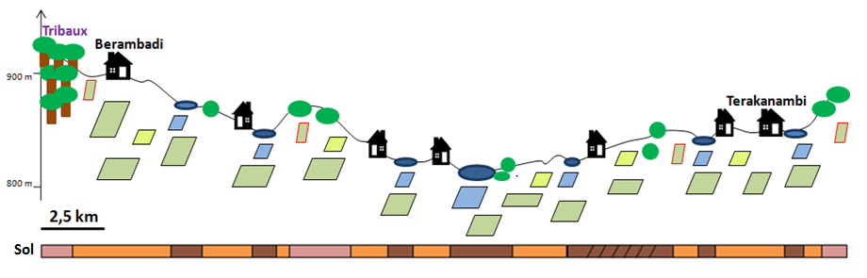
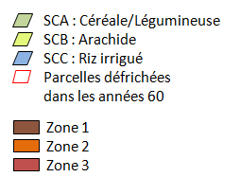
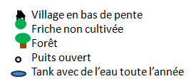
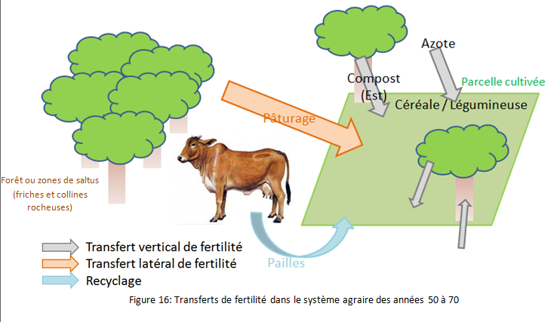
Agriculture = food-producing for self-consmption strongly integrated with breeding
Herds of local breed cattle = lateral transfert of fertility from marginal land/pastures/forest towards cultivated land
1% of the surface irrigated with tanks
Main crops :
Cereals, pulses – some peanut

Slide 7
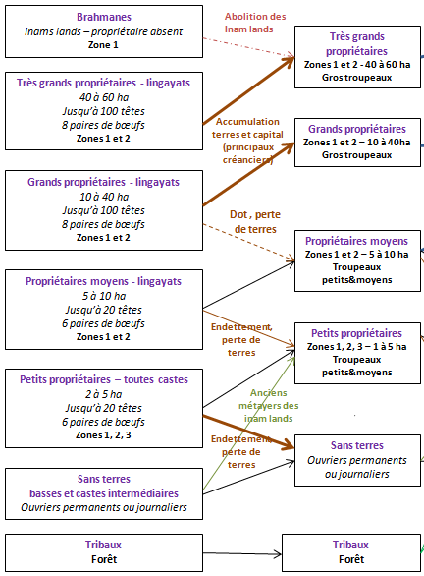
1970
Accumulation of capital
(loans, cash crops)
Vaches locales
Sufficient Production in « normal » years
Little capital, little debts
Insufiscient production
debts
Depend on demand for work
Debts

Slide 8
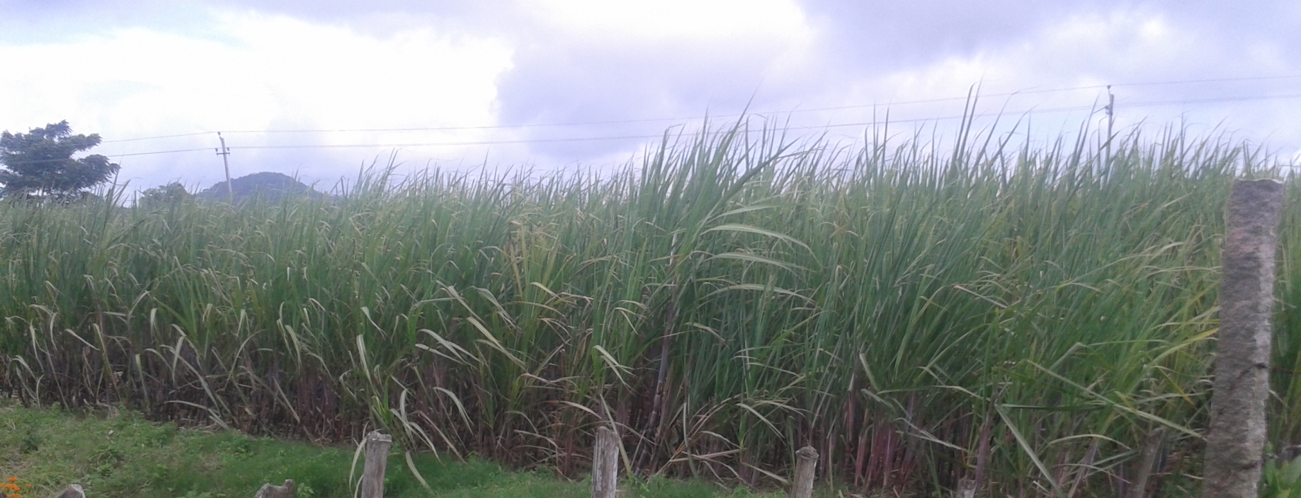
1970 - 1990: green revolution and beginning of well irrigation

Slide 9
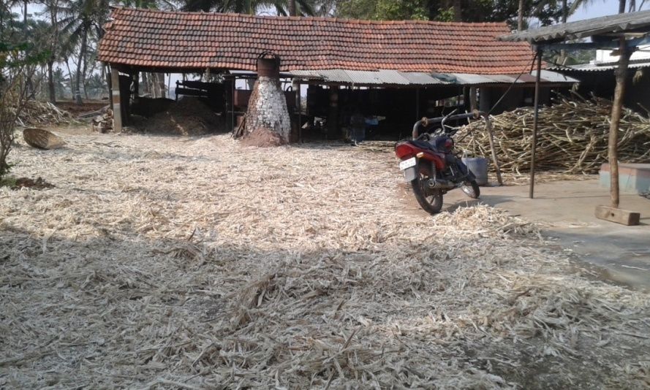
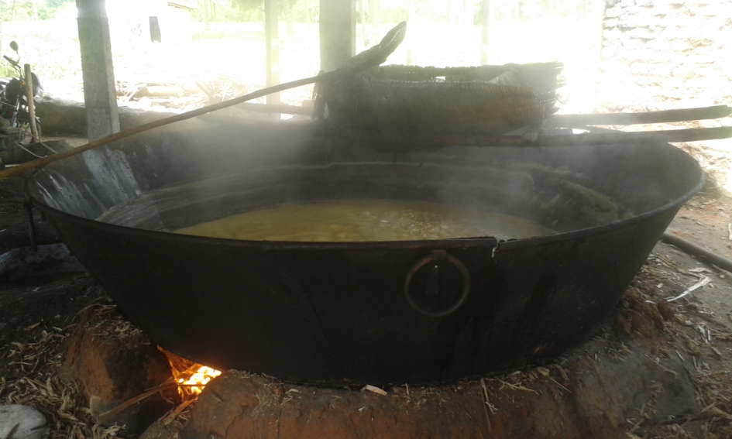
Availability of fertilizer + irrigation = Sugar cane …
Only big farmers can invest in Jaggery plants

Slide 10
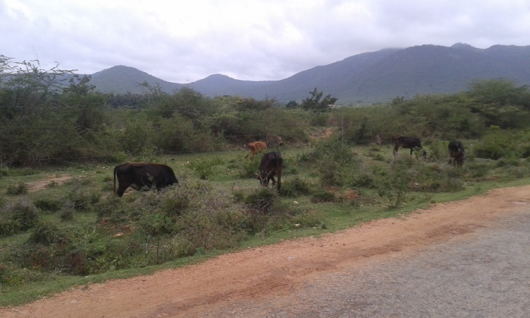
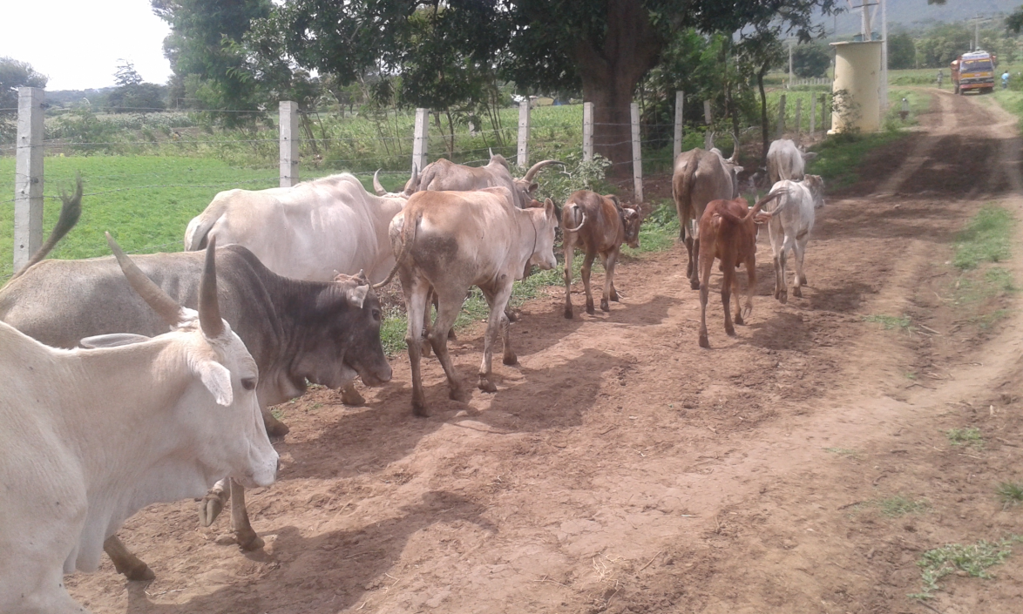
1974: « Tiger project »
Restricted access to forest = less cattle = less fertility transfert
Notes:
Adoption des engrais chimiques encouragée par:
Des subventions qui font qu’ils arrivent à des prix abordables pour les agriculteurs
Mais aussi par la réduction des troupeaux du fait de la diminution des surfaces de pâturage

Slide 11
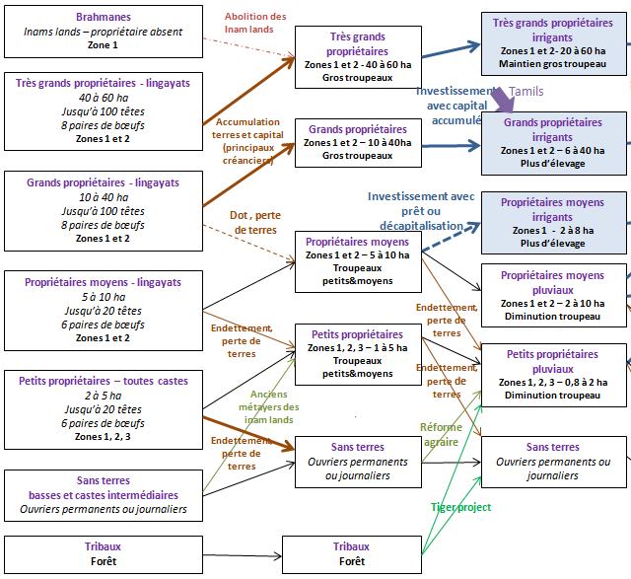
1970
1990
Local cows
Specialisation in crops
irrigation
Stop breeding
Decrese of nb of local cows

Slide 12
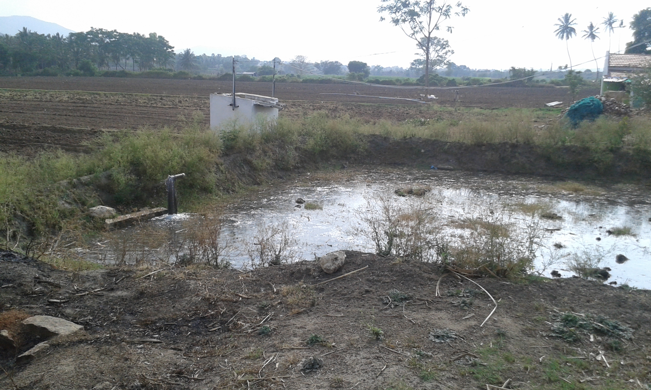
90’s: irrigation by tube wells

Slide 13
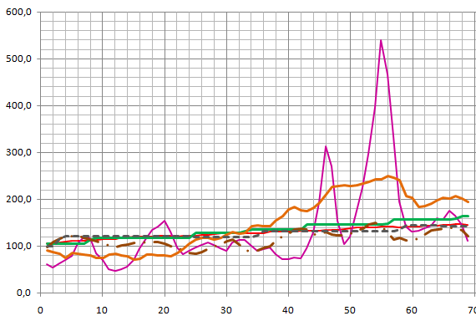
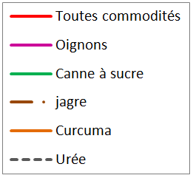
Incentives for irrigation
Sugar cane factory in Nandjangud, developpement of crop marketing
Free electricity for irrigation -1992 (but limited time)
Borewells with submersible pumps
Good prices for irrigated crops
Evolution de l’indice mensuel des prix de gros (base 100 = 1993 -1994)
Source: Ministry of Commerce and Industry – Government of India

Slide 14
Mechanism for access to irrigation
Mobilisation of land and livestock
mortgage
Mécanisme of mortgage
Hypothèque de la terre
Big farms
Irrigated since 70s
Small and medium farms
New irrigation users
Moulin à jagre + usine
Capital pour le forage
50% intrants + travail
Usine de canne
50% intrants
Sugar cane
50 % production
50 % production
METAYAGE
(crop-sharing)
Parcelle hypothéquée
Notes:
Insister sur le fait que le gros propriétaire peut ainsi optimiser son moulin à jagre sur une plus grande partie de l’année et a deux choix possibles de débouchés, selon le prix le plus optimal

Slide 15
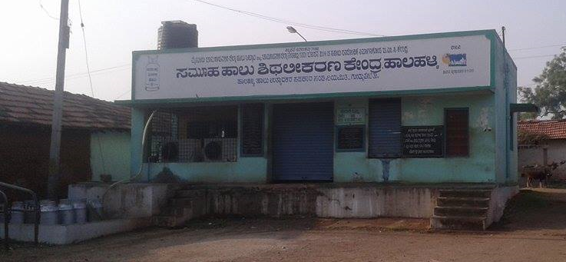
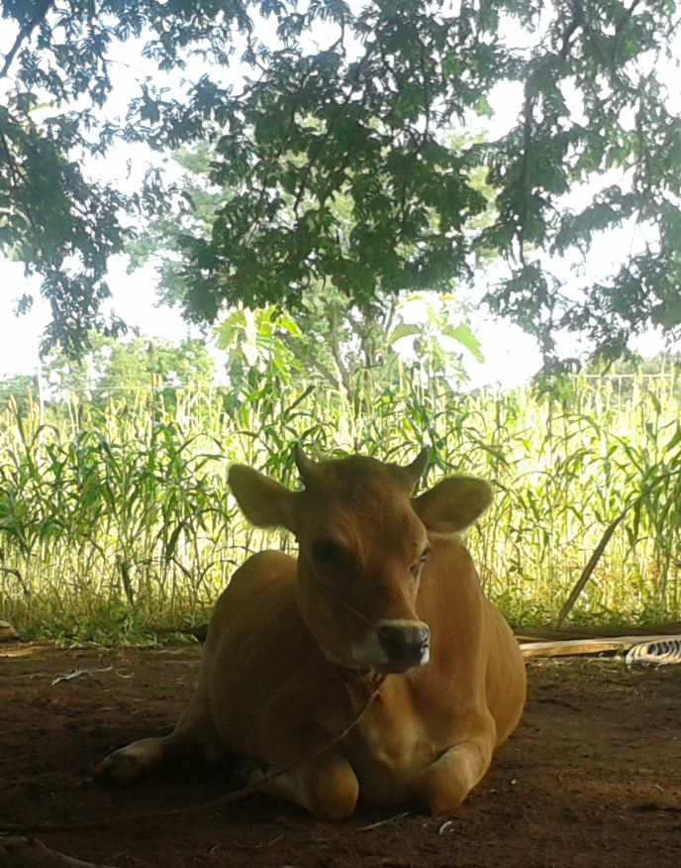
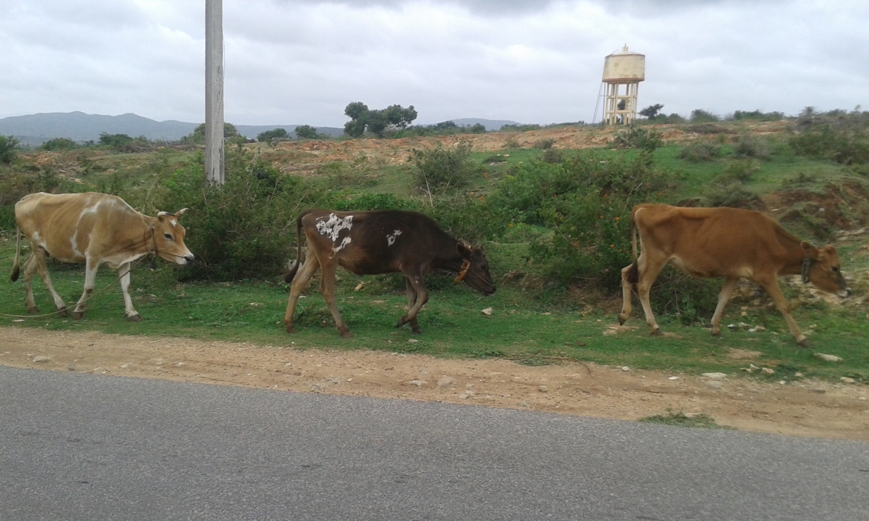
White Revolution
Milk Collection in every village
(cooperatives)
encourager et augmenter la production laitière
Production = irrigation users, rainfed and landless farmers

Slide 16
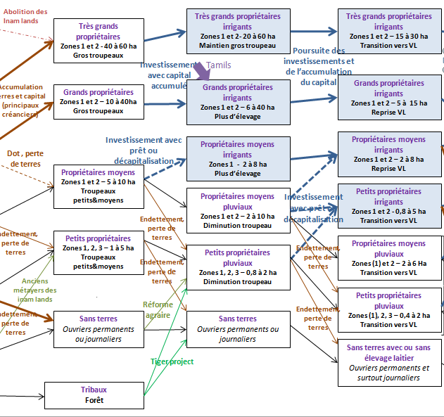
1990
2005
1970
Dairy production
Cane residues,
Crop residues
And concentrate
Dairy production
Grazing
Crop residues
And concentrate

Slide 17
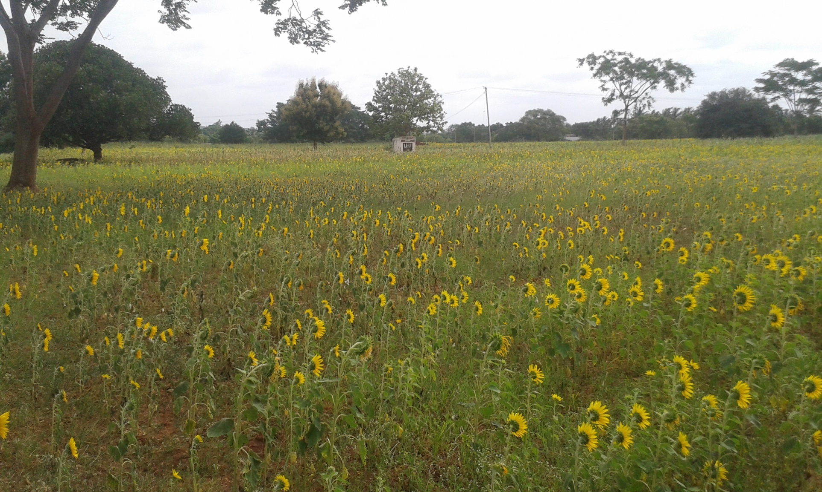
2005 to present
Groundwater resource depletion

Slide 18
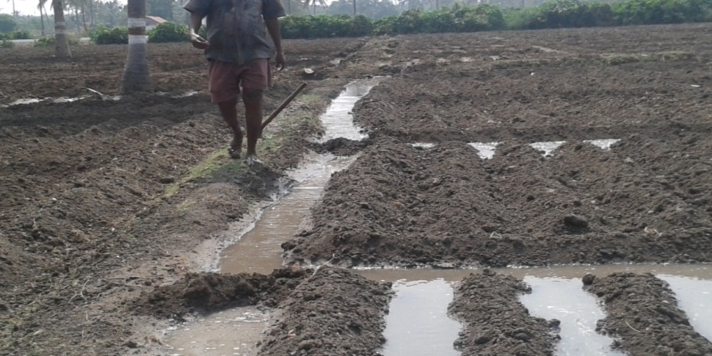
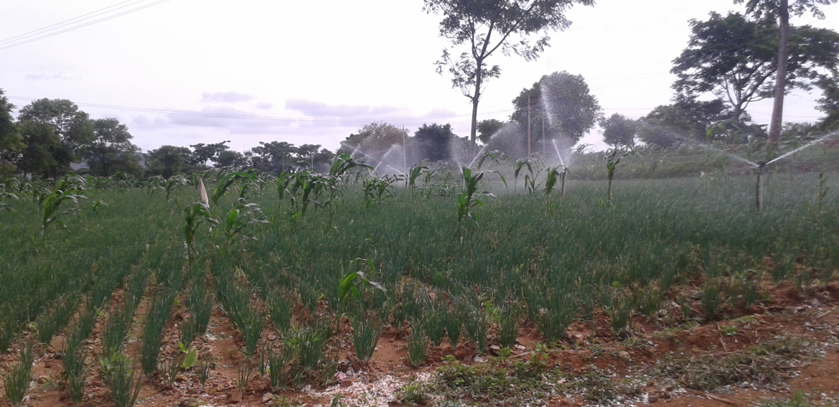
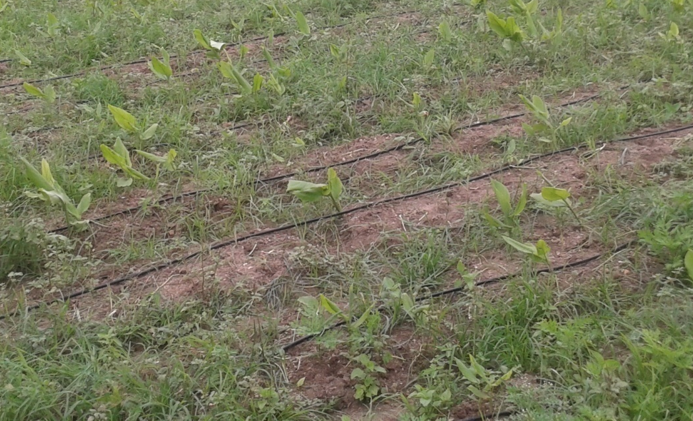
Adaptation of techniques
From furrow irrigation …
To spriklers…
Then drip irrigation

Slide 19
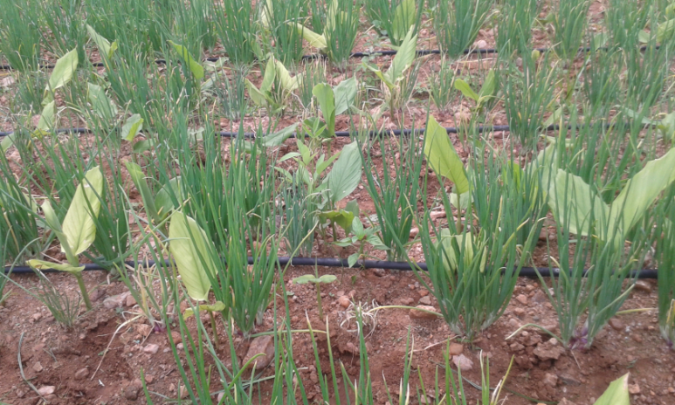
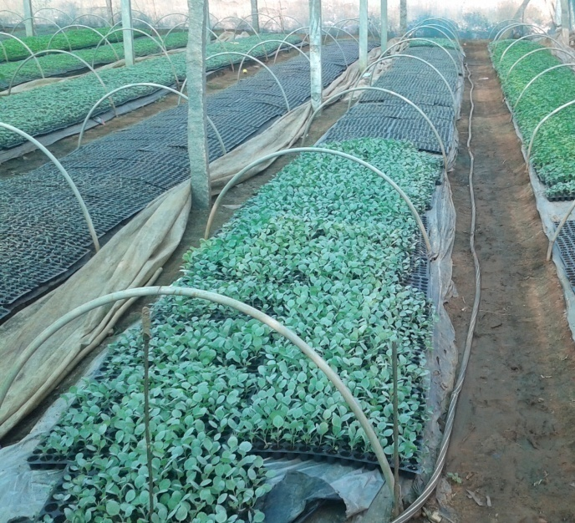
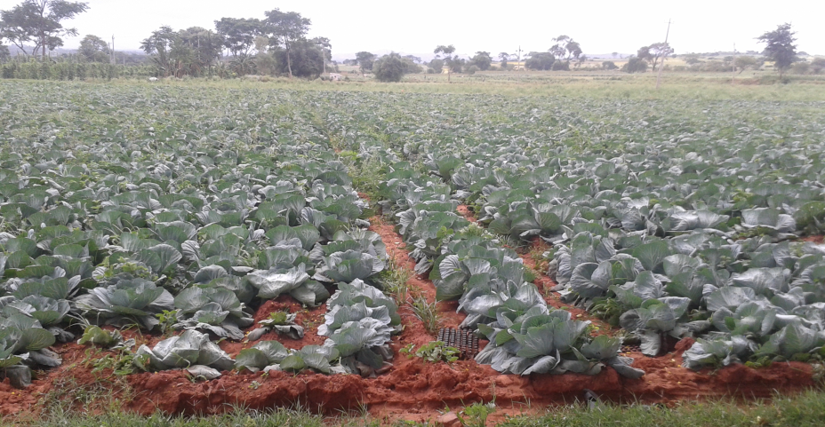
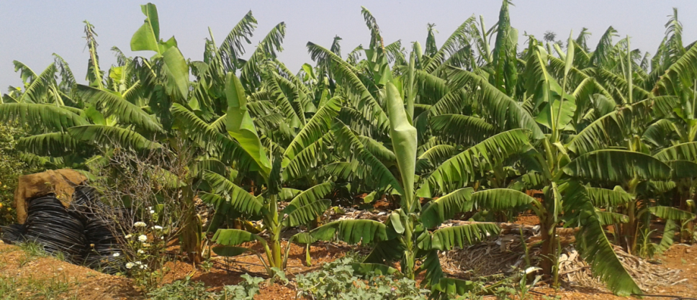
Adaptation of crops
Décline of sugar cane,
Increase of turmeric with associated crop
(garlic, onion, chilly)
Horticulture
Banana

Slide 20
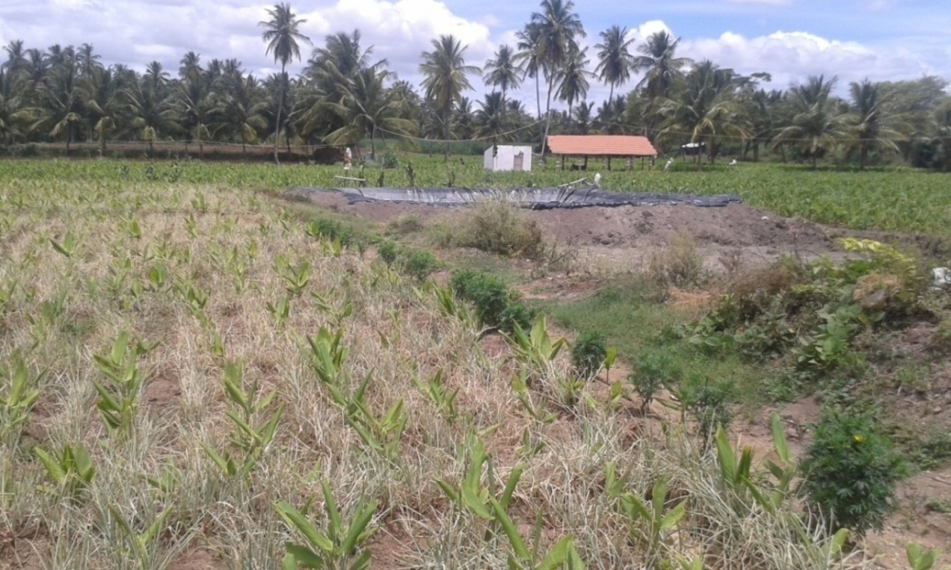
More capital intensive… small irrigation users can’t follow…

Slide 21
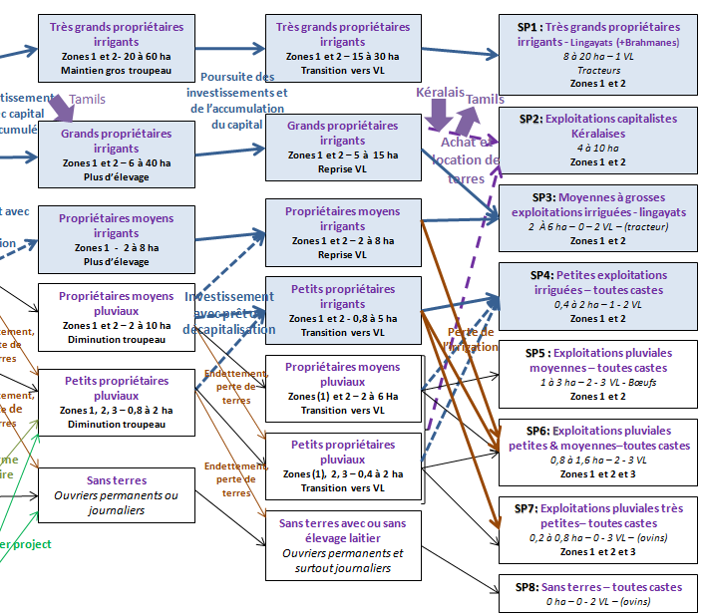
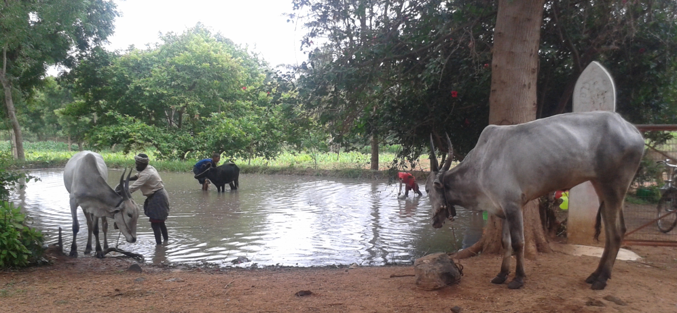
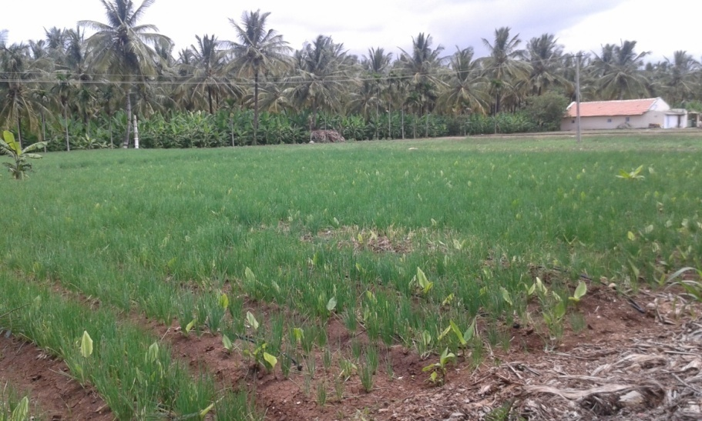
2005
present
Big irrigated farms
SP1=about 10 households
SP3 =about 500 households

Slide 22
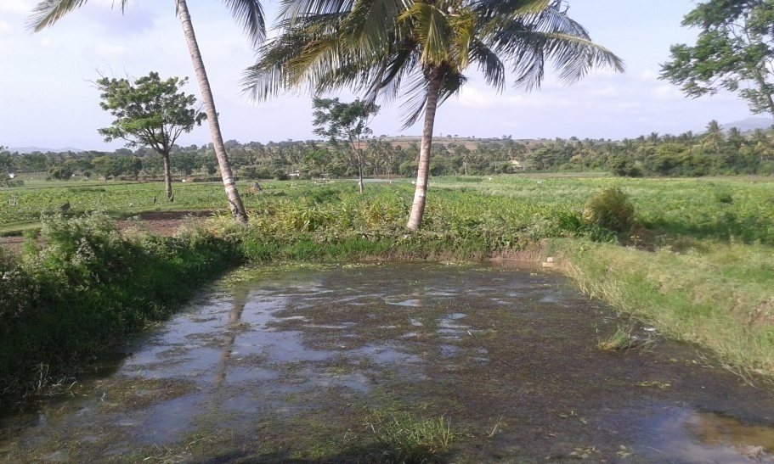
Small irrigated farms
SP4 = about 1000 households

Slide 23
Medium and Small rainfed farms
and landless farmers
= several 1000s of households

Slide 24
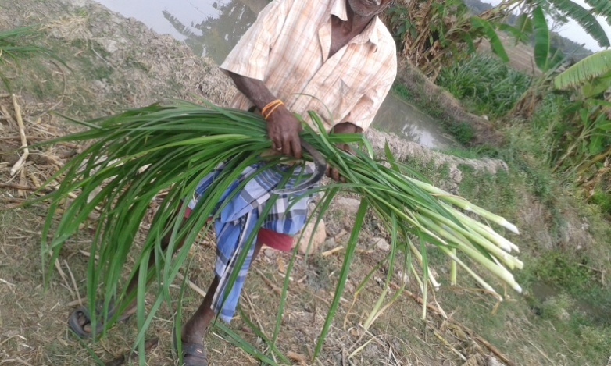
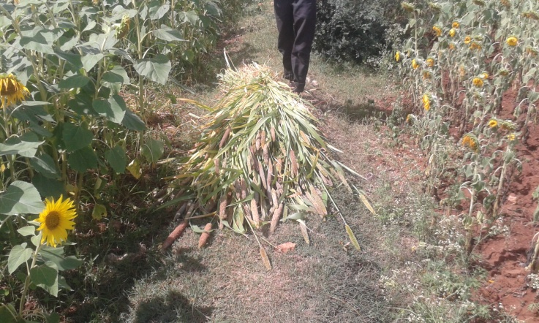
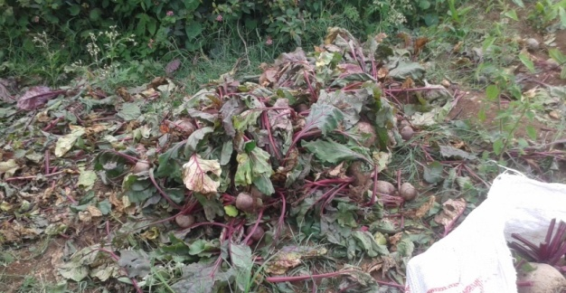
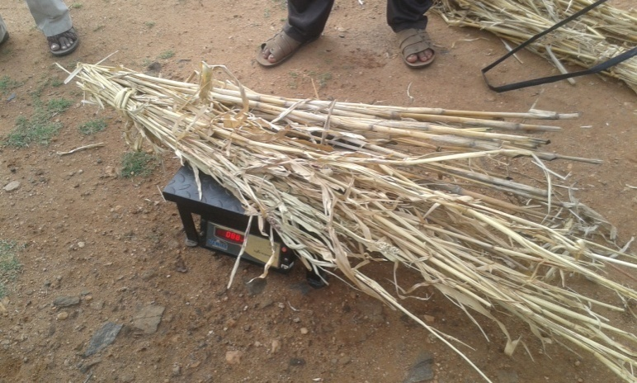
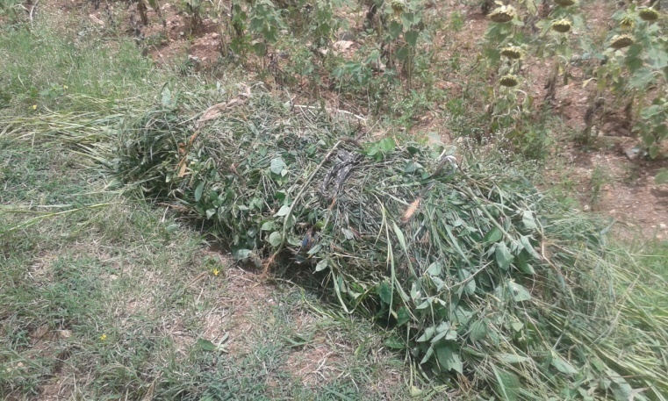
Milk production :
Irrigated fodder crops & concentrates
Milk production of rainfed and landless farmers :
Grazing, crop residue, concentrates

Slide 25
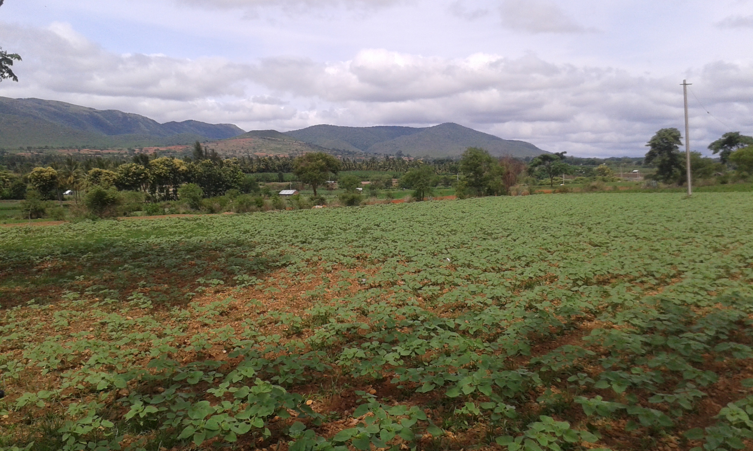
III. Economic analysis of production systems (based on modelled types)

Slide 27
Very small added value per work unit in rainfed farms
Net Added Value / agricultural work unit (AWU)
Capitalistic farms
Rainfed farms
UAA (utilised agricultural area ha)/agricultural work unit (AWU)

Slide 28
irrigation seems to be the only way to increase work productivity in small farms….
Net Added Value / agricultural work unit (AWU)
UAA (utilised agricultural area ha)/agricultural work unit (AWU)

Slide 29
… and agricultural income (depending on loan burden)
agricultural income (Rs) / Family Work Unit
Loans
interests
Income
comprises
wages
300 €/an
For a
family of 4,
2 active,
2 children
Landless farmers « specialized » can have higher income than some small rainfed farmers
UAA (utilised agricultural area in ha)/family work unit

Slide 30
Milk is essential for rainfed farms
But limited by forage availability

Slide 31
Much more in the report to come (december)
Summary
Important evolution of farms in recent past
depending on capital, water availability
Some doing well…
Many farmer back to rainfed agriculture (more East of Gundlupet) or became landless
Importance of livestock :
  land fertility / income from milk
  But limited by forage availability

