Slide 1
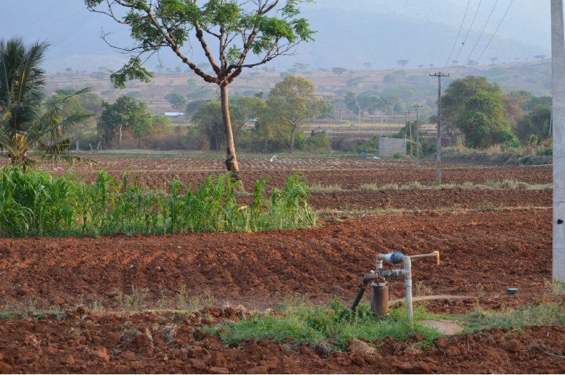

Accompanying
The adaptation of irrigated
agriculture to climate
CHAnge
AICHA ATCHA HAI
= AICHA IS ATCHA
= AICHA IS GOOD!

Slide 2
Short history of Indian Agriculture…
British Rule : landlords & plantations
1947 Land reform Obj = Equity
1960s Green revolution Obj = Food self-sufficiency
Source: FAOSTAT
Cereals Import / Export Mt
population
Total and Rural

Slide 3
GREEN REVOLUTION = GENETICS + FERTILIZERS + PESTICIDES + TRACTORS
GREEN REVOLUTION = GENETICS + FERTILIZERS + PESTICIDES + TRACTORS + IRRIGATION
Cereal production India (Mt)
Cereal Yield India (t/ha)

Slide 4
GREEN REVOLUTION = GENETICS + FERTILIZERS + PESTICIDES + TRACTORS + IRRIGATION
Cereal surface India (Mha)

Slide 5
Agricultural area (ha) / rural inhabitants
(survival threshold = about 0.2 ha)

Slide 6
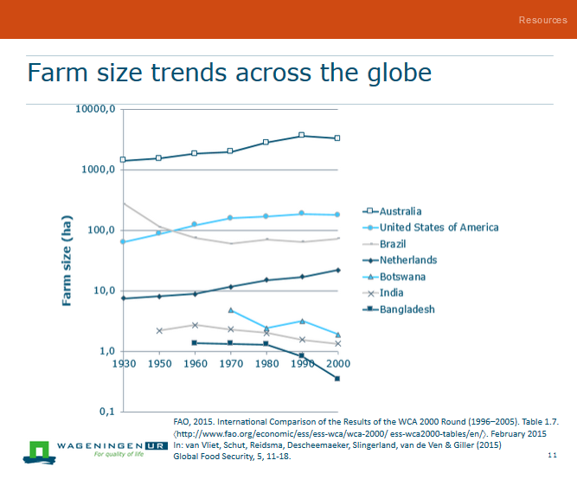
GREEN REVOLUTION = GENETICS + FERTILIZERS + PESTICIDES + TRACTORS + IRRIGATION

Slide 7
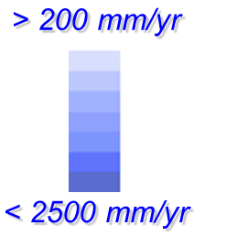
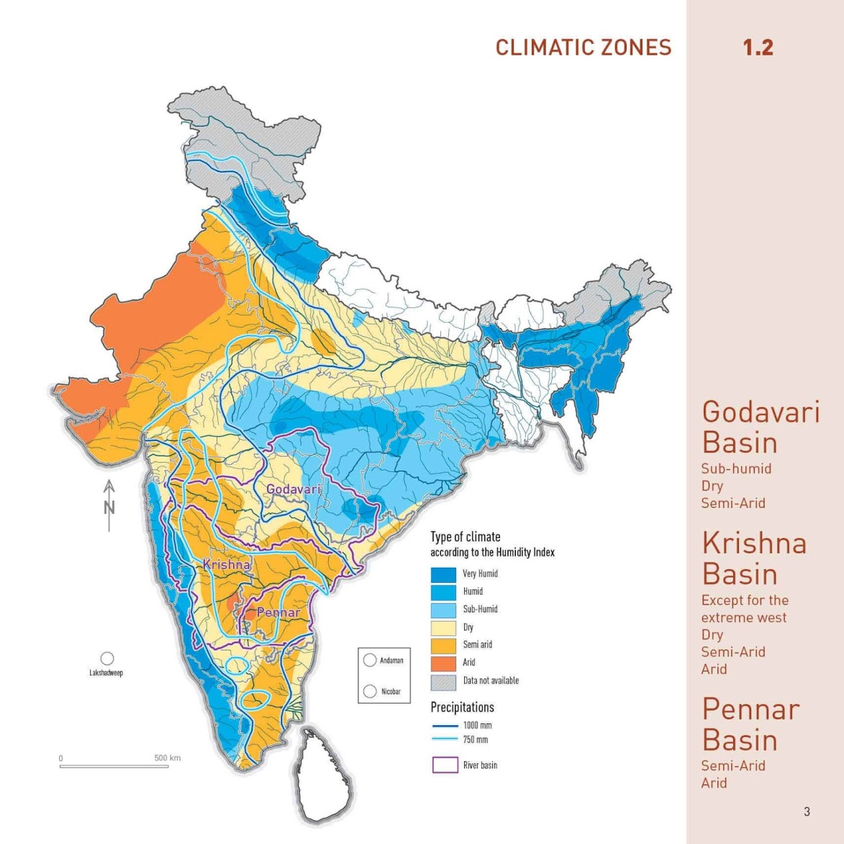
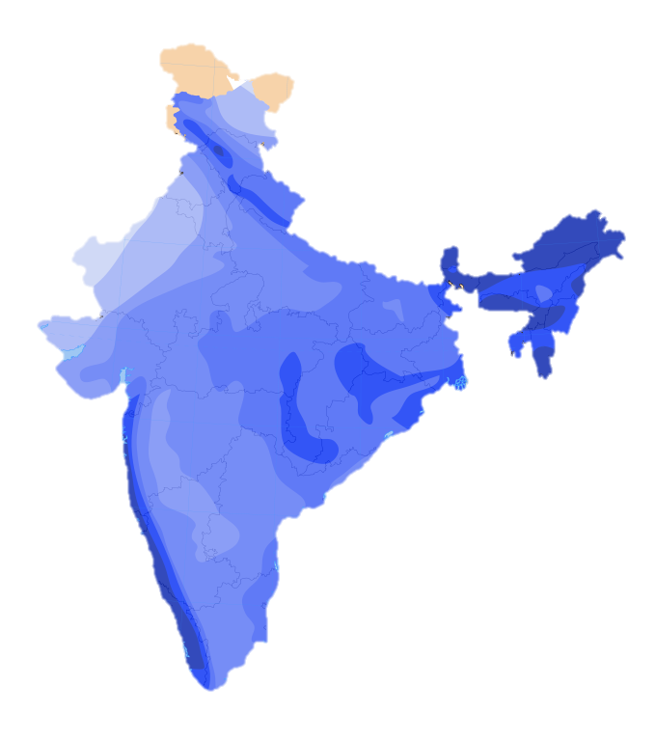
GREEN REVOLUTION = GENETICS + FERTILIZERS + PESTICIDES + TRACTORS
GREEN REVOLUTION = GENETICS + FERTILIZERS + PESTICIDES + TRACTORS + IRRIGATION
Specificity of water resources in India
Heterogeneous rainfall distribution
(space & time)
http://water-atlas.blogspot.in/p/chapter-1-andhra-pradesh-in-india.html
700 < P < 1000 mm
1200 <PET< 2000 mm

Slide 8
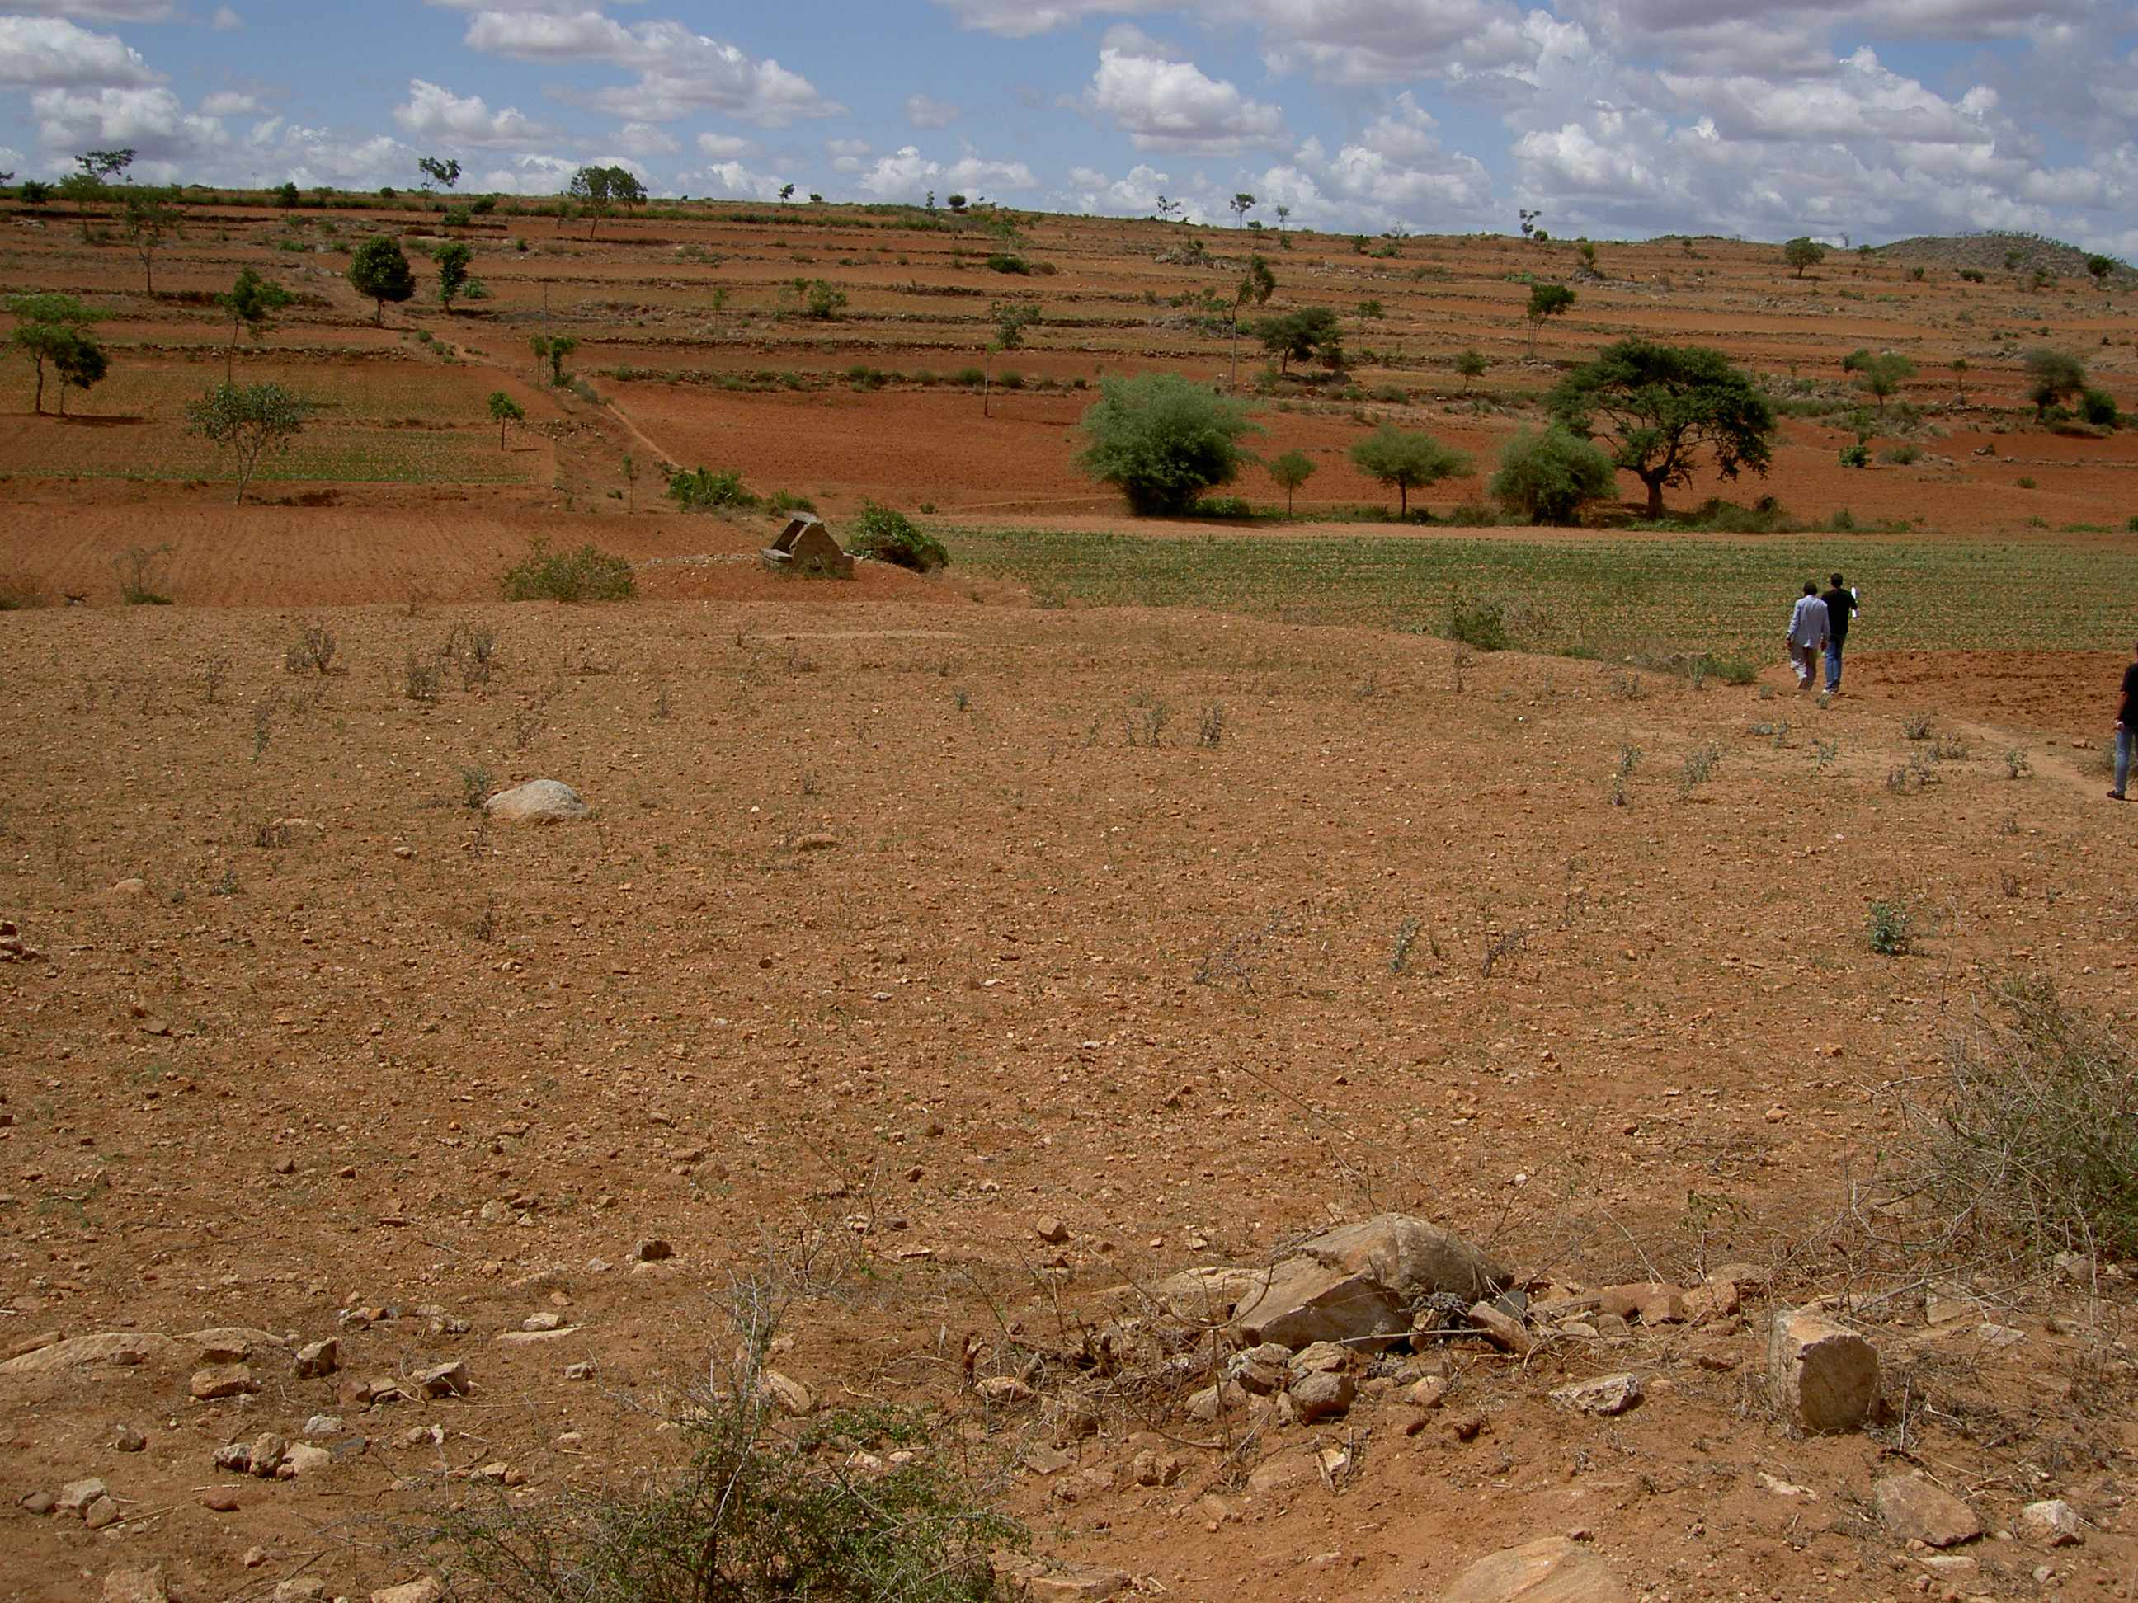
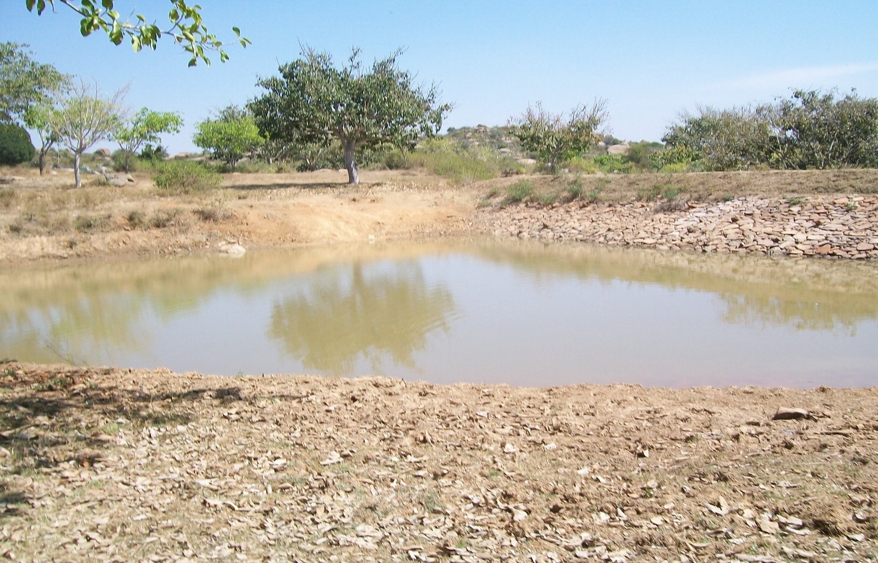
Until 19th century = mostly rainfed agriculture
+ few wells + traditional tank system

Slide 9
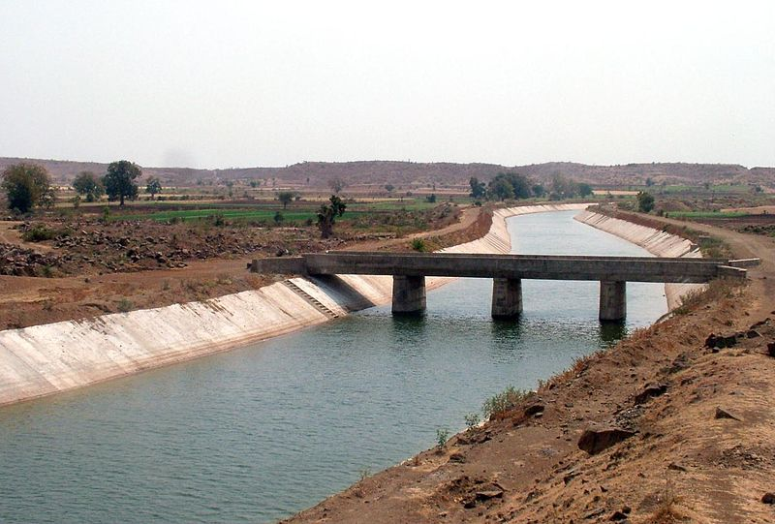
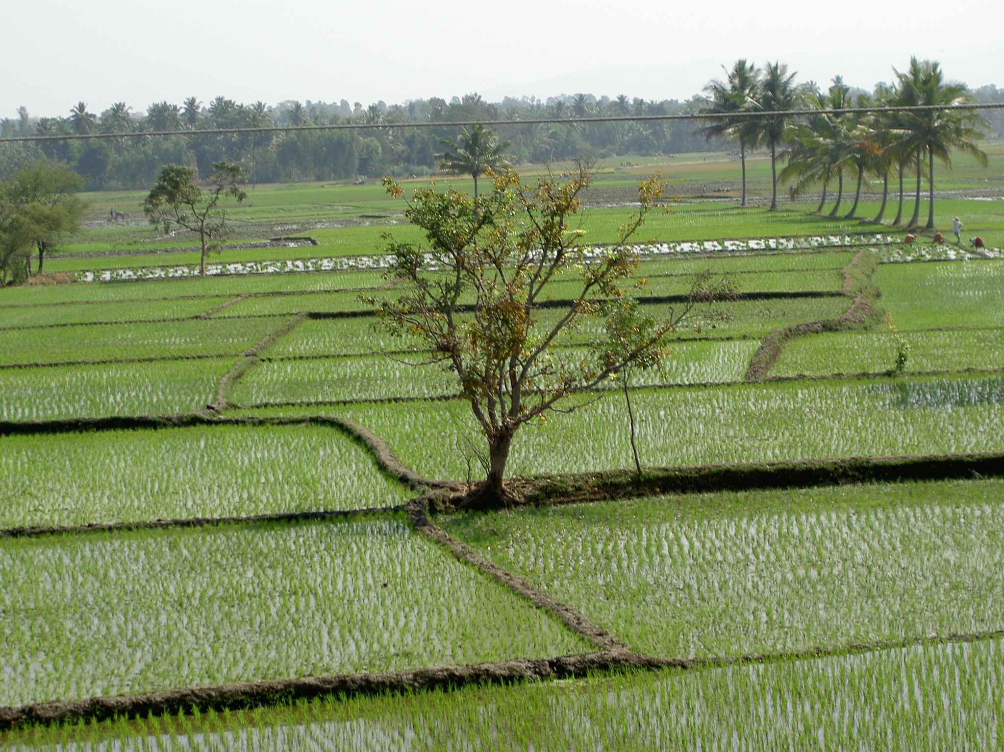
1830s until 1980s = from colonial time -> green revolution
Major irrigation
Saturation of areas / social and environmental cost

Slide 10
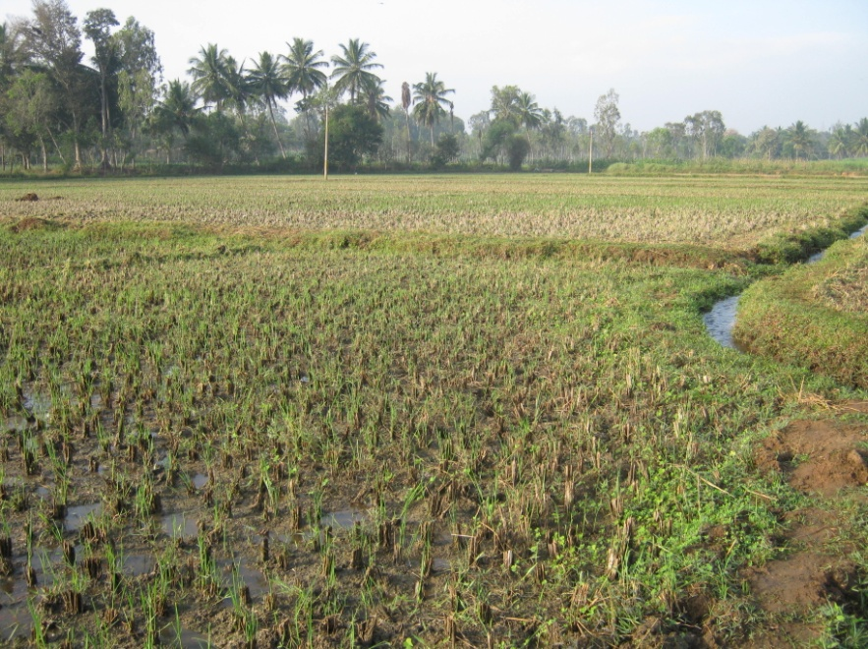
Source : NBSS&LUP Bangalore
Salinity in Mandya district
Very gently sloping canal irrigated midlands, S.No.158, Kyathaghatta village
Most part of the area in the village is affected by salinity
Economic loss : >Rs 1000 crores/year
(6.5 million $)

Slide 11
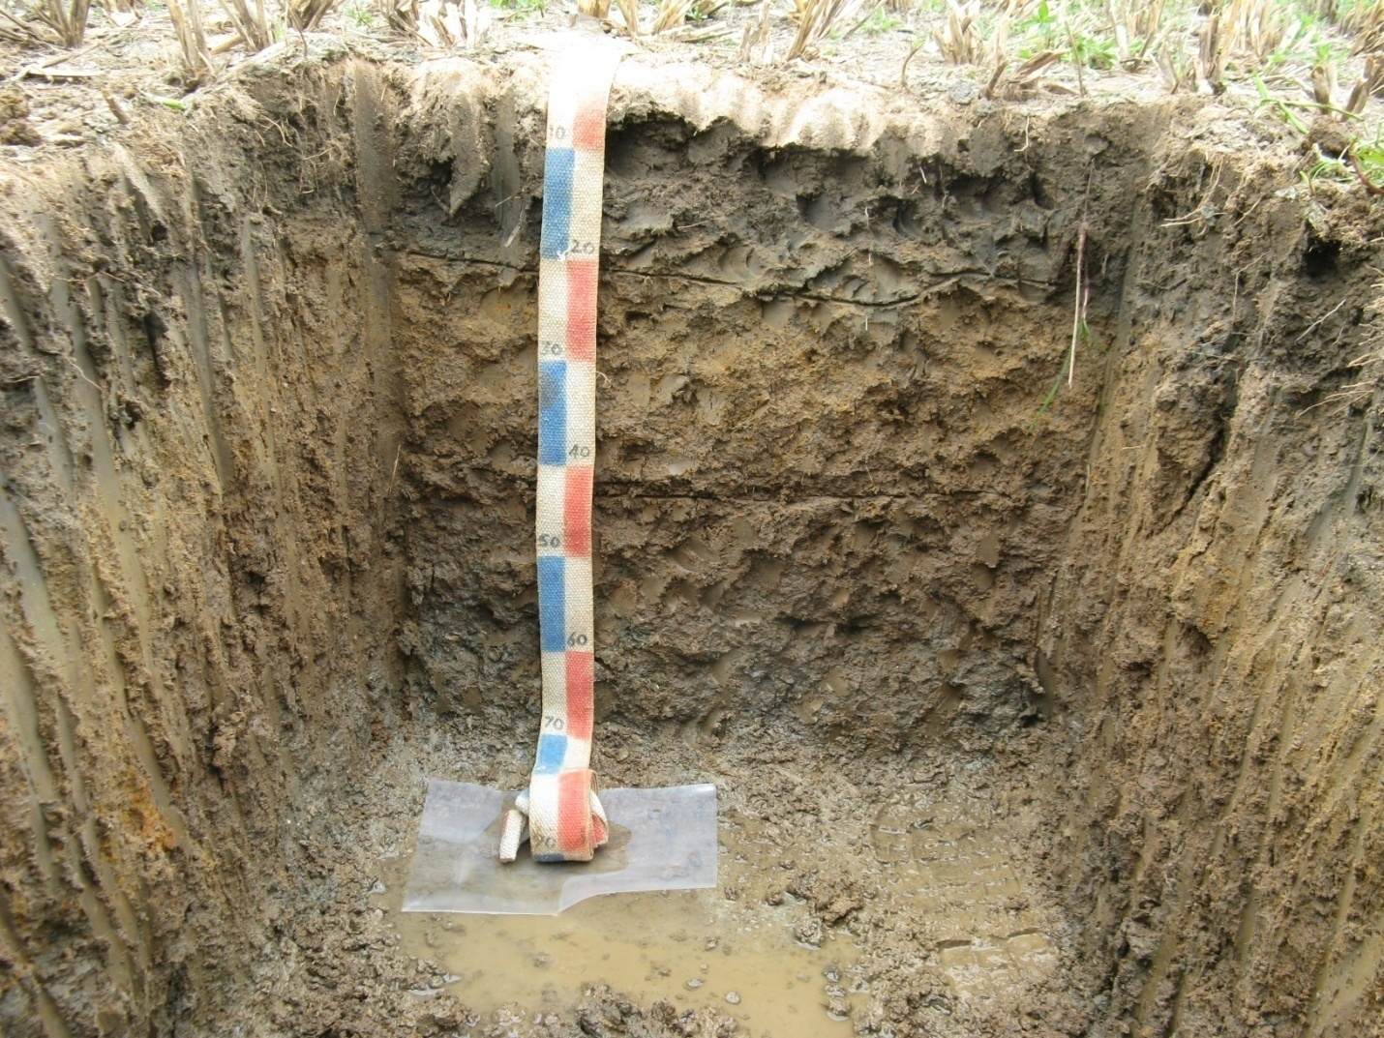
Source : NBSS&LUP Bangalore
Many villages in the command area are affected by salinity
Uncontrolled irrigation, rising water table and high rate of evaporation favour salinisation in the area

Slide 12
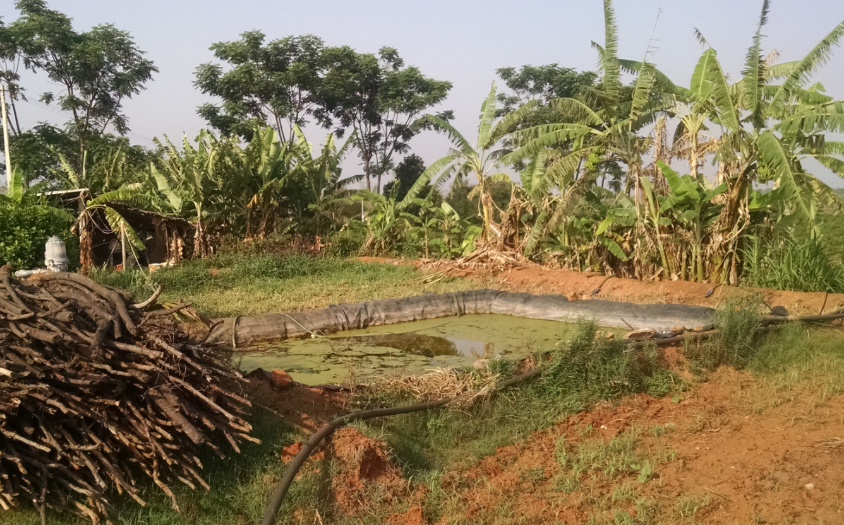
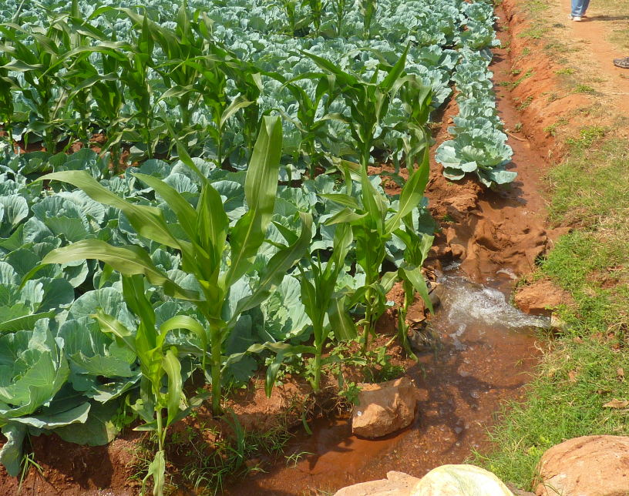
1980s :
Technology of
submersible pump
Become affordable :
Tubewells = Minor irrigation
PUMP
REVOLUTION!
(Molle et al. 2003)

Slide 13
INDIAN CONTEXT: Agricultural groundwater use
linkage with electricity supply (Water – Food – Energy nexus)
Strong growth of electricity consumption
UNESCO (2012)
Growth of installed capacity
INDIA
20-30% of electricity is for GW pumping !)
USA
25+ million wells (3+ China, 1+ USA)

Slide 14
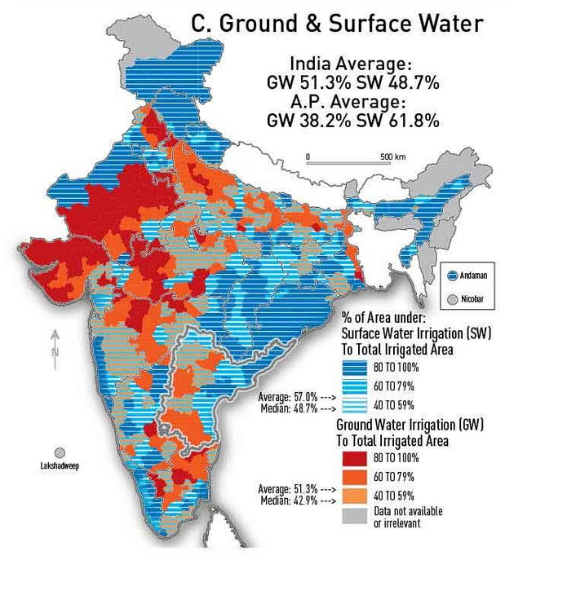
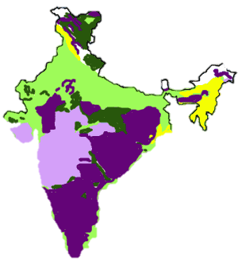
> 50% irrigation water = groundwater
2/3 Peninsular India => hard rocks
(low water storage)
160 million ha cultivated
about 1/3 irrigated :
22 million ha canals
39 million ha groundwater wells
http://water-atlas.blogspot.in/p/chapter-1-andhra-pradesh-in-india.html

Slide 15
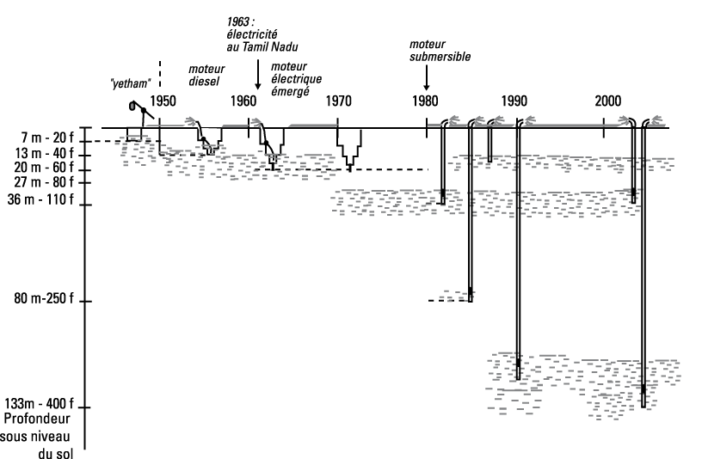
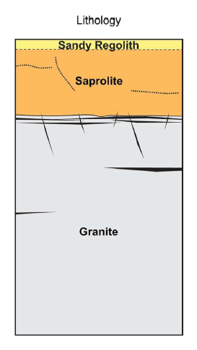
Olivia Aubriot. L'eau souterraine en Inde du sud. Un savoir réservé aux nouveaux maîtres de
l'eau?. Construire les savoirs dans l'action. Apprentissages et enjeux sociaux en Asie du Sud,
Edition de l'EHESS, pp.26, 2011, collection Purusartha 29
Boisson et al, 2015

Slide 16
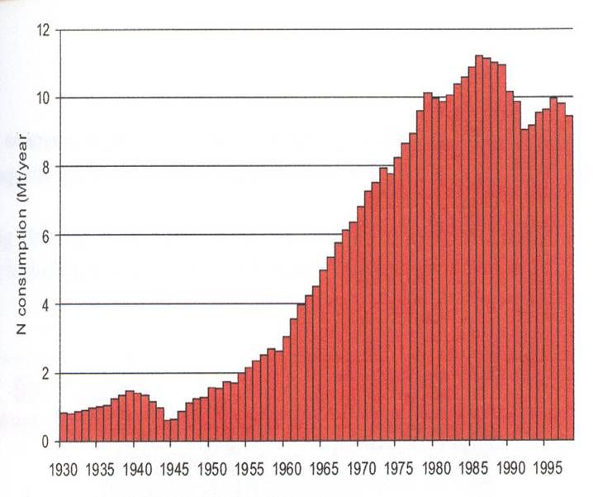
GREEN REVOLUTION = GENETICS + FERTILIZERS + PESTICIDES + TRACTORS + IRRIGATION
Ministry of Agriculture, Govt. of India,
Fertilizer Association of India
NPK Consumption
1970- 2010
India (Mt/year)
NPK Consumption EUROPE (15 countries)
1930-1999 (Mt/year)

Slide 17
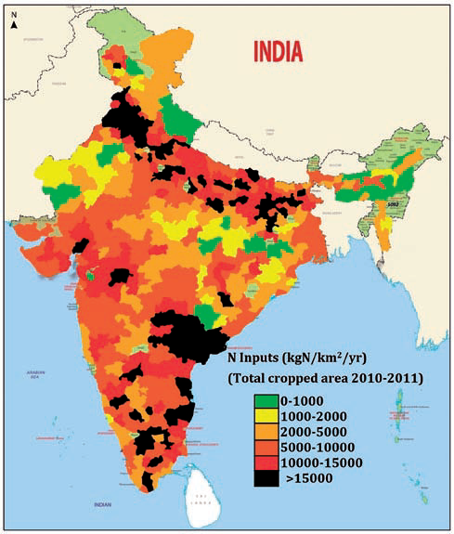
Heterogeneity of N inputs in agriculture
N inputs
2010-2011
Almost no consumption in North East
High in Indo-gangetic plain and south peninsula
Ministry of Agriculture, Govt. of India, & Fertilizer Association of India

Slide 18
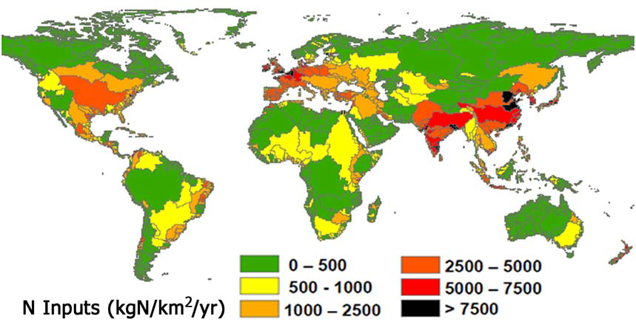
Example: Estimated net anthropogenic nitrogen inputs to the world’s main river catchments
Source: Sutton et al., 2013
Global issue linked with impact of agriculture
on water resources (quantity and quality)
Western Europe and South Asia among the most impacted
Needs to be addressed in a integrated way
18
Notes:
Western India

Slide 19
Accompanying
The adaptation of irrigated agriculture to climate
CHAnge
Objective: implement an Integrated Modelling and Assessment approach
with stakeholders to co-build and assess scenarios of sustainable development
of agriculture in Karnataka in the context of climate change.
Build on
- the knowledge gained through the ending project AICHA (2013-2016)
on the processes and drivers governing groundwater sustainability
and farmer adaptation
- The connection established with the project SUJALA-III (2014-2019, World Bank).

Slide 20
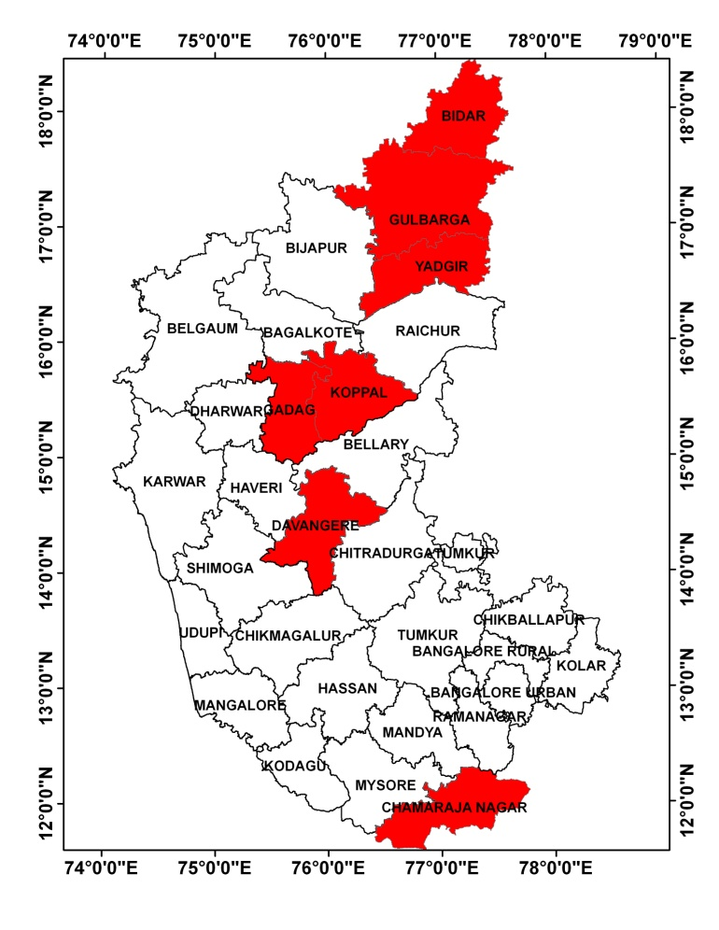
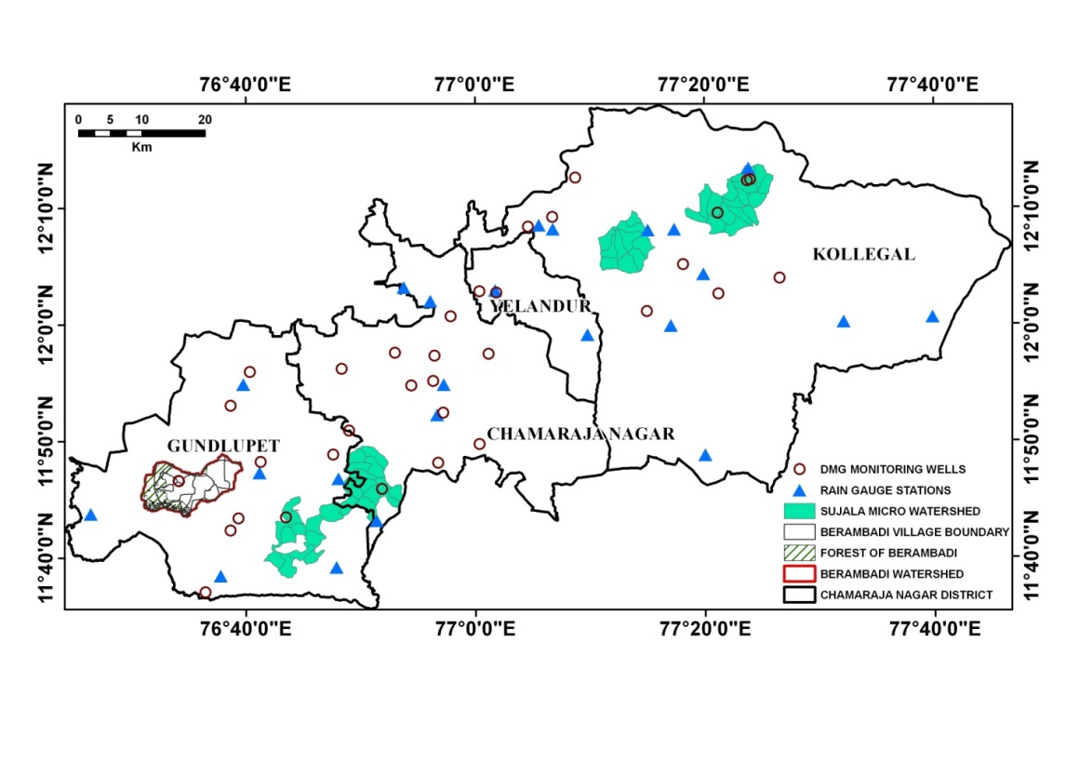
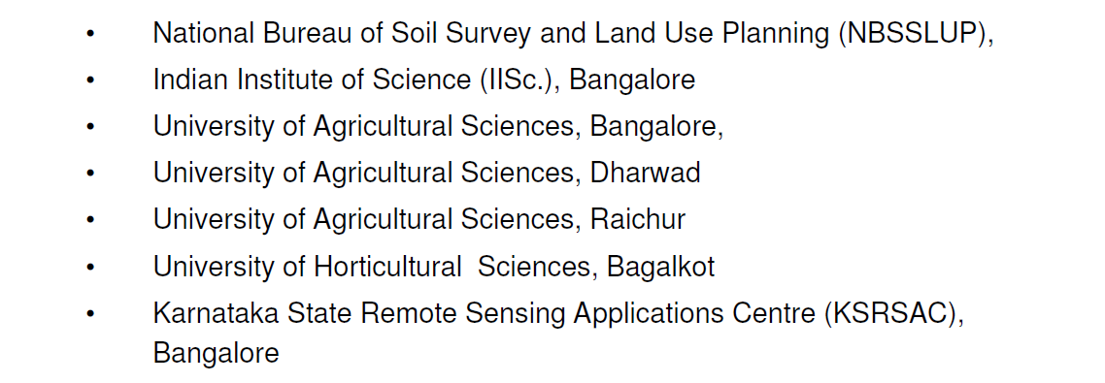
WAY FORWARD:
Co-building scenarios with stakeholders
Sujala III Project
2014-2019
Karnataka
Watershed
Department
Partners:
World Bank funded project for Intensive hydrological research in 14 micro-watersheds in 7 districts of Karnataka
Barambadi as a model : IISc (M Sekhar)
in charge of 3 micro-watersheds

Slide 21
Accompanying
The adaptation of irrigated agriculture to climate
CHAnge
Two main scientific hypotheses:
in hard-rock aquifers, management of groundwater resources in a changing climate
must take into account spatial interactions and feedback
between biophysical and socio-economic drivers influencing farmer decisions
2) integrated models and scenarios are boundary objects that can help,
through participatory processes, bridging the gaps between the knowledge produced,
used and needed both by scientists and stakeholders

Slide 22
ATCHA Partnership
French (14)
UMR SAS Rennes / UMR SELMET
UMR AGIR Toulouse / UR MIAT RECORD
UMR EMMAH Avignon / UMR LISAH / UR AGROCLIM/ UR AgroImpact
UMR TSE-R Toulouse
UMR GET Toulouse / UMR CESBIO / UMR LA
UR2 UMR LETG-COSTEL Rennes
Indo-French (2)
IFP Pondicherry
Indo-French Cell for water Sciences (LMI CEFIRSE)
Indian (3+)
Indian Institute of Science
ATREE
Watershed Development Department + Sujala-III partners
ICAR-NBSS&LUP, UAS Bangalore, UAS, Raichur, UAS Dharwad, UHS Bagalkot,
KSNDMC, KSRSAC

Slide 23
WORKPACKAGES
WP1: Building methodology to collect adequate spatial database for modelling (S Buis)
Task 1.1: Modelling land use and land cover change using multi satellite high resolution data.
Task 1.2: Digital Soil Mapping for spatial modelling .
WP2: Bridging knowledge gaps for agro system modelling in the tropics (J Riotte)
Task 2.1: Calibration and evaluation of the STICS crop model for a sufficient variety
of crops under tropical conditions
Task 2.2: Modelling nutrient cycling in irrigated tropical agro-systems.
Task 2.3 Modelling water fluxes
WP3: Sharing knowledge through scenarios (Coord JE Bergez)
Task 3.1: Scenario Design and Assessment
Task 3.2: Agrarian system analysis and ethnographic approach
to support the participatory process
WP4: Coordination, modelling, dissemination and capacity building (Coord. H Raynal)
Task 4.1 Coordination
Task 4.2 Integrated modelling under the RECORD platform
Task 4.3 dissemination and capacity building:

Slide 25
Time | Item | Lead | Notes
09:00 | Presentation of ANR ATCHA Presentation Sujala-III Project INRA metaprograms | L Ruiz M Sekhar C Gascuel-Odoux | AICHA ATCHA HAI
10:00 10:20 10:40 11:00 11:20 11:40 12:00 12:20 12:40 | Session 1 : methodology to collect adequate database for modelling 1.1 Land Use Land Cover 1.2 DIGITAL SOIL MAPPING Coffee Break Session 2 : crop and nutrient cycling 2.1 STICS CALIBRATION 2.2. NUTRIENT FLUXES 2.3 WATER FLUXES Session 3 : Sharing knowledge through scenarios 3.1 Scenario Design and Assessment 3.2 Agrarian system analysis/ ethnography Discussion | Coord. S Buis S Mangiarotti P Lagacherie Coord. J Riotte S Buis O Fovet/ J Riotte M Sekhar Coord. JE Bergez D Leenhardt A Richard-Ferroudji | Presentations 15’ each plus 5’ discussion Content : Objectives Methodology Data available Data needed partnership links with other tasks
13:00 | Lunch

Slide 26
Time | Item | Lead | Notes
2:00 2:20 2:40 3:00 3:20 3:40 4:00 | Session 4 : Coordination, modelling, dissemination and capacity building 4.1 Integrated modelling under the RECORD platform: 4.2 Budget / Organization of workshops Sessions 5 : Scientific presentations relevant to the project 5.1 Agrarian diagnostic of Gundlupet Taluk 5.2 Socio-hydrology 5.3 Ethnography 5.4 Assessment of Watershed development programs 5.5 Activities of CESBIO in India Sessions 6 : GENERAL DISCUSSION | Coord. H Raynal E Casellas L Ruiz C Aubron/ L Ruiz V.Srinivasan A Richard-Ferroudji S Badiger L Polidori | Presentations 15’ each plus 5’ discussion Content : Objectives Methodology Data available Data needed partnership links with other tasks Total 5 Presentations About 15’ each plus 5’ discussion
5:30 | End of the meeting

