Slide 1
ATCHA (2016 -2021)
WP1: Building methodology to collect adequate spatial database for modelling
Coordination : Samuel Buis
Task 1.1:
Modelling land use and land cover change
using multi satellite high resolution data
14/11/2016
Notes:
1

Slide 2
Task 1.1:
Modelling land use and land cover change
using multi satellite high resolution data
(S. Corgne, S Mangiarotti ; L Hubert-Moy ; L Ruiz ; M Sekhar)
main objective of this task is to develop a methodology which allows to Main objective : Identify not only the crop types but also characterize :
Associated agricultural practices (irrigation)
Phenological stages
Crop rotations (including intercrop and fallow periods)
Notes:
2

Slide 3
Task 1.1:
Modelling land use and land cover change
using multi satellite high resolution data
(S. Corgne, S Mangiarotti ; L Hubert-Moy ; L Ruiz ; M Sekhar)
Two temporal scales will be studied:
A long term analysis of irrigated area evolution since 1990’s.
A short term analysis on land use from 2011.
Notes:
3
Why these two scales?

Slide 4
Task 1.1:
Modelling land use and land cover change
using multi satellite high resolution data
(S. Corgne, S Mangiarotti ; L Hubert-Moy ; L Ruiz ; M Sekhar)
Two approaches will be investigated :
Data fusion combining radar and optical data
at high spatial and temporal resolution
(Sentinel-1 et 2, Radarsat-2, Spot 6/7…)
Chaos theory approach (S. Mangiarotti)
Notes:
4

Slide 5
Schedule
Notes:
5
DSM: Digital Soil Mapping
LULC: Land Use / Land Cover

Slide 6
Human resources
Engineer (1 year)
2 master 2 (Year 1 and 3 of the project)
Engineer of LETG Rennes
Amit K. Sharma (Thesis in Rennes 2)
Notes:
6

Slide 7
TOSCA PROGRAM
Irriga-Detection : Détection et caractérisation des cultures irriguées à partir d’une série d’images radar et optique à haute résolution spatiale et temporelle : Application au site expérimental du Berambadi en Inde.
- Coord. : S. Corgne
- Participants : L. Hubert-Moy, L. Ruiz, S. Mangiarotti, S. Muddu, G. Mercier, E. Pottier, J. Dezert, J. Betebeder, A. Thomas
Notes:
7

Slide 8
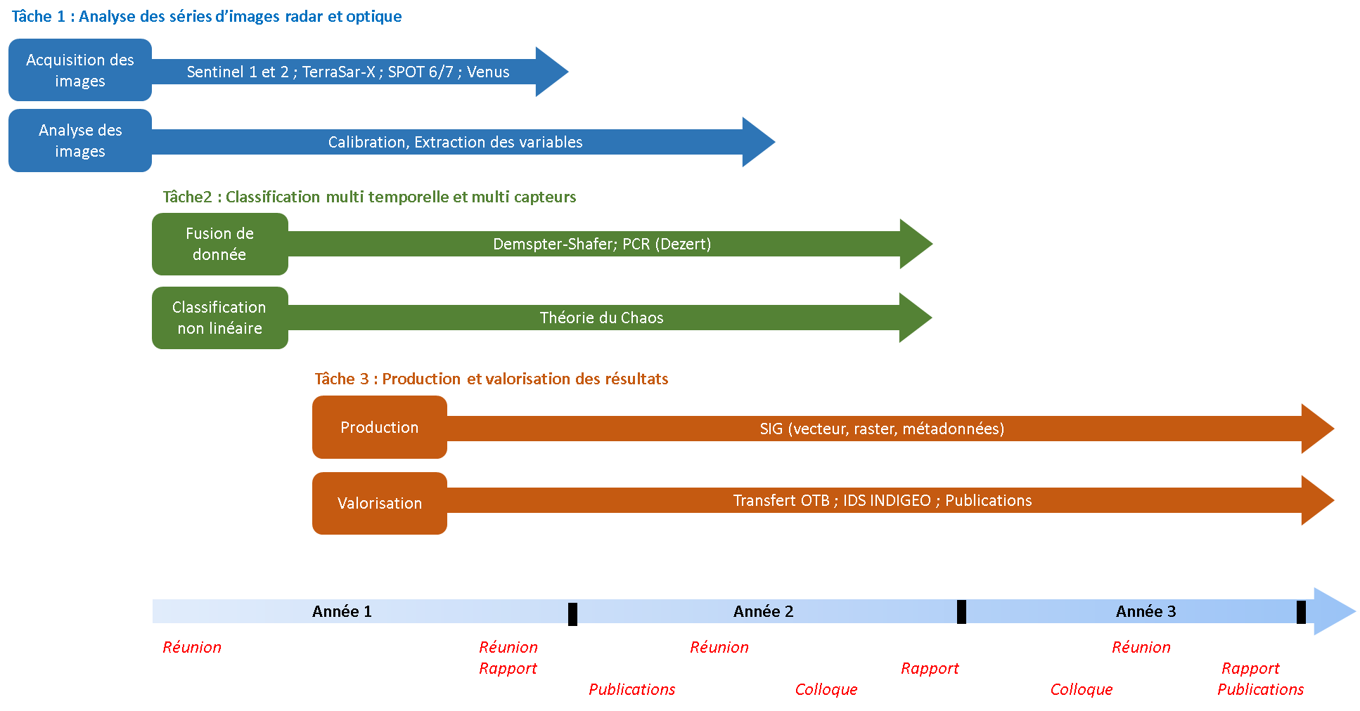
TOSCA PROGRAM
Notes:
8
Dempster-Shafer: approche de la théorie des croyances.
PCR: Proportional Conflict Redistribution
Approches probabilistes (bayesiennes) utiles pour combiner des données de sources hétérogènes

Slide 9
TOSCA PROGRAM
Start : March 2017 till 2020
Funding (CNES, TOSCA program): 65 K€
Engineer (2 years), Master 2, missions
Notes:
9

Slide 10
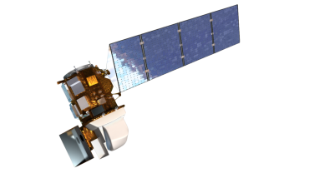







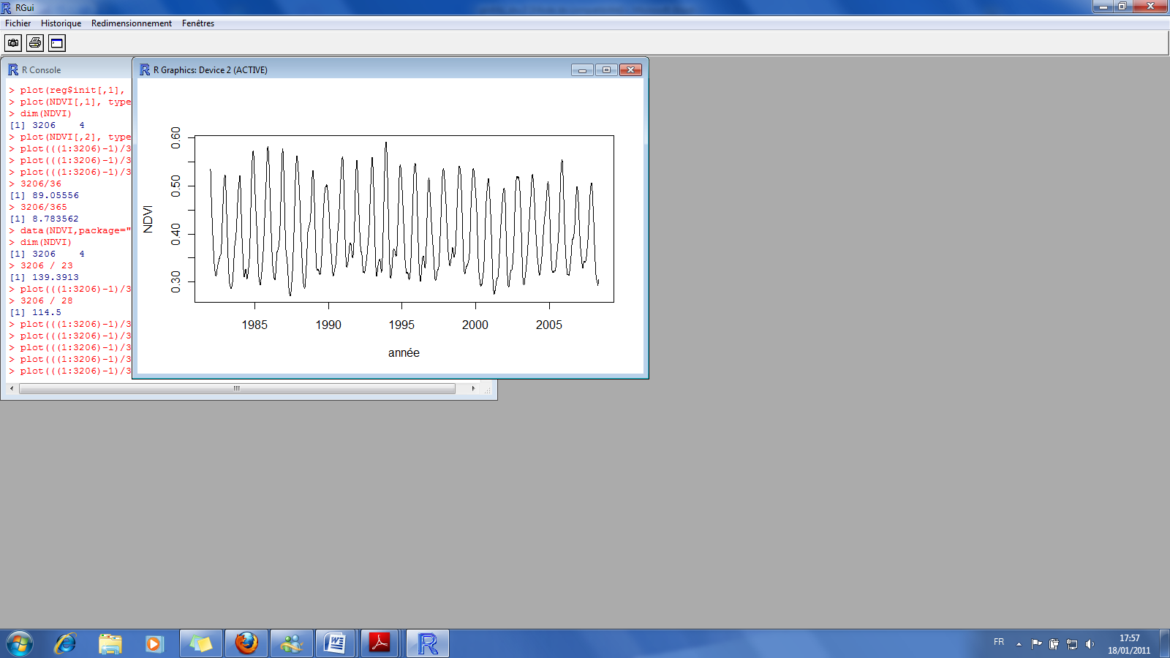
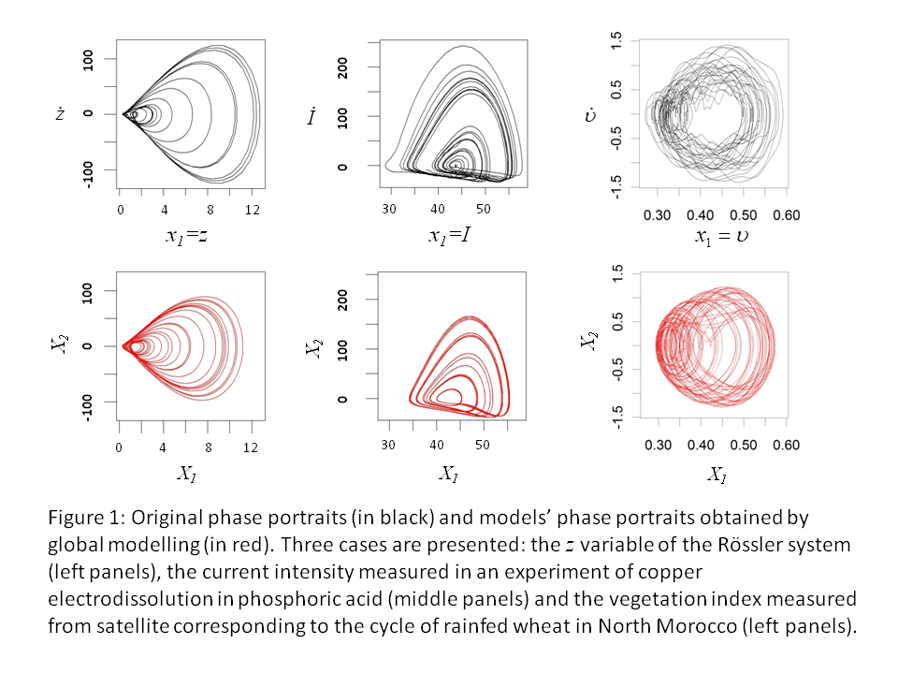
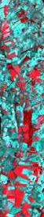
Chaos modelling applied to crops detection
in South India
S. Mangiarotti, A.K. Sharma, Sekhar M.,
L.Ruiz, S. Corgne, L. Hubert-Moy
V. Demarez, Y. Kerr , etc.
sylvain.mangiarotti@ird.fr
Original portrait
t
Model portrait
Poincaré section
1st weakly dissipative (D_{KY}=2.7)
ODE model
obtained from real world data
t
Mangiarotti et al. Chaos 2014

Slide 11
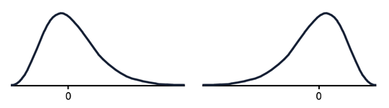
Chaos modelling applied to crops detection
in South India
S. Mangiarotti, A.K. Sharma, Sekhar M.,
L.Ruiz, S. Corgne, L. Hubert-Moy
V. Demarez, Y. Kerr , etc.
sylvain.mangiarotti@ird.fr
sunflower
…
bean
chili
?

Slide 12
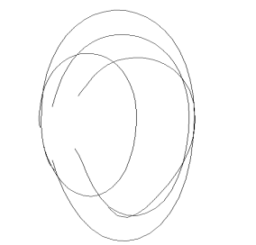
Chaos modelling applied to crops detection
in South India
S. Mangiarotti, A.K. Sharma, Sekhar M.,
L.Ruiz, S. Corgne, L. Hubert-Moy
V. Demarez, Y. Kerr , etc.
sylvain.mangiarotti@ird.fr
Ergodic hypothesis
Global
modelling

Slide 13
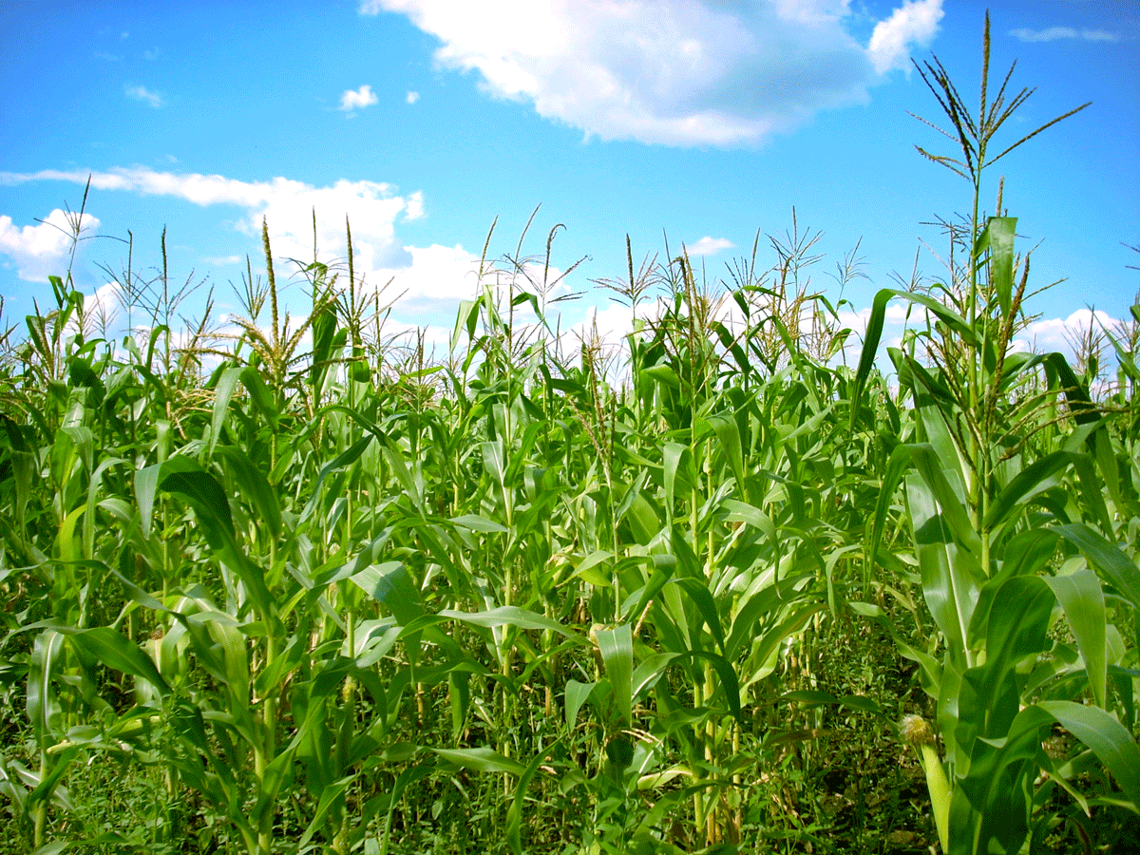
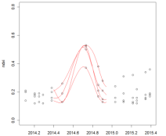

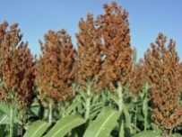
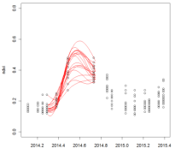
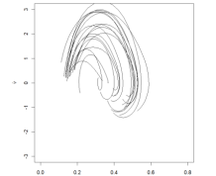

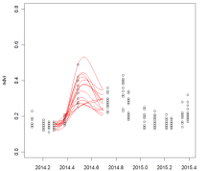
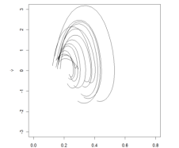
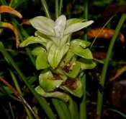
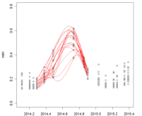
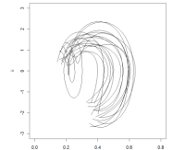
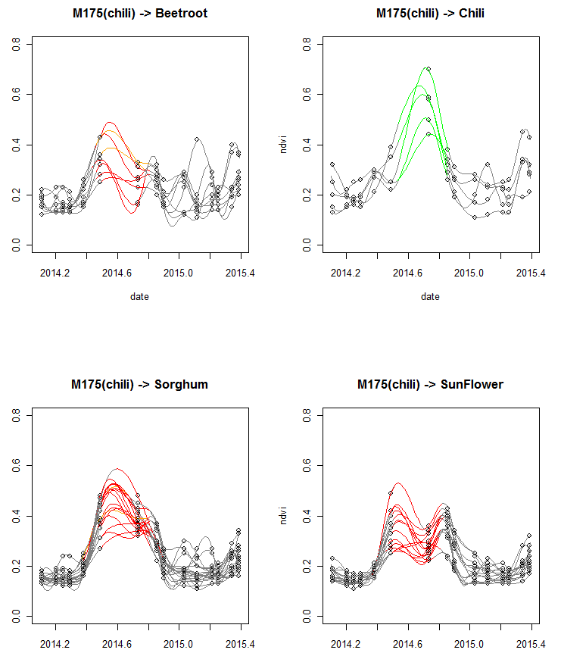
Maize
M_{Maize}
M_{Sorghum}
M_{Sunflower}
M_{Marigold}
M_{Chili}
M_{Beans}
M_{Beetroot}
M_{Banana}
M_{Garlic}
M_{Turmeric}
?
Sorghum
Phase space
Bank of models
Sunflower
M
…
…
…
…
Turmeric
100% ok
(5/5)
4% erroneous
(4/104)
Example:
Detection
statistics
M_{Chili}

Slide 14
Task 1.1:
Modelling land use and land cover change
using multi satellite high resolution data
(S. Corgne, S Mangiarotti ; L Hubert-Moy ; L Ruiz ; M Sekhar)
Any questions?
Notes:
14
Why these two scales?

Slide 16

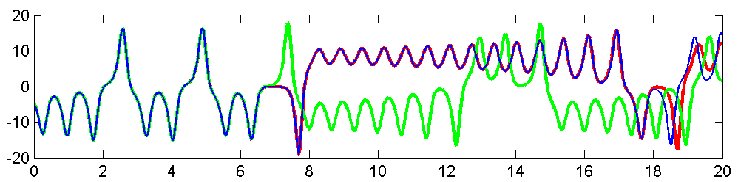
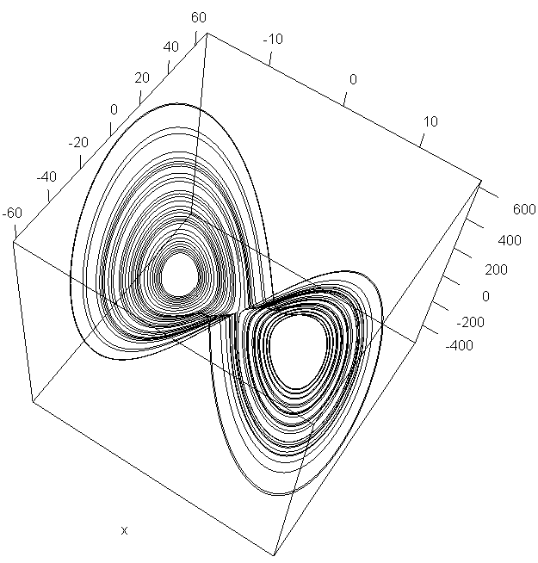
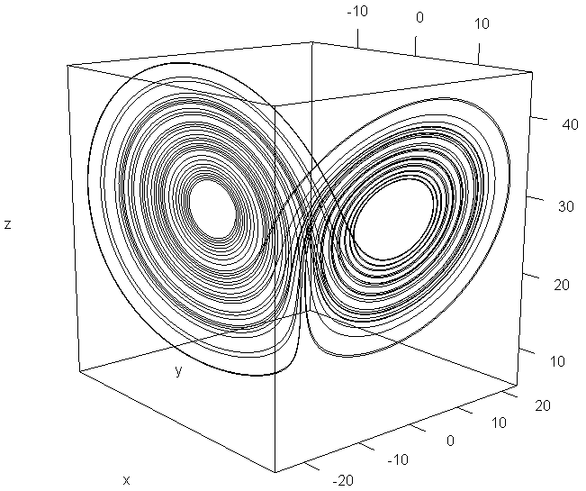
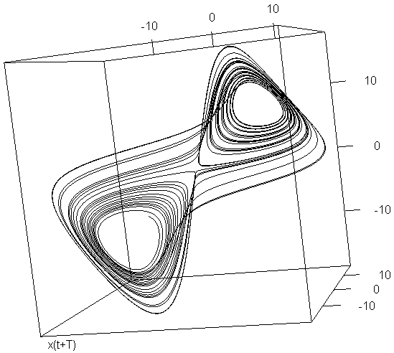
Theoretical background
Takens Theorem (1981)
F. Takens
z(t)
x(t +2 τ )
x(t)
x(t + τ )
y(t)
x(t)
Nonlinear invariants are conserved

Slide 17

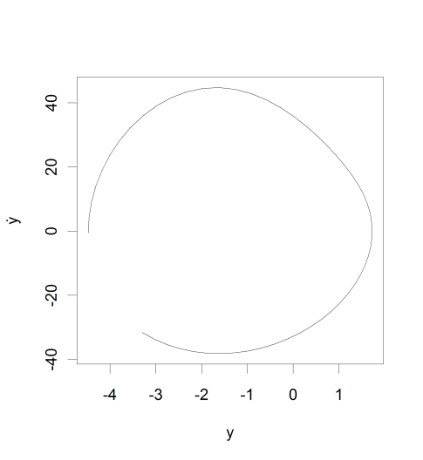
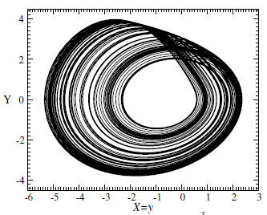
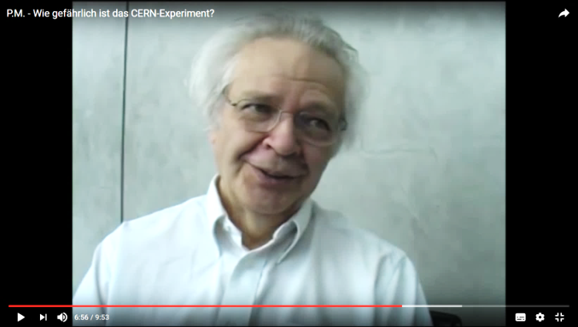
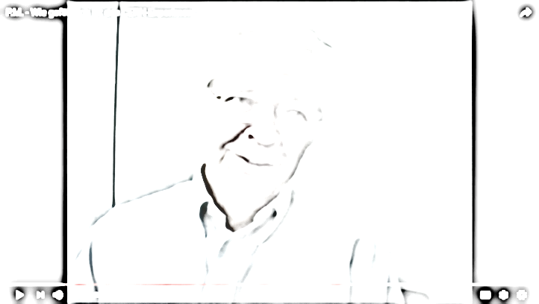
Examples
GPoM platform, the potential of the approach
Rössler-y
Unstable periodic orbits (e.g. period 1)
Original system
y
y
O. Rössler
Letellier, Mangiarotti & Aguirre (under revision)
Letellier et al., Entropie 1997

Slide 18
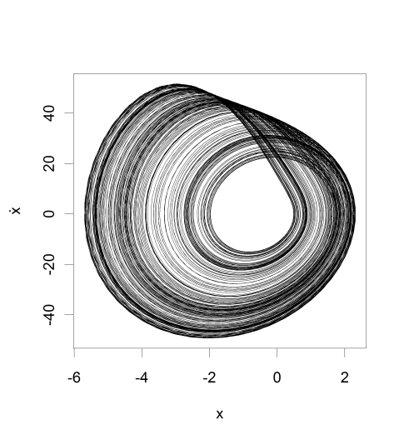

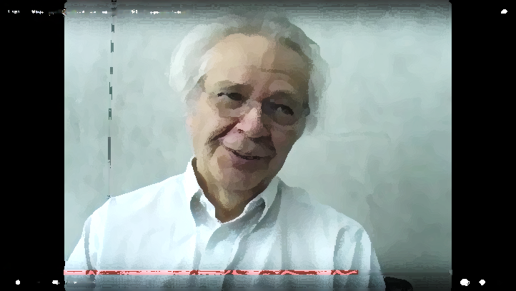
Examples
GPoM platform, the potential of the approach
Rössler-y
Unstable periodic orbits (e.g. period 1)
Global model
Original system
y
y
X₁
O. Rössler
Letellier, Mangiarotti & Aguirre (under revision)
Letellier et al., Entropie 1997

Slide 19


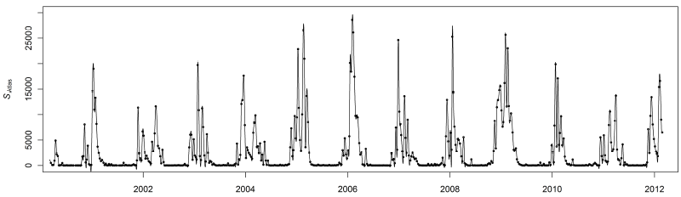
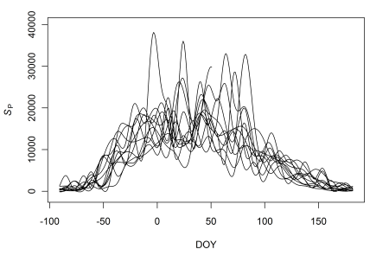
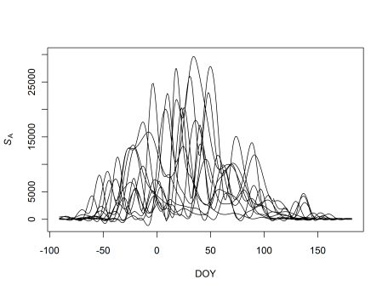
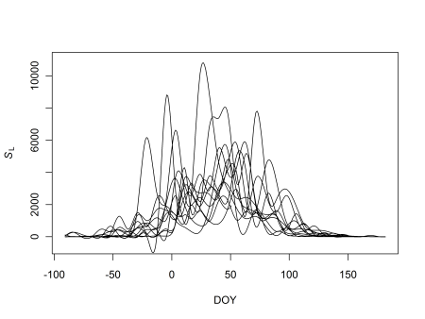
Univariate analysis – Snow
Snow surface cycles
Snow surface estimated from satellite (NDSI)
daily MODIS product used: MOD10A1
missing alues are interpolated (in time and space)
(Gascoin et al. HESS 2015)
S. Gascoin
L. Drapeau
Pyrenees
High-Atlas
Mount Libanon
-100
2002
2004
2006
2008
2010
2012
0
100
DOY

Slide 20
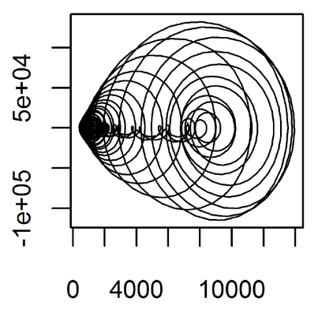
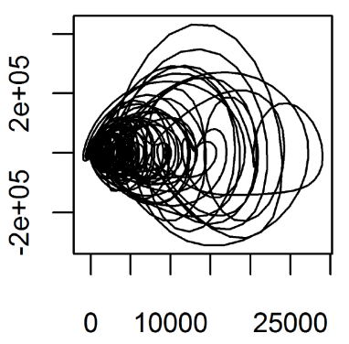
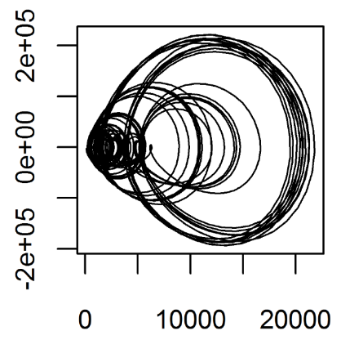
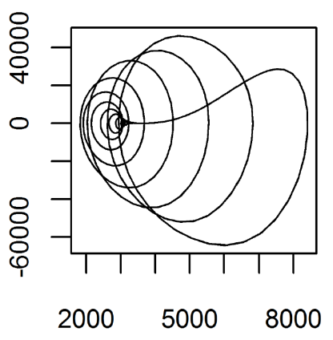
Univariate analysis – Snow
Snow surface cycles
Original data (2000-2012)
Global Models
Phase portraits
Pyrenees
High-Atlas
Mount Libanon

Slide 21
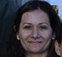
Univariate analysis – Soil Evaporative Efficiency
Autres analyses univariées
Soil Evaporative Efficiency
(thèse Vivien Stephan, Dir. O. Merlin)
Original data
(from TEC model)
4D Global Model

Slide 22
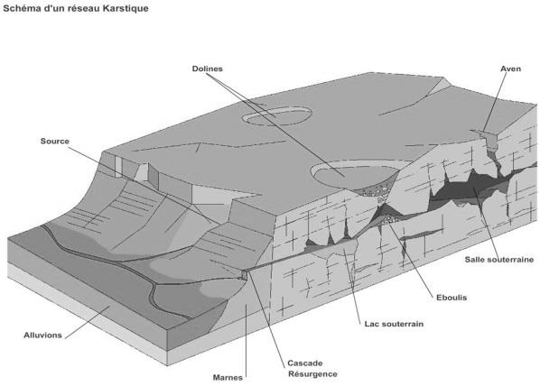
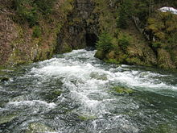
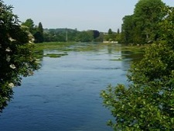
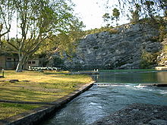
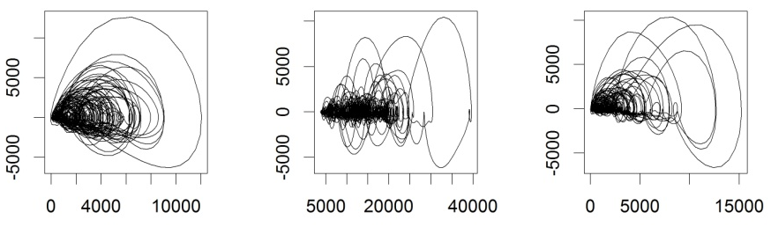
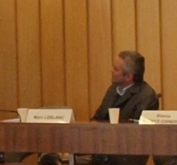

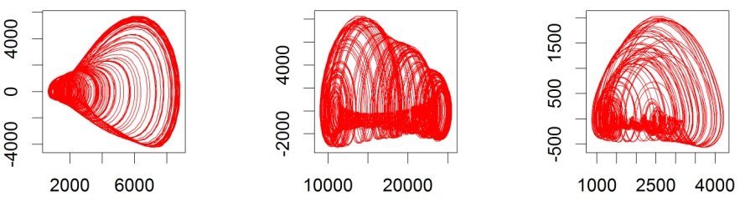

Univariate analysis – karstic springs
Autres analyses univariées
le Doubs
la Touvre
le Lez
The discharge of karstic springs (in France)
Original
data
M. Leblanc
Global
models
Y. Zhang
data HYDRO (http ://www.hydro.eaufrance.fr/)

Slide 23
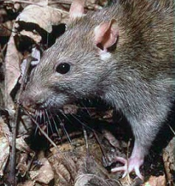
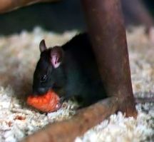
Multivariate analysis
x
y
z
Multivariate ODE directly obtained from observed time series
All the terms could be interpreted
A good tool for detection of couplings
Mangiarotti CSFrac 2015

Slide 24

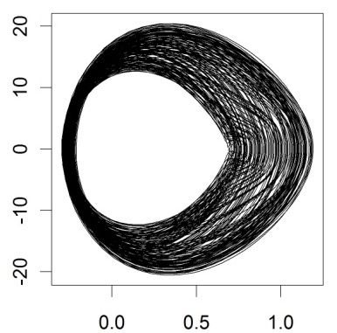
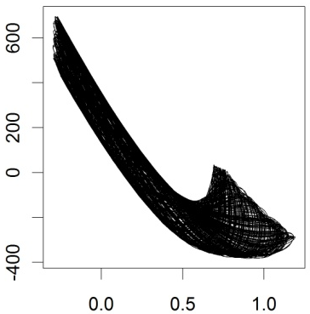
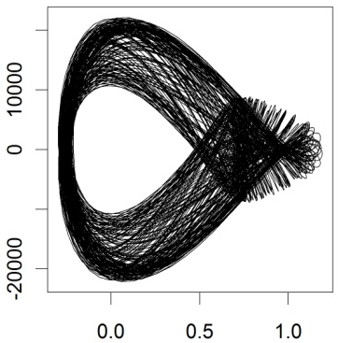



Topology of chaos
4D–models
Cereal crops (Al Ismailia)
model 1
model 2

Slide 25
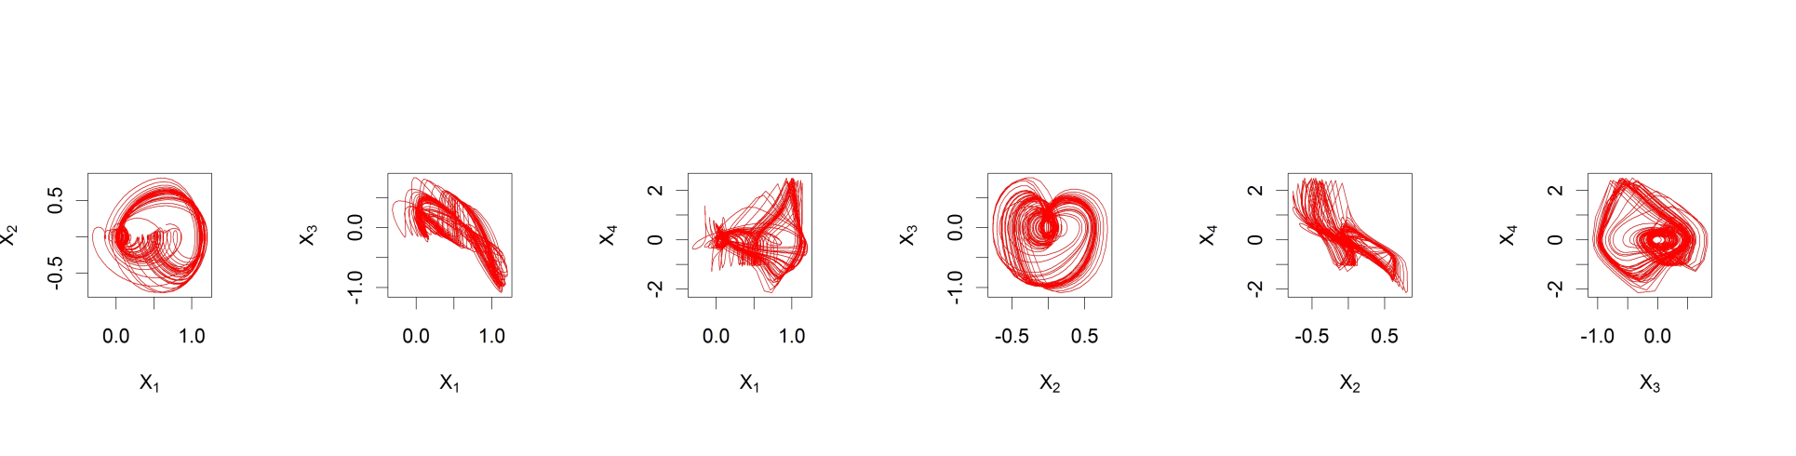
Topology of chaos
4D–models
E/E₀

Slide 26








Global modeling technique applied to Plague and to Ebola epidemics
1906-07
∞
Mangiarotti S. & Huc M.
défi
Inphyniti
sylvain.mangiarotti@ird.fr
Bombay
Prevalence of plague (in %)
(3)
(1)
1900
1905
1910
(2)
Multivariate analysis
Couplings
detection
Bombay plague
(1896-1911)
(Mangiarotti 2015)

Slide 27














Plague death per half-month
x
Number of captured infected brown rats
y
Number of captured infected black rats
z
y
brown rat
z
black rat
x
human

Slide 28


Ebola virus epidemic in West Africa
Phase Portrait
Infections
Infec. X₁
Deaths
Décès Y₁
Y₁
Cumulated
# daily
cases / death
Data source: OMS / CDC
# day
# days
X₁
One single model (4-dimensional) could be obtained
Y₁
Y₂
Y₃
Deterministic
low-dimensionnal
highly sensitive to I.C.
(λ₁ >> 0)
Any new case can have an important effect onto the propagation of the disease
X₁
X₁
X₁
X₁
High level of Complexity
Topological analysis …
# années

Slide 29

Topology of chaos
4D–models
Ebola attractor

Slide 30
Topology of chaos

Slide 31





Topology of chaos
Application to the Hénon attractor (1976)
M. Hénon
chronique of the torsions:
Mangiarotti
HDR 2014

Slide 32

Topology of chaos
Topological analysis for designing a suspension of the Hénon map
Mangiarotti & Letellier, Phys. Letters A 2015
Existence condition for a suspension

Slide 33



Topology of chaos
4D objects
Visualization tools
Extraction of multi-dimensional structures
Collaboration with J.-P. Jessel at IRIT (UPS)

