Slide 1


WP2: Bridging knowledge gaps for agro system modelling in the tropics
Task 2.1
Calibration and evaluation of the STICS crop model for a sufficient variety of crops under tropical conditions
Julie Constantin, Nicolas Beaudoin, Dominique Ripoche, Eric Justes, Samuel Buis

Slide 2
Origin and strategy of STICS
First meeting design, in ECOSPACE INRA project (1996):
"A single model (STICS) .... for different crops. Must integrate knowledge of specialists and generalists in order to remain general, robust, simple, operational, and flexible "(kick-off meeting in October 1996).
deterministic functional soil-crop model to describe the thermal balance, radiative, water, C and N across the crop cycle,
integrative modelling of the cropping system functioning.
Notes:
estimate production, consumption, losses
as a function of environment and agricultural practices
represent the whole plant cycle and a great range of variability of productions (simulation unit called « usm »): between years, areas and parcels
for many crops (maize, wheat, sorghum, grassland,…)
can represent the whole cropping system (linking successive
require few input data and to be non sensitive to up scaling

Slide 3

Main traits of the model
is a crop simulation model with agronomical and environmental vocation, aiming to be robust, simple, operational, and flexible. Motivation = scientific + operational
Collective building governed by the STICS Project Team.
Simulated processes = crop growth and development, energy, water and nitrogen balance
Way of process description = functional (analogic)
Simulated case = 1 agricultural condition (1 crop cycle + 1 environmental condition => simulation unit « usm »;
Informatic skills allows single or intercropped or successive usm under javastics and code integration within plateforms or GIS
Notes:
Stics est d’abord un outil de travail pour les chercheurs, un outil de collaboration,
et de transfert des connaissances vers des domaines scientifiques connexes.
Mais, il est utilisé également comme outil d’aide à la décision, outil de diagnostic
et de prévision par l’ensemble de la communauté des ingénieurs et des chercheurs
travaillant en agronomie (au sens large: depuis celui qui fait de l’écophysiologie végétale et observe les transferts d’eau et d’azote dans la plante,
À celui qui regarde l’impact des décisions européennes sur l’évolution des exploitations agricoles)

Slide 4
History and dynamic of STICS
De Wit, 1970
SWHEAT
TOMGRO
ORYZA
ARCWHEAT
Ecophysiology
SUCROS
WOFOST
GOSSYM
Monteith, 1977
CROPGRO
CERES
Agronomy
APSIM
Sinclair et coll. (1985 -1987)
STICS
AZODYN
1975
1985
1990
1995
2000
Agro-environment
EPIC
CROPSYST
CERES EGC
Environment
DAISY
PASTIS

Slide 5
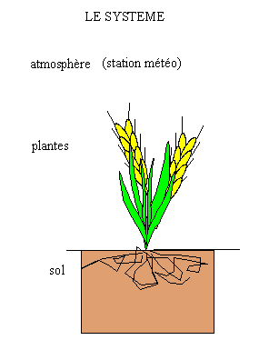
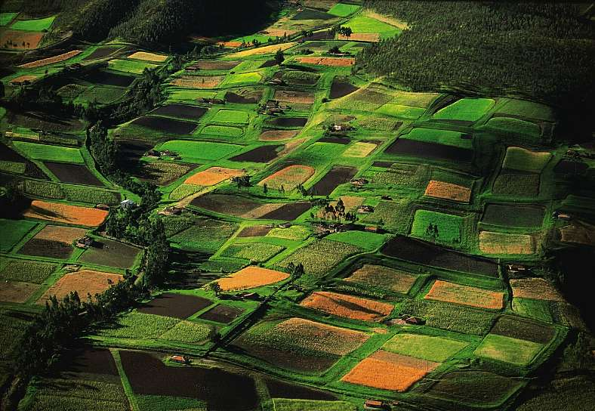
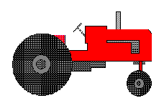
Simulation design
Crop generality
wheat, maize
soybean, sorghum
grassland, tomato
sugarbeet, pea
sunflower
vineyard
rapeseed
banana, carrot
lettuce, sugarcane
crop
Formalisation
Agricultural variables
Plant
Plant
sowing
harvest
Environmentalvariables
Fallow period
Management
Management
Notes:
• One of the key elements of STICS is its adaptability to various crops.
• This « crop generality » is effective through the choice of plant parameter values, crop management and formalisation options.
• The accounting for all these plants required to define general concepts for representing plant ecophysiology.
• An other strong point of the model is its conceptual modularity: sub-programs are identified for each group of ecophysiological process.

Slide 6
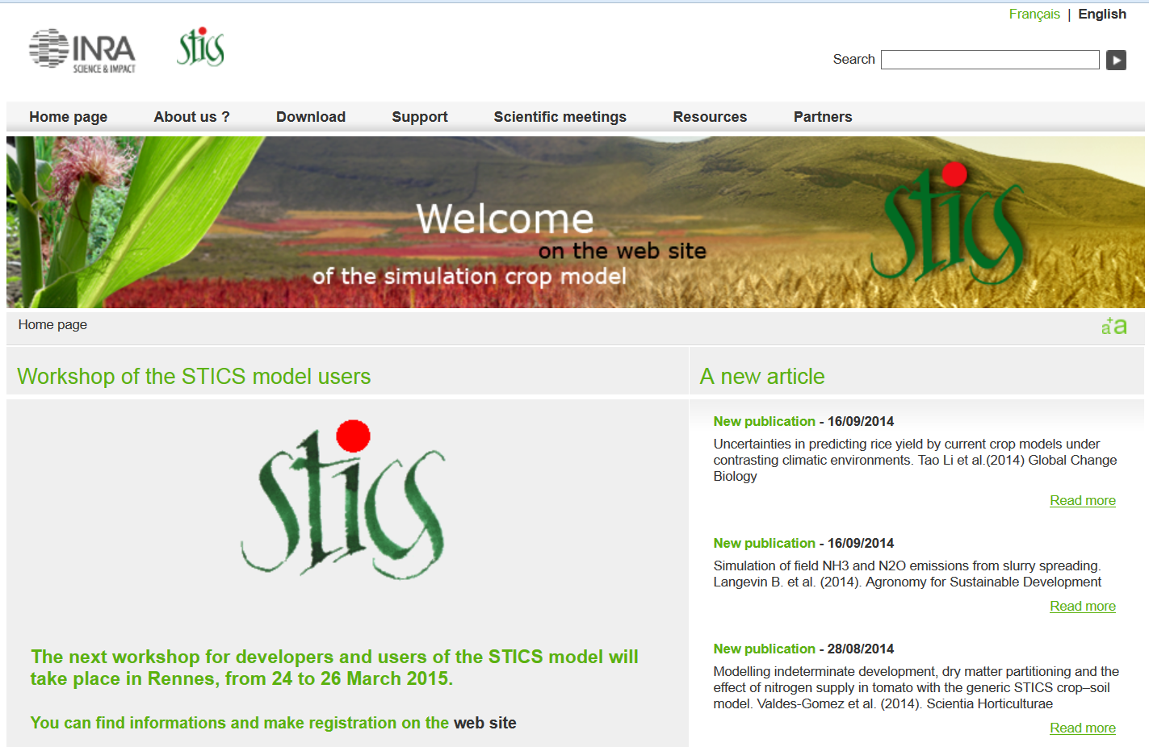
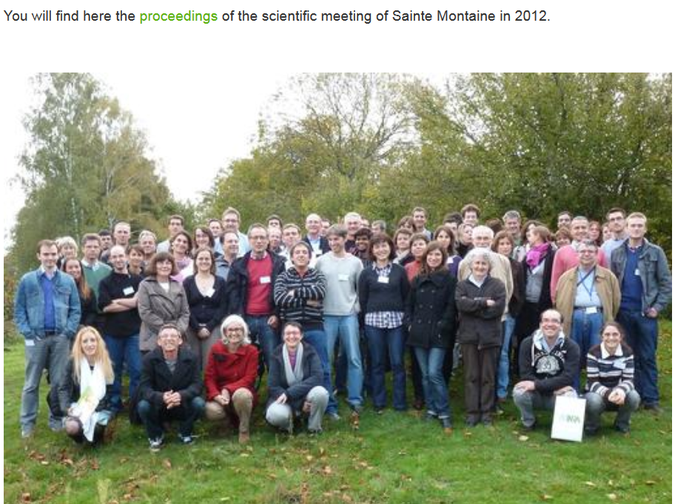
Management and Governance
STICS users can contribute to the scientific network of STICS through
the web site (http://www6.paca.inra.fr/stics_eng), users forum
every two years, at the STICS workshop (e.g. 2015, Rennes, France)

Slide 7
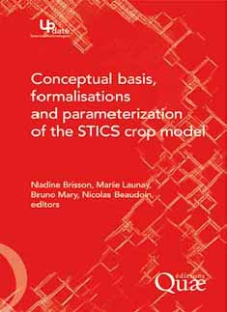

STICS community: an open international community
Handbook of concepts and algorithmes
Scientific papers and reports
Gathering skills, purposes and disciplines
Authors
> 50 scientists
Productions
> 150 citations (1998)
> 150 international
papers (2012)
> 30 PhD of which
10 in 2008-2010
> 250 downloads
(> 2008)
Agronomy
Ecophysiology
Climatology
Soil science
Themes, purposes
Global change, environment
New cropping systems
STICS widely used in AgMIP and MACSUR international Climate Change projects
Notes:
STICS has been developed since 1996 at INRA (French National Institute for Agronomic Research) in collaboration with other research or professional and teaching institutes. For more than 10 years STICS has been used and regularly improved thanks to a close link between development and application, involving scientists and technicians from various disciplines. Last year, a book dedicated to its concepts and formalisations was published, and we numbered more than 50 scientists who had collaborated to the stics program building.
Stics goes on evolving, thanks to many programs and phD thesis in which it is involved. Those research projects principaly address to global change (as impacts of climate change for example, or biotic stresses), environment (as Nitrogen evolution in long-term cropping systems or compaction-fragmentation effects on soil structure), and new cropping systems (as intercropping).

Slide 8

Crop model structure: main principles
(Bonhomme et al., 1996)
Duration of development phases
Phenology
- Photosynthesis
- Growth of different organs
- Yield accumulation
Dry matter production
and distribution
Constraints
-water
-mineral
- (pest and diseases)
Constraints due to environment (abiotic factors)
Notes:
What is a model?
Importance du schéma potentiel + contrainte

Slide 10
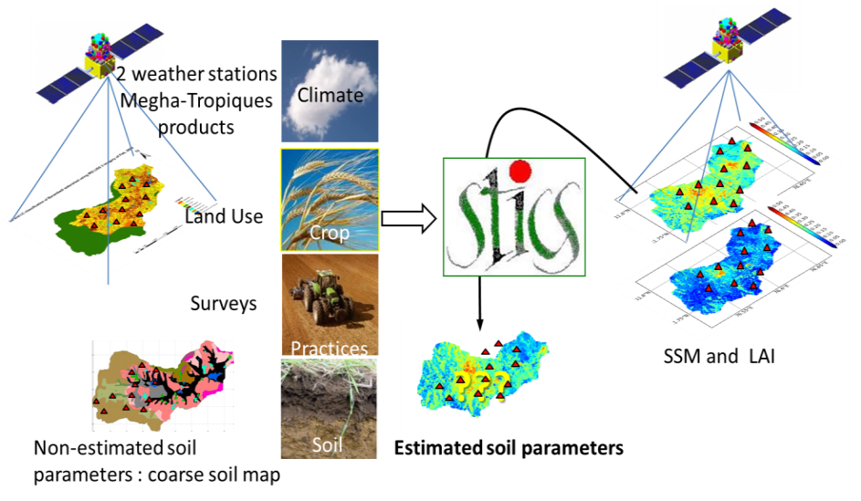
CHALLENGES : Calibration of crop models
STICS Calibrated for
the 5 major crops
In Berambadi
Adaptation of the methodology
the catchment scale
But need
to be validated,
and extended
to more tropical crops
(sugar cane, cotton, finger millet…)
and more practices
(types or irrigation, organic fertilisation,
Agroecology…)

Slide 11
Objectives of WP2 Task 2.1
In addition to providing more diversity to the ATCHA scenarios,
generic scientific outputs are expected from extending the domain
of validity of STICS to tropical situations:
evaluating the robustness of the model formalisms in a context of
water scarcity, hot temperature and short crop rotations;
effect of salinity on soil-crop system;
developing a method of calibration for a large panel of new species according
to their functional traits.
3 potential types of publications :
Calibration of new species in STICS
Development/improvement of new formalisms:
  new processes, new stresses, new agricultural practices
Use of STICS in the integrated AICHA model to test scenarios

Slide 12
WHICH SPECIES ?
For some, reinforce the calibration of the prototype already existing in STICS:
banana, sugarcane, sorghum, sunflower, turmeric
Or adapt to the local varieties
maIze
For others, need to design the prototype
cotton, pulses, marigold, finger millet, (flooded rice ? )
Need to discuss with agronomists partners which other crops should be added
Mixed cropping ?
Agroforestery ?

Slide 13
Principles of calibration
Ideally, the data for calibration base must contain
NON STRESSED situations (Potential Yield)
AND STRESSED situations – water and/or Nitrogen.
- Other biotic or abiotic stresses must be absent
- Better to have time series of variables :
soil water and N content, LAI, biomass, rooting depth, phenology
The data base for evaluating the calibration must be independent.
It must cover a wider range of pedoclimatic conditions,
and possibly crop rotations

Slide 14
AVAILABLE DATA
In Berambadi watershed
~80 situations monitored (LAI, SM, biomass, yield, farming practices, …) between 2010-2013 for maize, turmeric, sunflower, sorghum, marigold, horsegram
Some plots (turmeric?) also monitored for soil /plant(?) nitrogen
Remotely sensed LAI 2011-2013 (more?)
In the 14 microwatersheds of Sujala-III
Monitoring of SSM, LAI
In all sites : automatic weather station with all useful parameters

Slide 15
DATA NEEDED for calibration (each species)
Priority 1 STICS Calibration on agronomic experiments
4 sites x 2 years x 4 modalities irrigation x fertilisation x 2 repetitions ⇨
⇨ farming practices + meteo data (P, PET, T, Global radiation)
⇨ soil properties: C-N org, Ph, Bulk density, depth, SHPs
⇨ phenology
⇨ occurence of pests
⇨ biomass at 3 stages (stem elongation, flowering, harvest)
⇨ LAI – root profile
⇨ for legumes, N fixation (biomass; N and 15N )
Priority 2 Independent calibration of ecophysiological relations
1) N dilution curve in aerial biomass
=> 2 trials x 2 years with 5 N doses and 3 repetitions, 5 dates of measurement of
biomass and N content
2) extinction coefficient k (radiation sensors and energy balanceà
(intercepted vs absorbed.
3) N fixation
Calibration or test by forcing/assimilation of remote sensed data
⇨ network of farmer plots
⇨ ground truth (phenologie, density at emergence, health)

Slide 16
DATA NEEDED FOR CROPPING SYSTEM CALIBRATION
Common between Tasks 2.1 and 2.2
Test the prediction of yield and water-C-N balance vs cumulative effects
Monitoring 3 years of crop successions
10-15 plots of 15mx 15m x 2 -3 soil types
random sampling 6 sub plots of 8 sol cores (cf Beaudoin et al., 2008).
⇨ Test cumulative effects : mixed crops,, irrigation, manure
⇨ phenology, occurence of pests
⇨ soil properties: C-N org, Ph, Bulk density, depth
⇨ biomass at harvest
⇨ Salinity and biogeochemistry (task 2.2)

Slide 17
STRATEGY
Test 2 calibration methods
Classical : local data, agricultural trials, well characterized (IDE-STICS)
Data quality rather than quantity.
– high potential for Sujala partners (agronomists)
2) Global : few variables spatially and temporally distributed
Use of remotely-sensed data.
B) Data acquisition fn of skills/interest/constrains of actors
1) Field experiments possible only if agronomists of UASs are interested
2) Combined experiments with task 2.2 for « on farm » monitoring
Water-C-N balance by soil type, practices
C) People in charge of data acquisition should also be involved in
First data analysis (RUE, water and N efficiency eau, INN)
Collection of metadata
D) - Use the model as a tool for dialogue and training with experimentalists
- use STICS as an agronomic diagnostic tool
rationalize the experimental network
e.g. calibrate crops on simple case – red soil but use black soil to test N balance

Slide 18
WHERE DO WE START ?
Agronomic diagnostic
1 or 2 master students (ISTOM) next year (march-august)
Classical: explain yield elaboration (phenology and component of yield) with
field observations (soil, climate, practices, weeds, pests.
Thorough study of the system (soil analysis, soil profiles, root profiles)
Compare yield in agricultural stations and in farms
yield gap analysis with the model
2) Ecophysiological and environmental diagnostic (without STICS)
- Water, N, nutrient balances
- Local RUE local vs literature - aerial biomass = f(PAR)
- N dilution curve vs literature
3) Data base and metadata
Cf IIDE-STICS project : standardisation of calibration
Available : data and metadata formalism
In 18 month : automatic generation of STICS input files

