Slide 1

From climate changes to changes in agriculture, land and water at the village level
A foresight approach in the Pondicherry Region
van Klink Isabel, Richard-Ferroudji Audrey, Venkatasubramanian G., Aubriot O., Prabhakar I., Muthusankar G., (forthcoming 2017), From climate changes to changes in agriculture, land and water at the village level: a foresight approach in India, Sciences Eaux & Territoires
Notes:
Raises some question from rural perspective and at the village scale.
Why land and water? Because it is interconnected Not considéring water in isolation.

Slide 2
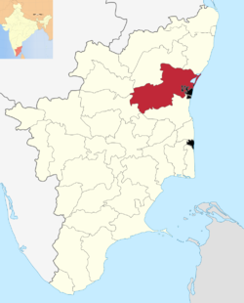
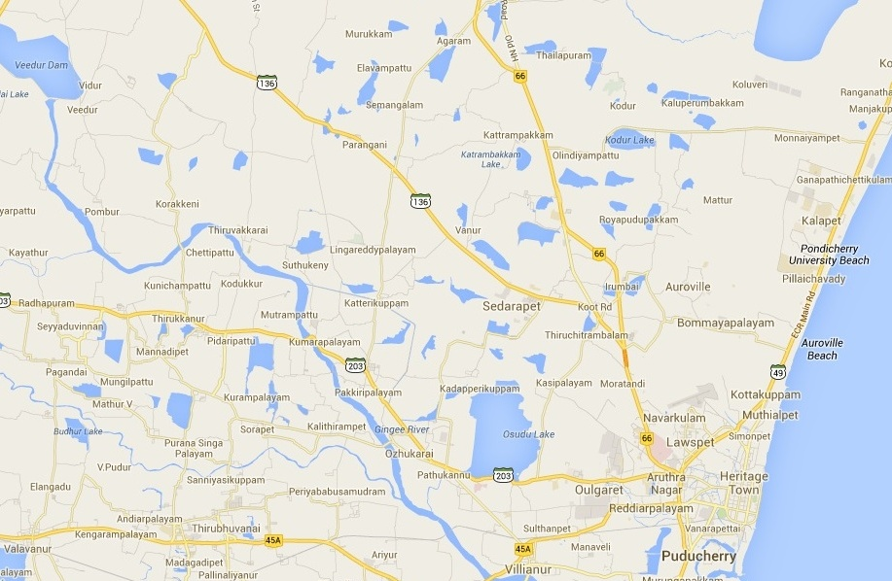
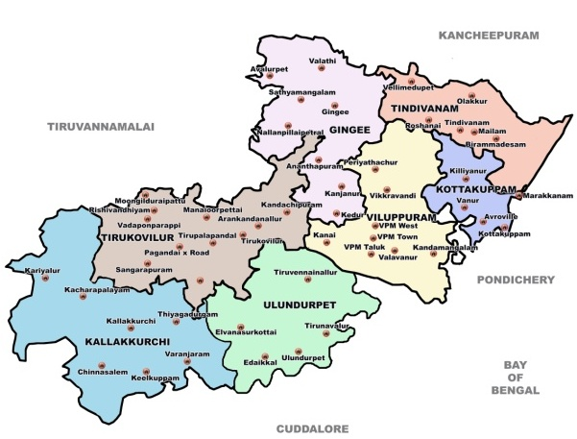
Sorapet
Census | 1991 | 2001 | 2011
Total population | 1989 | 3579 | 5110
% Cultivators (own and leased land) | 16% | 19% | 2%
% Agricultural laborers (male and female) | 68% | 58% | 20%
Previous surveys 2004-2006 (Aubriot, 2013)
3km
GoogleMap
Notes:
Focus on Sorapet
15 km form urban area - 375 ha Previous work O. Aubriot because of water scarcity and adaptation and why the tanks where no more uses.- To understand changes of the past
Survey 2006 and 2014 Same farmers Based on same questionnaire 2006 50, 2014 49 farmers
Adangal data
Interviews
Presentation
Participative meeting
Urbanization pressure of PY, influencing the land and water management in Sorapet; Less cultivators and labors

Slide 3
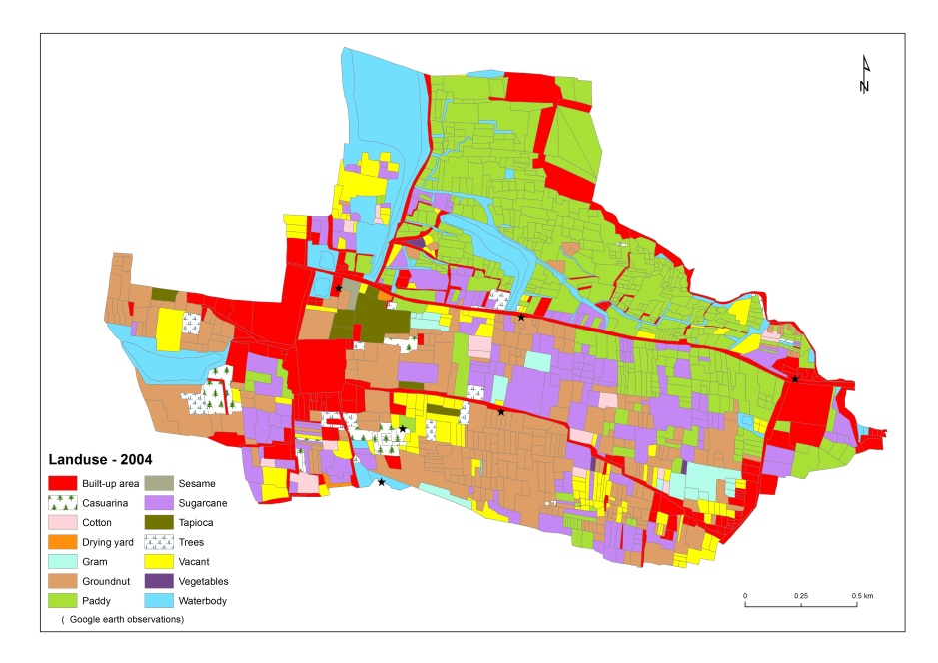
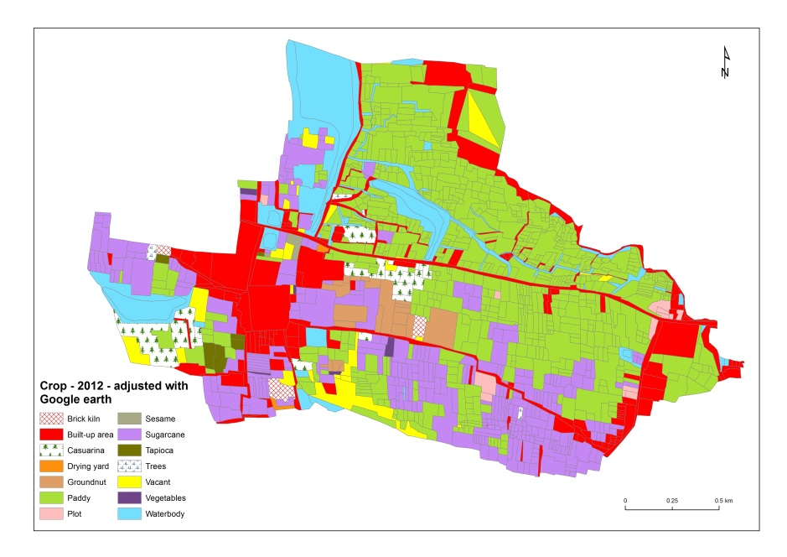
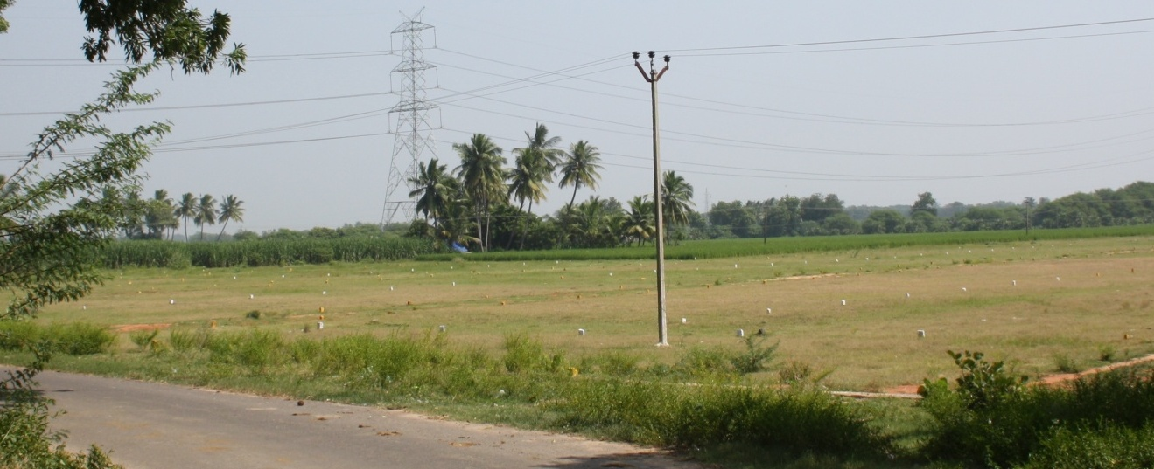
Changes in Land use and crops 2004-2014
Urbanizing area and focus on paddy
(Sources: Adangal + surveys)
2014 – Beside the Periya Eri
Notes:
Increase in built-up, paddy, sugarcane, casuarina, plots, brick kiln and cowpea (karamani) area
Decrease in groundnut, trees, gram, cotton and vacant cover
Water consuming crops – diminishing of lanf for farming+ land plot close to the tank
3

Slide 4
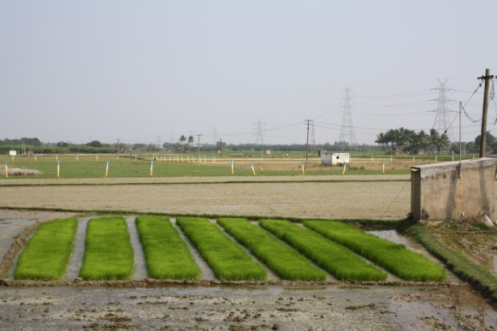
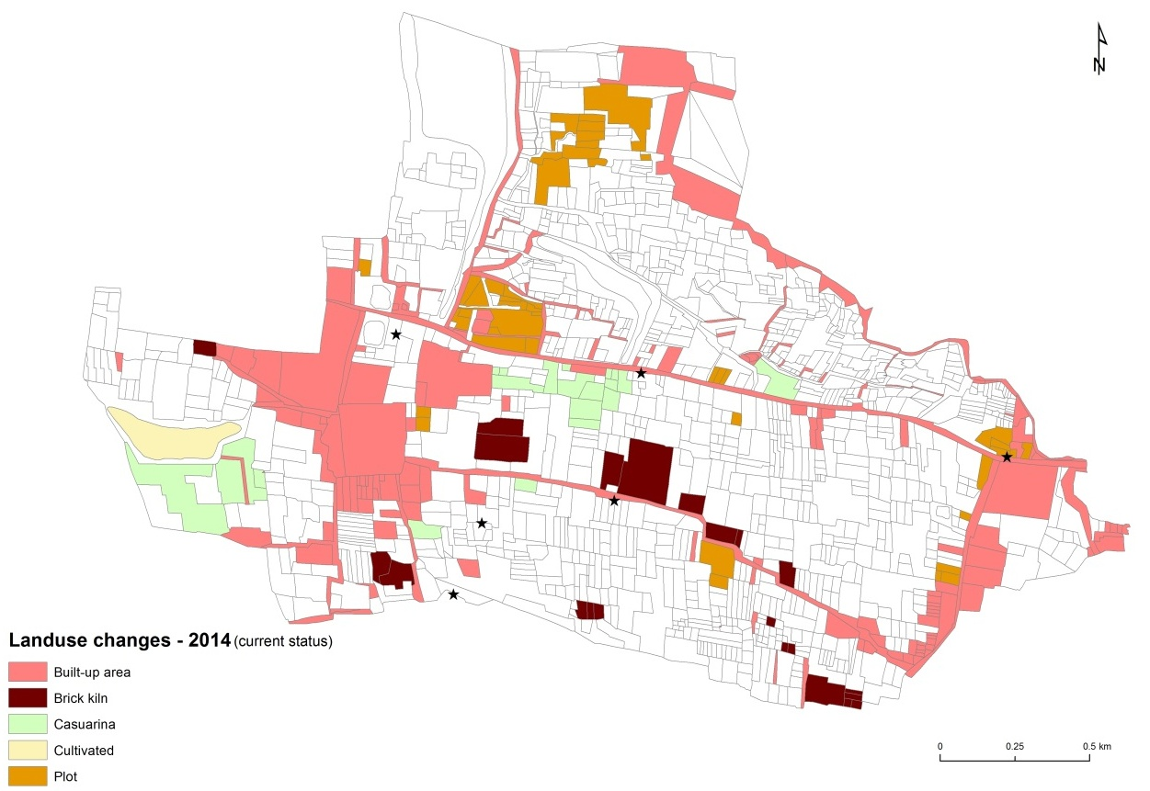
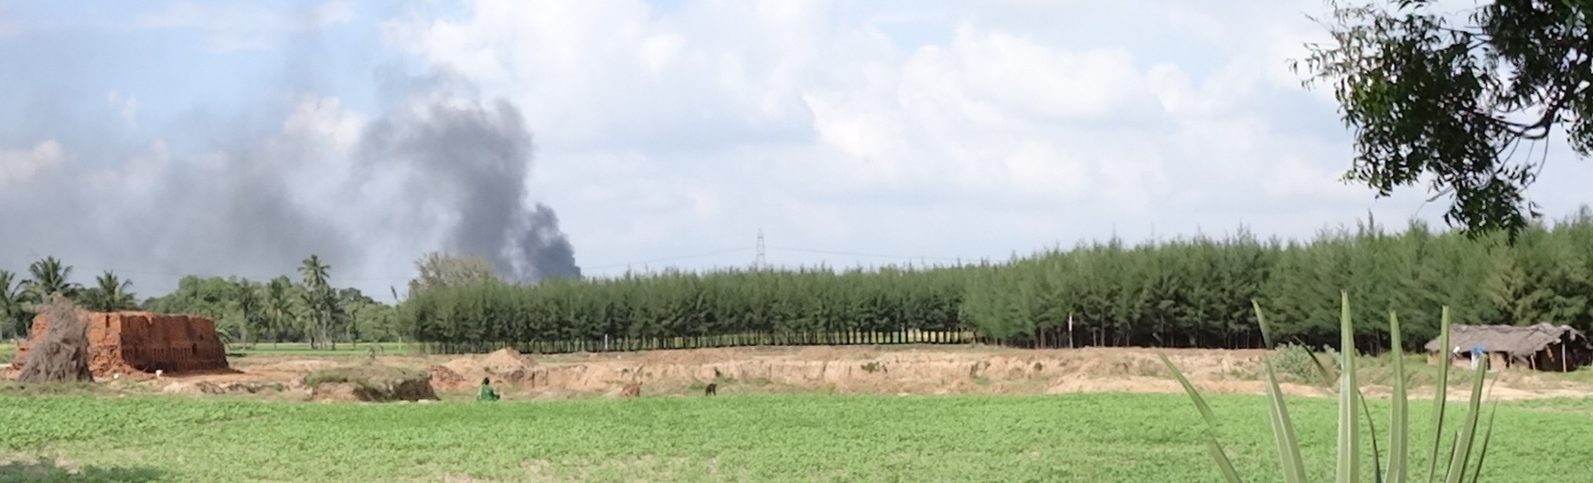
Notes:
Mark on the territory - Increase in built-up, paddy, sugarcane, casuarina, plots, brick kiln and cowpea (karamani) area
Decrease in groundnut, trees, gram, cotton and vacant cover

Slide 5
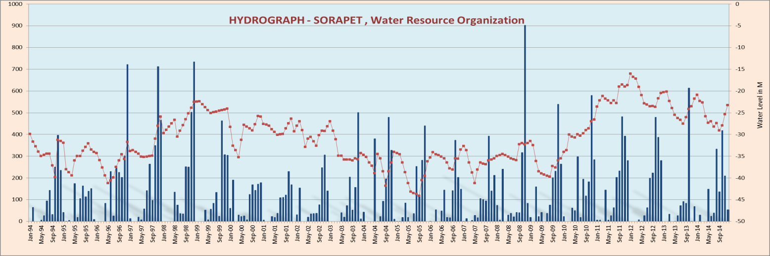
From tanks to wells : water as a secondary issue
Still increasing number of tube wells in Sorapet
Unequal water access and water markets
Few use of water tank or drip irrigation
Water concern comes after market and labor concerns

Slide 6
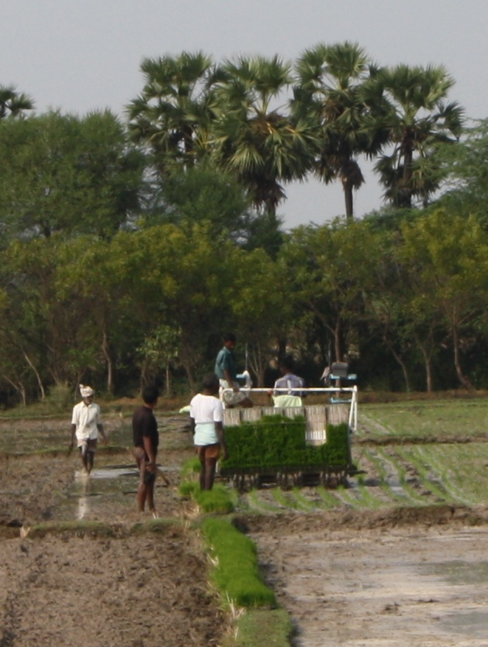
Labor scarcity and market issues:
Declining agriculture
Less agricultural labor and more mechanization
Low price - Few direct markets
High education and literacy rate by younger generation and less interest in farming
-> 40% of farmers have other jobs besides both in
2006 and 2014, but job type has changed: from
agricultural related to business and company work
Notes:
Answers first question, understand changes in the past

Slide 7
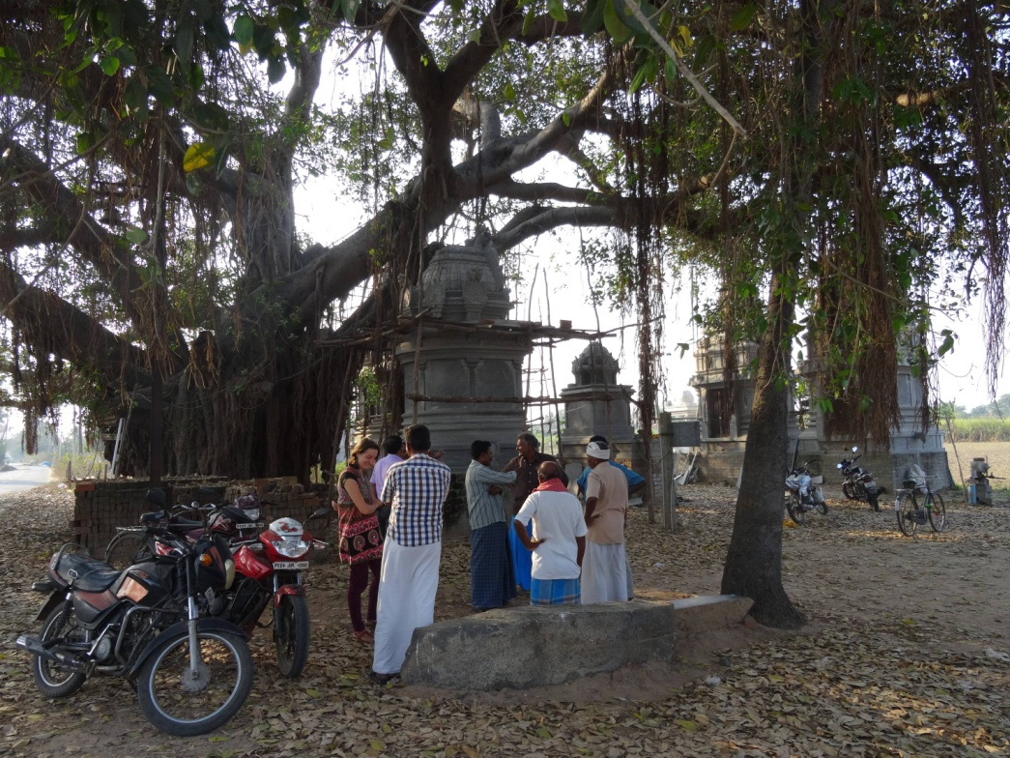
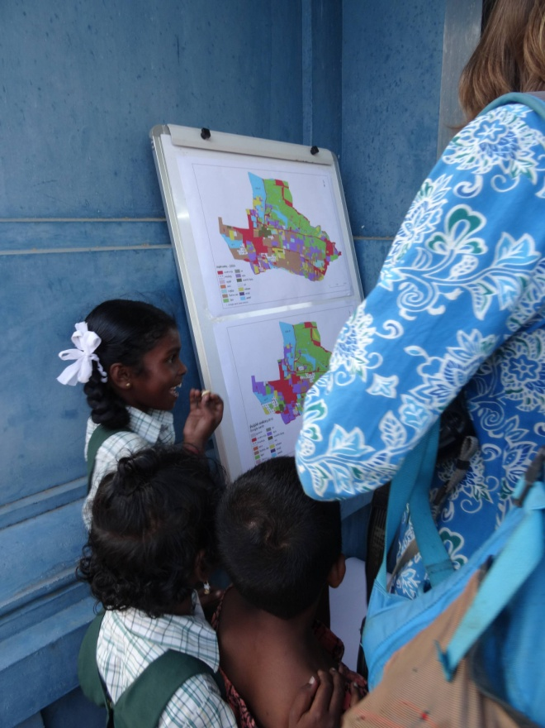
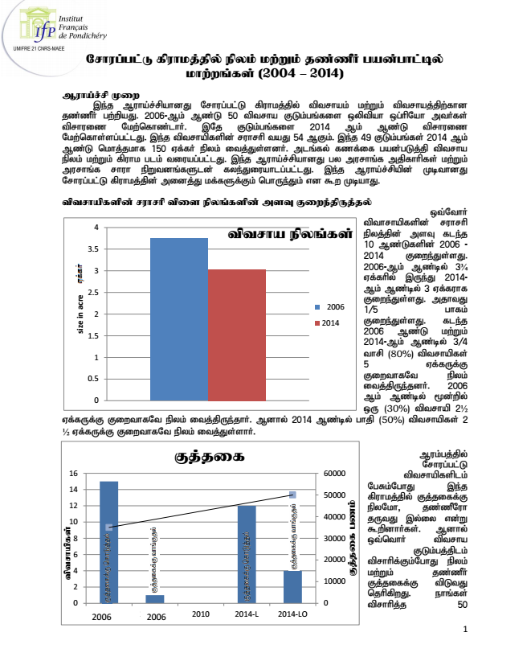
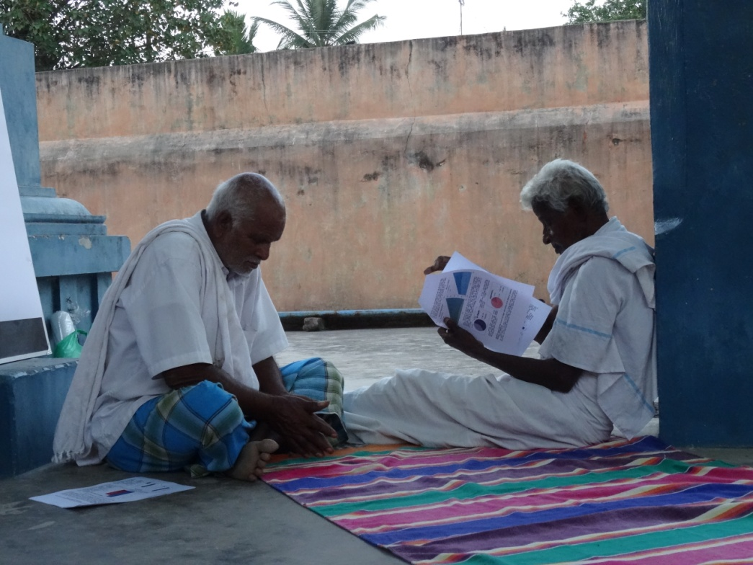
The Eve of the first workshop: in the village, inviting farmers
Presentation of these results in Sorapet
Dialogue engineering
Maps of changes
Booklet

Slide 8
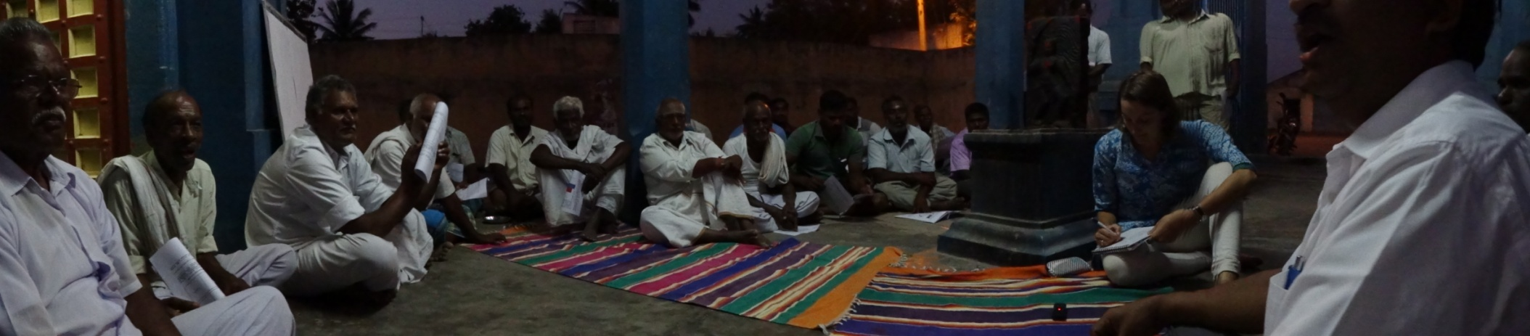
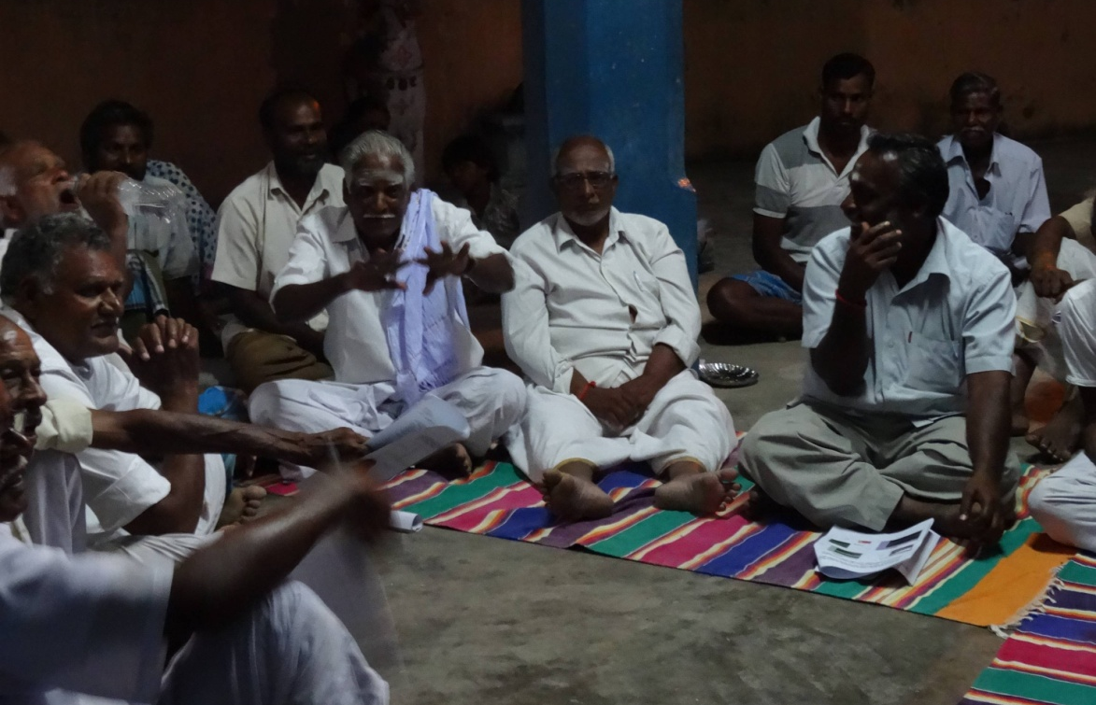
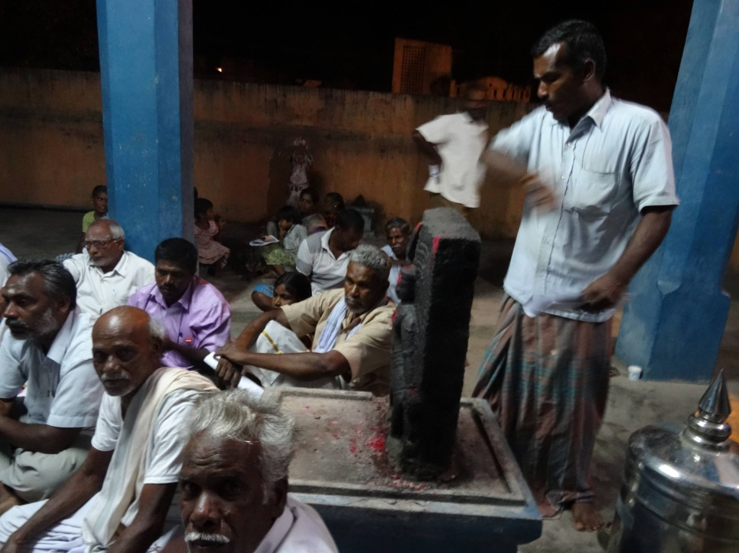
Invitation and Facilitation by the research team - Open to any interested person Place: Meeting in the temple - snacks

Slide 9
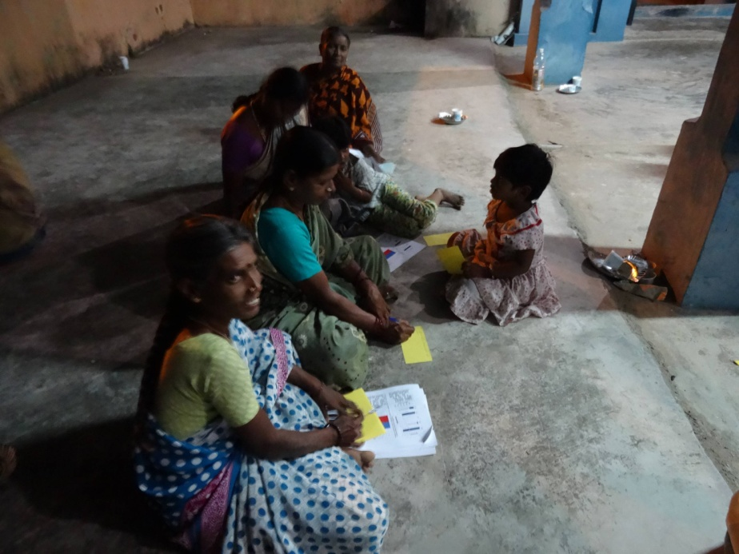
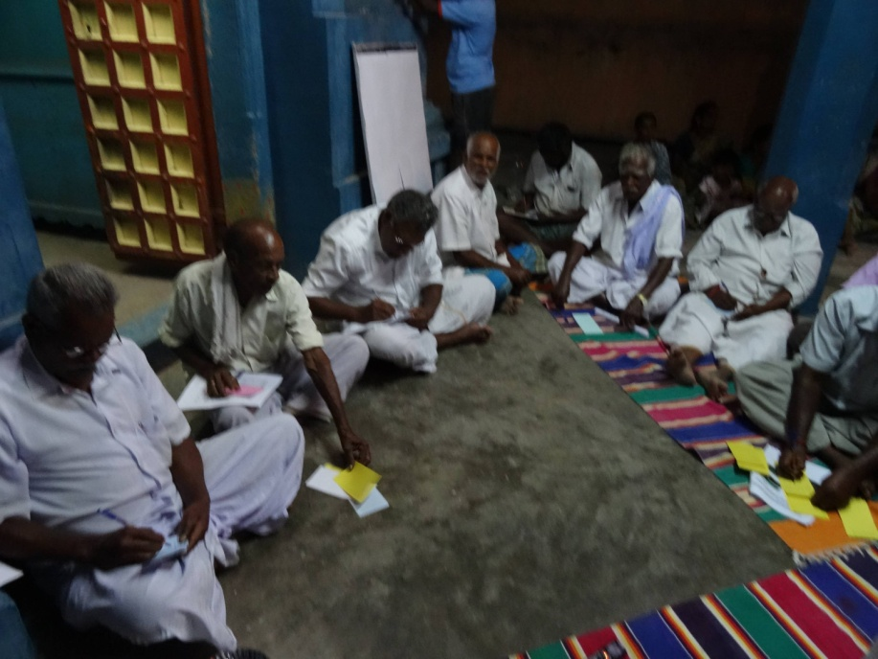
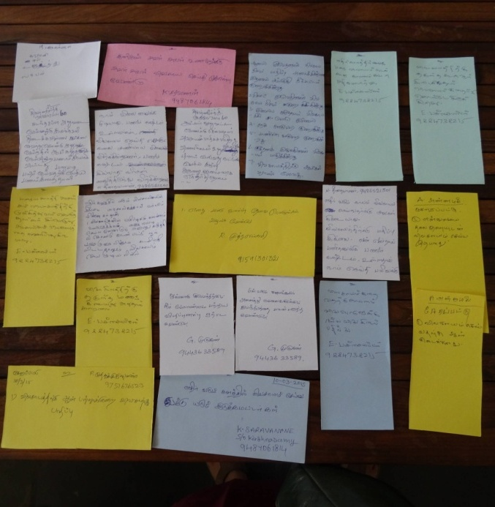
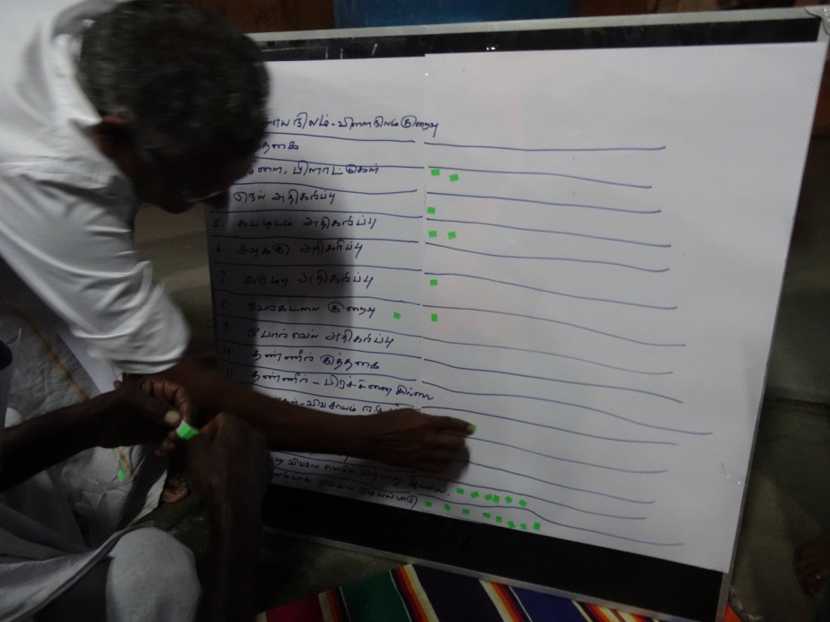
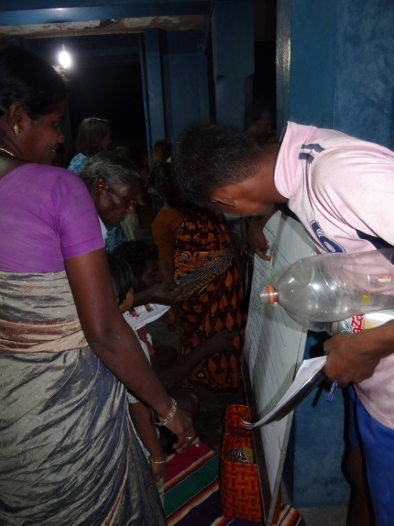
Collecting opinion on main factors of change for the future and scenarios

Slide 10
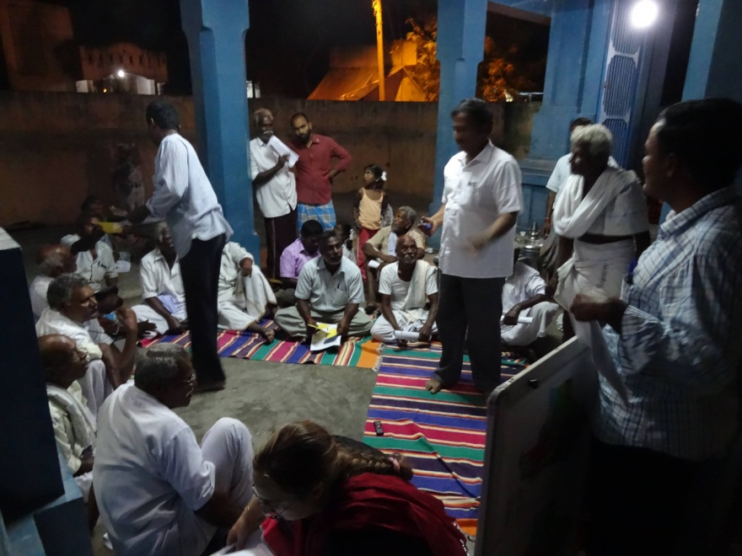
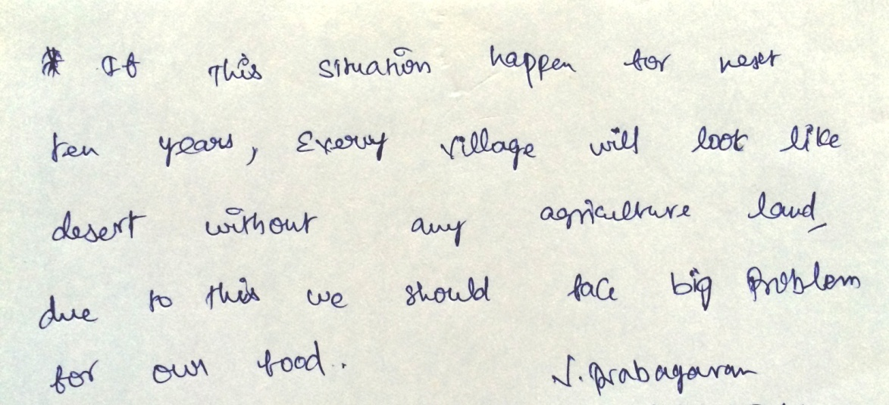
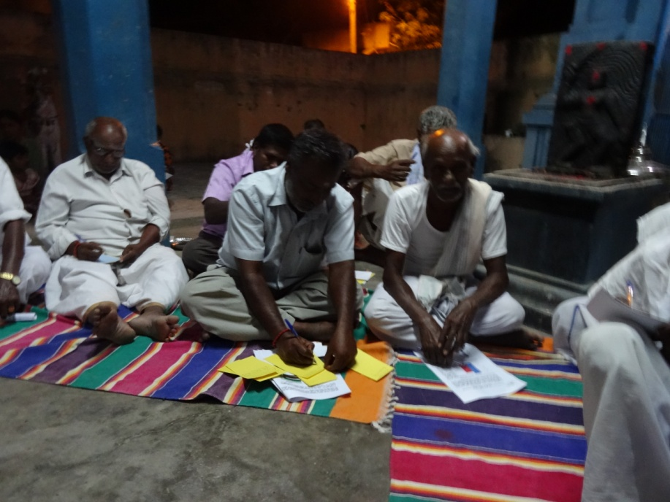
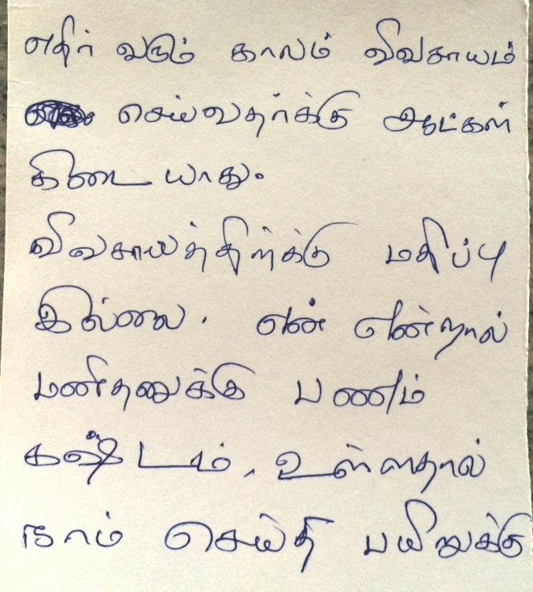
Future for farming in Sorapet
« In the future nobody will do agriculture because there is no recognition and financial return is too low»
Notes:
Pessimistic not all base on feed back and opinion of farmers we have identified important variabes and draft some scenarios as story telling

Slide 11
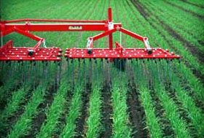
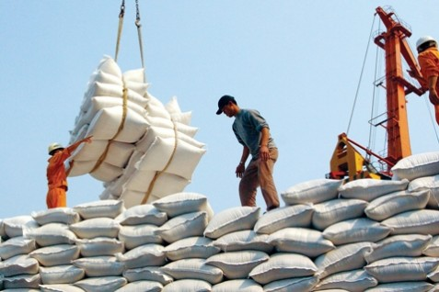
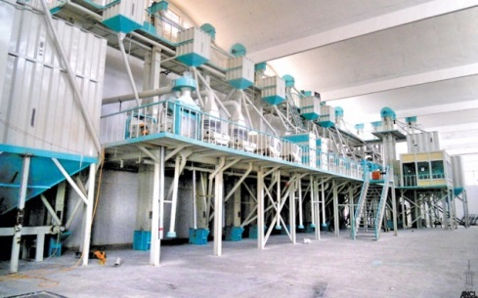
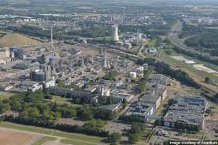
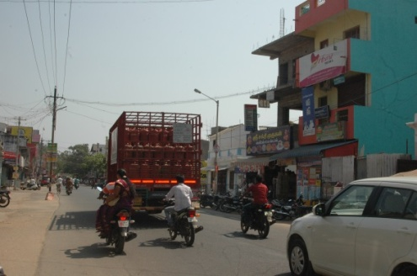
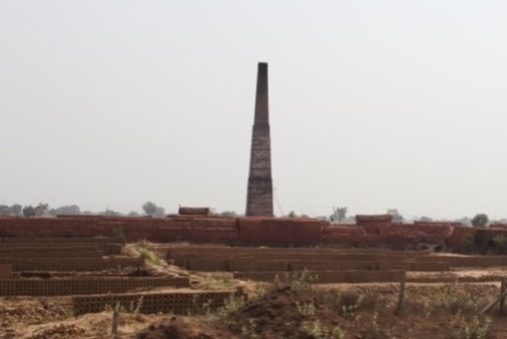
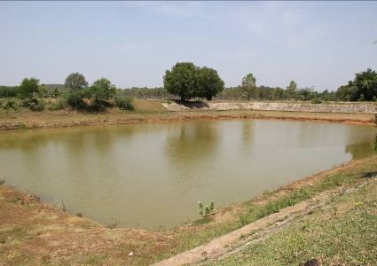
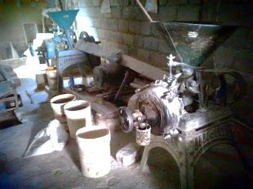
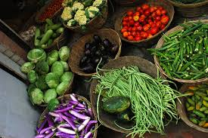
3 possible scenarios for 2040
Scenario 1: Extreme modernization of agriculture orientated towards export– a few large scale farms, high yield paddy and millet
Scenario 2: A real estate and industrial area in the suburb of Pondicherry – very few agriculture
Scenario 3: Food shed of Pondicherry Region, direct market or short circuit, diversification, small food business and traditional methods
Notes:
This answers second subquestion how do the farmers think Sorapet will look like?
Labor vs mechanization: 1 full mechanization but specialized well-paid labor needed
2 Income gap between agriculture and other work, going to cities, growing pondi and working for industries and businesses, outsiders
3 Labor scarce due to migration, new and traditional techniques but respect for farming, secondary activities, family farming, collective act
Conversion of land: 1 Majorly (hybrid/GMO) paddy, a paddy processing factory and some houses
2 Majorly built-up (industries, houses, college), some real estate and brick kiln
3 Vegetable, karamani, millets, legumes, nuts, trees, barren land some factories, cattle, houses
Water issue: 1 Polluted water, deep tube wells with new cleaning technique and use of water from outside Sorapet for domestic water supply
2 Polluted water, scarcity of drinking water, major use for industries, low groundwater recharge and flood risk
3 Little groundwater, water boards implement; increase water efficiency by drip irrigation, high electricity price, tank rehabilitation, groundwater only for domestic use

Slide 12
 | Scenario 1: modern-ization and export | Scenario 2: urbanization | Scenario 3: food shed of Pondicherry
Public policies | Liberal policies and subsidies for mechanization | Urbanization oriented government, focus on industrial economic growth | Subsidized drip irrigation and trainings, strict water policies and establishment of water boards
Land size | Only few farmers with intensive large-scale farms | Small plots with houses, large plots with industries, no farmers | Small and large scale farmers, fewer marginal farmers
Land cover | Mainly (hybrid/GMO) paddy, a paddy processing factory and some houses | Mainly built-up (industries, houses, college), some real estate and brick kiln | Vegetable, karamani, millets, legumes, nuts, trees, barren land, some factories, cattle and houses
Water | Polluted water, deep tube wells with new cleaning technique, no drinking water | Polluted water, scarcity of drinking water, low groundwater recharge and flood risk, imported water for domestic water supply | Water scarcity, groundwater only for domestic uses, tank rehabilitation, drip irrigation, high electricity price,
Marketing | Sold to large supermarkets in Europe. Contracts with merchants and societies. | No marketing. | Products directly supplied to stores in Pondicherry and making of end products in Sorapet with green economic growth and quality strategies
Economy | High input costs and higher income, results in high living standards for remaining farmers | Gaining a lot of money by working for companies and factories, attracting many newcomers, many have a better living standard | Little input costs and moderate income, many do secondary activities, like working for the food processing industries
Interest in farming | Major interest by large-scale farmers, only rich farmers gain respect, decrease in number of farmers | No interest in farming at all, large income gap, no respect | Interest in farming because of social recognition and better income opportunities.
Labor | Specialized well paid labor, but mainly machinery use | No agricultural labor, everyone working in industries and other businesses | Labor needed, but availability is still scarce, family farming and machinery use, crops cultivated with little workload
Collective action | Little collective action, work mainly individually but machineries collectively owned | Mobilization of citizens against environmental degradation caused by urbanization | Innovation platforms, communal storage, collective food processing factories and marketing, NGOs help with strengthening collective action

Slide 13
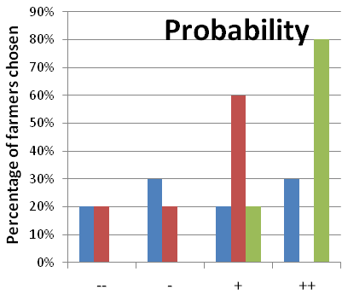
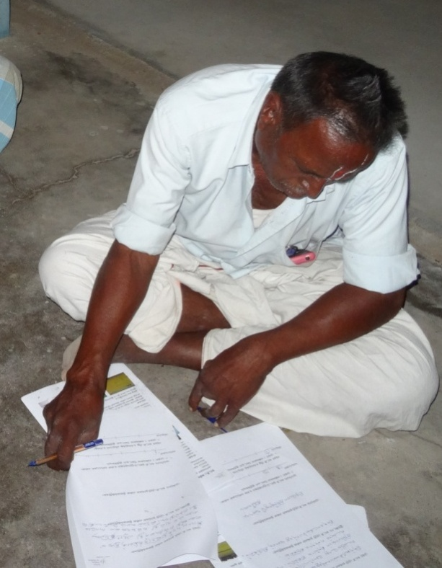
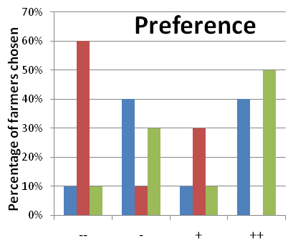
Scenario 1: Extreme modernization of agriculture
Scenario 2: A real estate and industrial area
Scenario 3: Food shed of Pondicherry

Slide 14
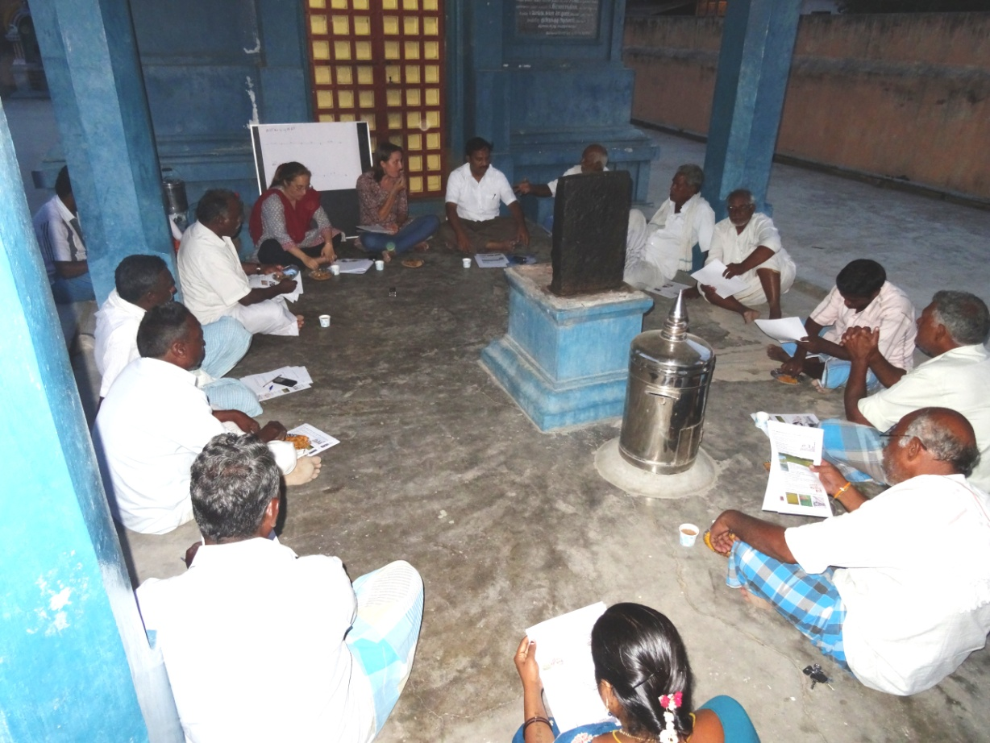
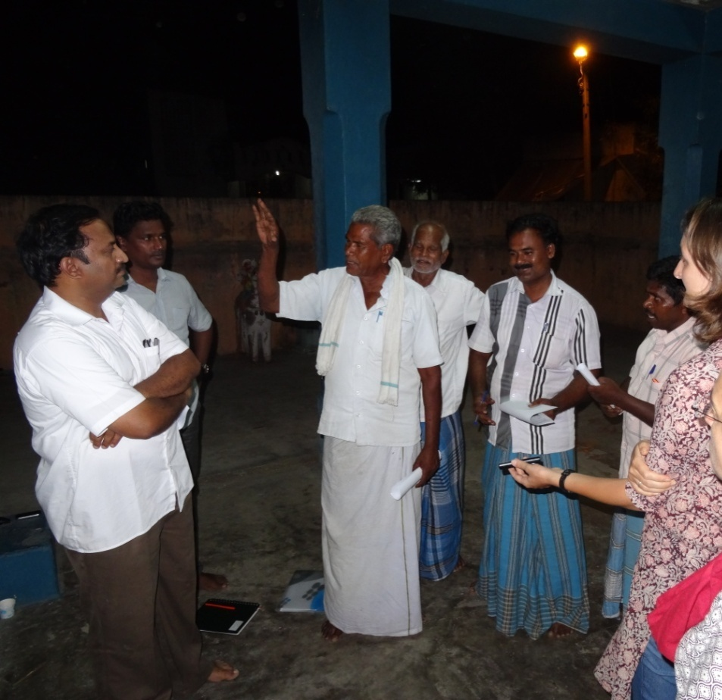
Farmers are attached to agriculture
-> Agriculture adaptation to climate change or agriculture survival?
Pathways for adaptation: mechanization, increase profits (markets, short circuits), increasing interest from new generations (education), water management and collective action
Notes:
More than 50% of the surveyed farmers are part of an organization like ATMA or MSS Foundation. One water user association from TRPP.

Slide 15
Perspectives from this study : developing foresight approaches at local level
Coupling land, agriculture and water management trough holistic approach -> relevance of scenarios methods
Scenarios to be enriched through complementary surveys and simulations including CC scenarios at local level
Upscaling at the regional level: forthcoming (DSTE Pondicherry funding)
Notes:
Storyline
Global change and not CC

Slide 16
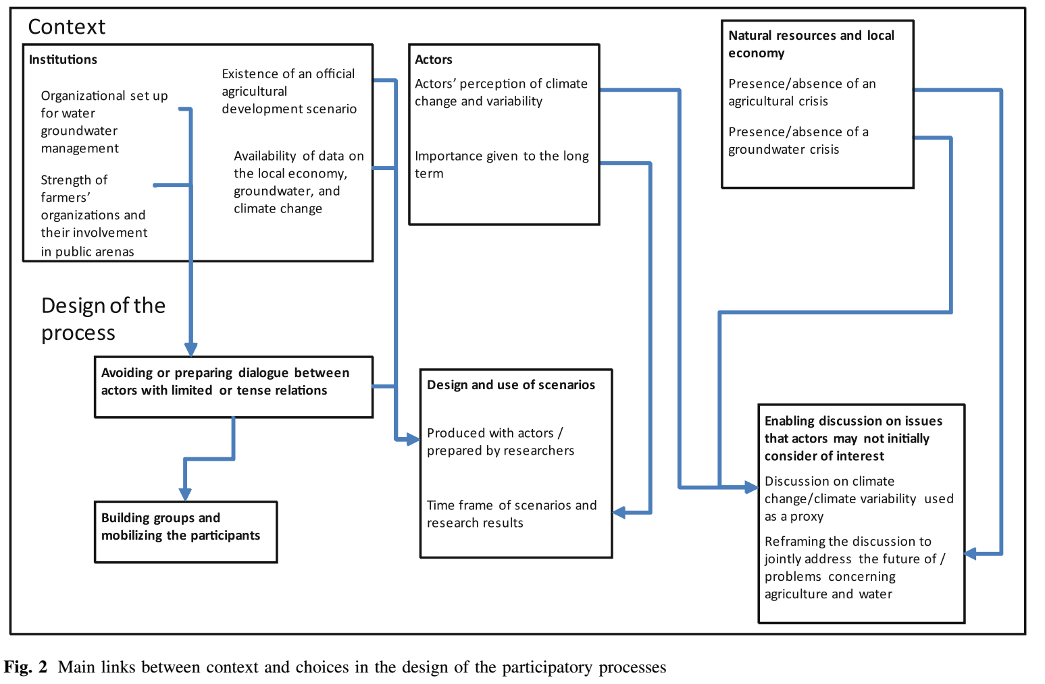
Questions for ATCHA
SCENARIOS ON SUMMER CULTIVATION
SUJALA - Increase water productivity
Other policies
Agricultural policies subsidies – Electricity Free
Which information to share? Formatting?
Water crisis but
Finance/endebtedness
Inclusion in the scenarios? Workshop? Scope?
Simulation from STICS: gap with farmer practices and point of view?
Complementary investigation: Summer revenue and activities
Farmers
Policy makers
Different publics? “Who to invite?
Scale and power?
Question the caibration of STICS?
Ask people to propose other scenarios to be tested – What would they like STICS to explore?
To what extend participatory?
Consultation on scenarios built?
Co-building the scenarios?
Open the black box of calibration/the model – discuss uncertainties? Time Frame?
(Faysse et al. 2014)

