Slide 1

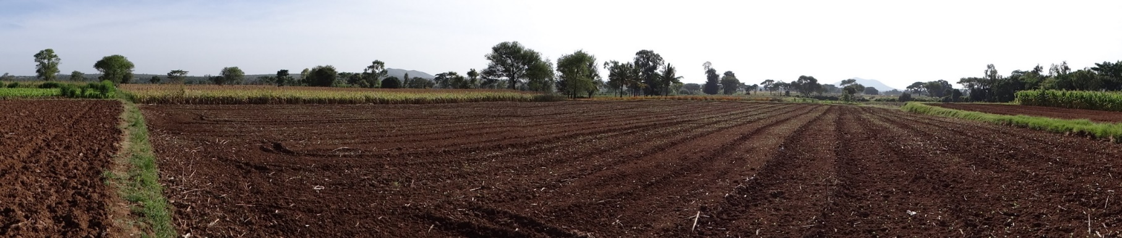





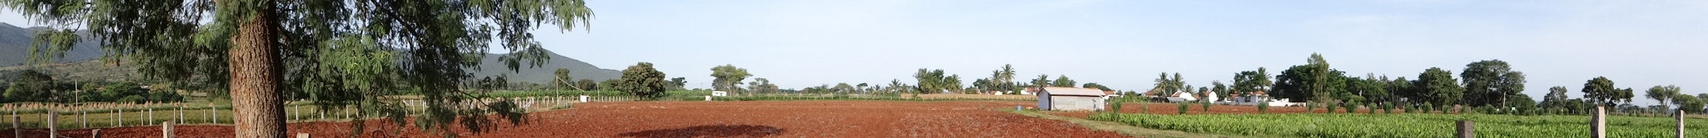
WP-2.2 Crops and nutrient cycling in Berambadi
J. Riotte, O. Fovet, Buvaneshwari S., L. Ruiz, Sekhar M., D. Serça, C. Delon, Tripti M., ….

Slide 2
WP-2 : Crops and nutrient cycling
Assessing nutrient fluxes at the watershed scale
… an ambitious task
Feedbacks between groundwater composition, soil properties, practices ?
Can we assess C & N stocks & cycles at watershed scale ?
At soil-plant scale : combined solute and gaseous mass balance ?
How to take into account groundwater salinity in STICS ?

Slide 3
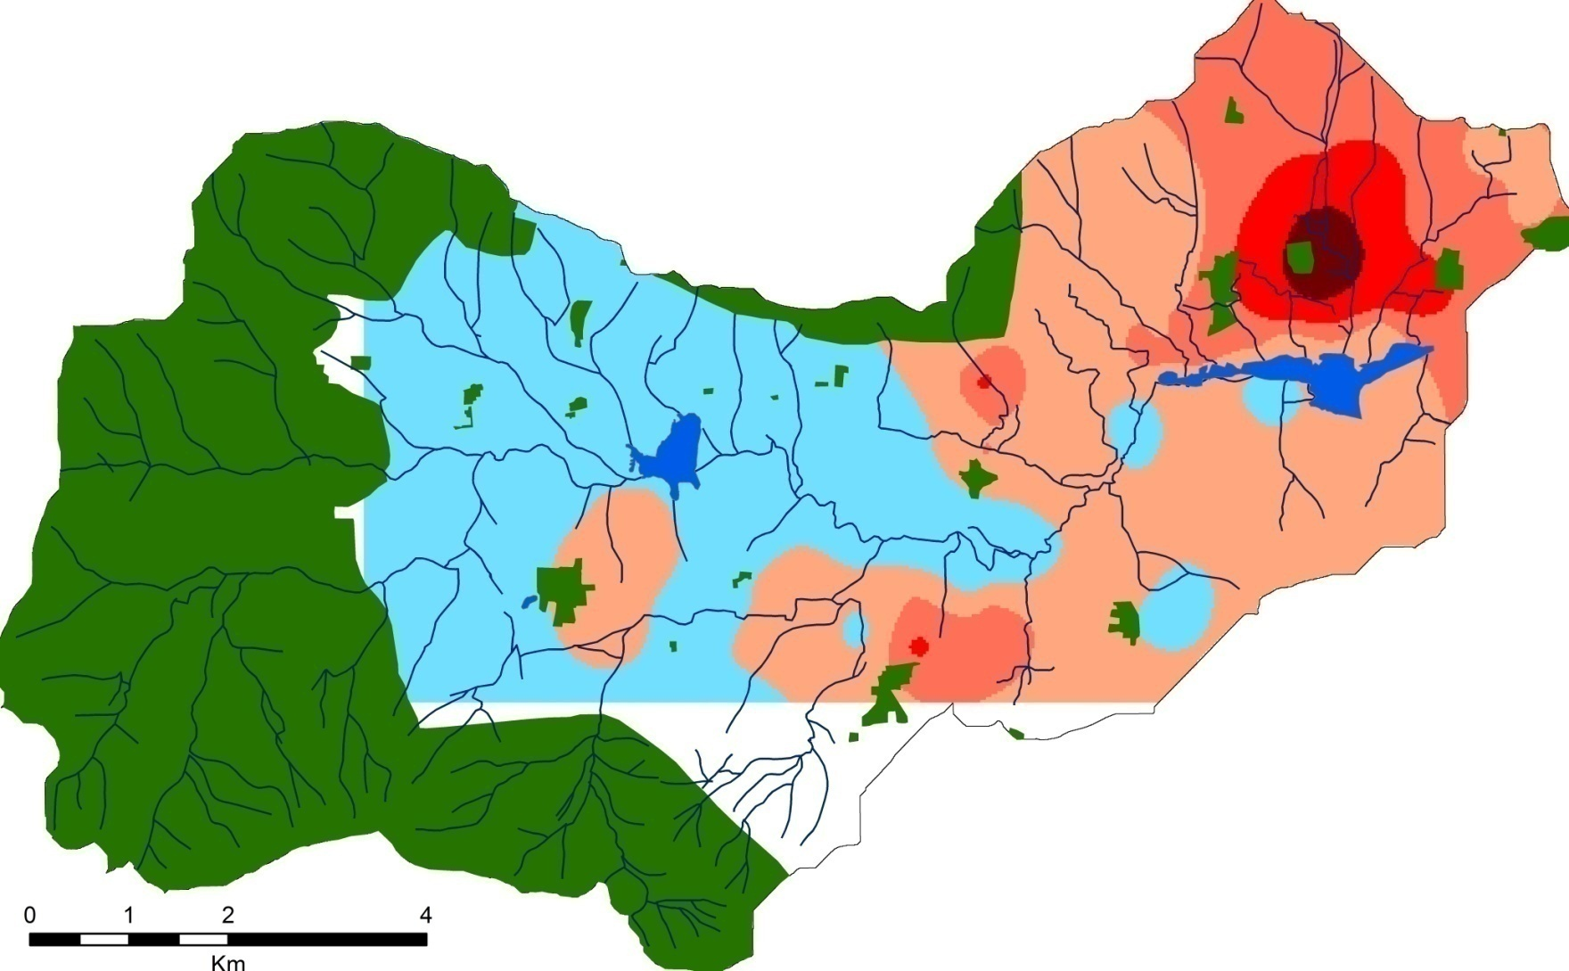
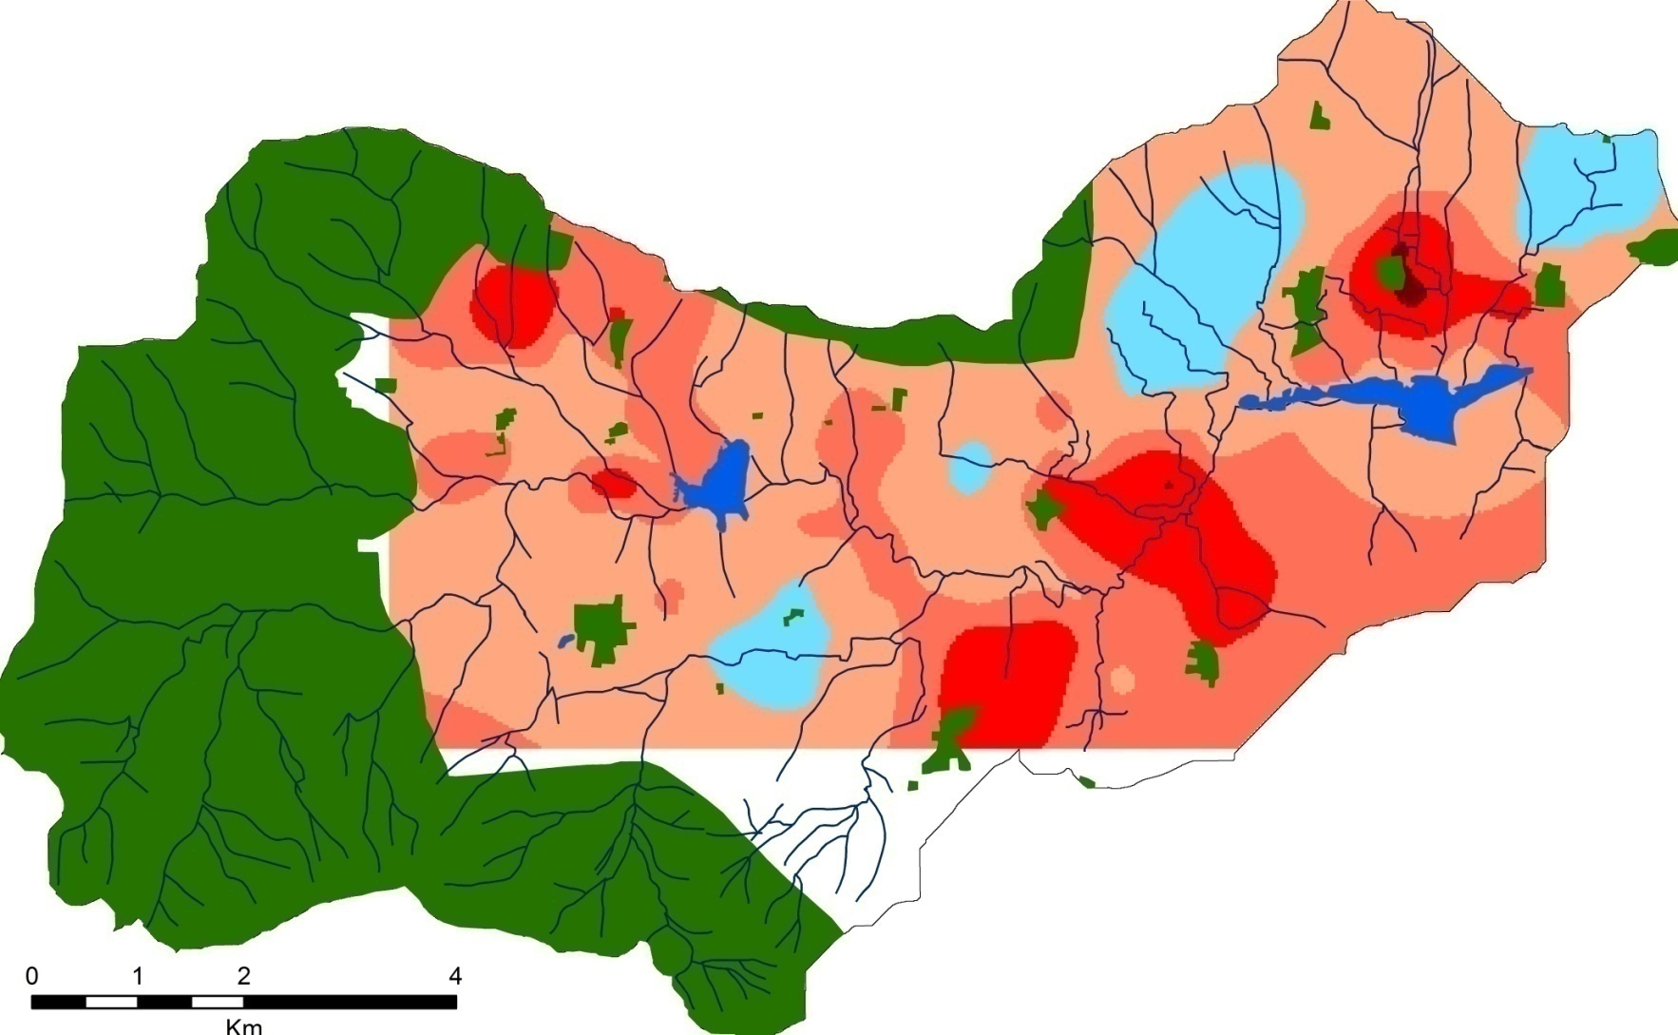
Objectives
Observation from AICHA: High spatial variability in GW quality
Objective in ATCHA: to relate this GW chemical composition to :
(i) hydrogeological dynamics,
(ii) soil properties,
(iii) irrigation practices at catchment scale
NO₃ in GW
Cl in GW
(ppm)
(ppm)

Slide 4
Monitoring of groundwater quality in Berambadi
Where and to which extent GW quality will evolve in the coming years ?
Implication of local GW N (& C) and Cl enrichment for its local use for irrigation?
= Spatial variations of GW NO₃ storage and temporal dynamics (vertical vs lateral flows?)
Temporal evolution of GW composition : a possible proxy of groundwater depletion ?
► continuation of spatial monitoring (3 times/year) for the 3 next years (n=160)
► high frequency sampling of GW to focus on recharge events ? (only for few wells…)
NO₃
(ppm)

Slide 5
Soil properties and nutrient stocks / cycles
Observation from AICHA
 | Ferralsol | Vertisol
Evapotranspiration | - | 
Recharge |  | -
Irrigation | - | 
Fertilization (NO₃ and KCl) | - | 
NO₃ soil profile |  More stable | - Variable
Cl soil conc | - | 
NO₃ leaching to GW |  | -
Recharge Cl conc | - | 
Questions in Atcha:
How are these differences related to soil Carbon?
Influence on recharge and N use efficiency by crops?
Gaseous component of C & N cycles (CO₂, N₂O…)?
How much N could be saved by farmers thanks to irrigation inputs?
Threat of irrigating crops with salty water?

Slide 6
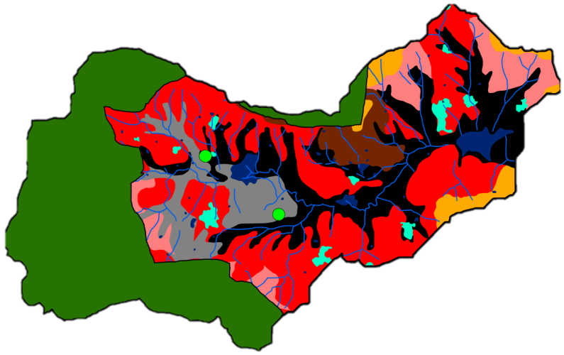
Soil properties and nutrient stocks
(1) Method/Data collection:
Relating existing map of soils properties to C and TN contents
12 plots including both ferralsols and vertisols monitored over 5 depths during 2 years
Can we benefit from current assessment of Berambadi and other SUJALA III watersheds by NBSS and LUP ?
Challenge: characterization of anthroposols/technosols?

Slide 7
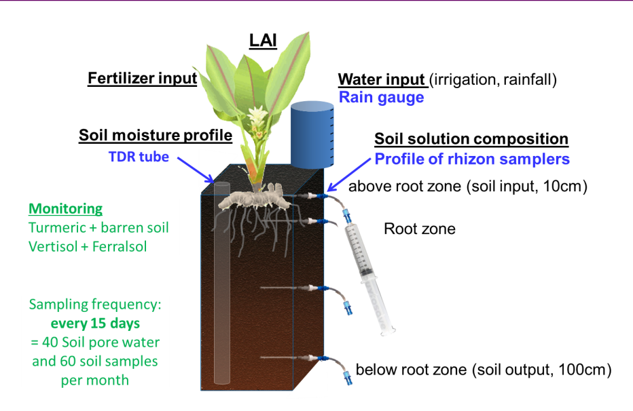
(2) Method/Data collection
Small plots experiments covering variability of crops x soils x GW compositions x fertilizer application :
  Soil solutions concentrations of anions, cations, DOC
  Biomass N content
  C & N gaseous emissions
In order to calibrate/apply STICS model
Ideal : site close to IISc and/or involve partner with experimental sites: strong need of involving UAS partnership
Challenge: modeling the effect of salinization on yields (crop model STICS)?

Slide 8
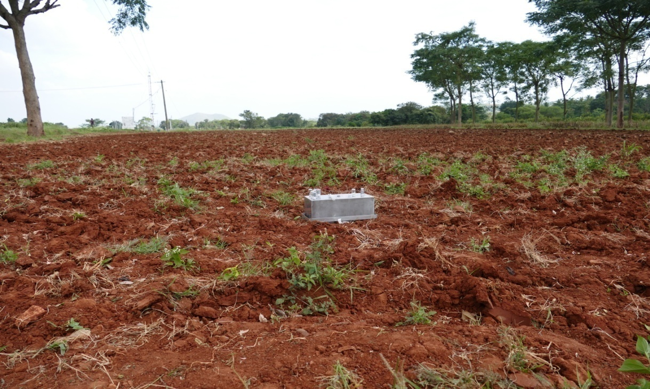
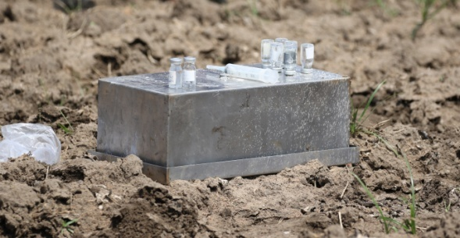
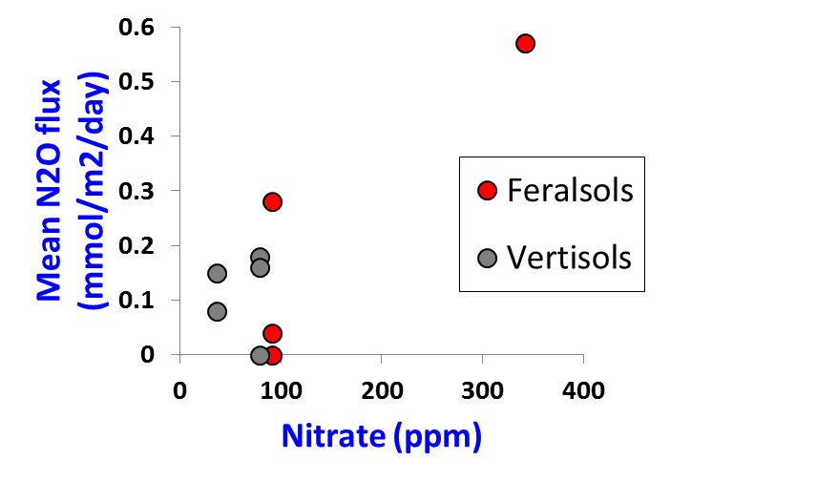
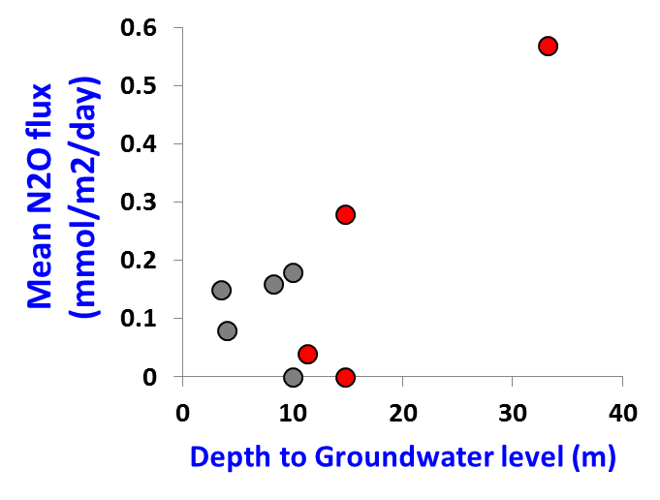
Gaseous emissions at soil-plant scale
Again small experimental plots with various treatments / crops / soils would be ideal :
= Should focus on N₂O, CO₂ (CH₄)
= Will rely on extended partnership
= New post-doc (Tripti M.) dedicated, funded by DST
for 2 years
Preliminary results (bare soils) :
At larger scale : Possibility of comparison with Eddy-covariance (CO2) ?

Slide 9
Interactions with other WPS and expected new partnerships
Towards STICS community (2.1) : providing N data for more calibrations
Towards design and assessment of scenarios (3.1) :
providing mass balances, C & N stocks, “hidden” fluxes of N….
Simplified integrated modelling of the overall complexity of the soil-groundwater system : identification of the critical interactions / feedbacks between the anthropogenics (farm practices) and natural driving factors, mapping of hot spots and hot moments,…
Government agencies (NBSS & LUP, UAS, WDD) :
Sharing our respective soil / land use databases ?
Common crop experiments ?
Feedbacks to farmers ?
Are groundwater quality, soil C & N susceptible to influence farmer practices ?

Slide 10
Thank you

Slide 11
…mmm… where is 2.2…..

Slide 12
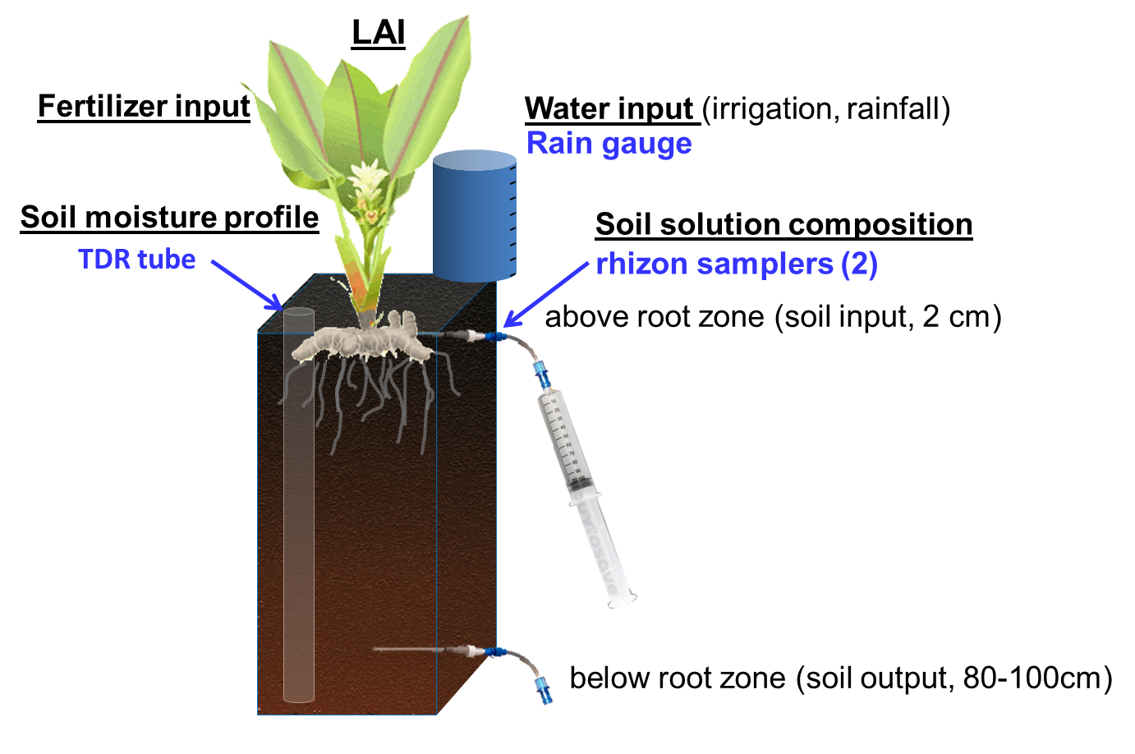
Solute mass balances at soil-plant scale
How to increase the number of monitorings ? Ideal : small experimental plots with various treatments / crops / soils,
Water input simplified (1 per set of plots)
Chlorine mass balance
Cl input
=
Cl output
Only 2 rhizons per experiment
But need of close site and/or involve partner with sites

Slide 13
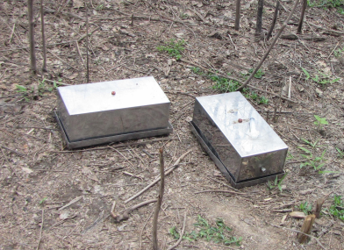
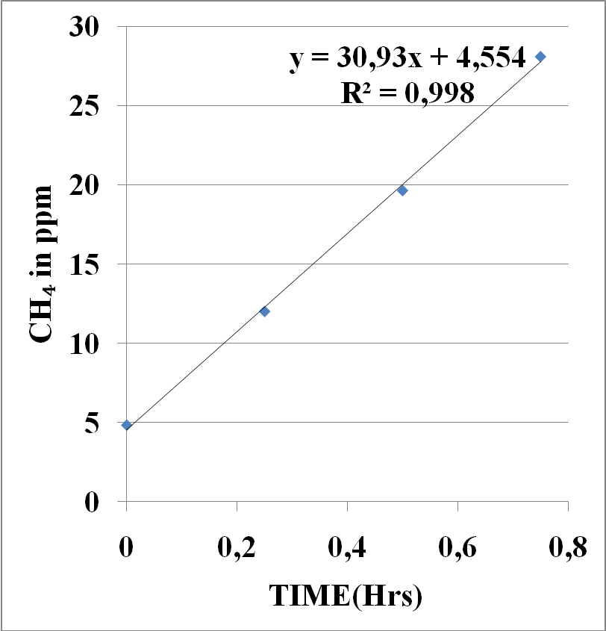
Surface GHG fluxes
Static chamber technique
Septum
N₂O
Chamber
CH₄
CO₂
CO₂, CH₄, N₂O
V: Ch. volume, Sa: Ch. surface areaF1 and F2: conversion factors

Slide 14
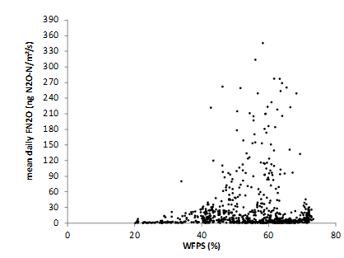
GHG sampling strategy – control parameters
Need to cover both full seasonal/annual cycles, including after harvest, and hot moments (short time resolution)
⇒ Comprehensive emission assessment
Need to monitor control in situ parameters (soil moisture or WFPS- see figure, NO₃⁻NH₄⁺ soil water content…) and record agricultural practices (seeding, mineral and organic fertilizer inputs, harvest, tillage…).
Possibility to conduct plot experiments with a variety
of fertilizer applications
⇒ Process studies, parameterization
Need to investigate spatial variability
⇒ Dependency on soil type / NO₃⁻ in soil / crops…
WFPS
N₂O emissions in temperate agrosystems- Nitrocosmes project, Toulouse, France, Tallec et al, in prep.

Slide 15
C & N fluxes and processes
Need to improve our understanding of processes governing element cycling for :
optimizing application / efficiency of fertilizer
Calibration of STICS
Realistic prediction of C and N fates according to land-use scenarios
Nutrient cycling / efficiencyFeedback of groundwater quality on
crop yield ?
agricultural practices ?
model the processes governing element cycling, (emphasis on C/N cycles and salinity), so that the feedback of groundwater quality can be taken into account in scenario assessment.
Is groundwater quality susceptible to influence some farmer decision ?

