Slide 1

Disaggregating the effects of climatic and anthropogenic drivers on groundwater availability in the Arkavathy watershed, India.
Veena Srinivasan
ATCHA Workshop, Nov 15, 2016

Slide 2
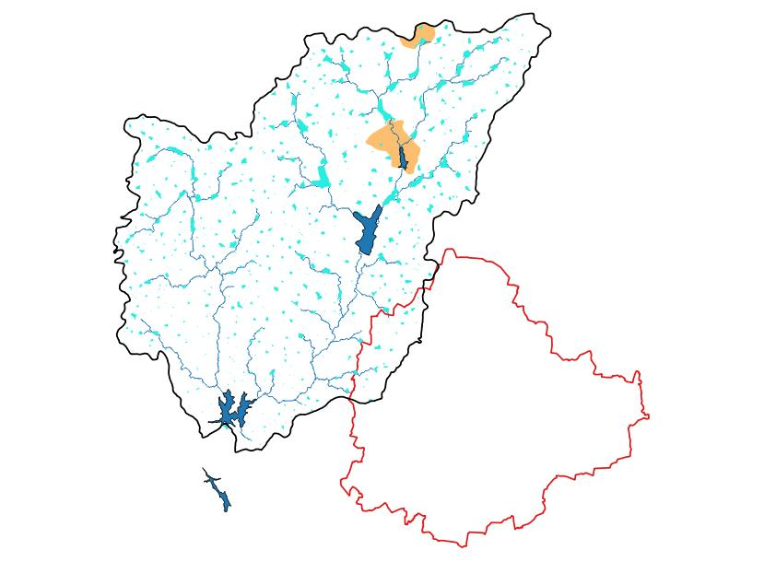
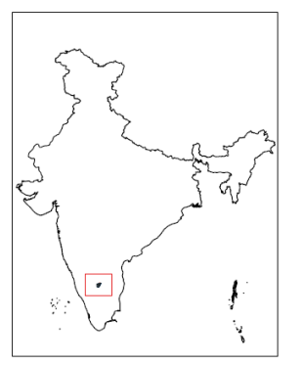
Milli-watersheds
TG Halli Catchment in peri-urban Bangalore in South India
Hesarghatta
1447 sq km
Tippegondana Halli
(TG Halli)
Bangalore

Slide 3
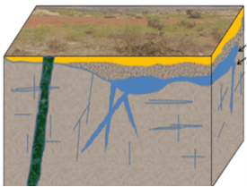
Traditional Approach: Downscale climate projections, apply them to hydrologic models
Water Supply
(Quantity,
Quality, Timing)
Livelihood / Domestic Water Security. Sustainability
Climate Stressors:
Rainfall
Temperature
Water Demand
(Quantity, Quality, Timing)
Assumes stable rainfall-runoff relationships

Slide 4
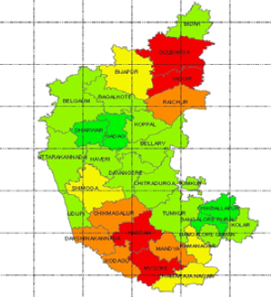
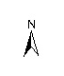

Climate models suggest an increasing trend in annual rainfall.
Projected Increase in Rainfall 2035 A1B Scenario
< -5%
-5% - 0%
0% - 5%
5% - 10%
10% - 15%
Source: BCCI-Karnataka, 2011

Slide 5
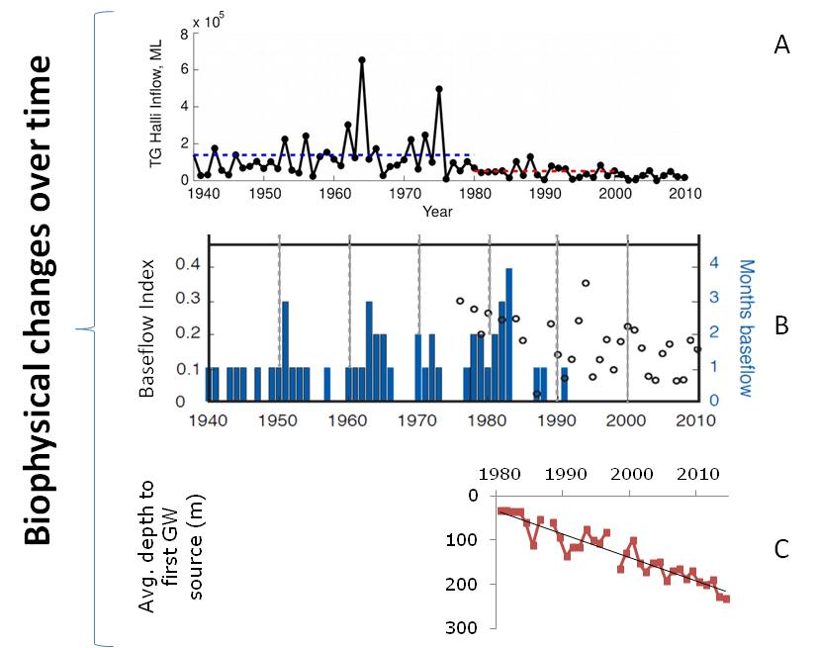
Baseflows into TG Halli also declined – virtually disappeared after 1992
Not one month after 1992, where there was inflow into TG Halli in a no-rain month
Source: Srinivasan et al. (2015)

Slide 6
BUT inflows into TG Halli catchment have declined sharply.
Source: Srinivsan et al., 2015

Slide 7
Secondary data show that the surface water irrigation and open wells disappeared by the mid-1990s.
Evidence the shallow aquifer dried up in the early 1990s
Source: KA Annual Season Crop Report. Doddaballapur Taluk

Slide 8






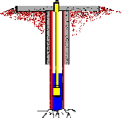
Secondary data suggest that climatic factors alone cannot explain the decline
4) Increased evapotranspiration due to land use change
1) Decreasing Rainfall
2) Increase in
Temperature
5) Check dams have converted surface to groundwater
3) Loss to Deep Aquifer
due to GW pumping
Source: Srinivasan et al., 2015
Notes:
*

Slide 9
Anthropogenic factors must have been responsible for past declines…
4) Increased evapotranspiration due to land use change
X
1) Decreasing Rainfall
X
2) Increase in
Temperature
5) Check dams have converted surface to groundwater
3) Loss to Deep Aquifer
due to GW pumping
Source: Srinivasan et al., 2015
Notes:
*

Slide 10
Applying the philosophy
to climate adaptation research
Past land use, demography, water extraction
+
Past policies, governance, institutions, rules
Past
Vulnerability,
Equity etc.
Past climate
+
Past/ Current
Climate Change
Physical Processes
Adaptation Scenarios
Outcomes
Future
+
Future land use, demography, water extraction
+
Future policies, governance, institutions, rules
Future
Vulnerability,
Equity etc.
Future climate
CLIMATIC
NON-CLIMATIC
MULTIPLE STRESSORS
CROSS-SCALE LINKAGES
MULTIPLE CONCERNS

Slide 11
Conceptual Framework
Other Drivers: Land, Labor,
Commodity
Markets, Policy
HH Assets: Natural, Financial,
Social and Physical
Land use
Global Climate Change
Economics of alternative land uses
Adaptation Coping
Land use decisions
ET, Recharge,
Runoff
Regional Impacts of CC
Institutions
Users
Water in
Streams, aquifers
Allocation Rules
Economic Livelihood, Health and Environment Outcomes
Rainfall, Temp.
Ag
Local Climate
Delivered to users
Infrastructure
HH
I
Treated effluent releases
Water Use
Wastewater generated
Fixed Biophysical:
Topography, Geology, Soils,
Conductivity etc.
Imports
GW Extraction
MULTIPLE STRESSORS
CROSS-SCALE LINKAGES
MULTIPLE CONCERNS

Slide 12
Anthropogenic changes in TG Halli catchment over the last 3 decades
Go big or quit: Urbanisation induces farmers to intensify (deep borewell irrigated commercial agriculture) or abandon agriculture (and place land under eucalyptus and work in the city.
Conversion of surface to groundwater: As groundwater has depleted, villages have introduced check-dams on streams to increase recharge.
Shallow to deep aquifer connectivity: As deeper fracture aquifers have depleted, this has induced recharge from shallower to deeper fractures.
=> Increase in ET, GW depletion AND surface water declines.

Slide 13
LULC 1972 - 73

Slide 14
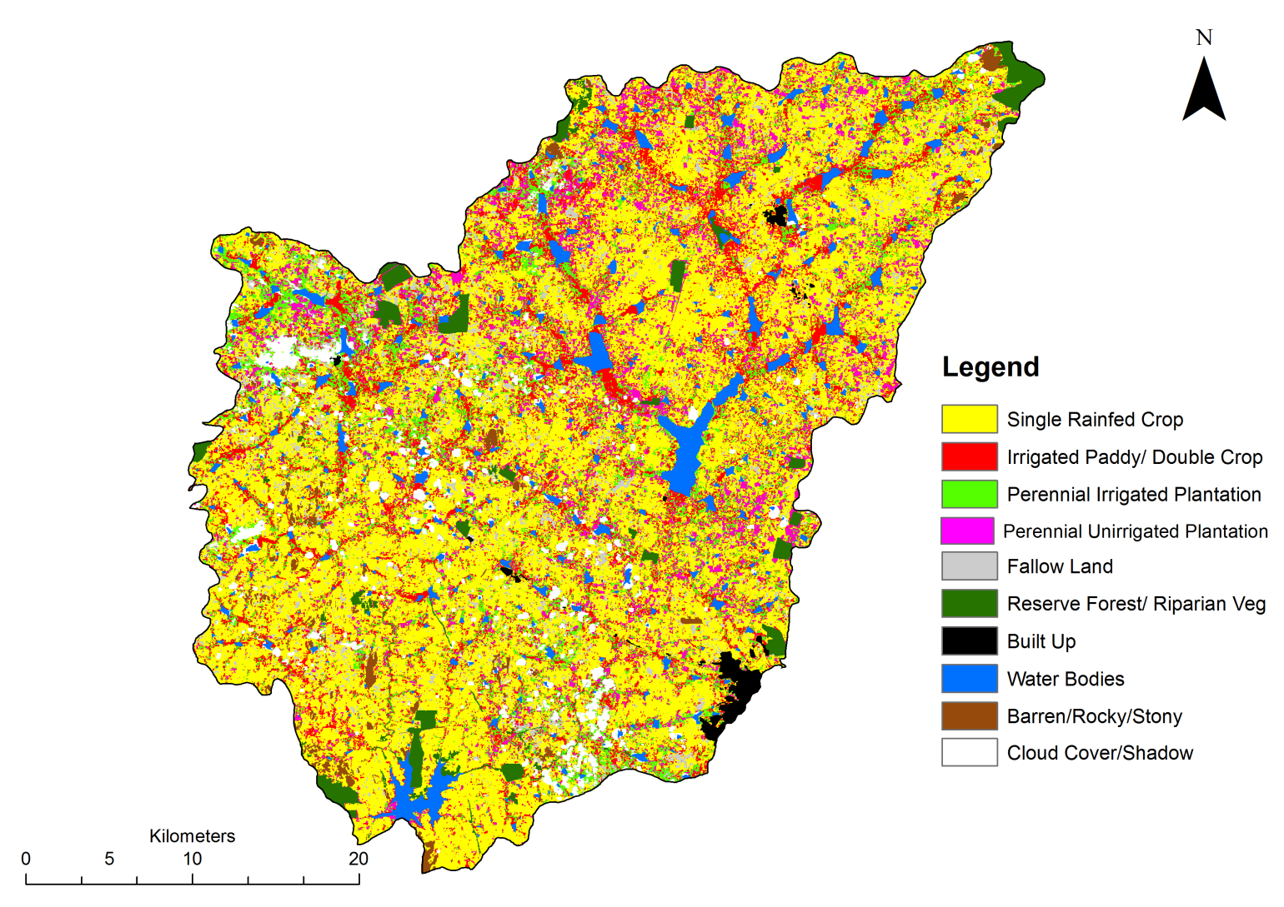
LULC 1993 - 94

Slide 15
LULC 2001 - 02

Slide 16
LULC 2013 - 14

Slide 17
Anthropogenic changes in TG Halli catchment over the last 3 decades
Go big or quit: Urbanisation induces farmers to intensify (deep borewell irrigated commercial agriculture) or abandon agriculture (and place land under eucalyptus and work in the city.
Conversion of surface to groundwater: As groundwater has depleted, villages have introduced check-dams on streams to increase recharge.
Shallow to deep aquifer connectivity: As deeper fracture aquifers have depleted, this has induced recharge from shallower to deeper fractures.
=> Increase in ET, GW depletion AND surface water declines.

Slide 18
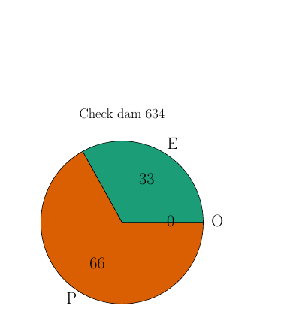
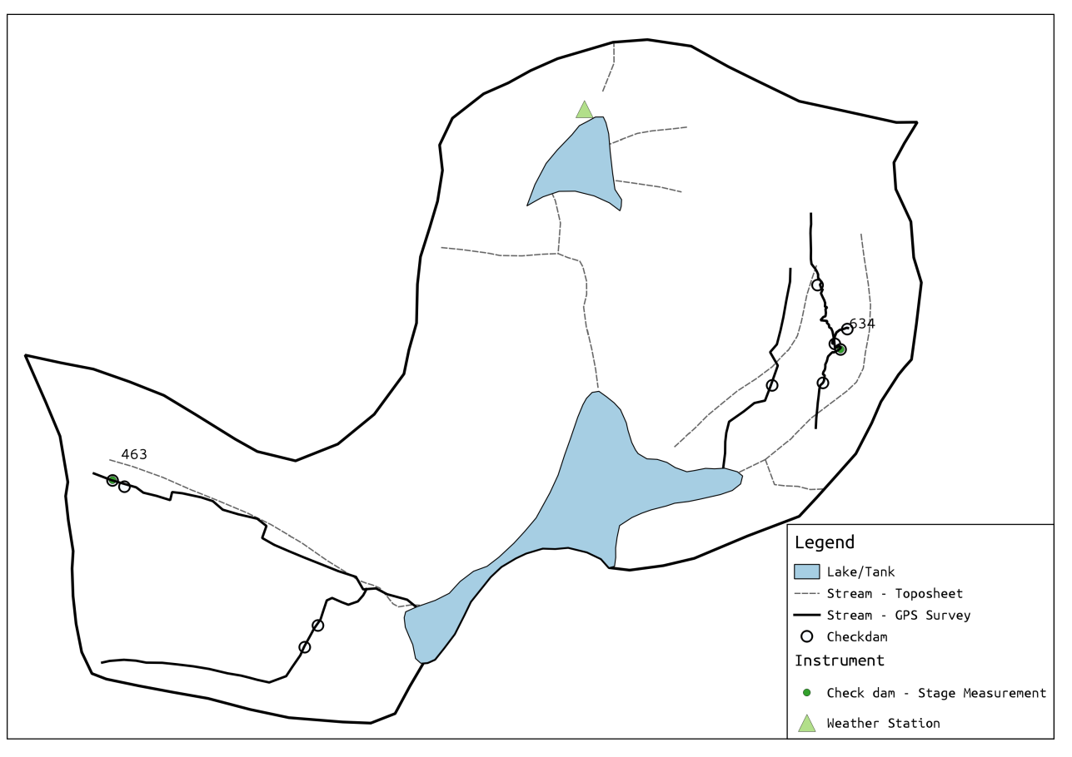
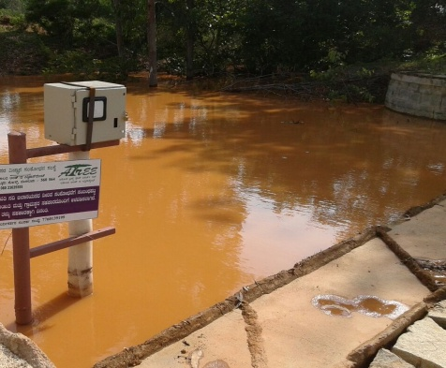
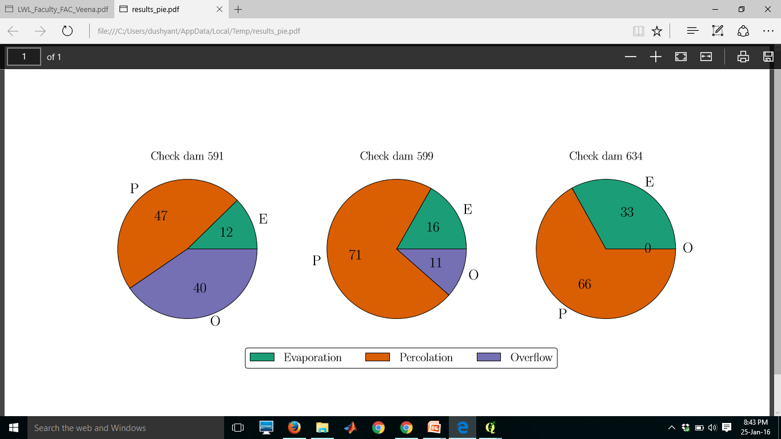
Check dams reduce runoff and increase recharge

Slide 19
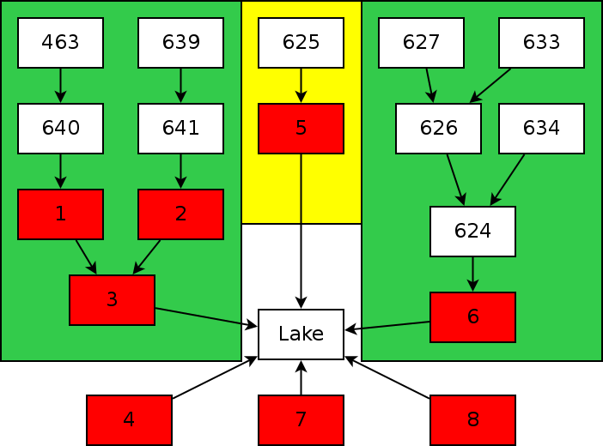
3B. Modelled cumulative impacts of chains of check-dams

Slide 20
3B. Cumulatively, capture much of the runoff – only large storms reach the tank

Slide 21
Anthropogenic changes in TG Halli catchment over the last 3 decades
Go big or quit: Urbanisation induces farmers to intensify (deep borewell irrigated commercial agriculture) or abandon agriculture (and place land under eucalyptus and work in the city.
Conversion of surface to groundwater: As groundwater has depleted, villages have introduced check-dams on streams to increase recharge.
Shallow to deep aquifer connectivity: As deeper fracture aquifers have depleted, this has induced recharge from shallower to deeper fractures.
=> Increase in ET, GW depletion AND surface water declines.

Slide 22
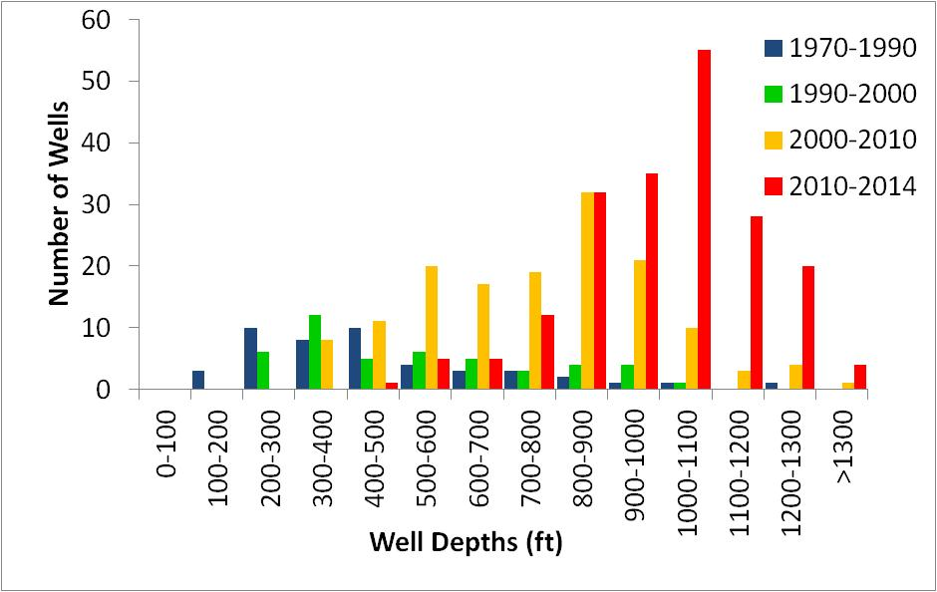
Evidence of depletion of deep fracture aquifers
Farmers have been drilling deeper and deeper borewells
Yet, the number of functioning borewells has increased.
=> More, deeper borewells irrigating a smaller area.
Increasing Number
Increasing Depth
Source: Primary Surveys - Well Census in two milli-watersheds

Slide 23
Evidence of connectivity: Recharge from shallow zones reaches deep zones
Participatory groundwater monitoring wells respond to rain => Rainfall recharge is definitely reaching deeper fractures.

Slide 24
Anthropogenic changes in TG Halli catchment over the last 3 decades
Go big or quit: Urbanisation induces farmers to intensify (deep borewell irrigated commercial agriculture) or abandon agriculture (and place land under eucalyptus and work in the city.
Conversion of surface to groundwater: As groundwater has depleted, villages have introduced check-dams on streams to increase recharge.
Shallow to deep aquifer connectivity: As deeper fracture aquifers have depleted, this has induced recharge from shallower to deeper fractures.
=> Increase in ET, GW depletion AND surface water declines.

Slide 25
Recap: Land Use, Land Cover Change
Greens are rainfed, reds are irrigated, yellows are fallow

Slide 26
Where does the rain end up?

Slide 27
Agricultural pumping and eucalyptus => GW depletion

Slide 28
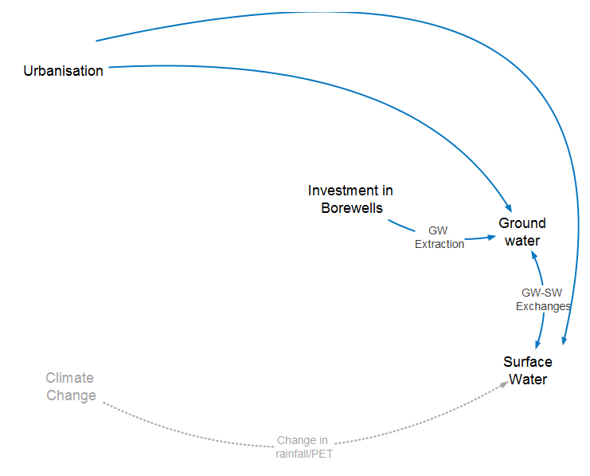
Hydrology of TG Halli catcment

Slide 29
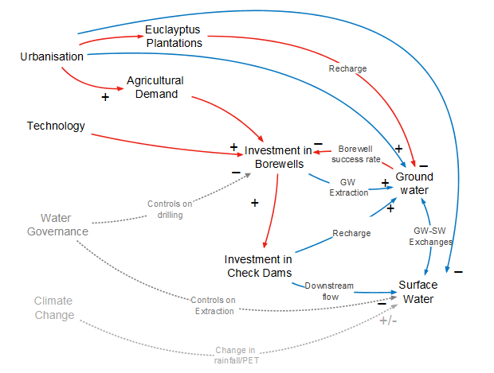
Socio-hydrology of TG Halli catchment

Slide 30
Climate Change
Days
Months
GW Depletion,
Loss of Ecosystem Services
Years
Decades
Drought
Supply Disruption
Human
Society
Natural Environment
Coping
Emergency Responses, Markets
New Infrastructure,
Technology Innovation, Governance Change
Political and Cultural Change

Slide 31
THANK YOU!
Consultants
Dr. Ballukraya (Hydrogeology)
RS/GIS support
Jayalakshmi, Ameya, Sowmyashree, Muneeswaran
FUNDING:
International Development Research Centre (IDRC) Grant No. 107086-001
NSF CNIC IIA-1427761 and USAID RI Fellowship Program for support of ATREE-UC Berkeley collaborations
NSF SESYNC Grant for socio-hydrologic synthesis work
ARKAVATHY RESEARCH TEAM
Research Staff
Meghana Eswar, Sanjeev Kenchaigol,
T. Zuhail, M. Idris, Praveen Urs, Kirubaharan Jeremiah, Apoorva R., Karthik Madhyastha,
Kavitha, Dipak Samal,
Field Enumerators
Chidanand, G. C. Guruswamy, D. S. Kumar, B. K. Manjunatha, P. Nagendra, A. H. Sathish.
Outreach/ Water Literacy Campaign
G.,Manjunatha, K. Janardhan
USAID-RI Fellow: Gopal Penny
Interns (2013, 2014)
Tagore, Nagaraju, Shilu, Veena, Pradnya
Shilpa, Sayan, Sana, Arjun, Kritika, Aravind

Slide 32
Note: Government monitoring wells do not show depletion
Dug Wells
Borewells

Slide 33
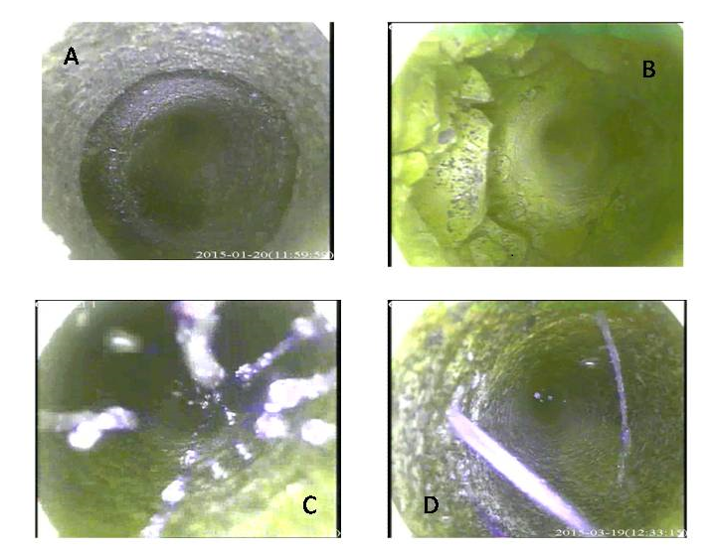
Evidence of depletion of deep fracture aquifers
Novel, low-cost approach: Crowdsourced borewell scans
Over 150 Well scans in two milli-watersheds!

Slide 34
Evidence of depletion in deep aquifers
Very little deep storage
Small changes in volume => big drops in depth

